Slide 1
IEEE 802.21 MEDIA INDEPENDENT HANDOVER
DCN: DCN 21-12-0036-00-0000
Title: Handover proposal vs. MIH_LL_Tunnel vs. ANQP
Date Submitted: March 14, 2012
To be presented at IEEE 802.21c Plenary meeting, March 14, 2012
Authors or Source(s):
Charles E. Perkins
Abstract: UE access to SFF can improve handover performance. OSFF and TSFF can be naturally reside in SPoS and TPoS using the MIH_LL_Tunnel design. GAS/ANQP protocol from 802.11u also seem to provide useful front-end for necessary location-based queries useful for SFF-based design.

Slide 2
IEEE 802.21 presentation release statements
This document has been prepared to assist the IEEE 802.21 Working Group. It is offered as a basis for discussion and is not binding on the contributing individual(s) or organization(s). The material in this document is subject to change in form and content after further study. The contributor(s) reserve(s) the right to add, amend or withdraw material contained herein.
The contributor grants a free, irrevocable license to the IEEE to incorporate material contained in this contribution, and any modifications thereof, in the creation of an IEEE Standards publication; to copyright in the IEEE’s name any IEEE Standards publication even though it may include portions of this contribution; and at the IEEE’s sole discretion to permit others to reproduce in whole or in part the resulting IEEE Standards publication. The contributor also acknowledges and accepts that this contribution may be made public by IEEE 802.21.
The contributor is familiar with IEEE patent policy, as outlined in Section 6.3 of the IEEE-SA Standards Board Operations Manual <http://standards.ieee.org/guides/opman/sect6.html#6.3> and in Understanding Patent Issues During IEEE Standards Development http://standards.ieee.org/board/pat/guide.html>
IEEE 802.21 presentation release statements
This document has been prepared to assist the IEEE 802.21 Working Group. It is offered as a basis for discussion and is not binding on the contributing individual(s) or organization(s). The material in this document is subject to change in form and content after further study. The contributor(s) reserve(s) the right to add, amend or withdraw material contained herein.
The contributor grants a free, irrevocable license to the IEEE to incorporate material contained in this contribution, and any modifications thereof, in the creation of an IEEE Standards publication; to copyright in the IEEE’s name any IEEE Standards publication even though it may include portions of this contribution; and at the IEEE’s sole discretion to permit others to reproduce in whole or in part the resulting IEEE Standards publication. The contributor also acknowledges and accepts that this contribution may be made public by IEEE 802.21.
The contributor is familiar with IEEE patent policy, as stated in Section 6 of the IEEE-SA Standards Board bylaws <http://standards.ieee.org/guides/bylaws/sect6-7.html#6> and in Understanding Patent Issues During IEEE Standards Development http://standards.ieee.org/board/pat/faq.pdf>

Slide 3
Outline of presentation
Quick review and summary of SFF-based and MIH_LL_Tunnel based approach
Comparison with handover into WiMAX network
Comparison with handover into HSPD network
Summary: need to ensure compatibility with existing Layer 2
Quick review and summary of LDB proposal
Comparison with 802.11u + 802.21 proposal
Solution when OSFF uses MN location to determine target network
Minimal call flow for latter case
Questions needing further resolution

Slide 4
SFF-oriented handover optimization supported by roaming agreement
HSFF
AN
OSFF
AN
MN movement
TSFF
Inter SFF SA
tAN
Preregistration

Slide 5
MIH_LL_Tunnel based handover

Slide 6
Adapting SFF-based preregistration to MIH_LL_Tunnel proposal
SPoS provides function previously called “OSFF”
TPoS provides function previously called “TSFF”
At conclusion of call flow, MN is pre-registered
Preregistration can require multiple round trips for some media, authentication methods.
If SPoS has knowledge of target network, it can create target-appropriate key MNmsrk for MN and TPoS.
Otherwise, SPoS creates MNmirk for use between MN and TPoS.
If TPoS receives MNmirk instead of MNmsrk, it creates MNmsrk

Slide 7
Handover execution
Next, the handover occurs. Authentication for fast network re-entry uses MNmsrk
TPoS must either be authenticator for TPoA, or else have installed MNmsrk into the authenticator’s security association with the MN.
TPoS becomes SPoS. MN can use MNmsrk for future handover-based communication with SPoS.

Slide 8
SFF-based preregistration for Handover into WiMAX network

Slide 9
MN into HRPD from WiMAX

Slide 10
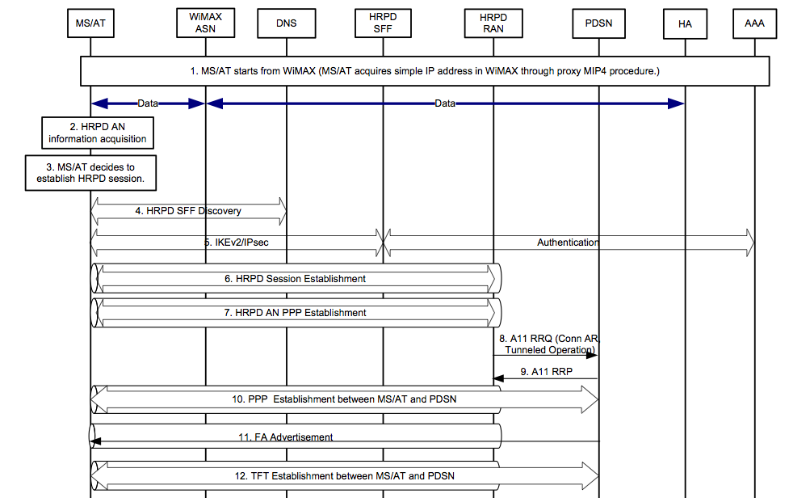
Handover into HRPD, part 1

Slide 11
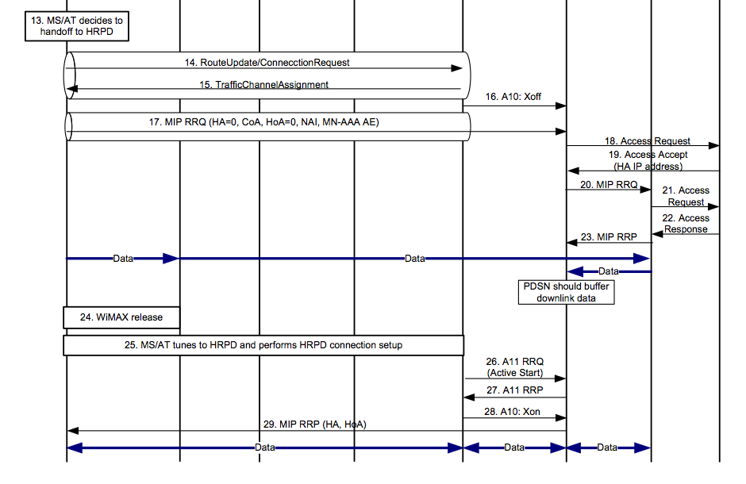
Handover into HRPD, part 2

Slide 12
Matching existing SFF designs to MIH_LL_Tunnel based handover
Basically is O.K.
For fitting TPoS into existing networks, make TPoS appear to be a base station.
For TPoS in new networks, can be a new function of anchor point (e.g., ASN-gw or PDSN).

Slide 13
System Architecture [802.11+802.21]

Slide 14
GAS/ANQP with MIH call Flow
STA
Provisioned Home Realm; FQDN
AP
Configured SSID
Information Server
MIH Information Server
Scan Request
Scan Response
Build the scan list;
Analyze SSIDs,
No AP to associate
Generated ANQP
GAS Init Req (bundled ANQP NAI + WAN…)
GAS Init Resp (Comeback Delay=1000TU …)
MIH [ANQP (IE) Request
MIH[ANQP(IE)] Response
GAS Comeback Req
GAS Comeback Resp
GAS Comeback Req
GAS Comeback Resp
Defrag ANQP;
Consolidate all inputs from all networks
Analyze ANQP;
Discover & select network
Association Req
802.11
802.21

Slide 15
Call flow using Location Data

Slide 16
SPoS vs. MN
802.11u is designed to enable MN queries
Proposed handover could allow SPoS to determine target network based on MN’s RAT availability and location
MN can provide “hints” to SPoS as part of initial signaling
Does SPoS reside between AP and MIIS?

