Slide 1
IEEE 802.21 MEDIA INDEPENDENT HANDOVER
DCN: 21-12-0028-00-0000
Title: P802.21d Group Management Framework
Date Submitted: March 13, 2012
To be Presented at IEEE802.15 WNG session #49 in Big Island
Authors or Source(s):
Yoshihiro Ohba and Toru Kambayashi (Toshiba), Antonio de la Oliva (UC3M), Stephen Chasko and Ruben Salazar (Landis+Gyr), Subir Das (ACS)
Abstract: This document describes a framework on group management in mesh networks in heterogeneous networks

Slide 2
IEEE 802.21 presentation release statements
This document has been prepared to assist the IEEE 802.21 Working Group. It is offered as a basis for discussion and is not binding on the contributing individual(s) or organization(s). The material in this document is subject to change in form and content after further study. The contributor(s) reserve(s) the right to add, amend or withdraw material contained herein.
The contributor grants a free, irrevocable license to the IEEE to incorporate material contained in this contribution, and any modifications thereof, in the creation of an IEEE Standards publication; to copyright in the IEEE’s name any IEEE Standards publication even though it may include portions of this contribution; and at the IEEE’s sole discretion to permit others to reproduce in whole or in part the resulting IEEE Standards publication. The contributor also acknowledges and accepts that this contribution may be made public by IEEE 802.21.
The contributor is familiar with IEEE patent policy, as stated in Section 6 of the IEEE-SA Standards Board bylaws <http://standards.ieee.org/guides/bylaws/sect6-7.html#6> and in Understanding Patent Issues During IEEE Standards Development http://standards.ieee.org/board/pat/faq.pdf>

Slide 3
Background
In January 802.15 WNG/802.21 joint session, group management use cases in mesh network were presented
In this presentation we clarify
How the proposed project P802.21d can realize the use cases
Relationship with existing group management mechanisms

Slide 4
Group Management in Mesh Networks (Presented Jan-2012, DCN 21-12-0009-01-0000)
Some specific functions/applications may impact segments of an AMI mesh network
Failover/Failback of an AMI network
If the devices were no longer on one network, it is needed to perform failover or migrate/handover (or failback) devices to another network
The takeout device (e.g., concentrator) is typically associated with a NAN (Neighborhood Area Network) segment
If that device goes down, other devices will failover to a second NAN segment
Software update or configuration for mesh devices and applications
The updating software or configuration for a large number of mesh devices and their applications
This should happen in multicast or broadcast mode
AMI mesh network
segments
A segment (i.e., a group of devices) may be formed independently of physical locations of the devices

Slide 5
Existing Solution: Individual Handover Based on IEEE 802.21-2008

Slide 6
1st Step: Registration
MIH Registration is needed for MIH Command Service so that PoS can send commands to STA/UE
STA/UE (MIH Client)
MIH PoS
MIH Registration
MIH_Registration request (reg. params.)
Register STA/UE
MIH_Registration response (reg. lifetime)
Registration parameters
MIHF-ID
List of link layer addresses
IP address (when IP is used for MIH transport)
STA- Station; UE – User Entity
PoS- Point of Service
MIH – Media Independent Handover
MIHF-ID: MIH Function Identifier (e.g. station1@utilityA.com)

Slide 7
2nd Step: Command Execution
MIH command is unicast
STA/UE (MIH Client)
MIH PoS
MIH Command (network initiated)
Initiate HO
MIH_Net_HO_Commit request (HO params)
HO (Handover) parameters:
Target link type
Target network information list
Network ID, PoA address, etc.
Assigned Resource set
List of link actions for each link
Perform HO
MIH_Net_HO_Commit response (HO result)
Link Actions:
0: NONE
1: LINK_DISCONNECT
2: LINK_LOW_POWER
3: LINK_POWER_DOWN
4: LINK_POWER_UP
STA- Station; UE – User Entity
PoS- Point of Service
PoA- Point of Attachment
MIH – Media Independent Handover

Slide 8
Group Handover To Be Defined by P802.21d

Slide 9
1st Step: Registration (Example Extension)
Registration response may contain a list of available group information provided by the MIH PoS
STA/UE (MIH Client)
MIH PoS
MIH Registration
MIH_Registration request (reg. params.)
Register STA/UE
MIH_Registration response
(reg. lifetime, group info.)

Slide 10
2nd Step: Group JOIN/LEAVE (New)
STA/UE (MIH Client)
MIH PoS
STA/UE (MIH Client)
STA/UE (MIH Client)
…
STA/UE (MIH Client)
Group Join/Leave
Group Join/Leave
Group Join/Leave
Group Join/Leave

Slide 11
3rd Step: Handover Command (Example Extension)
Group A
STA/UE (MIH Client)
MIH PoS
Group B
STA/UE (MIH Client)
Group A
STA/UE (MIH Client)
…
Group A
STA/UE (MIH Client)
Multicast MIH Command (network initiated)
Initiate HO
MIH_Net_HO_Commit (HO params, group A)
Perform HO
L2/IP
multicast /broadcast
Perform HO
…
Perform HO
Multicast security mechanisms need to be used.

Slide 12
Relationship with Existing Group Management Mechanisms

Slide 13
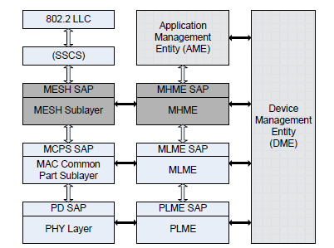
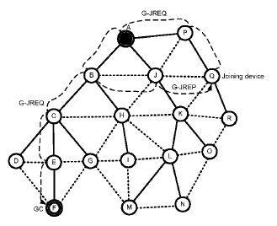
Group Mgmt in 802.15.5-2009
802.15.5 defines MHME (Mesh sublayer Management Entity) and its SAP over 802.15.4-2006, 802.15.3-2003 and 802.15.3b-2005 MAC
MHME SAP primitives for group management
MHME-JOIN
MHME-LEAVE
802.15.5 defines a protocol for general mesh service among MHMEs on different nodes
G_JREQ/G_JREP message are exchanged to realize MHME-JOIN

Slide 14
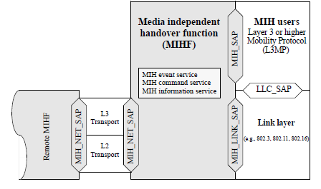
Relationship with existing group management mechanisms
For link-layer group management mechanisms, mapping between MIH_Link SAP and media-specific SAP used for group management (e.g., 802.15.5 MHME SAP) will need to be defined
For IP group management mechanisms (IGMP, MLD), a modification of MIH_NET_SAP may be needed
Interface to
IP group management
Interface to
Media-specific
group management

Slide 15
Summary
802.21d will define extensions to existing MIH services to do group management
By defining new primitives / attributes for group management
By defining a mapping between MIH_LINK_SAP and existing media-specific SAPs for interface with L2 group management, and possibly modifying MIH_NET_SAP for interface with IP group management
Multicast security mechanisms are also needed for group handover commands

