Slide 1
IEEE 802.21 MEDIA INDEPENDENT HANDOVER
DCN: 21-12-0005-00-0000
Title: A System Architecture of Network Discovery and Selection using 802.11 and 802.21 features
Date Submitted: January 16, 2012
Presented at IEEE 802.11 WNG session in Jacksonville
Authors or Source(s): Peretz Feder, Ajay Rajkumar and Dan Gal(ALU), Anthony Chan (Huawei), Antonio de la Oliva (UC3M), Farrokh Khatibi (QCOM), Charlie Perkins (Tellabs), Dapeng Liu (China Mobile), Christian Niephaus (Fraunhofer), Yoshihiro Ohba (Toshiba), Juan Carlos Zuniga (InterDigital), Junghoon Jee (ETRI), Subir Das(ACS) (Presenter)
Abstract: This document highlights the features of 802.21 and shows how it can complement 802.11 interworking features and can provide a complete system architecture

Slide 2
  IEEE 802.21 presentation release statements
This document has been prepared to assist the IEEE 802.21 Working Group. It is offered as a basis for discussion and is not binding on the contributing individual(s) or organization(s). The material in this document is subject to change in form and content after further study. The contributor(s) reserve(s) the right to add, amend or withdraw material contained herein.
The contributor grants a free, irrevocable license to the IEEE to incorporate material contained in this contribution, and any modifications thereof, in the creation of an IEEE Standards publication; to copyright in the IEEE’s name any IEEE Standards publication even though it may include portions of this contribution; and at the IEEE’s sole discretion to permit others to reproduce in whole or in part the resulting IEEE Standards publication. The contributor also acknowledges and accepts that this contribution may be made public by IEEE 802.21.
The contributor is familiar with IEEE patent policy, as stated in Section 6 of the IEEE-SA Standards Board bylaws <http://standards.ieee.org/guides/bylaws/sect6-7.html#6> and in Understanding Patent Issues During IEEE Standards Development http://standards.ieee.org/board/pat/faq.pdf>

Slide 3
Outline
Overview of IEEE 802.21
Relationship with IEEE 802.11 Internetworking features (e.g., 802.11u)
A complete system architectural view
Conclusion

Slide 4
IEEE 802.21 Overview

Slide 5
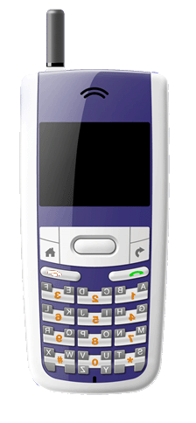

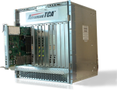
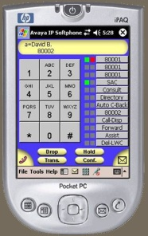


Handovers: Who makes the Decision ?
IEEE 802.21
Measurements, Triggers,
Neighbor Information
Measurements
Triggers
Neighbor Maps
Service Information
Mobile Device
(User)
Network
(Operators)
IEEE 802.21 enables Co-operative
Handover Decision Making

Slide 6
IEEE 802.21. Overview
IEEE 802.21 is a published standard
The purpose is to improve the user experience of mobile device by facilitating handover between heterogeneous access networks
Media Independent Handover Function (MIHF)
  802.21 provides mechanisms for network detection and selection, minimizing connectivity interruption while changing access link, and with an efficient battery usage
  Defined Services: Events, Commands, and Information
  The 802.21 layer belongs to the control plane
  Provides both L2 and L3 transports

Slide 7
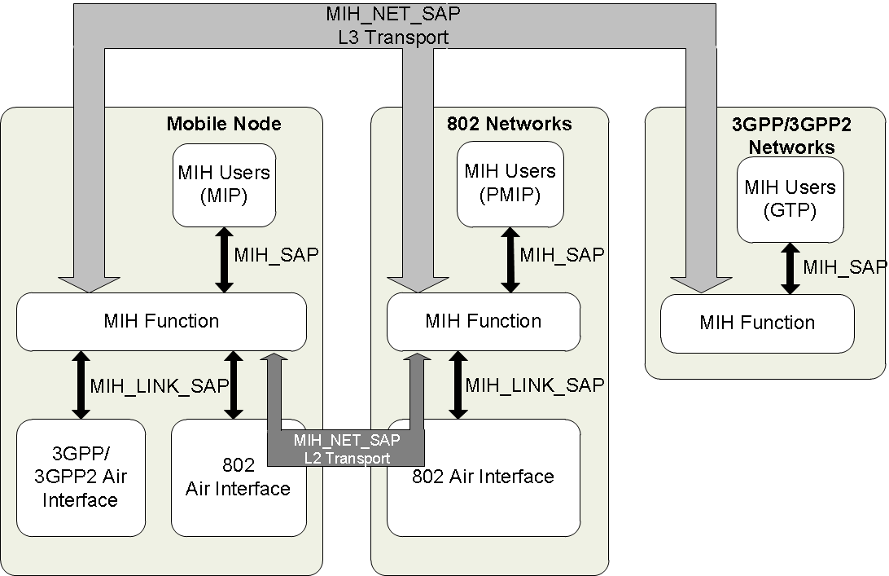
IEEE 802.21 Services(Logical Diagram)
MIES: Media Independent Event Service
  From Link layers to Upper layers
  Subscription mechanism
  L2/L3 communication
  Advisory nature, dynamic information
  Examples: Link Up, Link Down, Link Parameters change
MICS: Media Independent Command Service
  From MIH users to Lower layers
  Local or remote
  Its reception can generate an event
  Examples: Commit, Candidate_Query
MIIS: Media Independent Information Service
  Acquire network information
  Information can be accessed from any technology
  Network selection
  Examples: neighbor maps, coverage zones, etc.

Slide 8
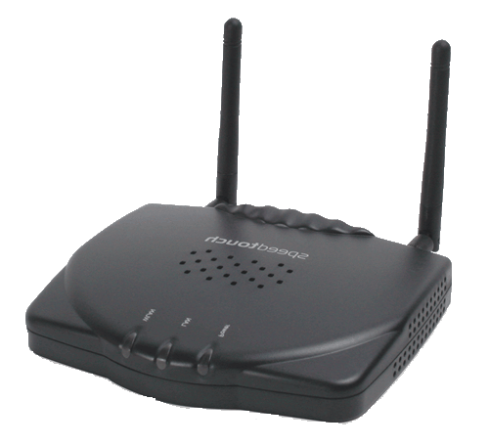


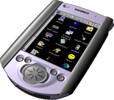
Media Independent Information Service
MIH Information Server
Network Map
WLAN
WWAN
List of Available Networks
- e.g., 802.11/16, GSM, UMTS, LTE
Link Layer Information
- Neighbor Maps
Higher Layer Services
- VoIP, Emergency (E911), VPN….
WMAN
Network Type | SSID/ Cell ID | BSSID | Operator | Security | Channel | QoS | Higher layer Service | Data Rate
GSM/HSPA | 13989 | N/A | Oper-1 | UMTS/AKA | 1900 | N/A | E911 | 9.6 Kbps
LTE | 12345 | N/A | Oper-2 | UMTS/AKA | 700 | N/A | E911 | 40Mbps
802.11 | Enterprise | 00:00:… | Oper-3 | 802.11i | 6 | N/A | VPN | 54 Mbps
802.16e | 3456 | N/A | Oper-4 | PKM | 11 | Yes | VoIP | 40 Mbps

Slide 9
MIH Information Service Call Flow
STA /UE
MIH
Information Server
IS Server Discovery
Information Service message Request
(MIH_GET_REQUEST)
Information Service message Response
(MIH_GET_RESPONSE)

Slide 10
IEEE 802.11u Overview

Slide 11
IEEE 802.11u:
Interworking With External Networks
IEEE 802.11-2011 (Includes 802.11u Standard)
Features :
  aiding network discovery and selection by providing information to the STA/UE about the networks prior to association
  enabling information transfer from external networks to STA
  enabling emergency services
  interfacing Subscription Service Provider Networks (SSPN) to 802.11 Networks that support Interworking with External Networks
Network Discovery and Selection allows for an architecture where external information server query is included

Slide 12
802.11u Interworking Functions
• Network discovery and selection
  Discovery of suitable networks through the advertisement of parameters via management frames, for example:
    access network type, roaming consortium, PLMN list
  Selection of a suitable IEEE 802.11 infrastructure using various services (e.g., Access Network Query Protocol (ANQP)) in the BSS
  Selection of an SSPN or external network with its corresponding IEEE 802.11 infrastructure
Emergency services
  Emergency Call and Network Alert support at the link level
QoS Map distribution
SSPN interface - service between the AP and the SSPN (Home Subscription Service Provider)

Slide 13
GAS/ANQP call Flow
STA
Provisioned Home Realm; FQDN
AP
Configured SSID
Scan Request
Scan Response
Build the scan list;
Analyze SSIDs,
No AP to associate
Generated ANQP
GAS Init Req (bundled ANQP NAI + WAN…)
GAS Init Resp (Comeback Delay=1000TU …)
ANQP Request
Information
repository
ANQP Response
GAS Comeback Req
GAS Comeback Resp
GAS Comeback Req
Out of Scope of 802.11
(but relevant for Wi-Fi certification
process for example)
GAS Comeback Resp
Defrag ANQP;
Consolidate all inputs from all networks
Analyze ANQP;
Discover & select network
Association Req

Slide 14
MIH Capability Discovery
802.11u supports MIH Function through GAS (Generic Advertisement Service)
Generic Advertisement Service (GAS) provides a L2 access to an information server (e.g. an IEEE 802.21 IS)
  While selecting Wi-Fi networks, 3G/4G connected device may prefer L3 connectivity instead
802.11u supports MIH query to an external source through higher layer transport
  The 802.21 IS could be accessed over L3 after ‘Association’ has been achieved

Slide 15
IEEE 802.21 Complements 802.11u from a System Perspective

Slide 16
802.21 Information Service Features
802.21 Network Discovery and Selection function provides Information Service which is a MIH Information Server in the architecture
MIH protocol supports both L2 and L3 transports
    Ethertype is defined (IEEE Registry)
    UDP/TCP transport and ports are assigned by IANA (RFC 5677)
Similar to ANQP, MIH protocol defines a container to carry other messages
Information Service defines a number of Information Elements
  Vendor specific namespace is defined
  Provide both TLV and XML/RDF encodings
The multiple available IEs should not be a deterrent but viewed as an opportunity to use as/if desired

Slide 17
802.21 Information Service Features Contd..
MIH Server requires registration by the client to provide the service
MIH security is defined in IEEE 802.21a
  Specification is in RevCom’s March agenda
Discovery of MIH Server is defined in IETF
  DHCP Option (RFC 5678)
  DNS Option (RFC 5679)

Slide 18
Similarities between 802.21 IS and 802.11u
Attribute | MIH | 802.11u
Inter-access (WLAN, 3G/4G) | Yes | 802.11 focused
AP Dependency | Yes | Yes
UE Dependency | Yes (Connection Mgr or client) | Yes (Connection Mgr)
AP Upgrade | SW upgrade | Software upgrade
UE Upgrade | Software Upgrade | Software Upgrade
Access selection based on Operator Policy (access characteristics, application requirements, subscriber profile, charging info., etc.) | Yes. WAN elements can be loaded through MIH exchange | Yes. WAN elements can be loaded through ANQP inquiry
Per APN Decision granularity | No | No
Standardization | IEEE-802.21-2009 | IEEE 802.11 -2011

Slide 19
A System Architecture [802.11+802.21]
Core network
MIH [ANQP(IE)]
Response
MIH Information Server
Access network
MIH [ANQP(IE)]
Request
Network Map
GAS/ANQP response
List of Available Networks
802.11
Server assisted Network Discovery
GAS/ANQP request
802.21 Standard
802.11 Standard

Slide 20
GAS/ANQP with MIH call Flow
STA
Provisioned Home Realm; FQDN
AP
Configured SSID
MIH Information Server
Scan Request
Scan Response
Build the scan list;
Analyze SSIDs,
No AP to associate
Generated ANQP
GAS Init Req (bundled ANQP NAI + WAN…)
GAS Init Resp (Comeback Delay=1000TU …)
MIH [ANQP (IE) Request
MIH[ANQP(IE)] Response
GAS Comeback Req
GAS Comeback Resp
GAS Comeback Req
Use of 802.21 MIH
GAS Comeback Resp
Defrag ANQP;
Consolidate all inputs from all networks
Analyze ANQP;
Discover & select network
Association Req

Slide 21
Conclusion
A system architecture comprising 802.11 and 802.21 is already captured in 802.11u and straightforward
Industry requires such a capability
This an opportunity for IEEE 802 to provide a complete system solution
Some additional work may be required and it is an opportunity to work together
  802.21 is discussing a work item
  802.11 ISD SG work seems to be inline with 802.21 work item
We would like to understand and address any reasoning contradicting the apparent synergy of ANQP and MIH queries to the IS

