Slide 1
IEEE 802.21 MEDIA INDEPENDENT HANDOVER
DCN: DCN 21-11-0160-00-0000
Title: SFF operations augmented with UE location information
Date Submitted: September 20, 2011
To be presented at IEEE 802.21c interim meeting, Sep. 21
Authors or Source(s):
Charles E. Perkins
Abstract: UE access to SFF can improve handover performance. Additional performance improvements are available if the SFF can use UE location information to determine candidate target access networks.

Slide 2
  IEEE 802.21 presentation release statements
This document has been prepared to assist the IEEE 802.21 Working Group. It is offered as a basis for discussion and is not binding on the contributing individual(s) or organization(s). The material in this document is subject to change in form and content after further study. The contributor(s) reserve(s) the right to add, amend or withdraw material contained herein.
The contributor grants a free, irrevocable license to the IEEE to incorporate material contained in this contribution, and any modifications thereof, in the creation of an IEEE Standards publication; to copyright in the IEEE’s name any IEEE Standards publication even though it may include portions of this contribution; and at the IEEE’s sole discretion to permit others to reproduce in whole or in part the resulting IEEE Standards publication. The contributor also acknowledges and accepts that this contribution may be made public by IEEE 802.21.
The contributor is familiar with IEEE patent policy, as outlined in Section 6.3 of the IEEE-SA Standards Board Operations Manual <http://standards.ieee.org/guides/opman/sect6.html#6.3> and in Understanding Patent Issues During IEEE Standards Development http://standards.ieee.org/board/pat/guide.html>
  IEEE 802.21 presentation release statements
This document has been prepared to assist the IEEE 802.21 Working Group. It is offered as a basis for discussion and is not binding on the contributing individual(s) or organization(s). The material in this document is subject to change in form and content after further study. The contributor(s) reserve(s) the right to add, amend or withdraw material contained herein.
The contributor grants a free, irrevocable license to the IEEE to incorporate material contained in this contribution, and any modifications thereof, in the creation of an IEEE Standards publication; to copyright in the IEEE’s name any IEEE Standards publication even though it may include portions of this contribution; and at the IEEE’s sole discretion to permit others to reproduce in whole or in part the resulting IEEE Standards publication. The contributor also acknowledges and accepts that this contribution may be made public by IEEE 802.21.
The contributor is familiar with IEEE patent policy, as stated in Section 6 of the IEEE-SA Standards Board bylaws <http://standards.ieee.org/guides/bylaws/sect6-7.html#6> and in Understanding Patent Issues During IEEE Standards Development http://standards.ieee.org/board/pat/faq.pdf>

Slide 3
Outline of presentation
Problem statement / basic assumptions
Solution Overview
Solution when UE determines target network
Solution when OSFF uses MN location to determine target network
Call Flow for latter case

Slide 4
Basic Assumptions:
Enabling smooth handovers
Single Radio
  But should work with multiple active radio transceivers
Signaling may traverse the Internet
IP address must remain the same during handover
Mobility anchor (e.g., home agent) sits on path for data traffic from Internet
Handover between single operator (or roaming partners)
  SFFs can establish/maintain secure tunnels
Quality metric for results: VoIP (interactive video?)

Slide 5

SFF-oriented handover optimization supported by roaming agreement
HSFF
AN
OSFF
AN
MN movement
TSFF
Inter SFF SA
tAN
Preregistration

Slide 6
MN ←→ SFF security
Tunneled traffic between SFFs may traverse the internet ➔ tunnel security requirement
When MN enters a network, it gets a security association (SA) with the local SFF in the originating network (OSFF)
When MN decides to handover to a target network, the OSFF uses its existing SA to tunnel preregistration traffic to target SFF (TSFF)
OSFF also supplies derived (MN ←→ TSFF) security association to MN and TSFF as part of preregistration

Slide 7
MN moves: using OSFF
Handover preparation:
MN decides to move
MN acquires information about {tAN, tBS, pAN, …}
MN signals target network to complete preparation from its current point of attachment, in “originating network”
(a) MN ←→ SFF in originating network (i.e., “OSFF”).
(b) OSFF ←→TSFF in network of a roaming partner
Overall, MN ←→ OSFF ←→ TSFF ←→ {tAN, tBS, pAN, …}

Slide 8
OSFF can determine TSFF
If UE supplies its location to OSFF when losing signal at its current PoA, OSFF can identify neighboring PoA for UE
UE should supply preferred RAT
Once OSFF determines TSFF, it can supply derived security assocition to TSFF and UE as before
This would probably save UE power, since background or low duty-cycle scanning would no longer be needed.
OSFF can also check policy requirements
  UEs home operator is known.
OSFF can check with ANDSF if it exists; in that case, OSFF probably already has security association with ANDSF

Slide 9
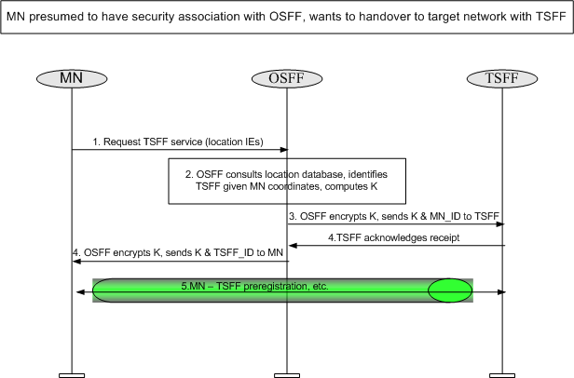
Call flow using Location Data

Slide 10
MN moves: relying more on OSFF
Handover preparation:
MN decides to move
MN supplies location information to OSFF
OSFF determines target network, TSFF
OSFF distributes K_{MN-TSFF} to TSFF and MN
MN signals target network to complete preparation from its current point of attachment, in “originating network”
(a) MN ←→ SFF in originating network (i.e., “OSFF”).
(b) OSFF ←→TSFF in network of a roaming partner
Overall, MN ←→ TSFF ←→ {tAN, tBS, pAN, …}

Slide 11
Further optimization
Initial MN request to OSFF can also be the initial step of the preregistration procedure, eliminating the first round trip between OSFF ←→ TSFF
If used, would be dependent on the target network

