Slide 1
Future Project Planning Meeting
Antonio de la Oliva (UC3M)
Fabio Giust (Institute IMDEA Networks)
Carlos Jesús Bernardos (UC3M)

Slide 2
.21 Paradigm division
IMHO IEEE 802.21 provides two main things
Media Abstraction
Transport Protocol
These two things are currently being specified for Handovers
But it does not have to be this way!!!
Split the specification in these two main functionalities
Explain to other WGs the benefits of using the protocol already defined
Try to be the transport protocol of choice for new standards that need a upper layer transport protocol

Slide 3
Some ideas for future projects related to IEEE
Mapping of QoS classes between technologies
Intermediate layer between applications and new technologies
Example: 802.11aa requires cross-layer communication
Event to change codec
Way of indicating more relevant frames etc..
It is relevant that IEEE 802.21 continues monitoring other standards and react upon new technologies
IEEE 802.11av supports load management
IEEE 802.11av supports BSS transition mechanisms to indicate possible handover targets

Slide 4
Some ideas related to industry
One problem I see with .21 is that it is not clear how to do things with it
Example: Pretty sure with .21 you can do an automatic handover to home AP but it is not defined how to
Example: How to move load information from APs to MIIS
Maybe it is worth to create a doc explaining how to do certain things in .21 that are relevant to industry or 3GPP

Slide 5
Some ideas regarding IETF
IETF is moving much faster than us
Currently there are several projects which can use .21
Flow mobility requires a flow manager which can implement .21
Right now flow mobility is not supported by .21
3G offload is getting momentum, we should get this train
Distributed Mobility Management is being created
Need to analyze if .21 supports this concept

Slide 6
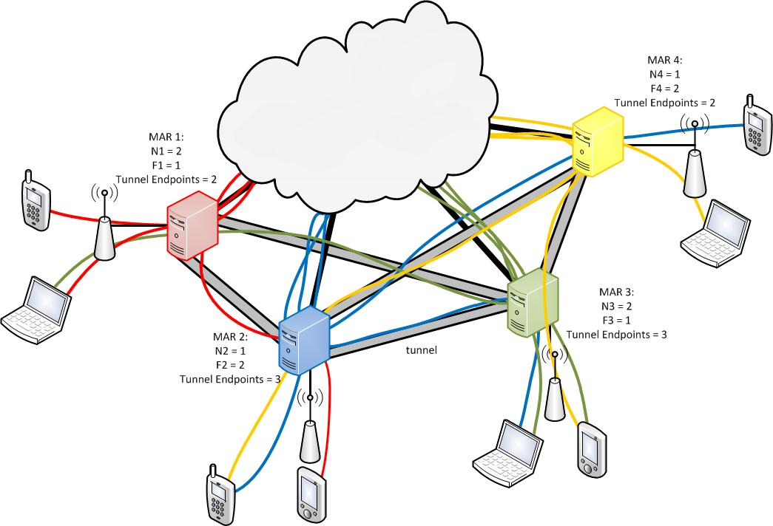
Dynamic Mobility Anchoring
N: number of flows that do not require mobility
F: number of flows that require mobility

