Slide 1
IEEE 802.21 MEDIA INDEPENDENT HANDOVER
DCN: 21-10-0146-00-0000
Title: IEEE 802.19.1 as a Media Independence Service Layer
Date Submitted: July 13, 2010
Presented to Joint session IEEE 802.21 and IEEE 802.19.1 at IEEE 802.21 session #39 in San Diego
Authors or Source(s):
Antonio de la Oliva (UC3M)
Johannes Lessmann (NEC)
Christian Niephaus (FhG)
Abstract: Relation between IEEE 802.19.1 and Media Independence

Slide 2
  IEEE 802.21 presentation release statements
This document has been prepared to assist the IEEE 802.21 Working Group. It is offered as a basis for discussion and is not binding on the contributing individual(s) or organization(s). The material in this document is subject to change in form and content after further study. The contributor(s) reserve(s) the right to add, amend or withdraw material contained herein.
The contributor grants a free, irrevocable license to the IEEE to incorporate material contained in this contribution, and any modifications thereof, in the creation of an IEEE Standards publication; to copyright in the IEEE’s name any IEEE Standards publication even though it may include portions of this contribution; and at the IEEE’s sole discretion to permit others to reproduce in whole or in part the resulting IEEE Standards publication. The contributor also acknowledges and accepts that this contribution may be made public by IEEE 802.21.
The contributor is familiar with IEEE patent policy, as outlined in Section 6.3 of the IEEE-SA Standards Board Operations Manual <http://standards.ieee.org/guides/opman/sect6.html#6.3> and in Understanding Patent Issues During IEEE Standards Development http://standards.ieee.org/board/pat/guide.html>

Slide 3
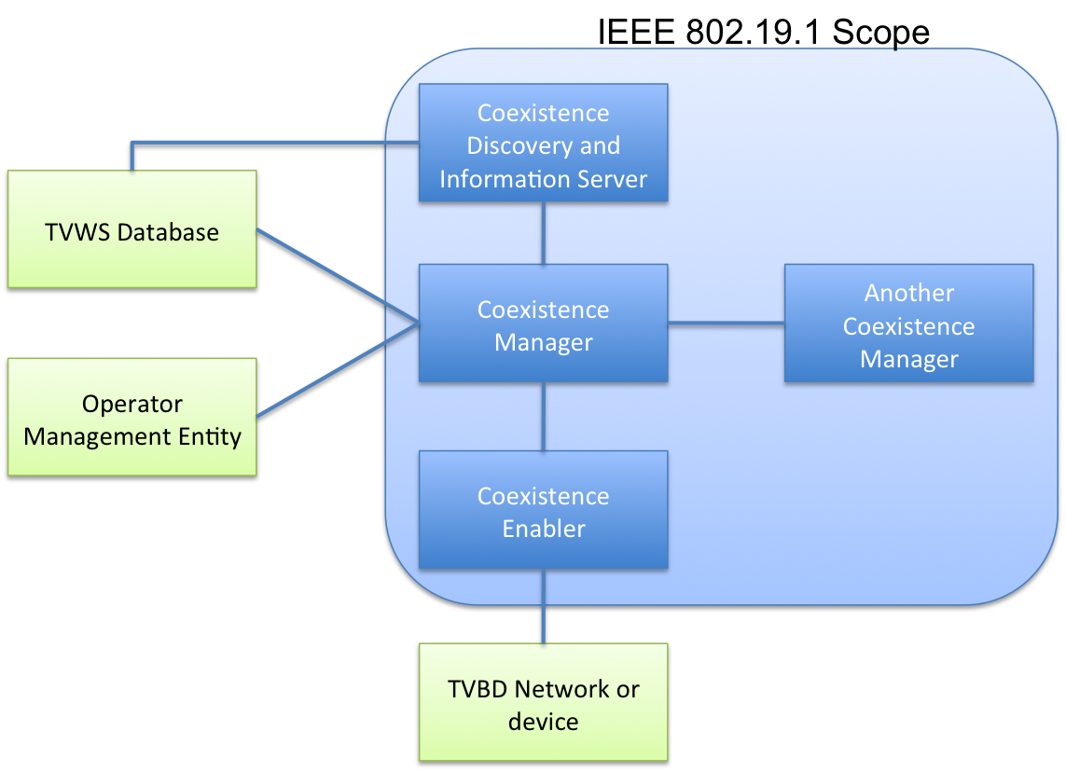
IEEE 802.19.1 Scope
TVWS: TV White Space
TVBD: TV Band Device

Slide 4
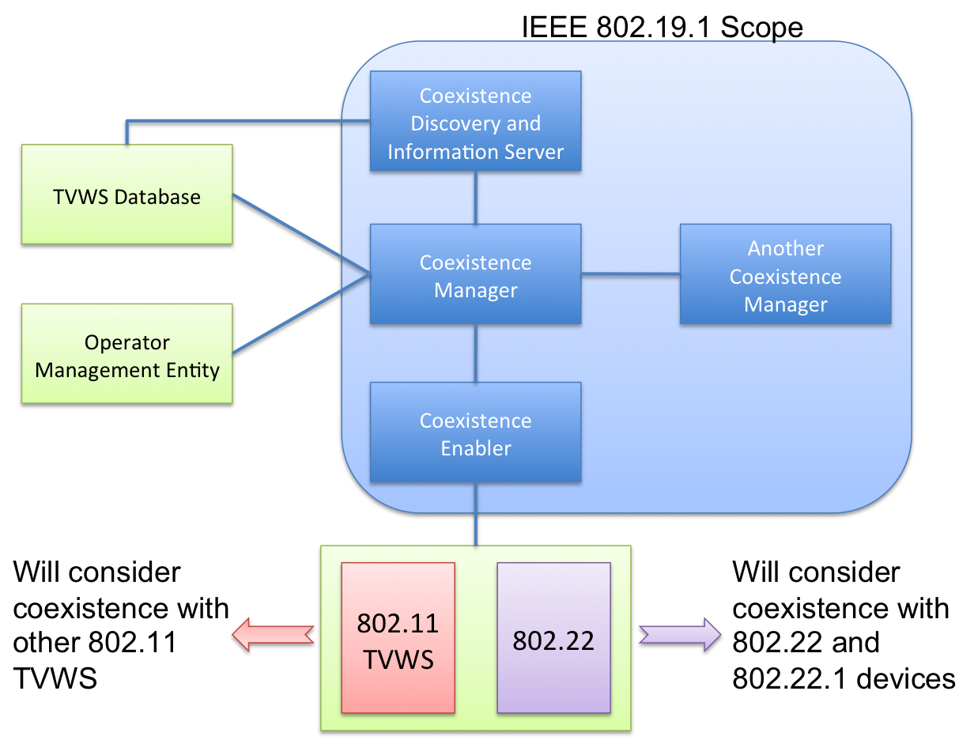
Why a Media Independent Layer?

Slide 5
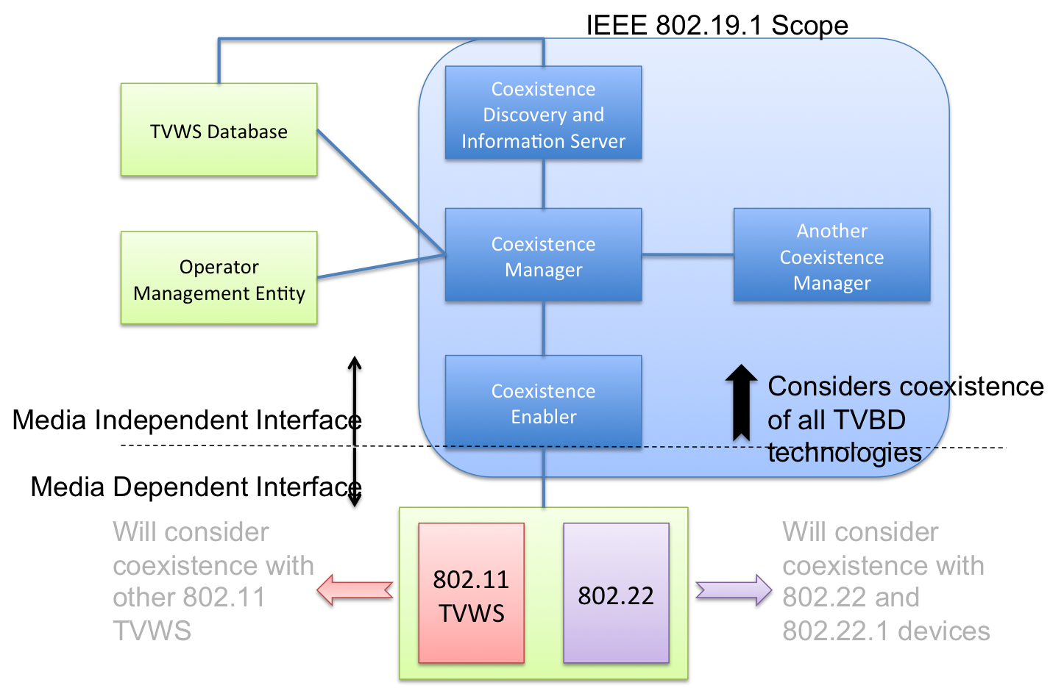
Why a Media Independent Layer?

Slide 6
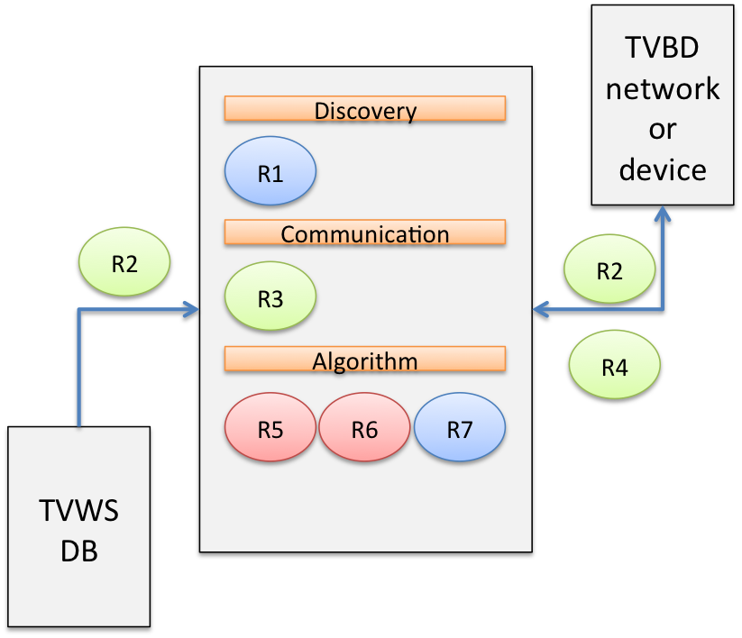
What System Requirements can be done in a Media Independent Way?
R1: 802.19.1 system shall enable discovery for 802.19.1 compliant TVBD networks and devices
R2: 802.19.1 system shall be able to obtain and update information required for TVWS coexistence
R3: 802.19.1 system shall have means to exchange obtained information
R4: 802.19.1 system shall be able to provide reconfiguration requests and/or commands as well as corresponding control information to 802.19.1 compliant TVBD networks and devices to implement TVWS coexistence decisions
R5: 802.19.1 system shall analyze obtained information
R6: 802.19.1 system shall be capable of making TVWS coexistence decisions
R7: 802.19.1 system shall support different topologies of decision making for TVWS coexistence (e.g. centralized, distributed and autonomous)
R8: 802.19.1 system shall support appropriate security mechanisms. This shall include user/device authentication, integrity and confidentiality of open exchanges, and data privacy and policy correctness attestation and enforcement
R9: 802.19.1 system shall utilize a set of mechanisms to achieve coexistence of TVBD networks and devices
Taken from 19-10-0085-00-0000-802-19-tg1-and-system-design-document

Slide 7
System Requirements: What can be done following a Media Independent Approach
Requirement | Media Independence Idea
R1: 802.19.1 system shall enable discovery for 802.19.1 compliant TVBD networks and devices | Discovery can be helped by defining Media Independent Scanning/Sensing primitives so the CM can order the CE to perform a scanning/sensing for all technologies, returning an abstract structure as result
R2: 802.19.1 system shall be able to obtain and update information required for TVWS coexistence | Media Independent Events and Information services can be defined
R3: 802.19.1 system shall have means to exchange obtained information | Common mechanisms to exchange obtained information through layer 2 and layer 3
R4: 802.19.1 system shall be able to provide reconfiguration requests and/or commands as well as corresponding control information to 802.19.1 compliant TVBD networks and devices to implement TVWS coexistence decisions | Media Independent Commands to control the TVDB which can be of heterogeneous technologies. This is worth with one interface per device but becomes critical when the node has multiple heterogeneous interfaces

Slide 8
System Requirements: What can be done following a Media Independent Approach
Requirement | Media Independence Idea
R5: 802.19.1 system shall analyze obtained information | Out of scope, but if we are able to abstract the required information, the algorithm may be simpler
R6: 802.19.1 system shall be capable of making TVWS coexistence decisions | Out of scope, but if we are able to abstract the required information, the algorithm may be simpler
R7: 802.19.1 system shall support different topologies of decision making for TVWS coexistence (e.g. centralized, distributed and autonomous) | Out of scope, but nothing is impeding it
R8: 802.19.1 system shall support appropriate security mechanisms. This shall include user/device authentication, integrity and confidentiality of open exchanges, and data privacy and policy correctness attestation and enforcement | Out of scope, but nothing is impeding it
R9: 802.19.1 system shall utilize a set of mechanisms to achieve coexistence of TVBD networks and devices | Out of scope

Slide 9
Why Media Independence?
In the general case, the coexistence must be assured between different technologies
  The CE will work on top of multiple technologies
  The CM algorithm will decide the correct configuration of a set of technologies, which may not be homogeneous
In order to reduce cost and complexity is better to have the algorithm part decoupled from the actual technologies
A common configuration and information gathering layer can be used to provide tools to the CM

Slide 10
Similarities to IEEE 802.21
We have seen how the IEEE 802.19.1 can benefit from a Media Independence Layer
In the following we present an example of this Media Independence Layer applied to 802.19.1 following an 802.21 approach

Slide 11
Entities belonging to 802.19.1 System and their similarities to IEEE 802.21
Coexistence Manager | Coexistence Enabler | Coexistence Discovery and Information Server
Coexistence decision making | Communication between Coexistence Manager and TVBD network or device | Providing coexistence related information to Coexistence Managers
This includes generating and providing corresponding coexistence requests/commands and control information to Coexistence Enablers | Obtaining information, required for coexistence, from TVBD network or device | Supporting discovery of Coexistence Managers and opening interfaces between Coexistence Managers
Discovery of and communication with other Coexistence Managers | Translating reconfiguration requests/commands and control information received from the Coexistence Manager into TVBD-specific reconfiguration requests/ commands | Collecting, aggregating information related to TVWS coexistence.
Assist network operators in management related to TVWS coexistence |  | Coexistence Discovery and Information Server may connect to TVWS database to obtain primary users information.
This is similar to MIHF functionality
This is similar to MIIS functionality
Taken from 19-10-0085-00-0000-802-19-tg1-and-system-design-document

Slide 12
Interfaces
Interface | Entities | Description | IEEE 802.21 Equivalent
Interface A | CE<->TVBD | Exchange of information, measurements, configuration requests | MIH_LINK_SAP
Interface B1 | CE <->CM | Exchange of information and request/commands and control information | MIH_SAP
Interface B2 | CM<->CDIS | Information required for discovery and coexistence | MIH_NET_SAP+MIH_SAP
Interface B3 | CM<->CM | Information and message required for discovery and coexistence | MIH_NET_SAP+MIH_SAP
Interface C | CM/CDIS<->TVWS DB | Information on available TV channels | --
Interface D | CM<->OME | Network operator info. | --
CE: Coexistence Enabler
CM: Coexistence Manager
CDIS: Coexistence Discovery and Information Server
TVWS DB: TV White Spaces Database
OME: Operator Management Entity

Slide 13
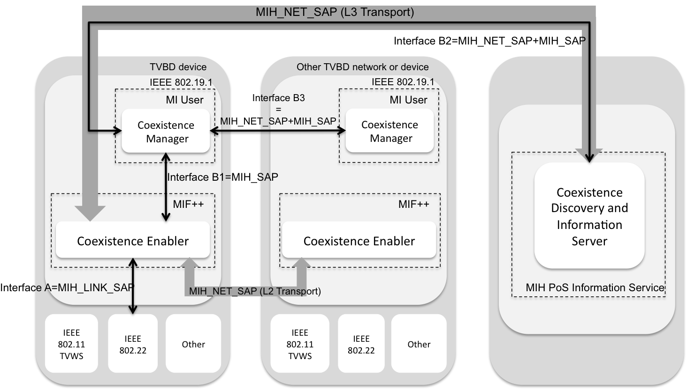
Integrating IEEE 802.19.1 Functional Elements in IEEE 802.21 Framework
TVWS and Operator Management Entity out of scope (interface C and D),
although communication may be based on .21 also

Slide 14
.21 Remote communication and MIIS
IEEE 802.21 has already defined mechanisms for L2/L3 communication which may be re-used.
  MIH Protocol
  RFC 5677
MIIS extensions can be defined to store new IE such as TV bands occupied, etc.
  Schema and communication mechanisms ready
  Just requires extensions to be used

Slide 15
Interface Management
Currently limited support in .21 standard
May provide a set of primitives allowing:
  Change of operating channel of the interface
  Change current transmission power of the interface
  Change current modulation rate
  Scanning/Sensing
  Others as required by application (IEEE 802.19.1)
In a Media Independent Way

Slide 16
How is currently done in .21
Upper Layers
MIH User
MIH_Link_Actions(MIHF_ID, [(Link_802.16, Link_Power_Up), (Link_802.11, Link_Power_Up)])
MIH_SAP
MIHF
MSGCF-ESS-Link-Command.request(NonAPSTAMacAddress, ESSIdentifier, POWER_UP)
M-SSM-REQ( Operation_Type: Action, Action_Type: Power On, Destination: SS, Attribute_List: )
CS_SAP
LSAP
Service-specific convergence sublayer
LLC
MAC_SAP
MSGCF_SAP
MAC State Generic Convergence Function
C_SAP
MSGCF_SME_SAP
MAC_SAP
MAC common part sublayer
MLME
SME
MAC
Security sublayer
Management Entity
MLME_SAP
PHY_SAP
MLME_PLME_SAP
PHY_SAP
M_SAP
PLME
PLCP and PMD
PHY
PLME_SAP
IEEE 802.16
IEEE 802.11

Slide 17
How is currently done in .21
Upper Layers
MIH User
MIH_Link_Actions(MIHF_ID, [(Link_802.16, Link_Power_Up), (Link_802.11, Link_Power_Up)])
MIH_SAP
MIHF
MSGCF-ESS-Link-Command.request(NonAPSTAMacAddress, ESSIdentifier, POWER_UP)
M-SSM-REQ( Operation_Type: Action, Action_Type: Power On, Destination: SS, Attribute_List: )
CS_SAP
LSAP
Service-specific convergence sublayer
LLC
MAC_SAP
MSGCF_SAP
MAC State Generic Convergence Function
C_SAP
MSGCF_SME_SAP
MAC_SAP
MAC common part sublayer
MLME
SME
MAC
Security sublayer
Management Entity
MLME_SAP
PHY_SAP
MLME_PLME_SAP
PHY_SAP
M_SAP
PLME
PLCP and PMD
PHY
PLME_SAP
IEEE 802.16
IEEE 802.11

Slide 18
How can be done in .19.1
Upper Layers
Coexistence Manager
Media Independent Sensing/Scan, TxPower_mangement, Switch Channel etc..
MIH_SAP
CE
Extended SAP to be defined by specific WGs!!
CS_SAP
LSAP
Service-specific convergence sublayer
LLC
MAC_SAP
MSGCF_SAP
MAC State Generic Convergence Function
C_SAP
MSGCF_SME_SAP
MAC_SAP
MAC common part sublayer
MLME
SME
MAC
Security sublayer
Management Entity
MLME_SAP
PHY_SAP
MLME_PLME_SAP
PHY_SAP
M_SAP
PLME
PLCP and PMD
PHY
PLME_SAP
IEEE 802.22
(SAP diagram not correct)
IEEE 802.11 TVWS
(SAP diagram not correct)

Slide 19
Example of MIIS functionality
Upon changes on the TVWS (interface C)
A MIIS approach will be able to use push mode to send the new information to registered nodes either in the network or a TVBD

Slide 20
Summary
A Media Independent Approach makes sense for IEEE 802.19.1 functionality
  The CM can be made Media Independent, algorithms agnostic from technology
  The CE working as a Media Independent Service Layer translate the technology agnostic calls to technology dependent primitives

Slide 21
Summary
An schema where Events, Commands and Information services are used can be applied to the problem
  Commands for reconfiguration of interfaces, sensing, etc..
  Events for neighbor discovery, reporting, monitoring, etc..
  Information service to gather information regarding coexistence
Current SAPs with specific technologies may need to be extended

