Slide 1
IEEE 802.21 MEDIA INDEPENDENT HANDOVER
DCN: 21-10-0145-00-0000
Title: Heterogeneous Wireless Management for Coexistence
Date Submitted: July 13, 2010
Presented to Heterogeneous Wireless Networks Mgmt. SG at IEEE 802.21 session #39 in San Diego
Authors or Source(s):
Antonio de la Oliva (UC3M)
Johannes Lessmann (NEC)
Christian Niephaus (FhG)
Abstract: Relationship between 802.19.1 and 802.21

Slide 2
  IEEE 802.21 presentation release statements
This document has been prepared to assist the IEEE 802.21 Working Group. It is offered as a basis for discussion and is not binding on the contributing individual(s) or organization(s). The material in this document is subject to change in form and content after further study. The contributor(s) reserve(s) the right to add, amend or withdraw material contained herein.
The contributor grants a free, irrevocable license to the IEEE to incorporate material contained in this contribution, and any modifications thereof, in the creation of an IEEE Standards publication; to copyright in the IEEE’s name any IEEE Standards publication even though it may include portions of this contribution; and at the IEEE’s sole discretion to permit others to reproduce in whole or in part the resulting IEEE Standards publication. The contributor also acknowledges and accepts that this contribution may be made public by IEEE 802.21.
The contributor is familiar with IEEE patent policy, as outlined in Section 6.3 of the IEEE-SA Standards Board Operations Manual <http://standards.ieee.org/guides/opman/sect6.html#6.3> and in Understanding Patent Issues During IEEE Standards Development http://standards.ieee.org/board/pat/guide.html>

Slide 3
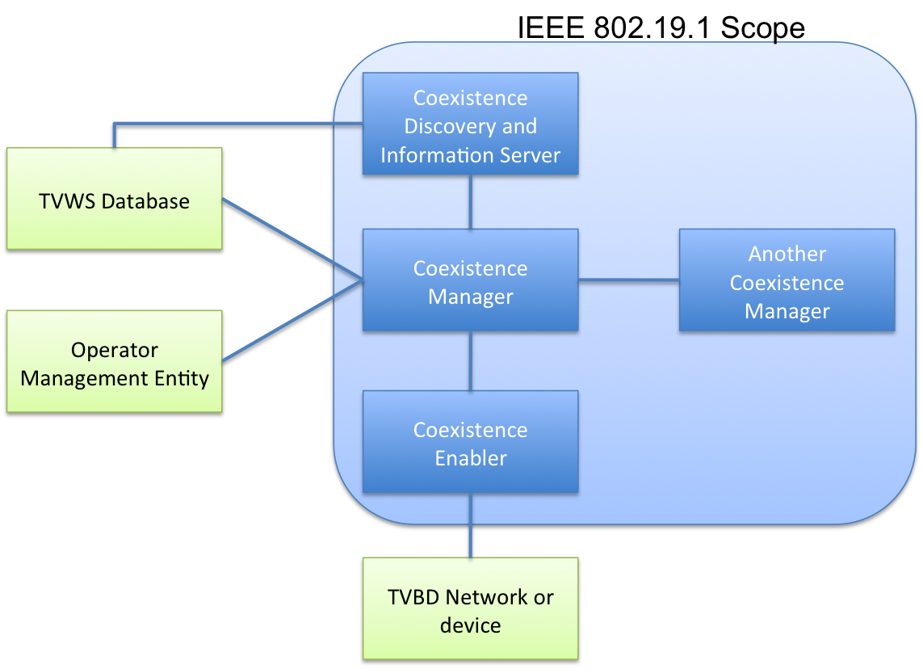
IEEE 802.19.1

Slide 4
IEEE 802.19.1
Entities in the scope
  Coexistence Manager (CM): This entity is the brain of the system, its main functionality corresponds to the coexistence decision making. Once the corresponding coexistence configuration is decided, the CM issues the appropriate commands through the Coexistence Enabler (CE) to the TVBDs (TV Band Device) which will be reconfigured accordingly.
  Coexistence Enabler (CE): The main task of this entity is to translate reconfiguration requests/command and control information issued by the CM to technology dependent primitives which are then sent to the specific TVBD. It is also in charge of requesting and obtaining information pertinent to coexistence from the TVBD.
  Coexistence Discovery and Information Server (CDIS): This entity collects and aggregates information regarding coexistence, it also serves as a support point for the discovery of CMs.

Slide 5
IEEE 802.19.1
External Entities
  TVWS Database: Database containing current free/allocated channels
  Operator Management Entity: Entity controlled by the operator which can influence te decision of the CM
  TVBD Device or network: TV Band Device, namely IEEE 802.11af or IEEE 802.22 currently.

Slide 6
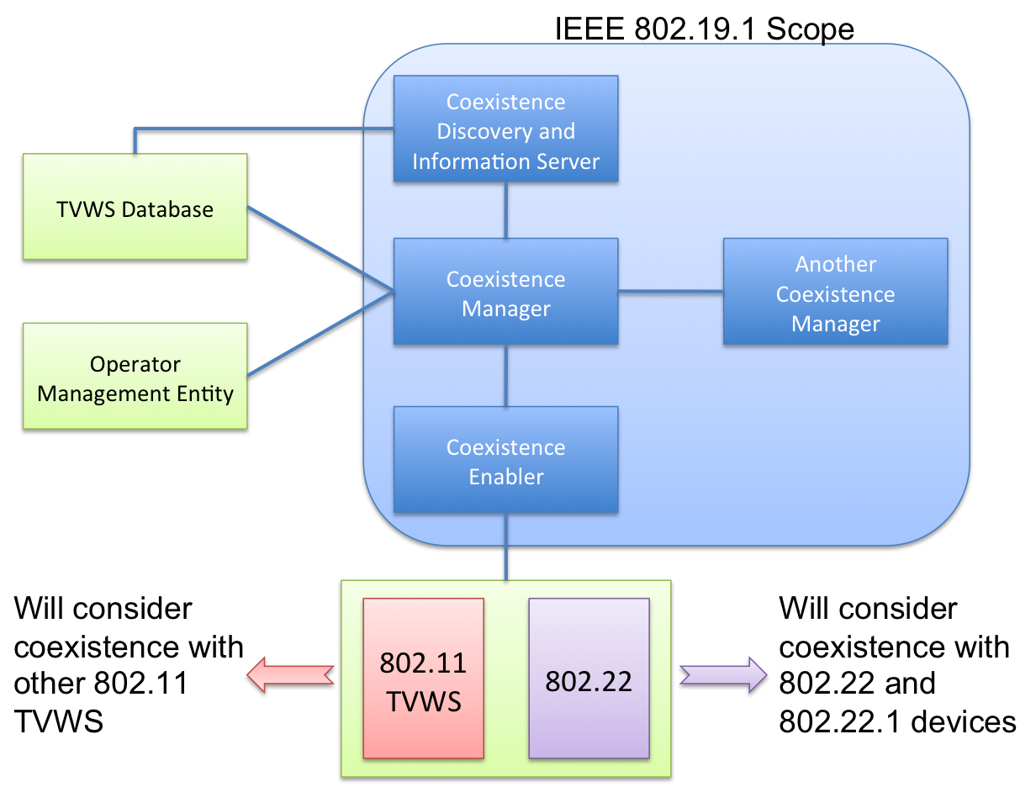
Media Independence in IEEE 802.19.1

Slide 7
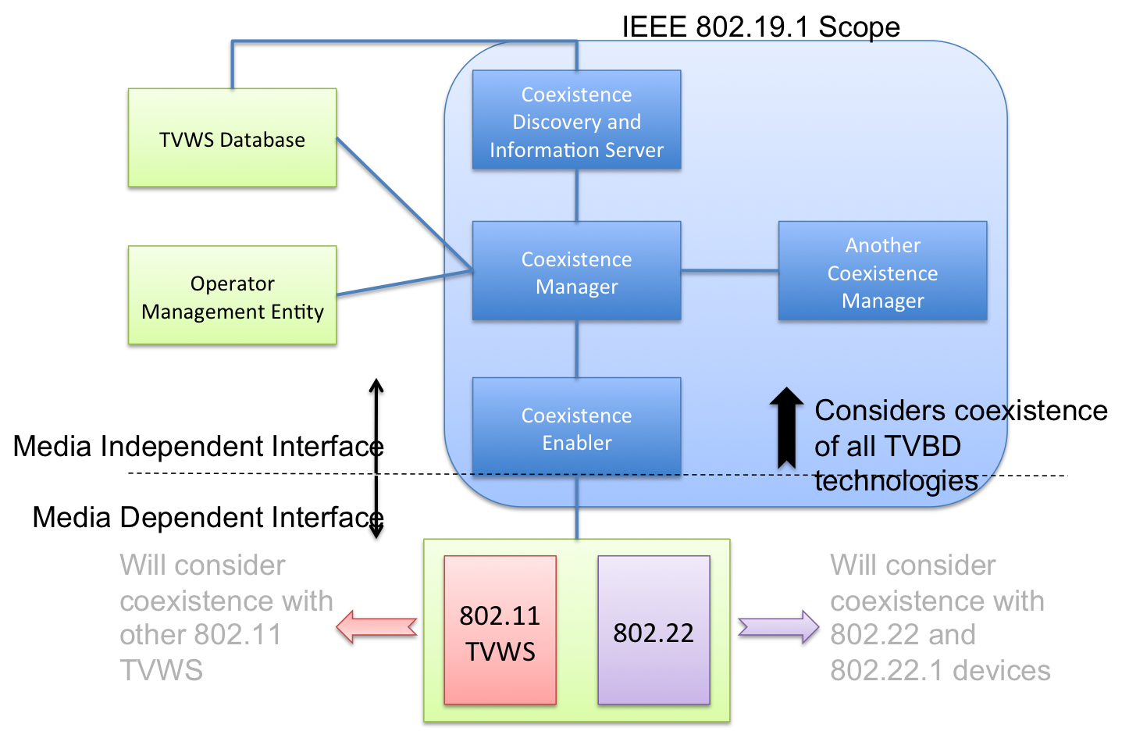
Media Independence in IEEE 802.191.

Slide 8
Configuration Parameters
Some parameters identified in 802.19.1
  Operating channel
  Maximum transmit power
  Modulation and coding rate
  Bandwidth
  OFDMA uplink client sub-band
  Transmit scheduling
    CSMA parameters
    Transmit duty cycle limit
  Antenna configurations
Taken from TVWS Coexistence Tutorial Slides

Slide 9
Scenarios Discussed in SG
Backhaul management
Cross-layer routing
DSL Backhaul
Smart Grid
TVWS Coexistence

Slide 10
Conclusion
TVWS Coexistence seems to require a Media Independent Layer to handle coexistence of heterogeneous technologies
The required configuration parameters (although tentative) seem to be inline with other scenarios
TVWS sums up to the list of scenarios discussed in the SG, showing how technology is moving towards heterogeneity and a control layer managing it in a media independent way is needed

