Slide 1
Experimental results of coexistence between
IEEE 802.11ah and IEEE 802.15.4g using actual devices
Date: 2025-03-13
Authors:
Notice: This document has been prepared to assist IEEE 802.19. It is offered as a basis for discussion and is not binding on the contributing individual(s) or organization(s). The material in this document is subject to change in form and content after further study. The contributor(s) reserve(s) the right to add, amend or withdraw material contained herein.

Slide 2
Introduction
We have conducted coexistence evaluations of IEEE 802.11ah and IEEE 802.15.4g through computer simulations.
In this document, we report the results of evaluating the impact of coexistence through experiments using actual IEEE 802.11ah and IEEE 802.15.4g devices.
This time, we are presenting the preliminary evaluation results. We are planning additional experiments for the May meeting. If you have any comments on the measurement items or conditions that should be obtained, please let us know.

Slide 3
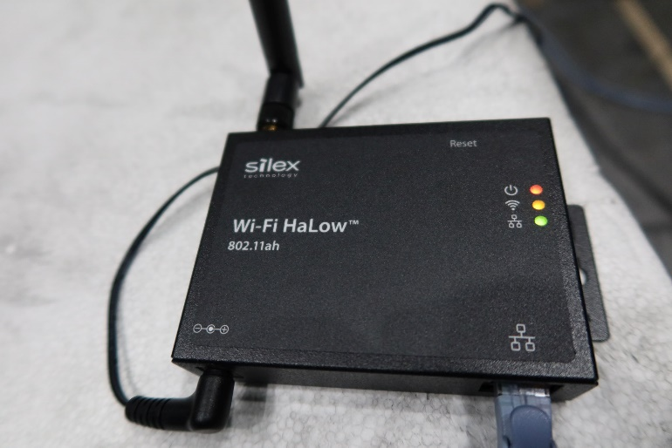
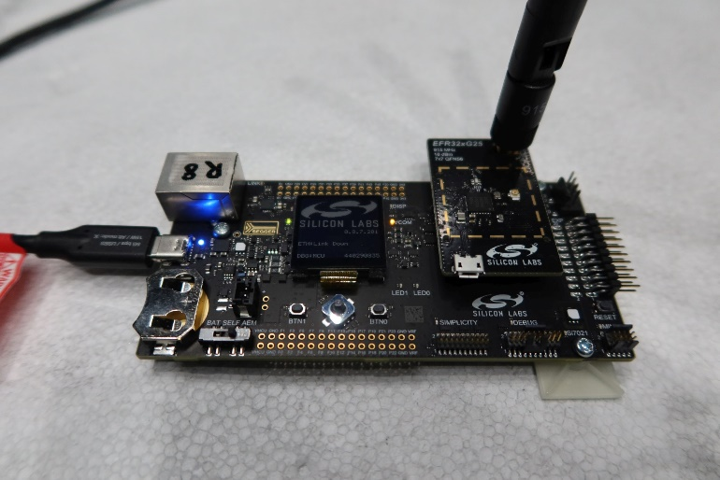
Measurement Equipment
IEEE 802.11ah
IEEE 802.15.4g
AP : Silex AP-100AH(JP)
STA: Silex BR-100AH(JP)
Silicon Labs EFR32FG25
https://www.silex.jp/products/accesspoint/list/ap100ah
https://www.silex.jp/products/bridge/list/br100ah
https://www.silabs.com/wireless/proprietary/efr32fg25-sub-ghz-wireless-socs

Slide 4
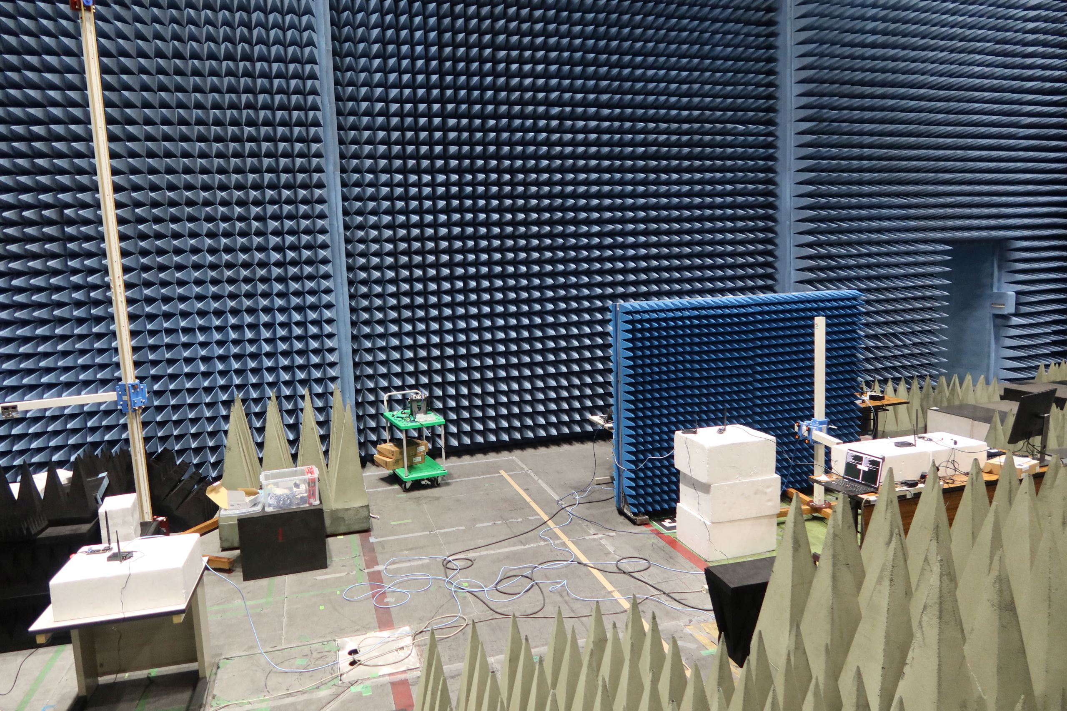
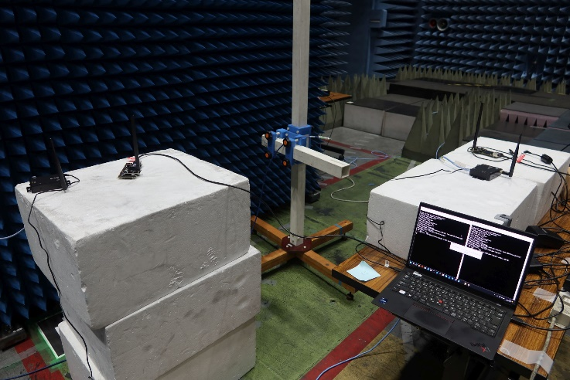
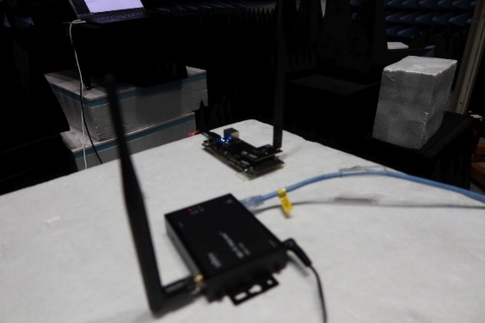
Measurement Environment
802.15.4g
Node#2
802.15.4g
Node#1
802.15.4g
PANC
802.11ah
STA#1
802.11ah
STA#2
802.11ah
AP
Uplink traffic
Uplink traffic is transmitted from both IEEE 802.11ah STAs and IEEE 802.15.4g nodes.

Slide 5
Evaluation Specifications
802.11ah uplink data rate/STA[kbps] | 10 – 60
802.11ah packet size[Byte] | 100
802.11ah MCS | 0 (333 kbps), 3 (1333 kbps), 7 (3333kbps)
802.11ah bandwidth[MHz] | 1
802.15.4g uplink data rate/node[kbps] | 1.6
802.15.4g packet size[Byte] | 100
802.15.4g MCS | Option3 MCS 4 (300 kbps), Option3 MCS 5 (400 kbps)
802.15.4g bandwidth[kHz] | 400
Both IEEE 802.11ah and IEEE 802.15.4g perform transmissions to maintain a duty cycle of less than 10%.

Slide 6
Evaluation Results
IEEE 802.11ah Jitter
IEEE 802.15.4g Frame Error Rate
* If the IEEE 802.11ah device is not activated, the frame error rate is 0.
11ah MCS0
11ah MCS3
11ah MCS3
11ah MCS0
11ah MCS7
11ah MCS7
As the PHY rate of IEEE 802.15.4g increases, the jitter of IEEE 802.11ah decreases.
On the other hand, the frame error rate of IEEE 802.15.4g remains unchanged even if the PHY rate of IEEE 802.15.4g increases.
Additionally, since there are cases where the frame error rate increases with MCS 3 compared to MCS 0 in IEEE 802.11ah, an increase in the PHY rate of IEEE 802.11ah does not necessarily result in a decrease in the frame error rate of IEEE 802.15.4g.

Slide 7
Summary
This contribution presents the results of a preliminary evaluation of coexistence between IEEE 802.11ah and IEEE 802.15.4g using actual devices.
  When IEEE 802.11ah and IEEE 802.15.4g coexist, the jitter of IEEE 802.11ah can increase to around 70 ms, and the frame error rate of IEEE 802.15.4g can increase to around 30 %.
We are presenting the preliminary evaluation results. We are planning additional experiments for the May meeting. If you have any comments on the measurement items or conditions that should be obtained, please let us know.

