Slide 1
Coexistence Simulation of IEEE 802.11ah and IEEE 802.15.4g SUN PHYs Compliant with Japanese Standard
ARIB STD-T108 version 1.5
Date: 2025-03-13
Authors:
Notice: This document has been prepared to assist IEEE 802.19. It is offered as a basis for discussion and is not binding on the contributing individual(s) or organization(s). The material in this document is subject to change in form and content after further study. The contributor(s) reserve(s) the right to add, amend or withdraw material contained herein.

Slide 2
Summary
Presentation to TG3a of simulation update for coexistence of IEEE 802.15.4g and IEEE with the Japanese Standard
ARIB STD-T108 Version 1.5[1].
In ARIB STD-T108 Version 1.5 revisions have been made for IEEE 802.11ah. ARIB STD-T108 Version 1.5 was released in March 2023 and was not considered by the IEEE 802.19.3 TG.
This document gathers relevant material from 19-24/0018r0, 19-19/0019r1, 19-18/0056r3, 19-18/0039r1 and 19-19/0021r2 for simulation conditions and use cases.
[1] https://www.arib.or.jp/english/std_tr/telecommunications/std-t108.html

Slide 3
Background: S1G Coexistence Simulations in TG3
Developed the coexistence simulator based on NS-3.23, which support IEEE 802.15.4g-FSK (400 KHz bandwidth) and IEEE 802.11ah (1 MHz bandwidth) for IEEE 802.19.3.
Extended this simulator to support IEEE 802.15.4-OFDM (400 KHz bandwidth) to evaluate IEEE 802.19.3a.
Simulation parameters and simulator deployment were discussed in TG3.
  [19-18/0039r1] Steve Shellhammer, “Sub-1GHz Coexistence Simulation Parameters”
  [19-19/0021r2] Yukimasa Nagai, “S1G Coexistence Simulation Profile”
  [19-18/0071r0] Takenori Sumi, “Sub-1GHz Coexistence Simulation Models Update”
Simulation parameters were updated in TG3a.
  [19-24/0018r0] Yukimasa Nagai, “Simulation Parameter Update for S1G Bands OFDM systems”
Simulation results were also shared in TG3.
  19-19/0019r1, 19-18/0056r3

Slide 4
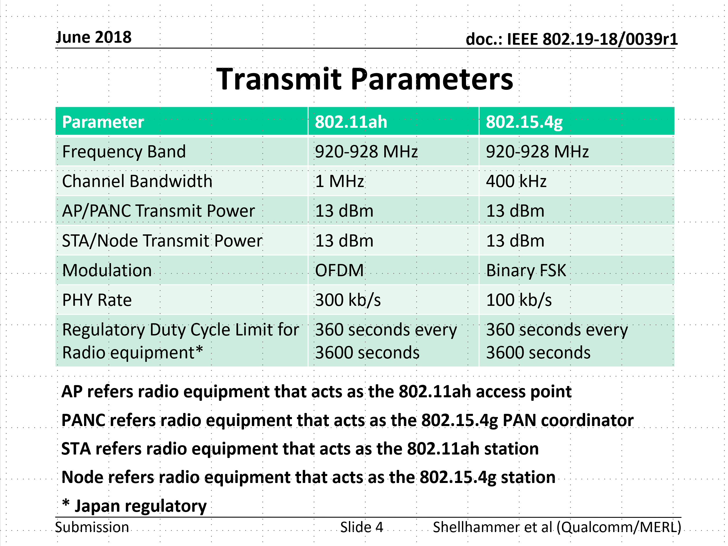
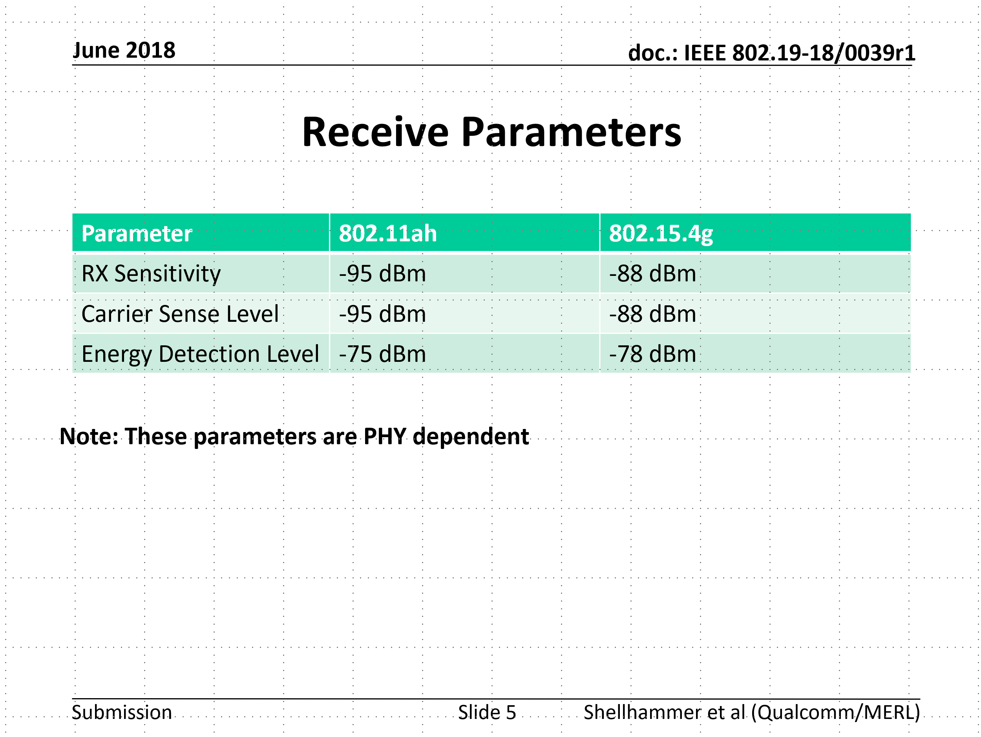
Simulation parameters discussed in TG3
Energy detection level is specified as -80 dBm in ARIB STD-T108 Version 1.5.
Refer to 19-18/0039r1

Slide 5
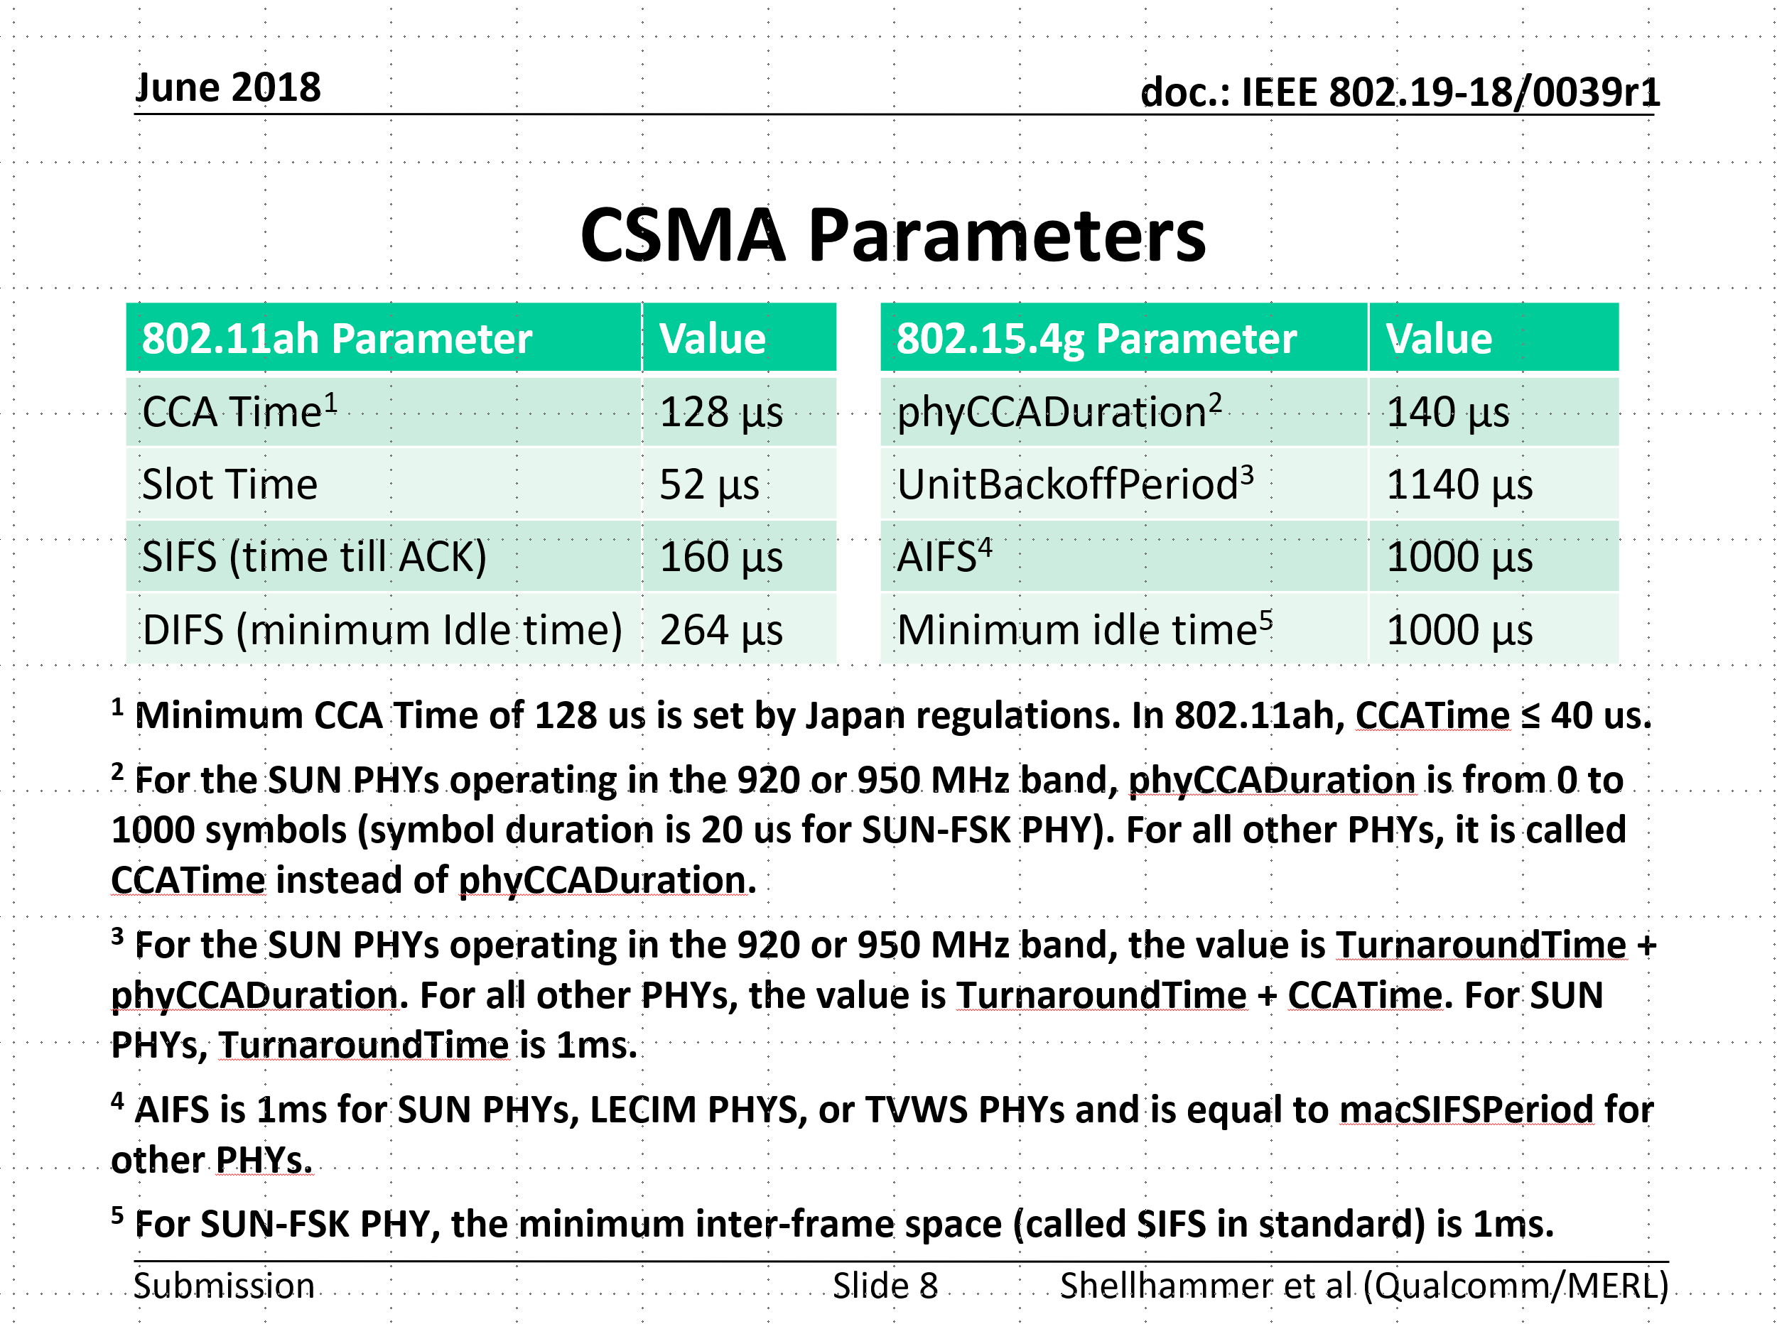
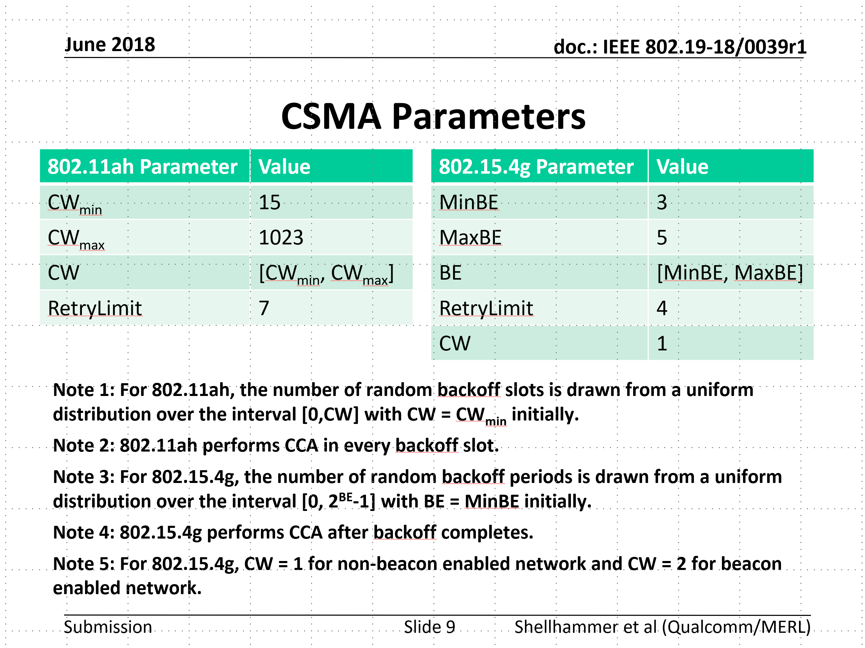
Simulation parameters discussed in TG3*
Refer to 19-18/0039r1
*Same with 19-24/0042r0

Slide 6
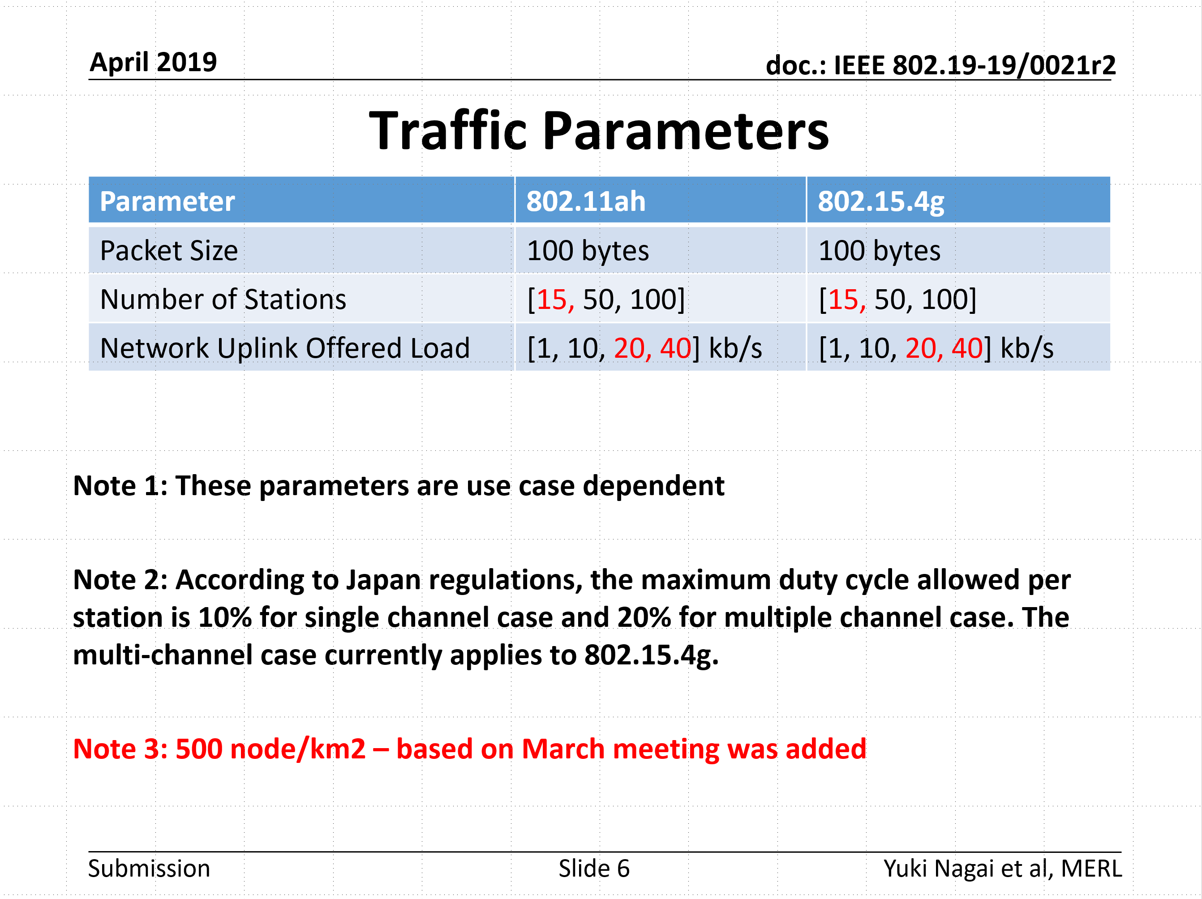
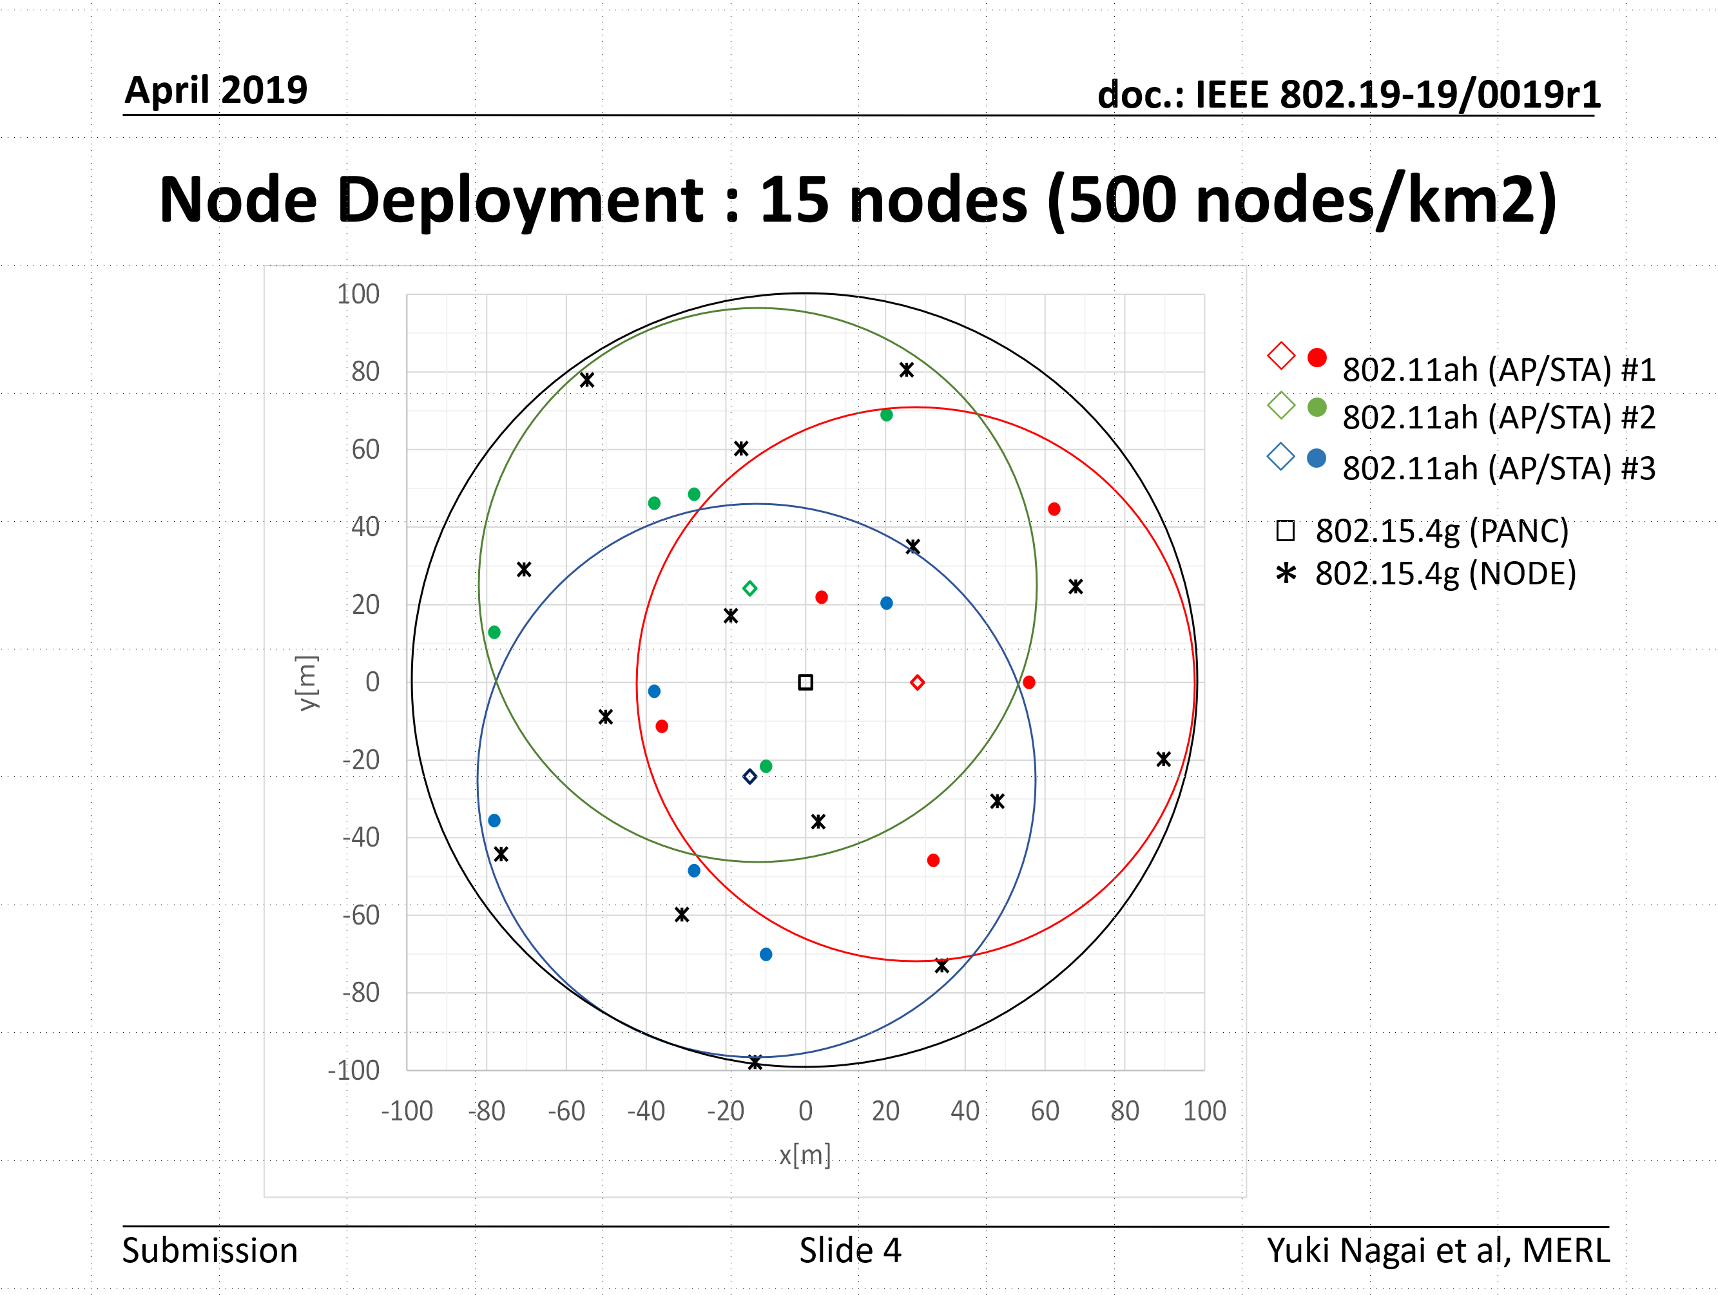
Simulation parameters discussed in TG3*
Refer to 19-19/0021r2
Refer to 19-19/0019r1
*Same with 19-24/0042r0

Slide 7
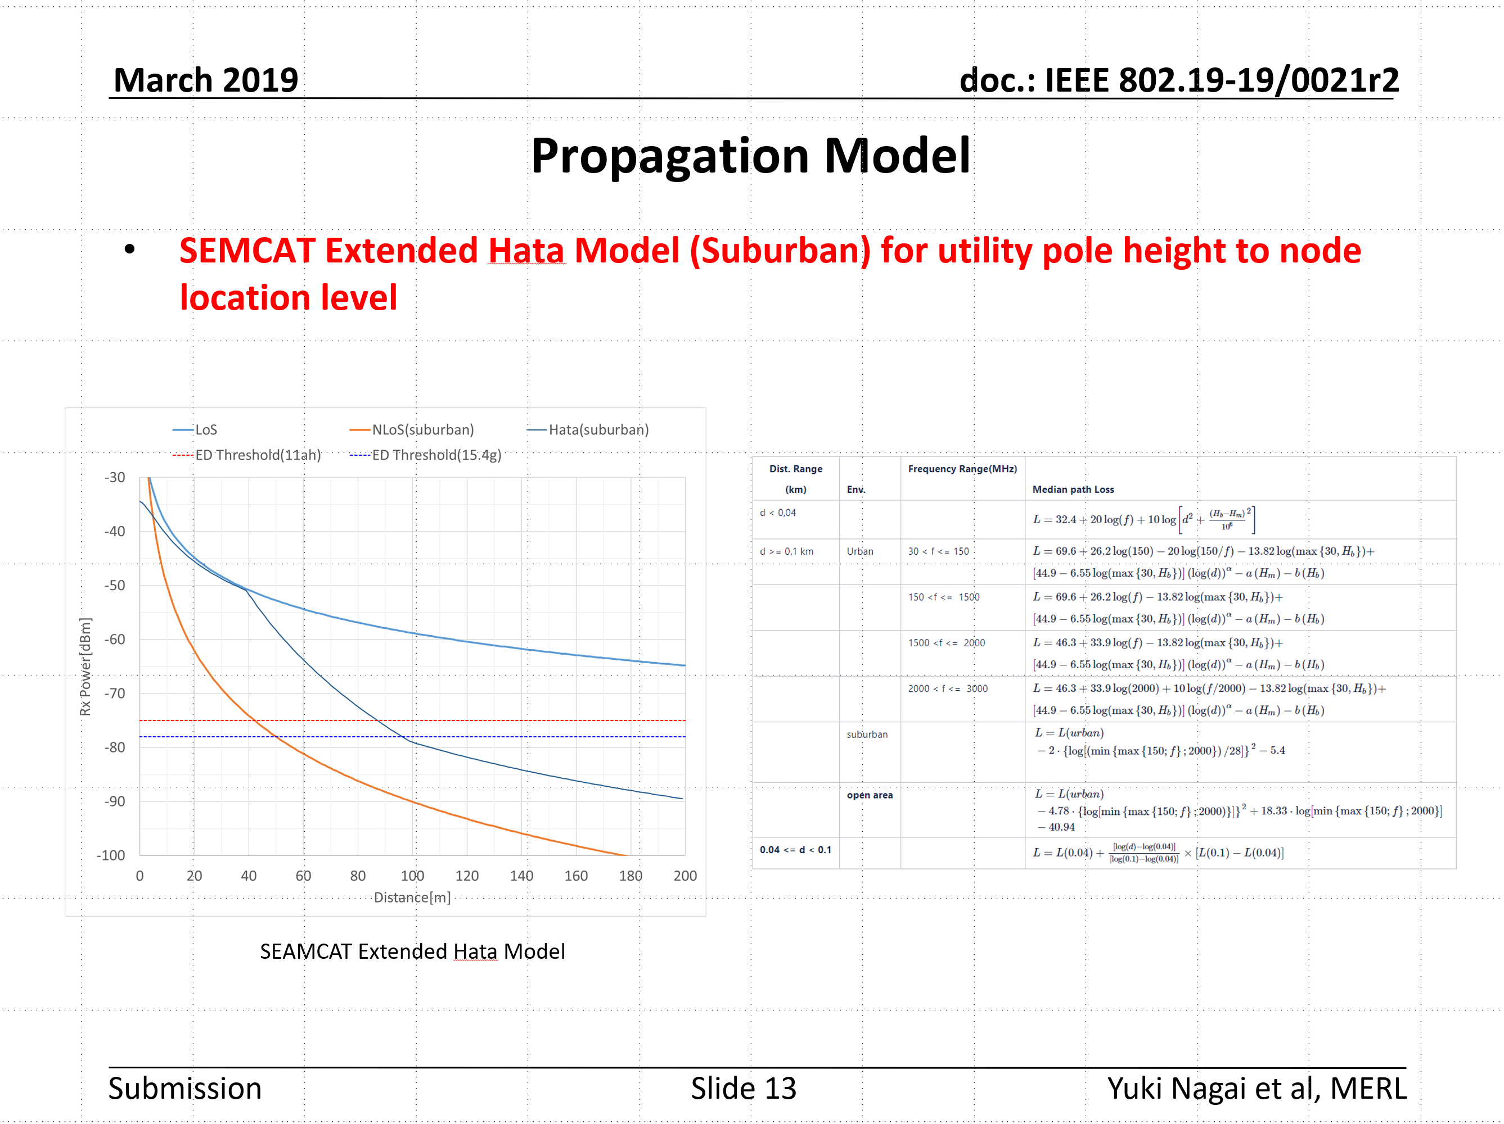
Simulation parameters discussed in TG3*
*Same with 19-24/0042r0
Refer to 19-19/0021r2

Slide 8
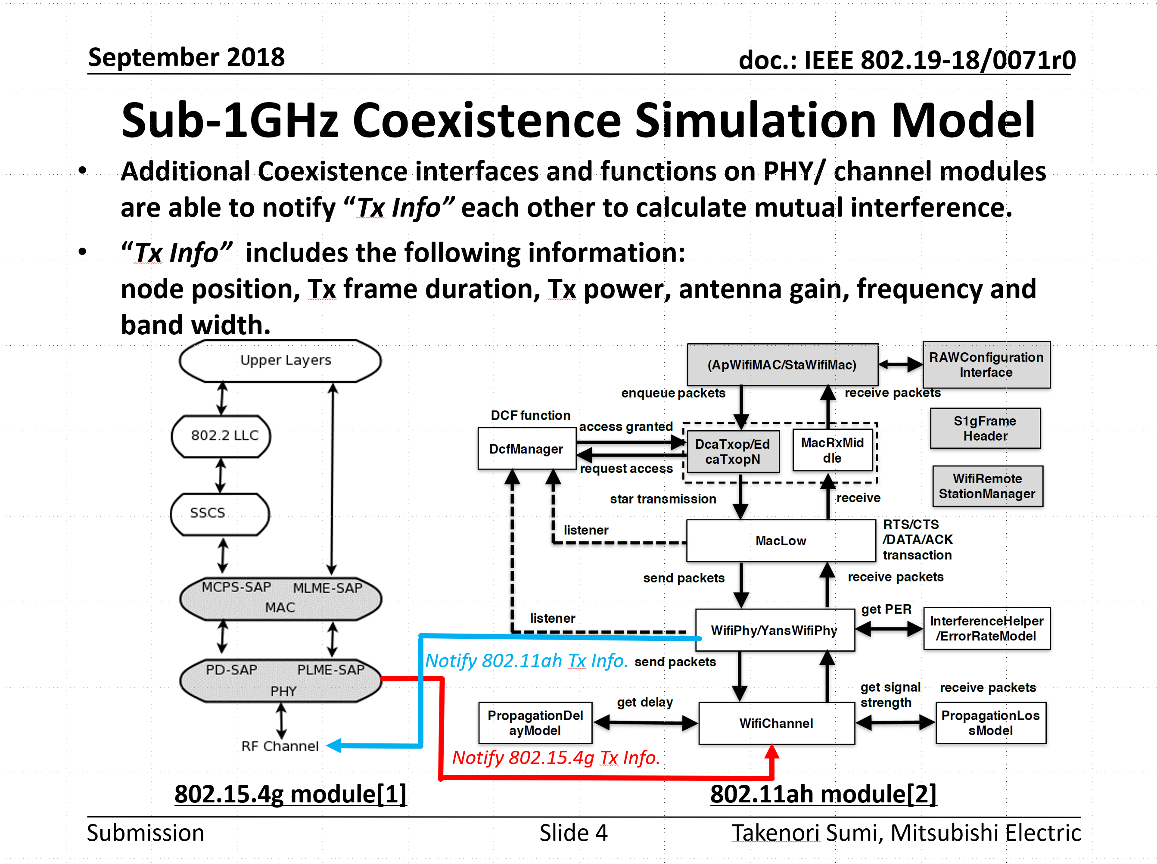
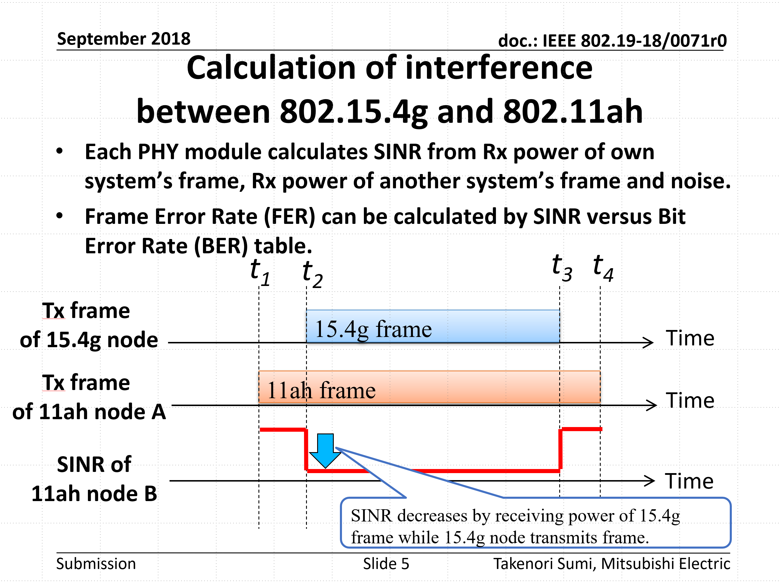
Simulation models discussed in TG3*
Refer to 19-18/0071r0
*Same with 19-24/0042r0

Slide 9
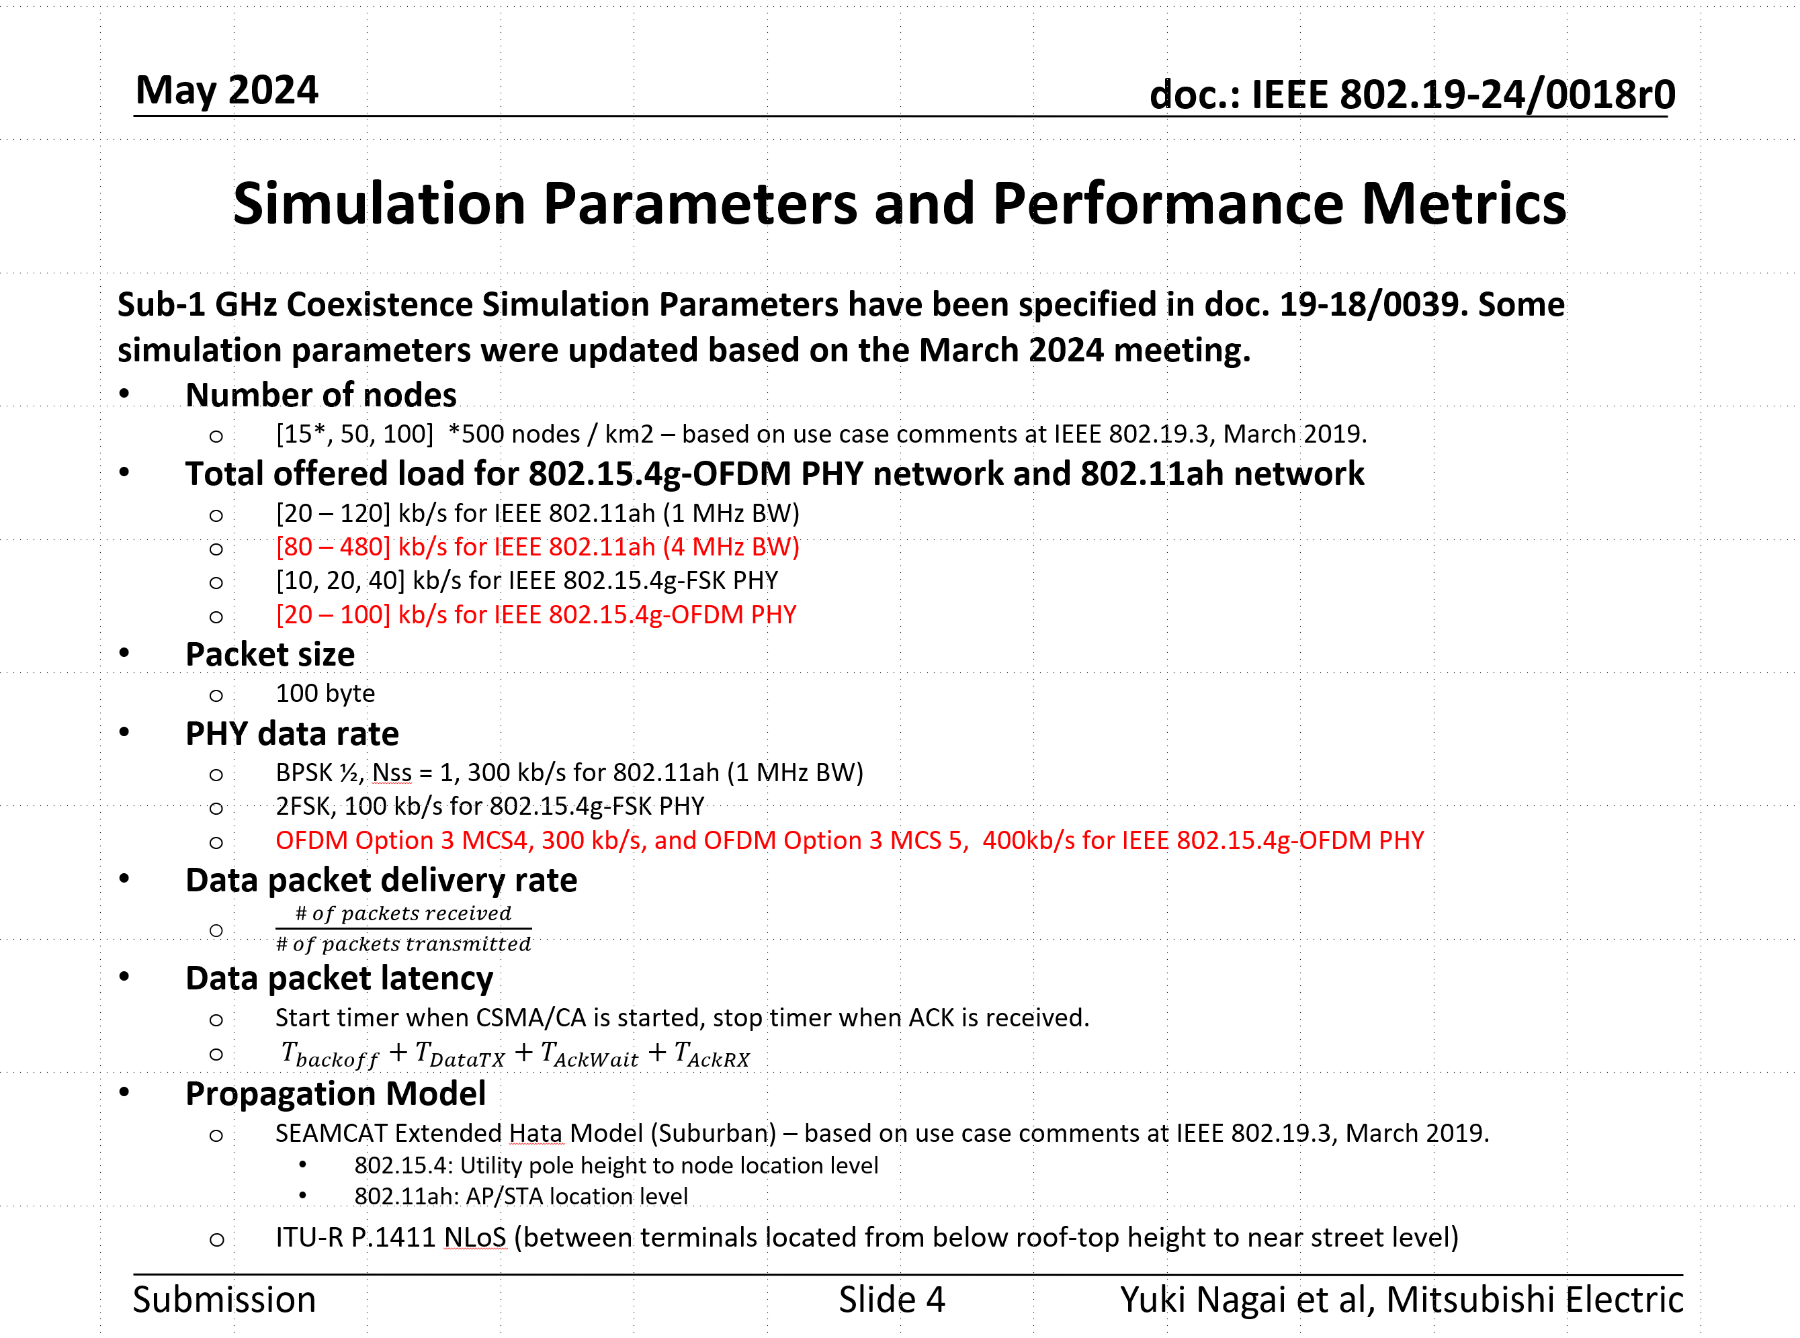
Simulation parameters updated in TG3a May meeting*
Refer to 19-24/0018r0
*Same with 19-24/0042r0

Slide 10
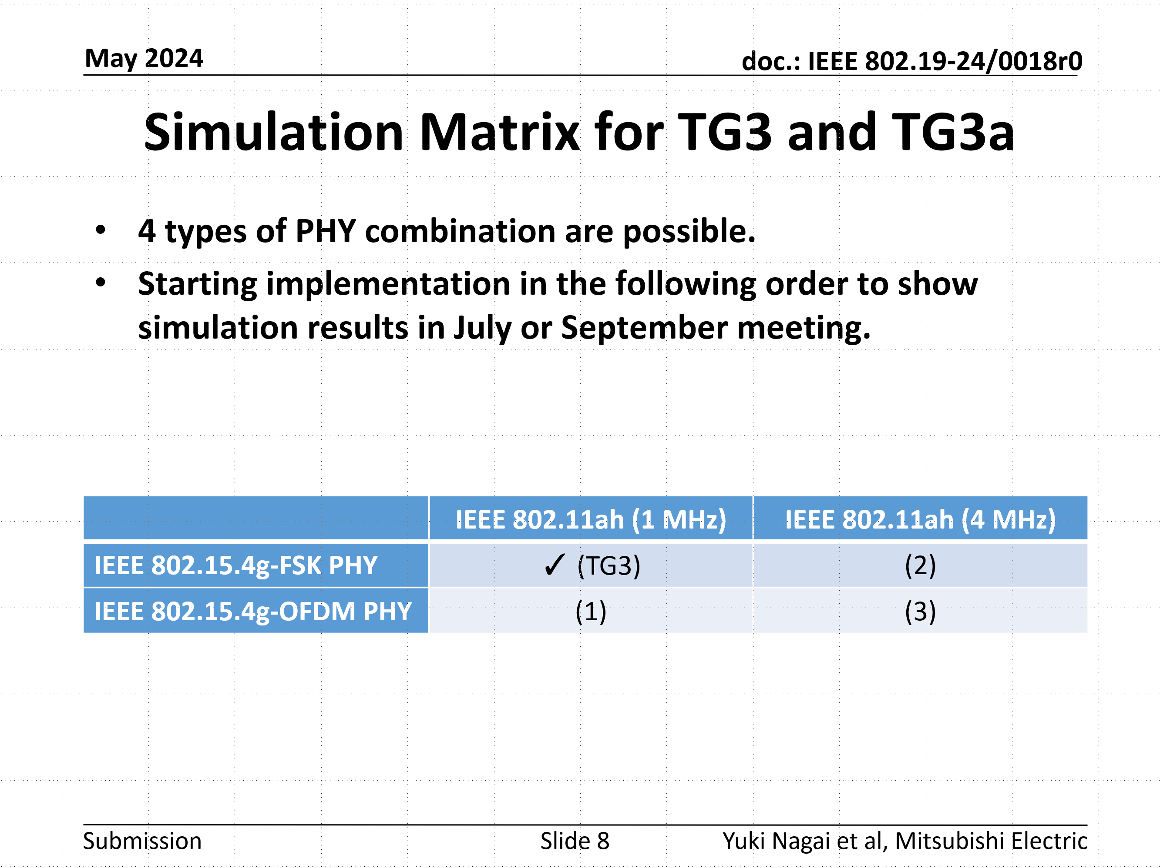
Simulation parameters updated in TG3a May meeting*
From the next page, simulation results are shown for each combination of the simulation matrix.
Refer to 19-24/0018r0
*Same with 19-24/0042r0

Slide 11
Simulation Results
IEEE 802.15.4g offered load: 20 kbps
IEEE 802.11ah: 1MHz PHY, IEEE 802.15.4g: 2-FSK
Packet Delivery Rate
Average Latency
The Packet Delivery Rate of IEEE 802.15.4g slightly improves by applying the energy detection threshold of -80 dBm specified in ARIB STD-T108. There is no impact on the latency.

Slide 12
Simulation Results
IEEE 802.15.4g offered load: 20 kbps
IEEE 802.11ah: 1MHz PHY, IEEE 802.15.4g: OFDM MCS 4
Packet Delivery Rate
Average Latency
Even when applying the energy detection threshold of -80 dBm specified in ARIB STD-T108, the simulation results were almost equivalent to those obtained with the energy detection threshold specified by TG3.

Slide 13
Simulation Results
IEEE 802.15.4g offered load: 20 kbps
IEEE 802.11ah: 1MHz PHY, IEEE 802.15.4g: OFDM MCS 5
Packet Delivery Rate
Average Latency
Even when applying the energy detection threshold of -80 dBm specified in ARIB STD-T108, the simulation results were almost equivalent to those obtained with the energy detection threshold specified by TG3.

Slide 14
Simulation Results
IEEE 802.15.4g offered load: 20 kbps
IEEE 802.11ah: 4MHz PHY, IEEE 802.15.4g: 2-FSK
Packet Delivery Rate
Average Latency
The Packet Delivery Rate of IEEE 802.15.4g slightly improves by applying the energy detection threshold of -80 dBm specified in ARIB STD-T108. There is no impact on the latency.

Slide 15
Simulation Results
IEEE 802.15.4g offered load: 20 kbps
IEEE 802.11ah: 4MHz PHY, IEEE 802.15.4g: OFDM MCS 4
Packet Delivery Rate
Average Latency
The Packet Delivery Rate of IEEE 802.15.4g slightly improves by applying the energy detection threshold of -80 dBm specified in ARIB STD-T108. There is no impact on the latency.

Slide 16
Simulation Results
IEEE 802.15.4g offered load: 20 kbps
IEEE 802.11ah: 4MHz PHY, IEEE 802.15.4g: OFDM MCS 5
Packet Delivery Rate
Average Latency
The Packet Delivery Rate of IEEE 802.15.4g slightly improves by applying the energy detection threshold of -80 dBm specified in ARIB STD-T108. There is no impact on the latency.

Slide 17
Summary
By applying the energy detection threshold of -80 dBm specified in ARIB STD-T108, the packet delivery rate of IEEE 802.15.4g slightly improves when coexisting with the 4 MHz PHY of IEEE 802.11ah or when using 2-FSK.
In the Japanese region, it is advisable to consider ARIB STD-T108. We would like to reflect the contents of ARIB STD-T108 in the recommended practice.

