Slide 1
IEEE 802.11ah and IEEE 802.15.4g SUN OFDM PHY
Coexistence Simulation for Case 1-3 with Suspendable CSMA/CA
Date: 2025-01-16
Authors:
Notice: This document has been prepared to assist IEEE 802.19. It is offered as a basis for discussion and is not binding on the contributing individual(s) or organization(s). The material in this document is subject to change in form and content after further study. The contributor(s) reserve(s) the right to add, amend or withdraw material contained herein.

Slide 2
Summary
Presentation to TG3a of simulation update for coexistence of IEEE 802.15.4g and IEEE 802.11ah using new simulation parameters for smart utility use cases.
The new feature “Suspendable CAMA/CA” on IEEE 802.15-2024 was evaluated.
This document gathers relevant material from 19-24/0042r0, 19-24/0018r0, 19-19/0019r1, 19-18/0056r3, 19-18/0039r1 and 19-19/0021r2 for simulation conditions and use cases.
Plan for March meeting.

Slide 3
Background: S1G Coexistence Simulations in TG3*
Developed the coexistence simulator based on NS-3.23, which support IEEE 802.15.4g-FSK (400 KHz bandwidth) and IEEE 802.11ah (1 MHz bandwidth) for IEEE 802.19.3.
Extended this simulator to support IEEE 802.15.4-OFDM (400 KHz bandwidth) to evaluate IEEE 802.19.3a.
Simulation parameters and simulator deployment were discussed in TG3.
  [19-18/0039r1] Steve Shellhammer, “Sub-1GHz Coexistence Simulation Parameters”
  [19-19/0021r2] Yukimasa Nagai, “S1G Coexistence Simulation Profile”
  [19-18/0071r0] Takenori Sumi, “Sub-1GHz Coexistence Simulation Models Update”
Simulation parameters were updated in TG3a.
  [19-24/0018r0] Yukimasa Nagai, “Simulation Parameter Update for S1G Bands OFDM systems”
Simulation results were also shared in TG3.
  19-19/0019r1, 19-18/0056r3
*Same with 19-24/0042r0

Slide 4
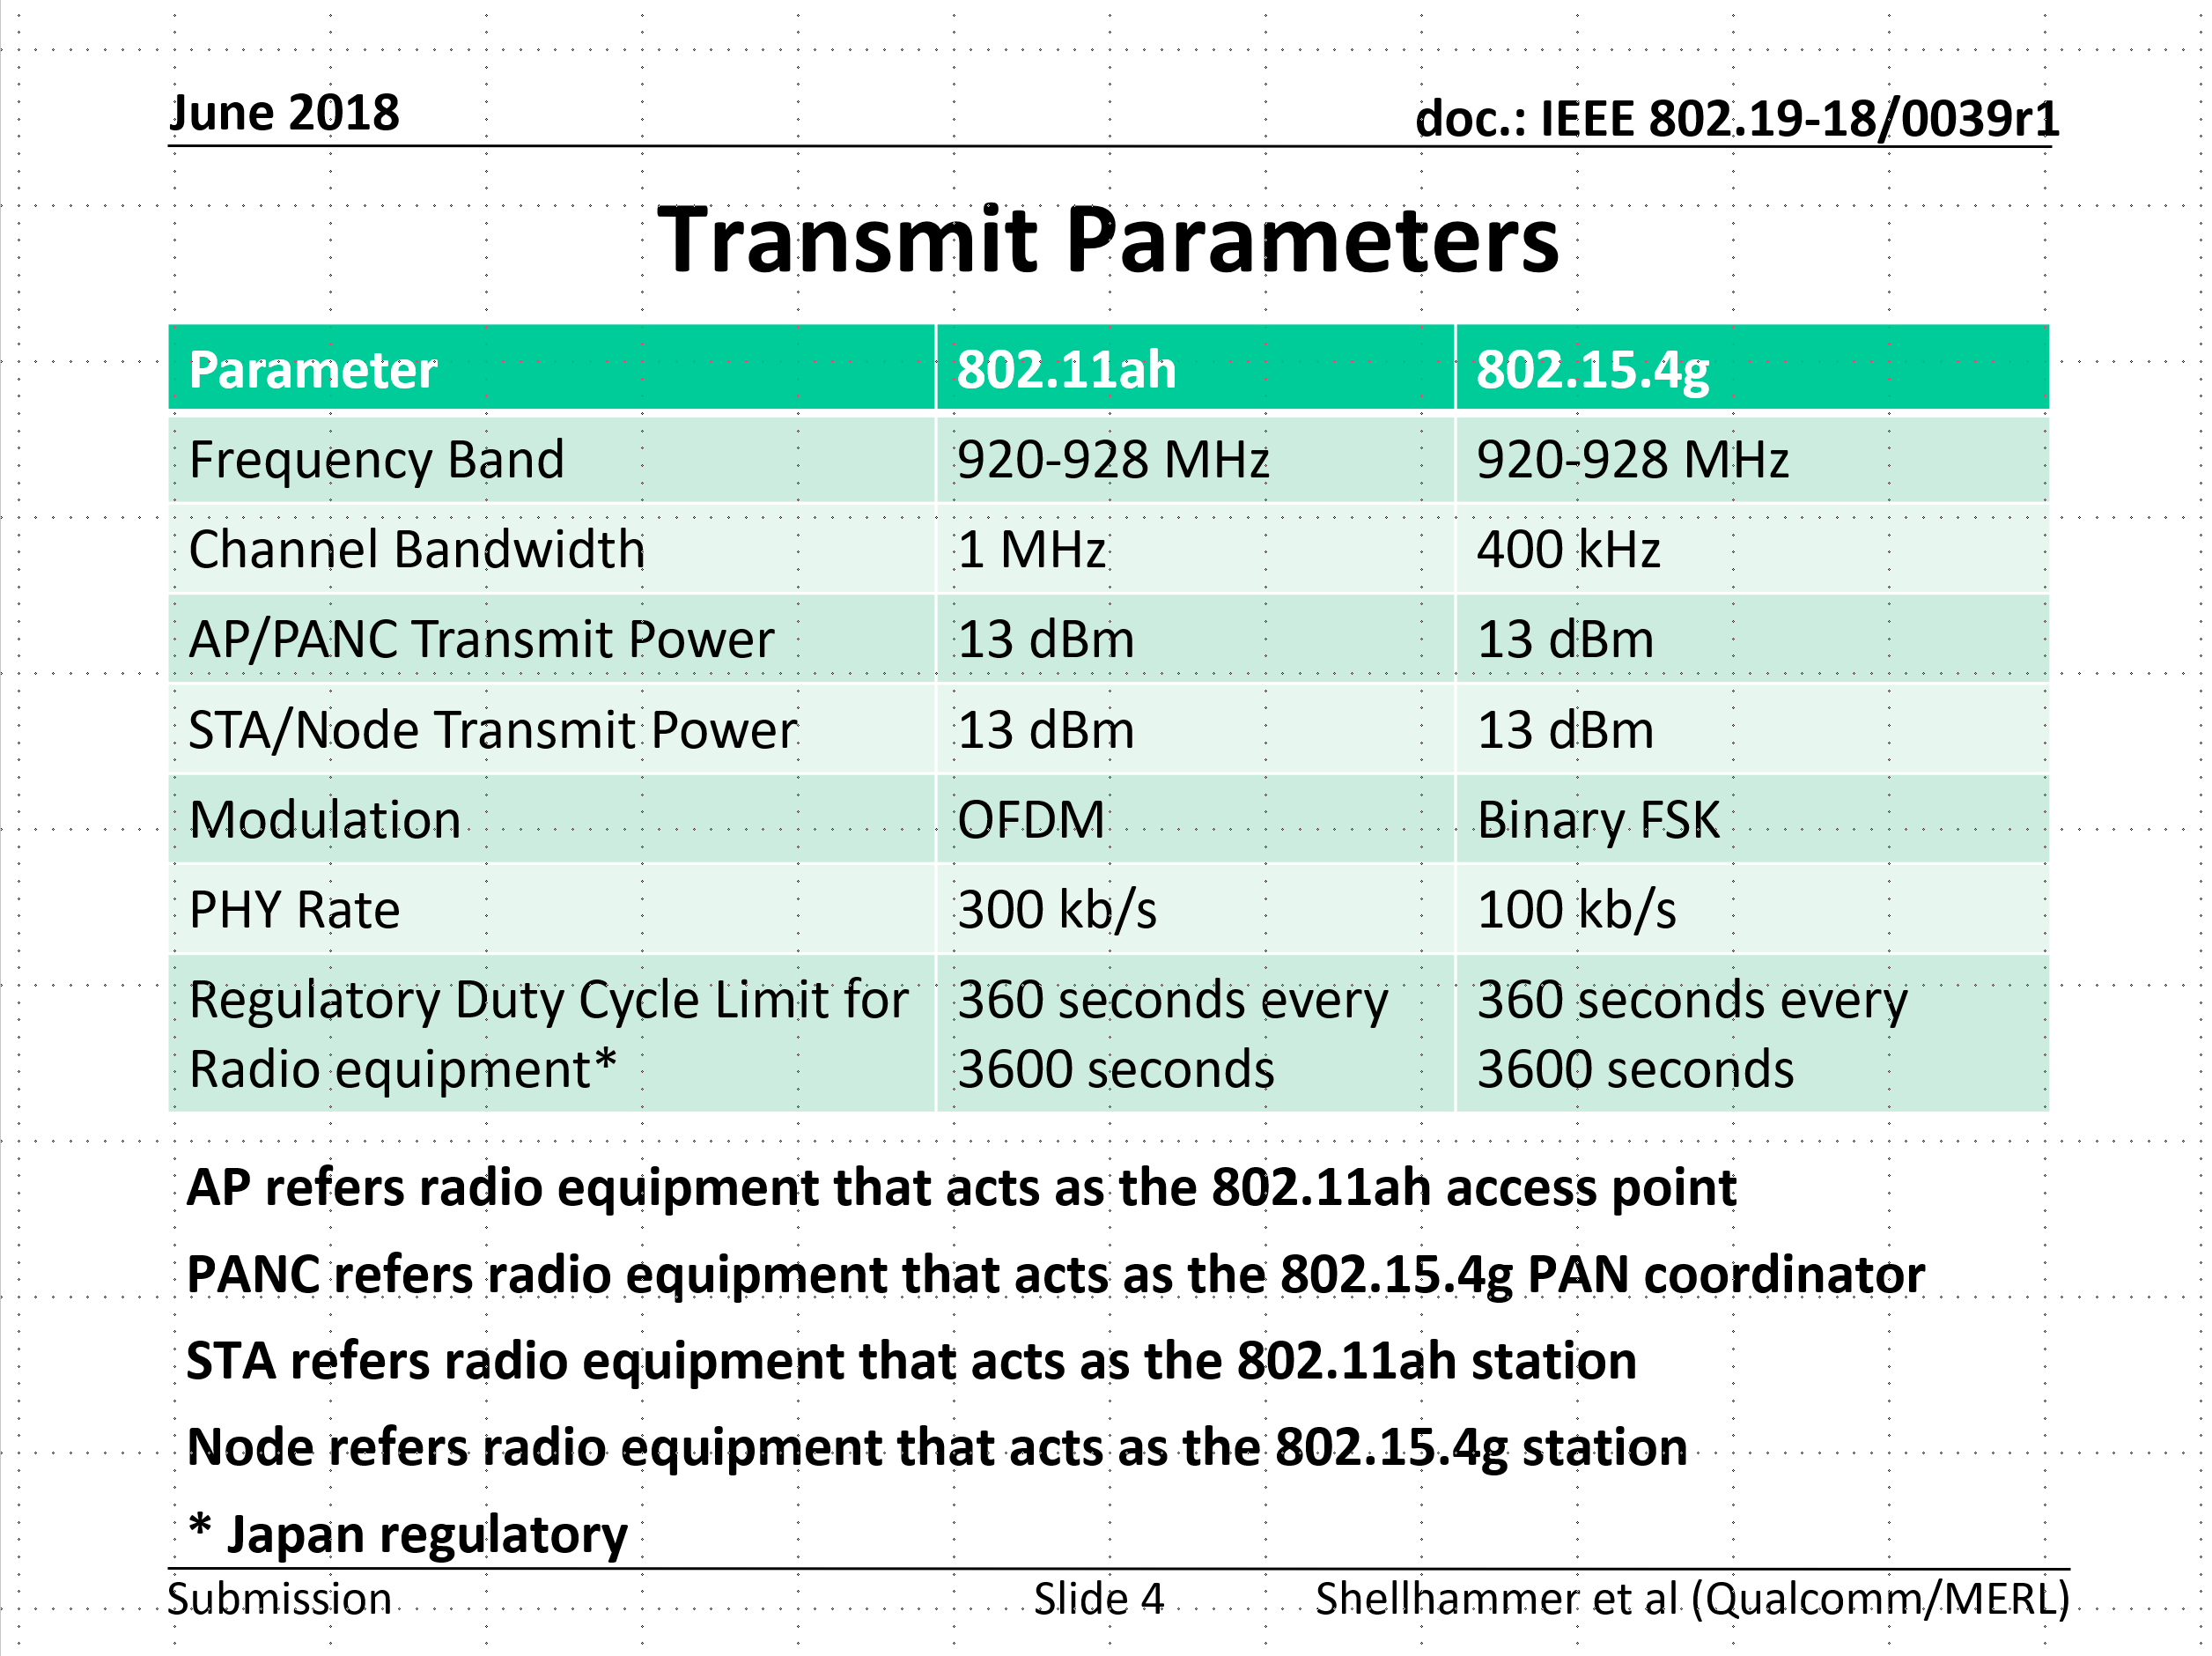
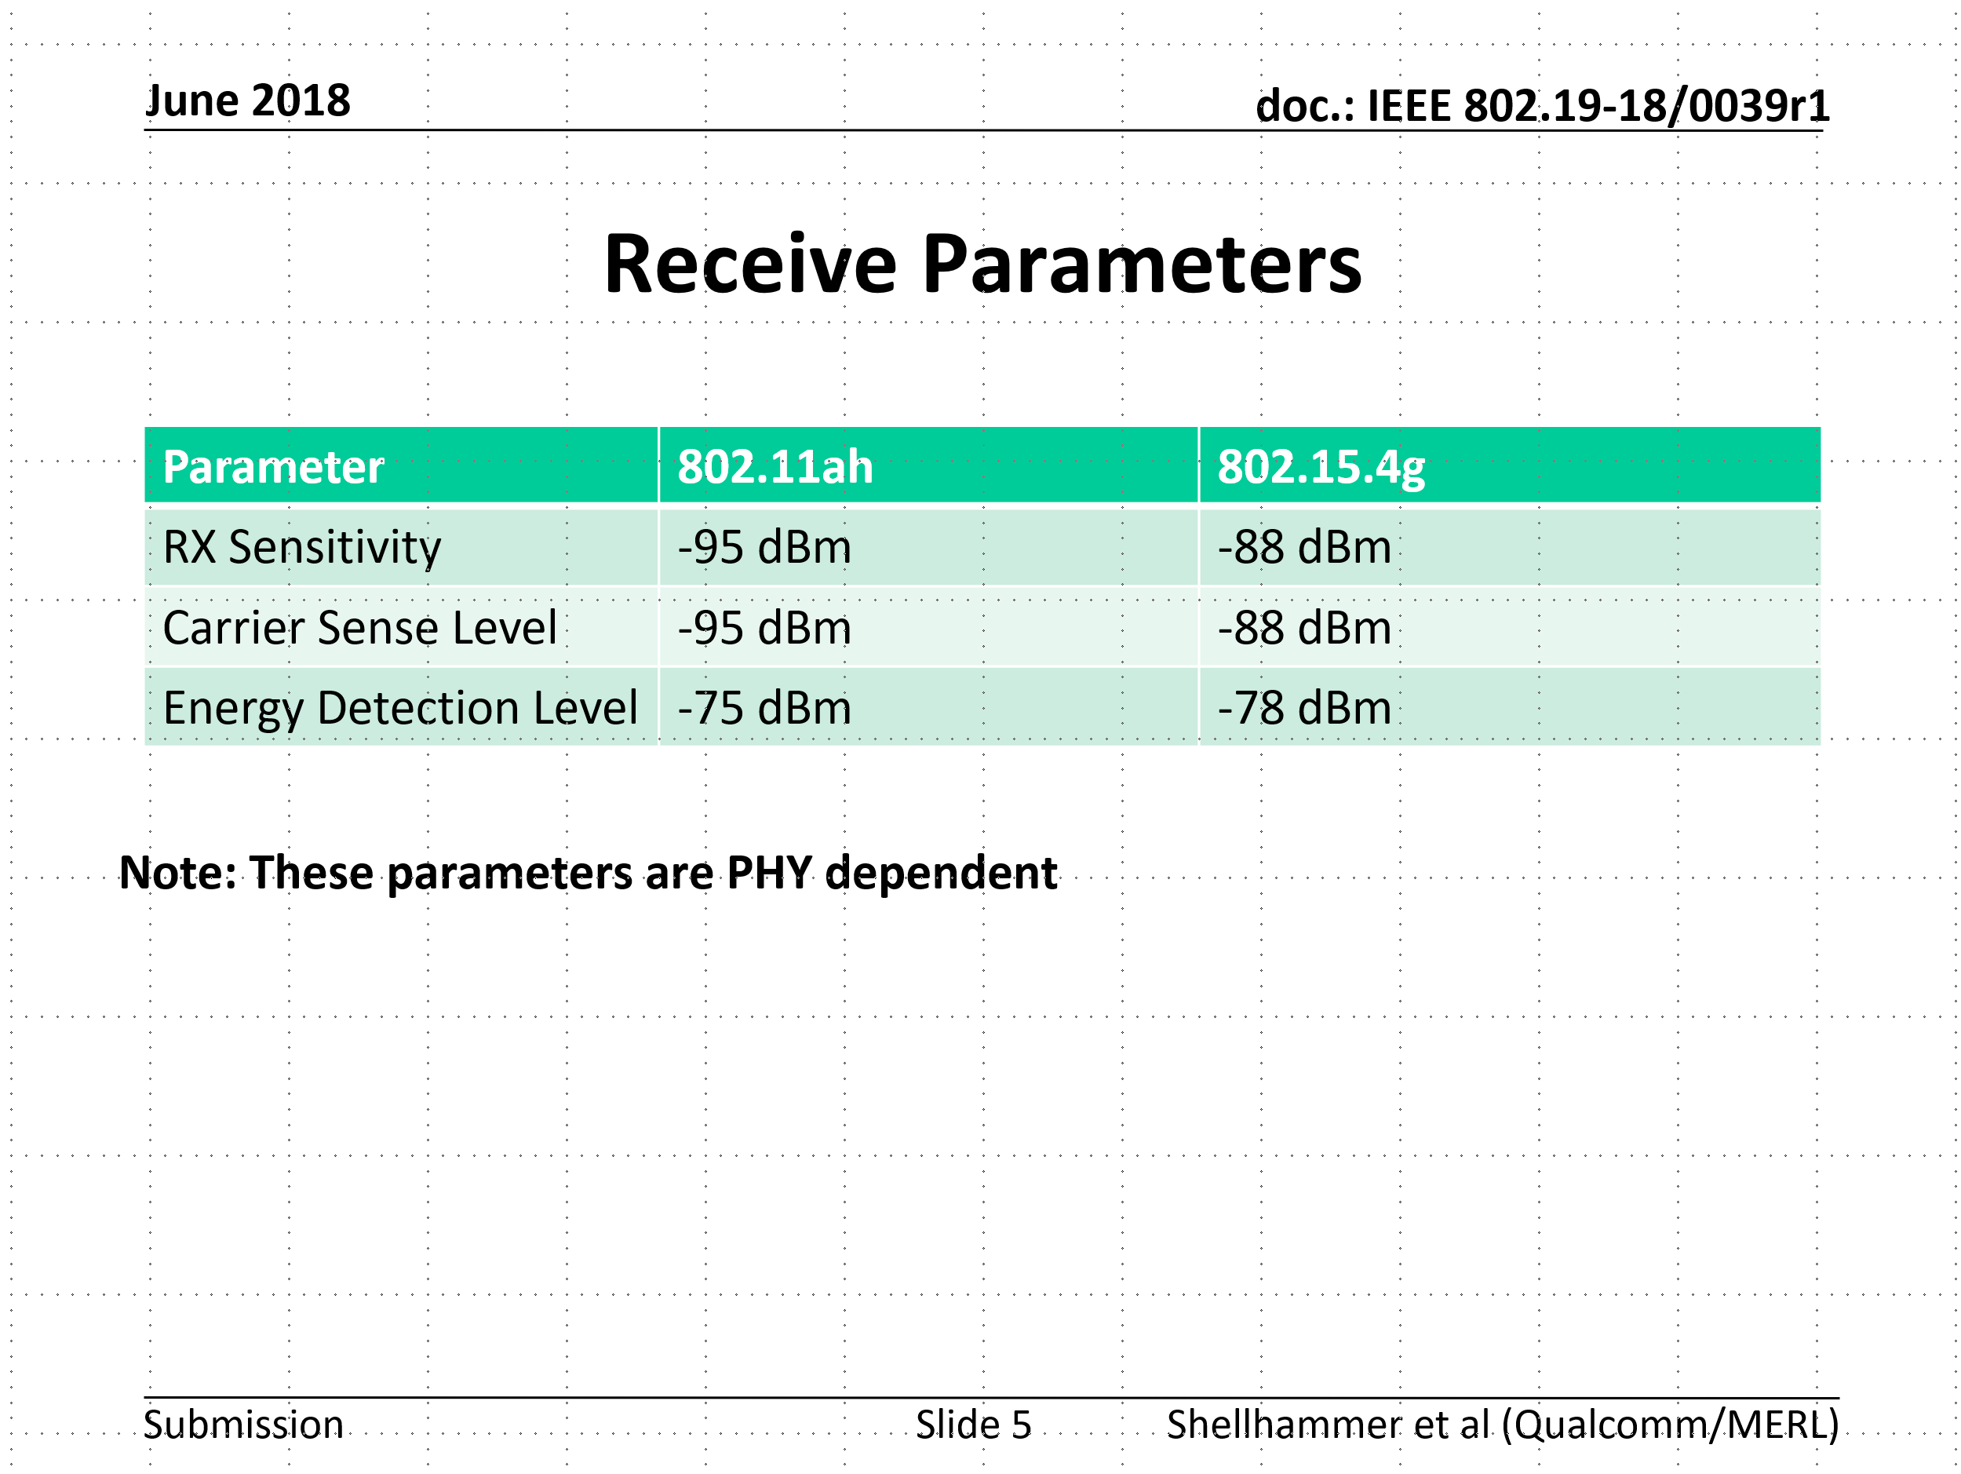
Simulation parameters discussed in TG3*
Refer to 19-18/0039r1
*Same with 19-24/0042r0

Slide 5
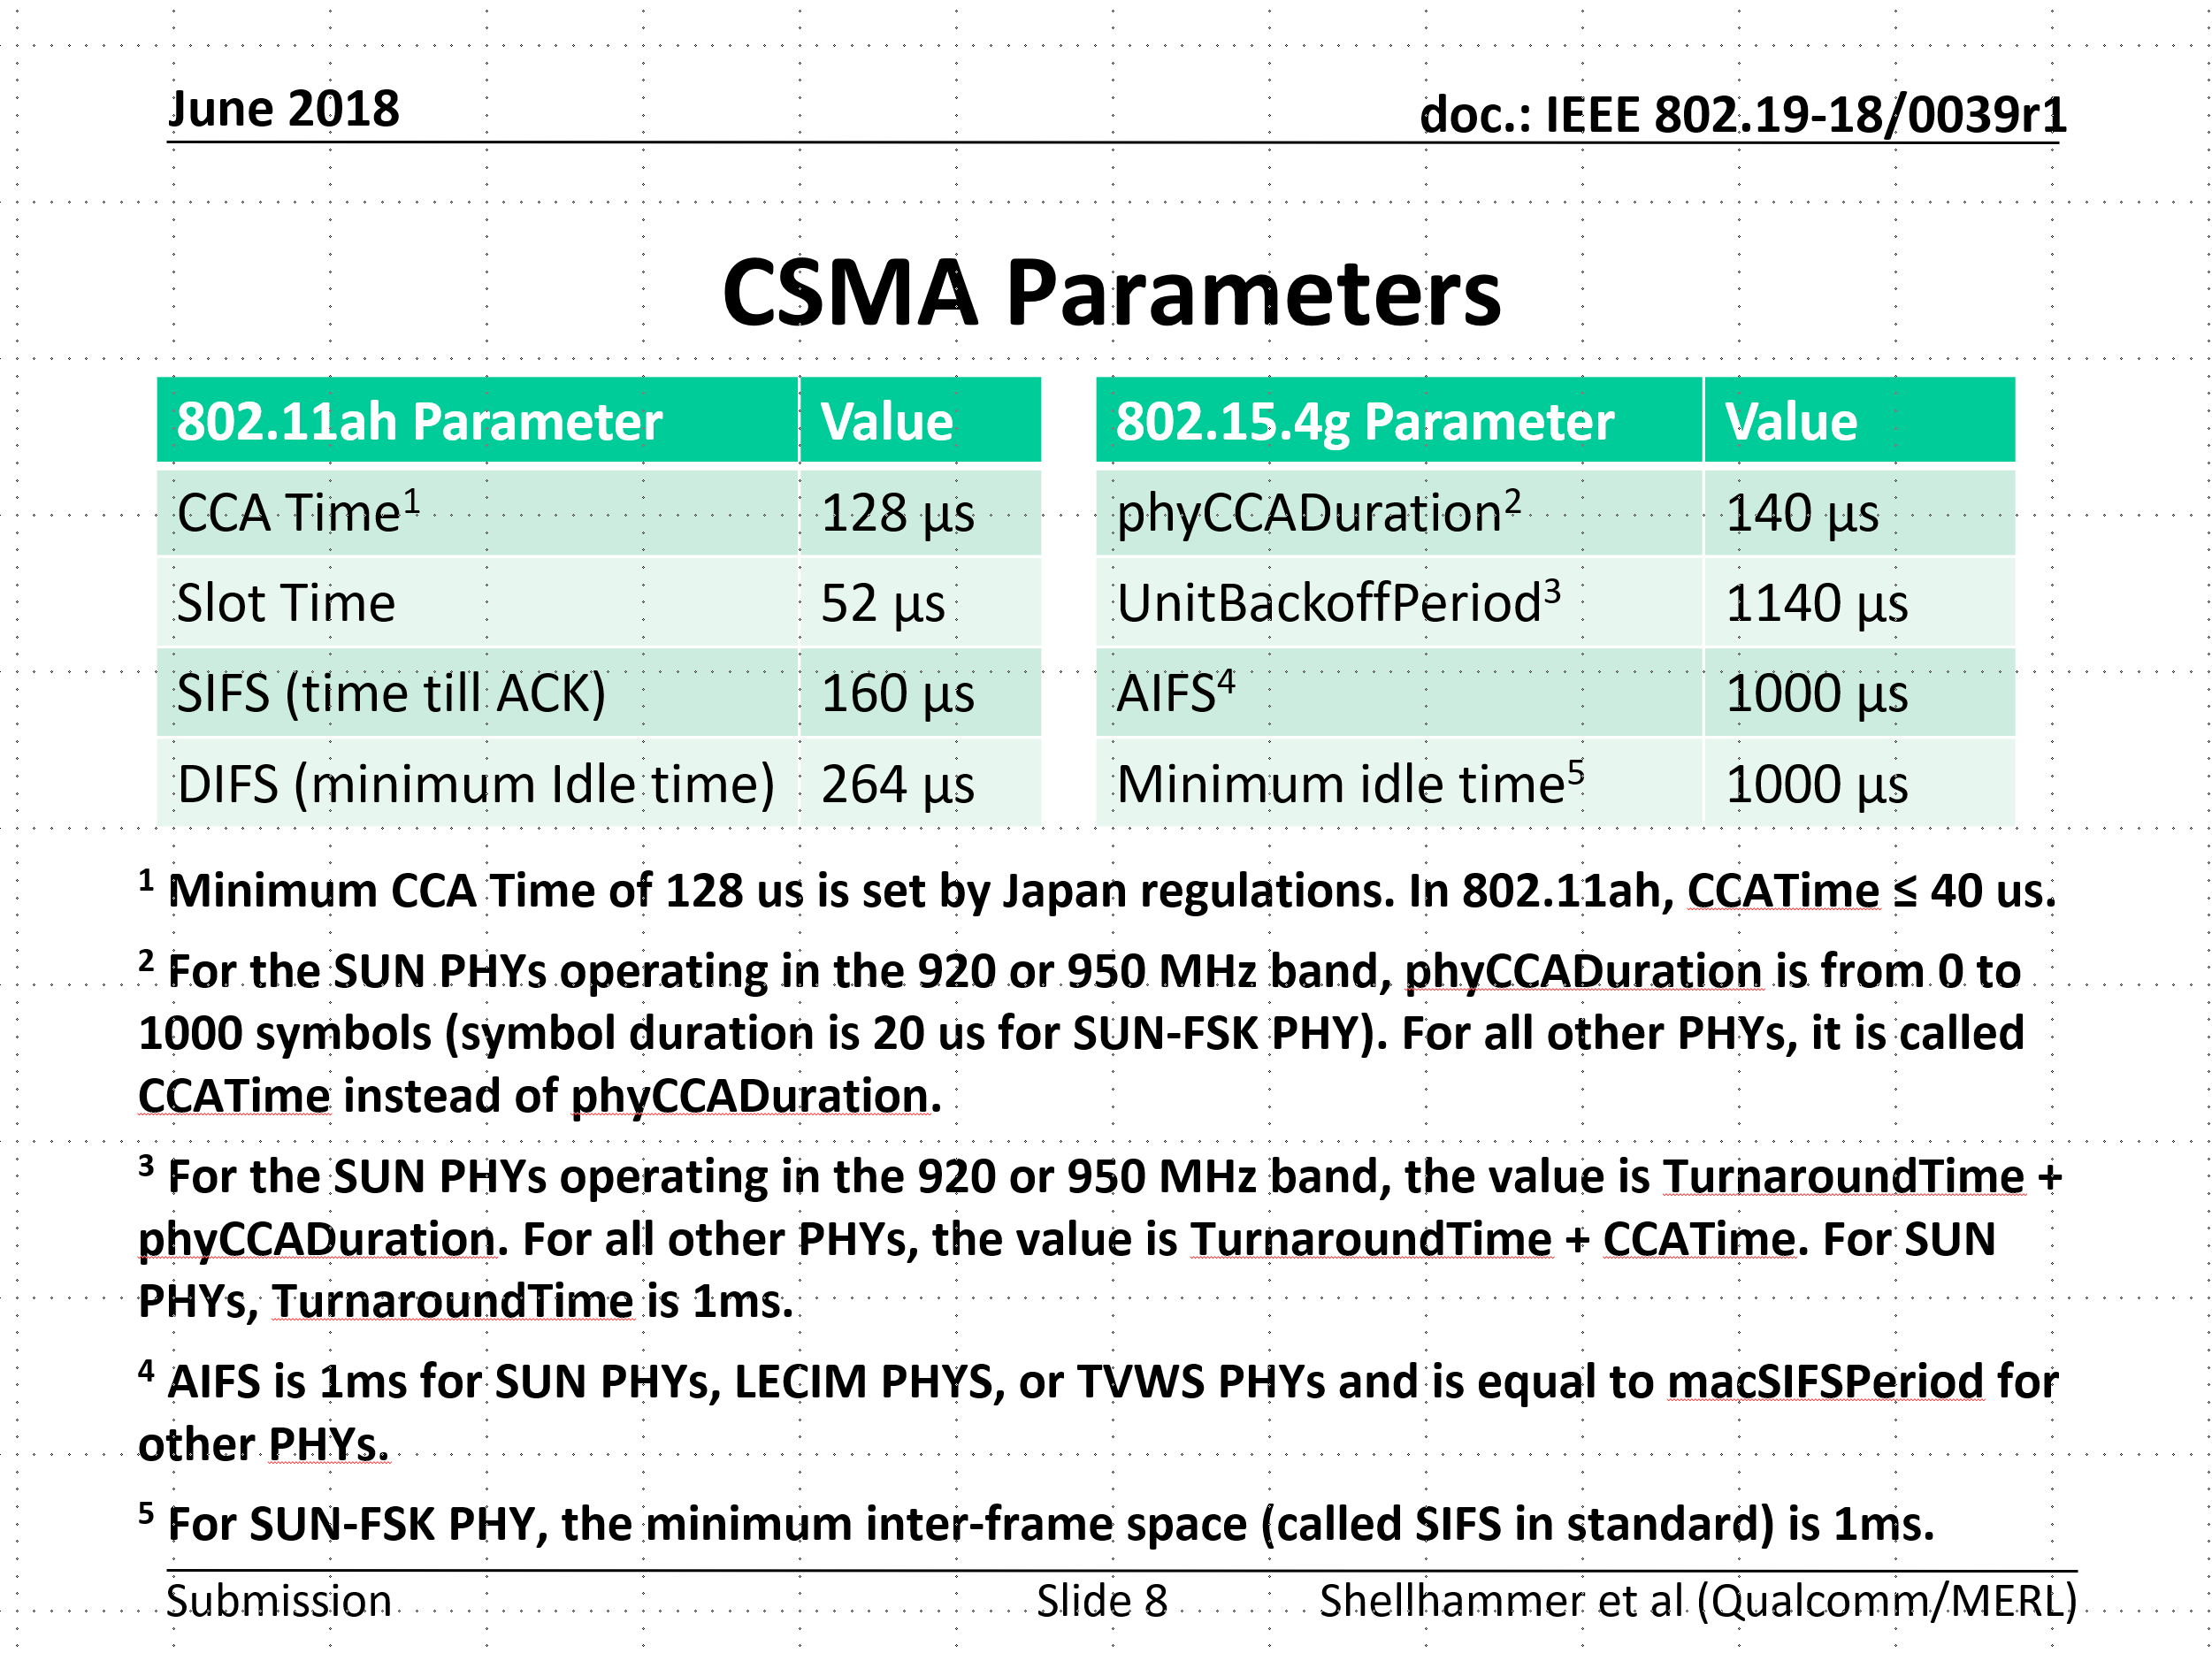
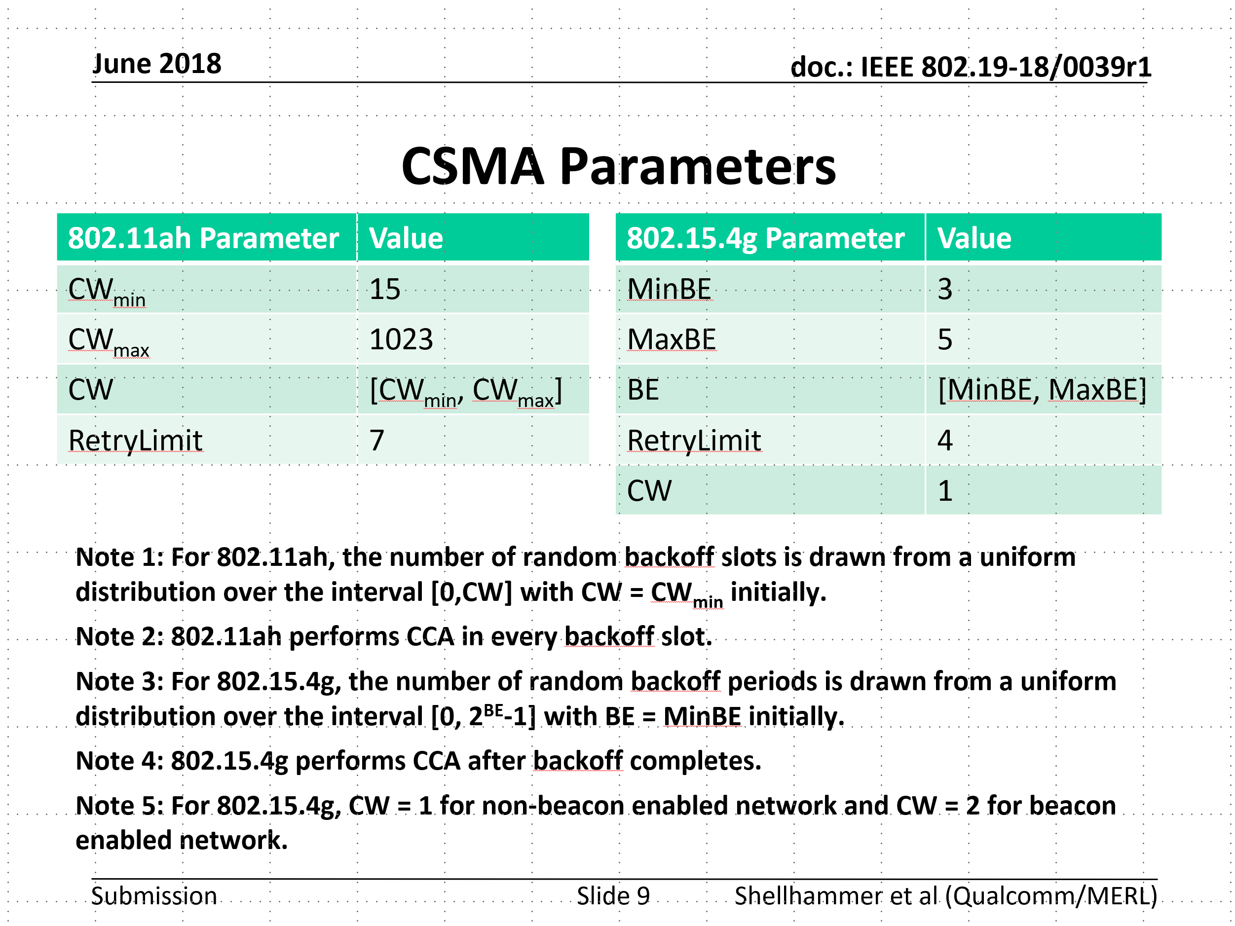
Simulation parameters discussed in TG3*
Refer to 19-18/0039r1
*Same with 19-24/0042r0

Slide 6
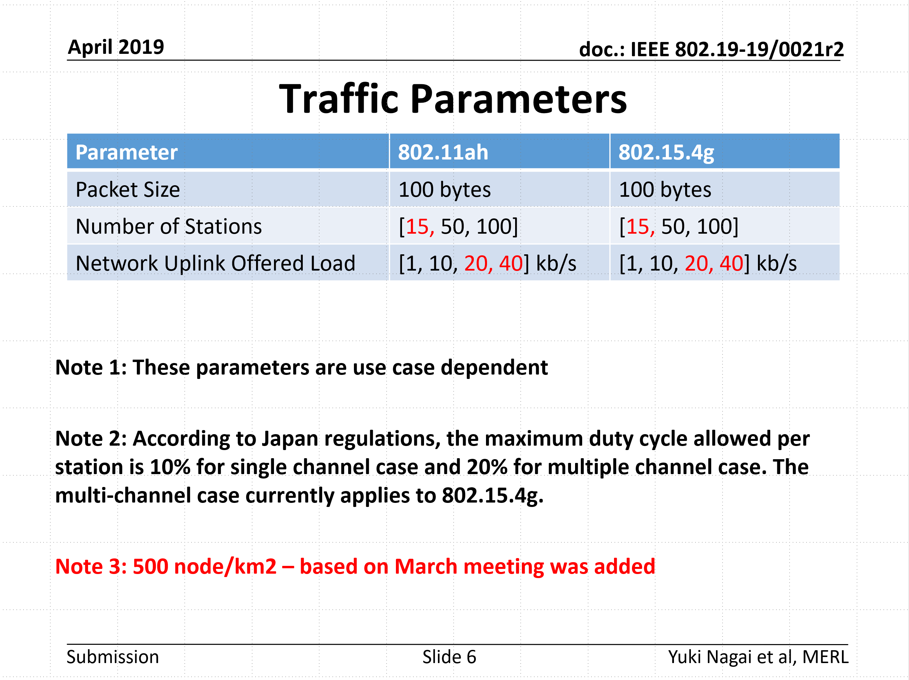
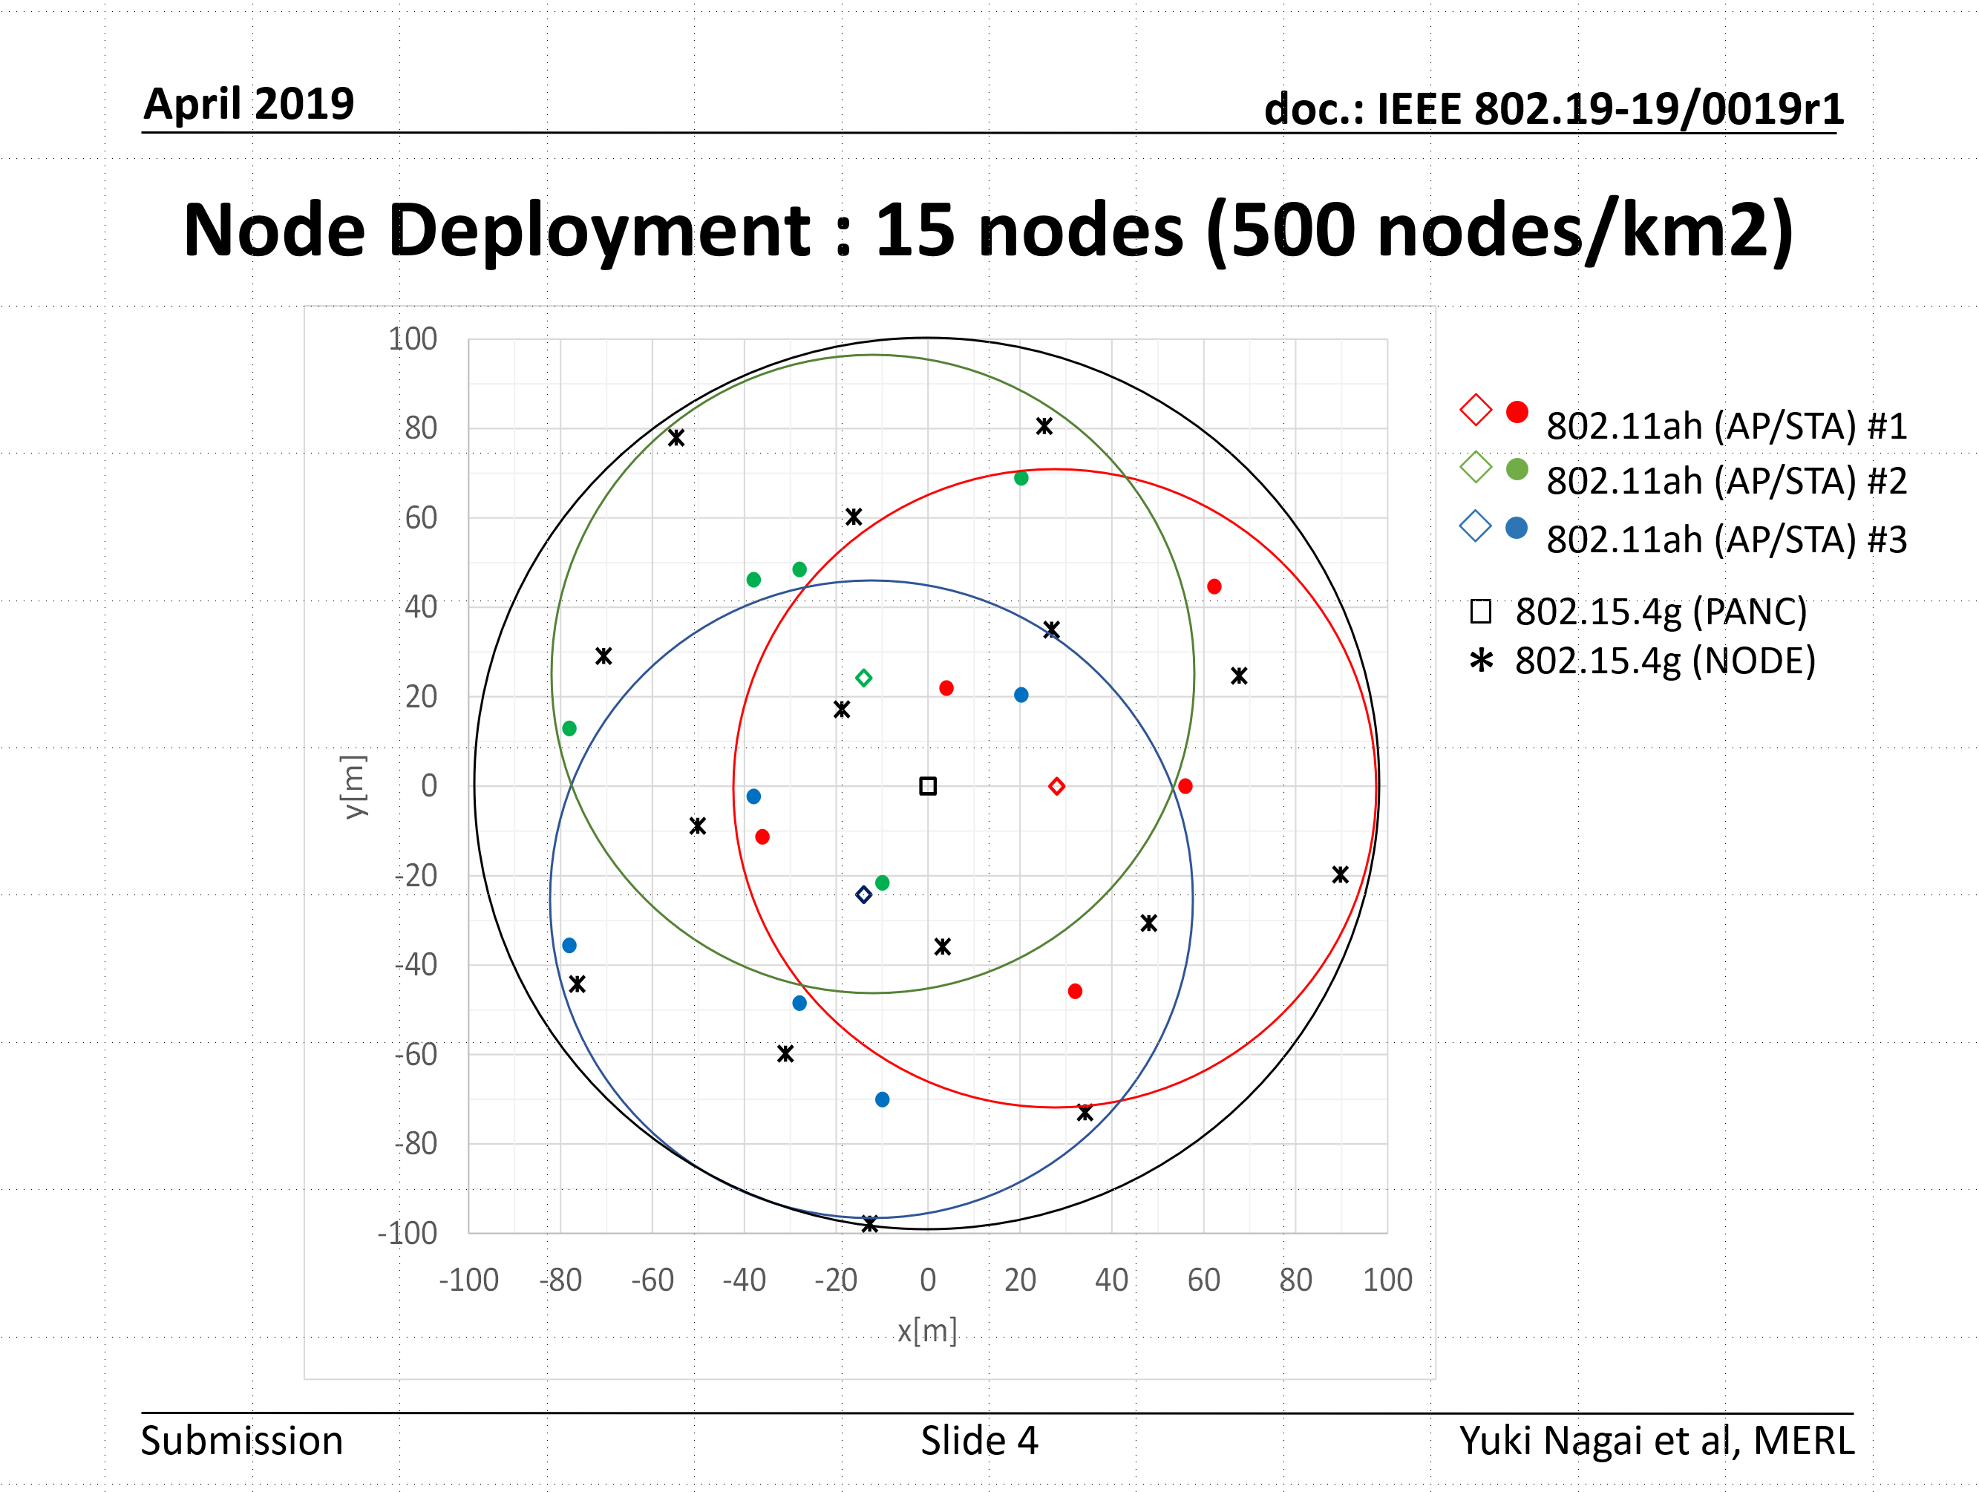
Simulation parameters discussed in TG3*
Refer to 19-19/0021r2
Refer to 19-19/0019r1
*Same with 19-24/0042r0

Slide 7
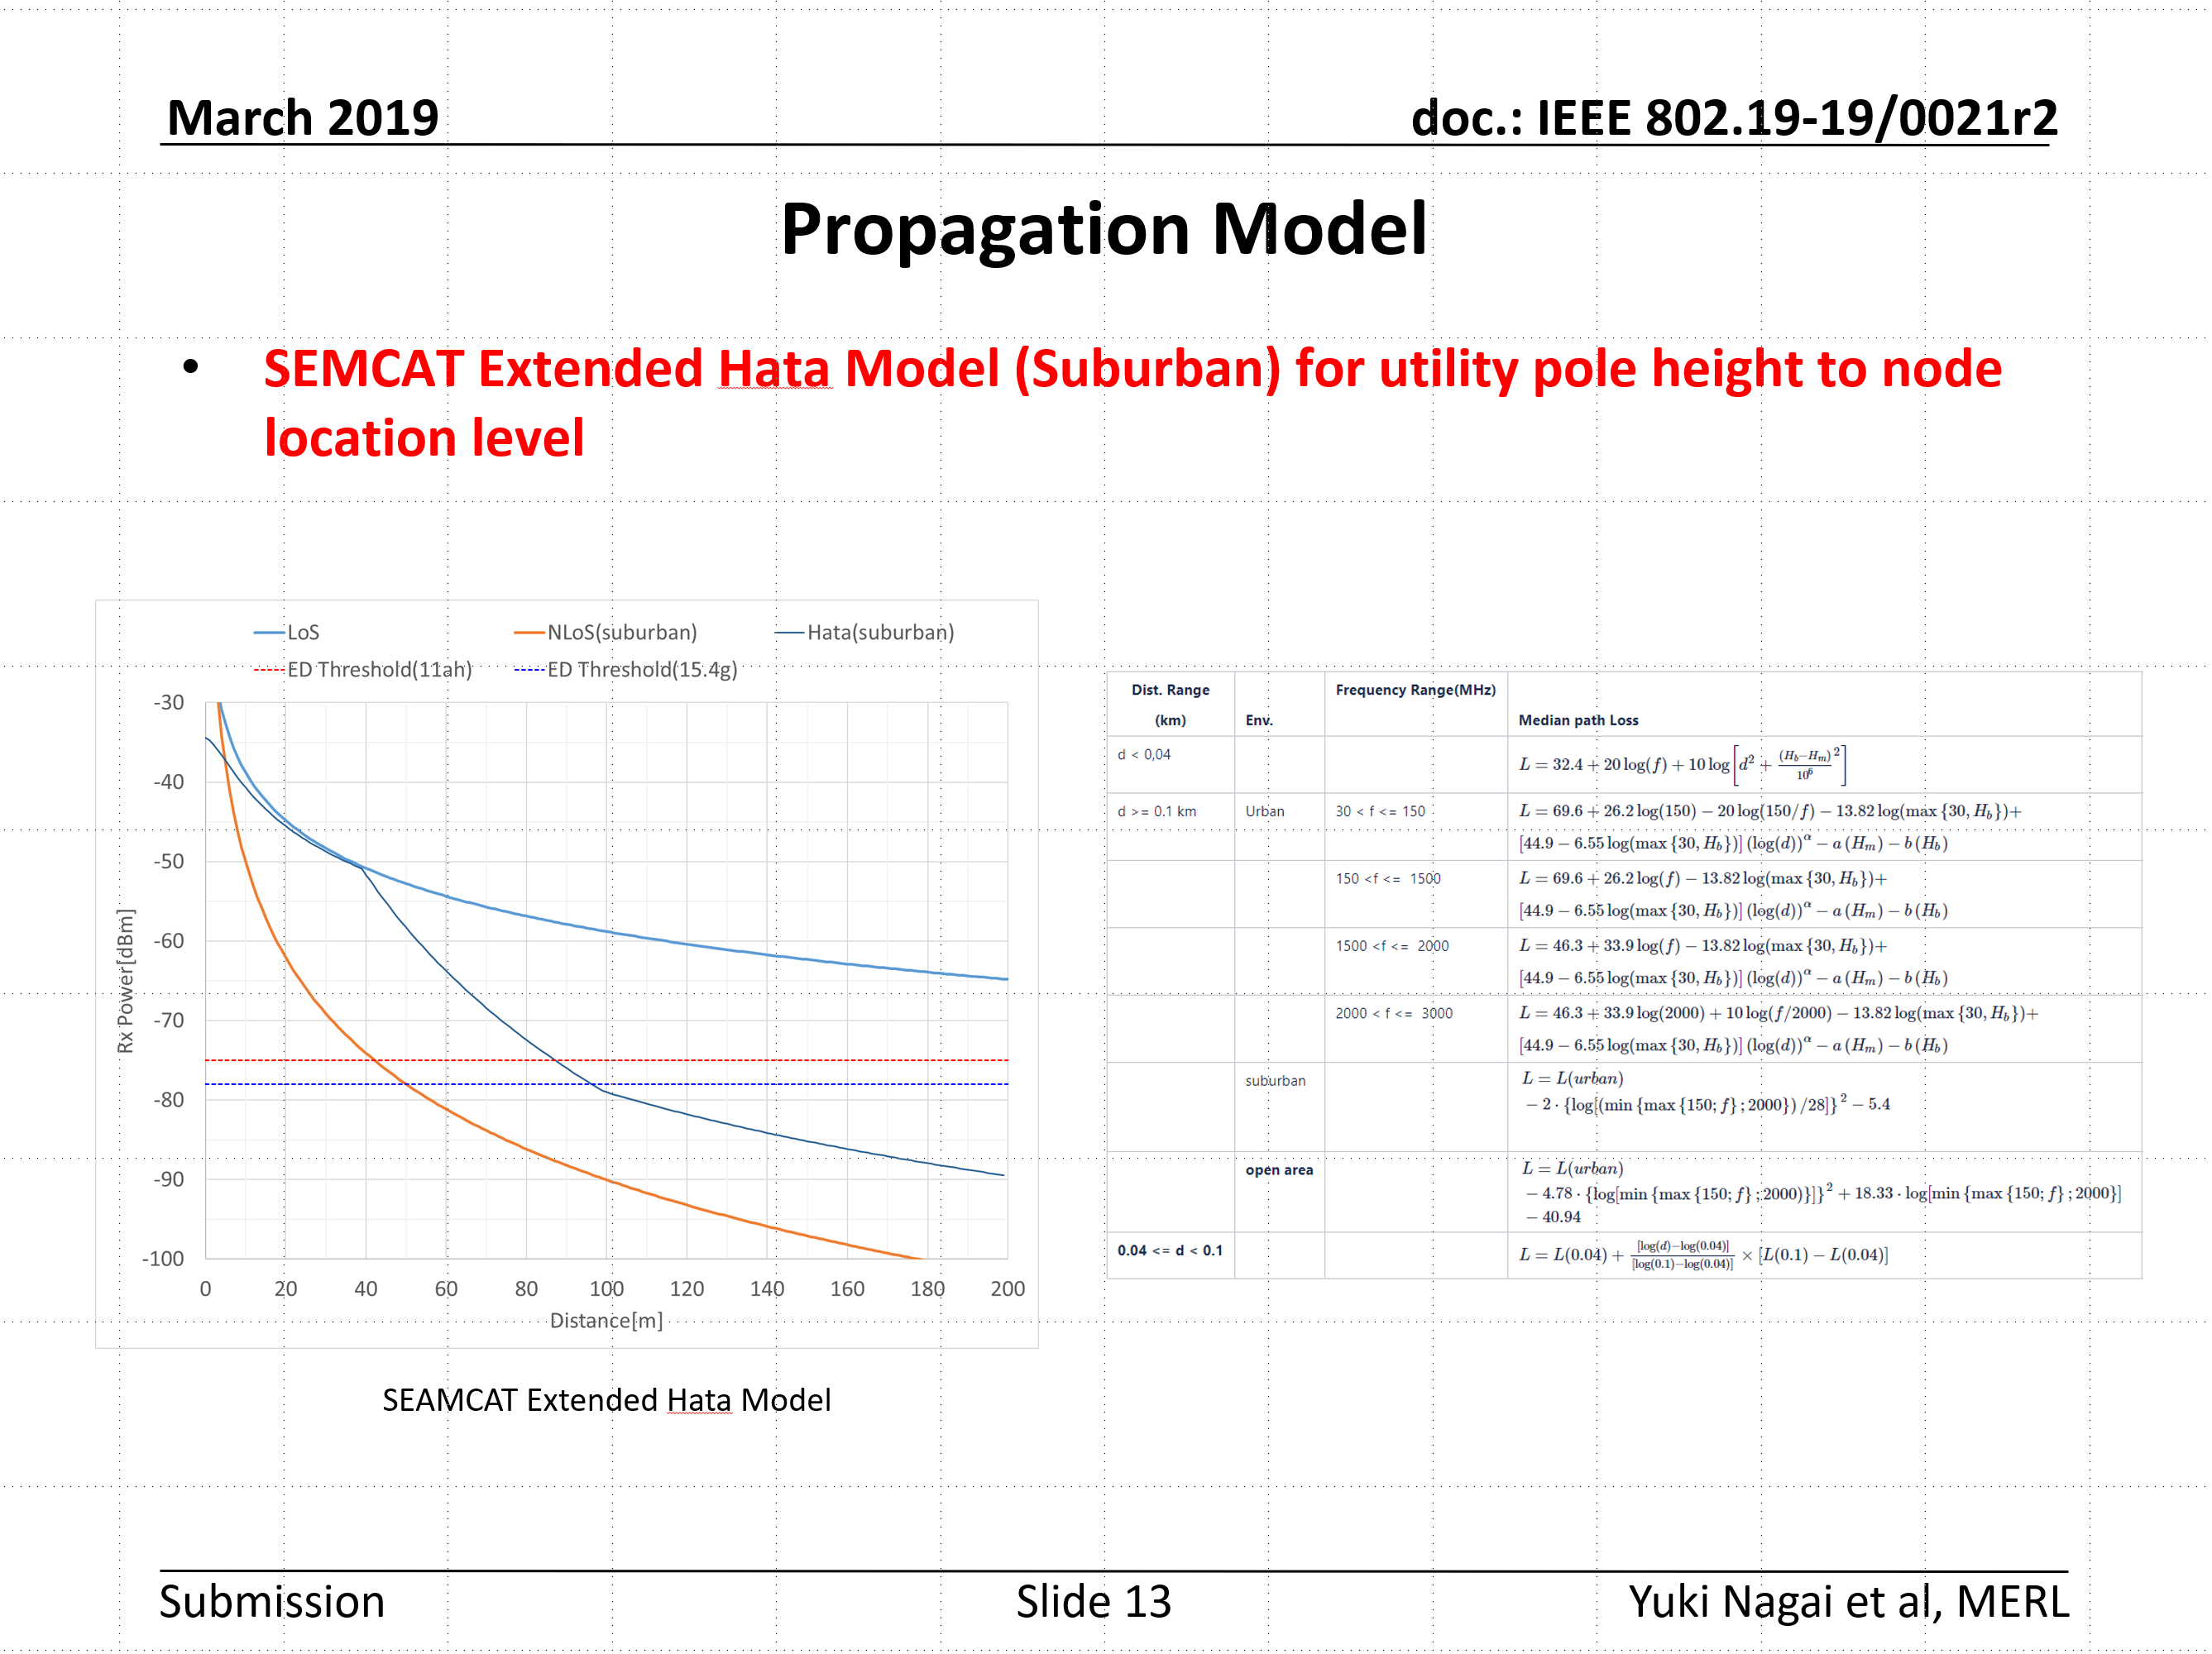
Simulation parameters discussed in TG3*
*Same with 19-24/0042r0
Refer to 19-19/0021r2

Slide 8
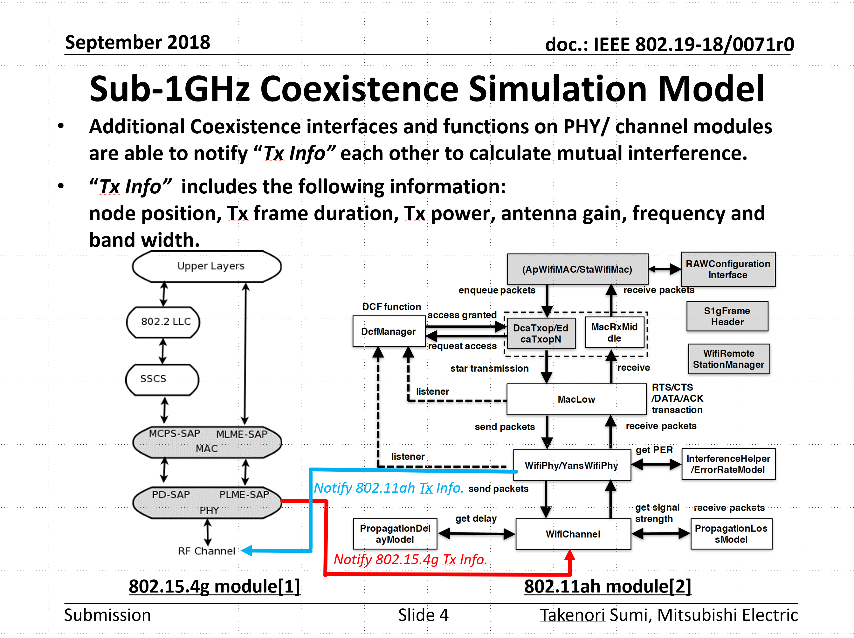
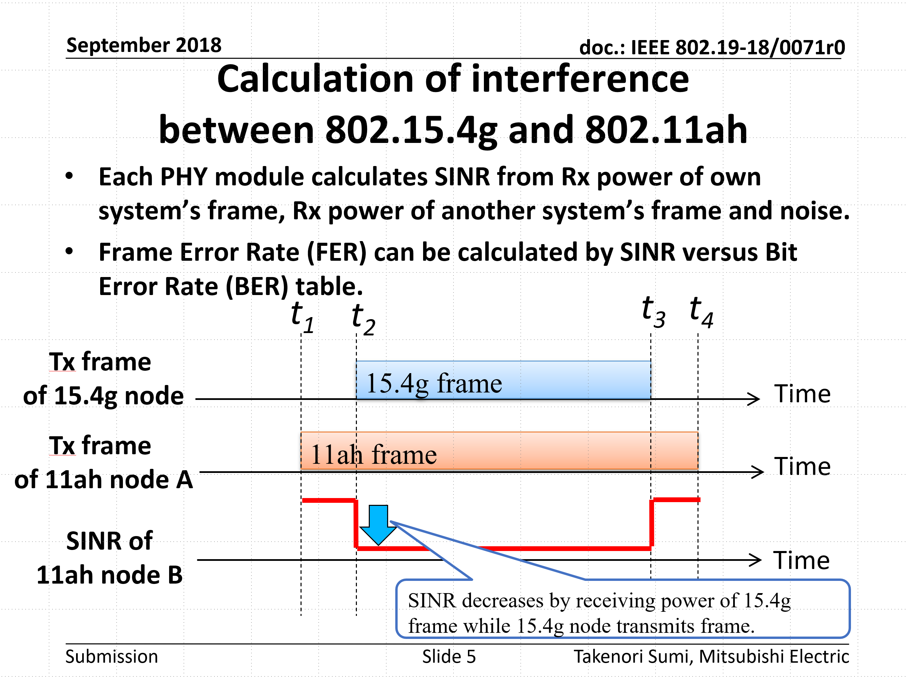
Simulation models discussed in TG3*
Refer to 19-18/0071r0
*Same with 19-24/0042r0

Slide 9
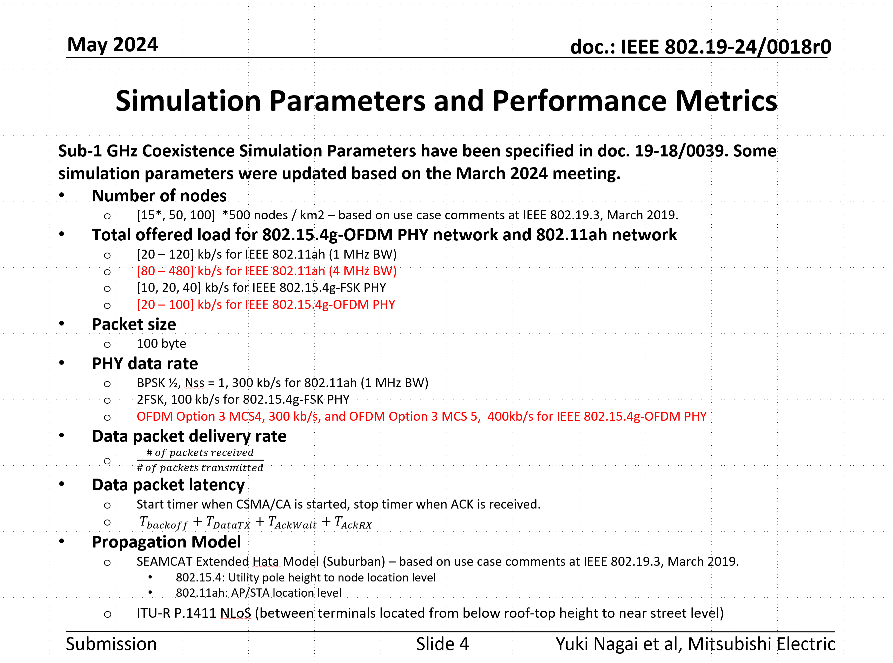
Simulation parameters updated in TG3a May meeting*
Refer to 19-24/0018r0
*Same with 19-24/0042r0

Slide 10
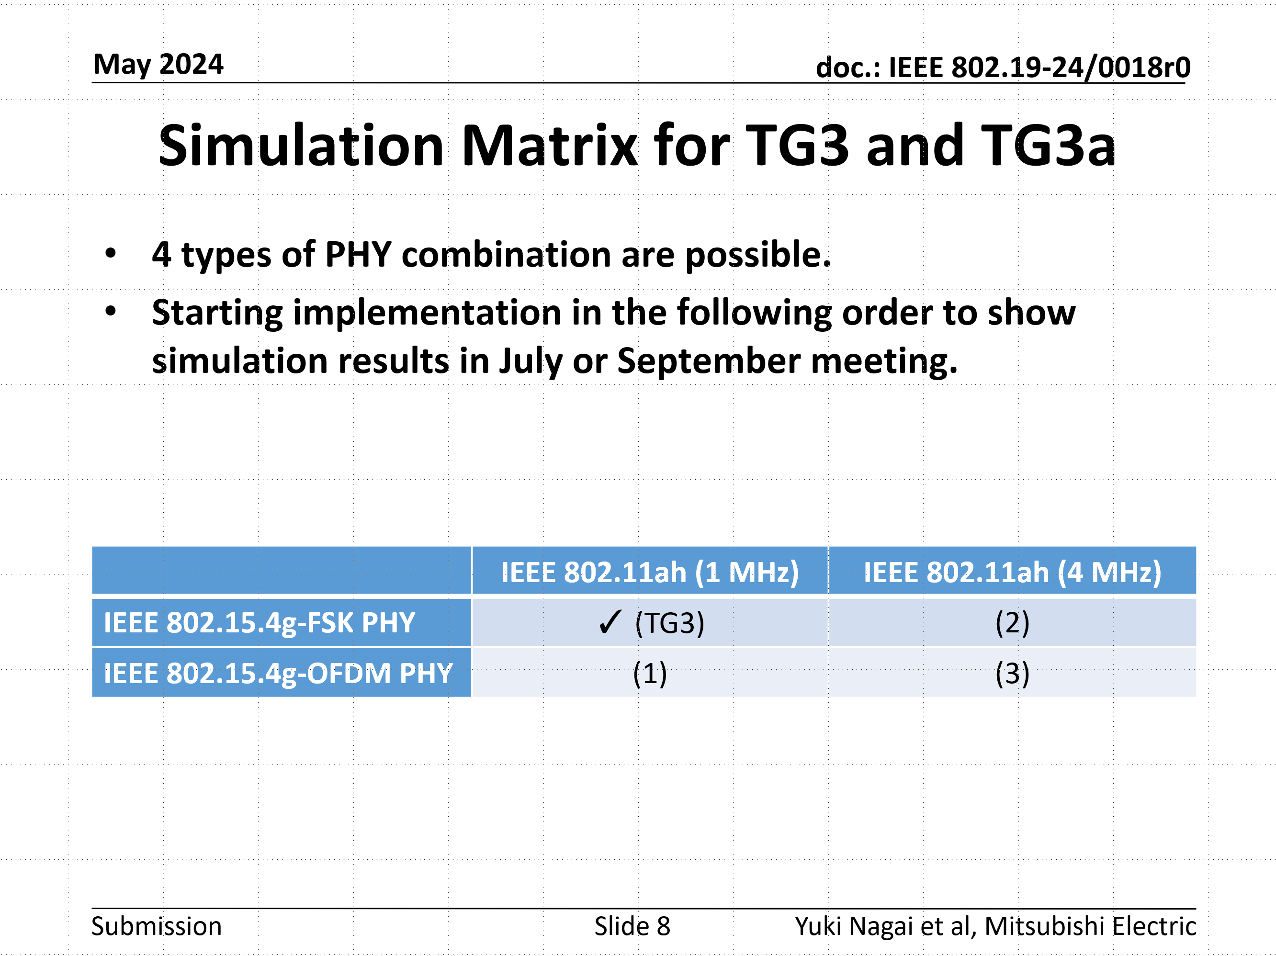
Simulation parameters updated in TG3a May meeting*
From the next page, simulation results are shown for each combination of the simulation matrix.
Refer to 19-24/0018r0
*Same with 19-24/0042r0

Slide 11
Simulation updated with Suspendable CAMA/CA on IEEE 802.15.4-2024
IEEE 802.15.4-2024 was published on Dec 12, 2024.
New feature “Suspendable CAMC/CA algorithm” was added to improve coexistence performance and efficiency for highe density condition on Section 10.12 (P. 320).
Coexistence performance for Use Case 1-3
with “Suspendable CAMA/CA” is presented on this slide.
Ref: Suspendable CAMA/CA
  802.15-23/0268r0、IEEE 802.15.4-2024
  Y. Nagai et al., "Improve IEEE 802.15.4 Network Reliability by Suspendable CSMA/CA," 2024 IEEE WCNC,2024, pp. 1-6, doi: 10.1109/WCNC57260.2024.10570554.

Slide 12
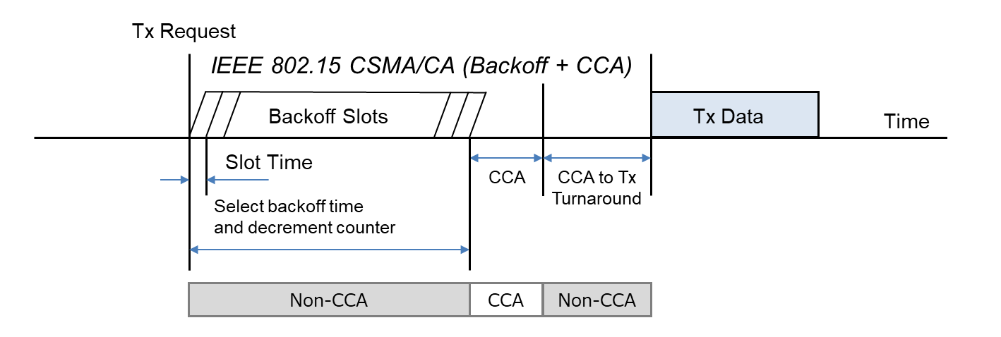
Abstract of Suspendable CAMA/CA
IEEE 802.15.4 CSMA/CA is originally designed for battery-powered devices and has features for reducing power consumption. Therefore, IEEE 802.15.4 CSMA/CA does not perform carrier sense to minimize power consumption except in CCA (Clear Channel Assessment) period before transmission.
This is a point where the IEEE 802.15.4 CSMA/CA differs significantly from IEEE 802.11 CSMA/CA and others.

Slide 13
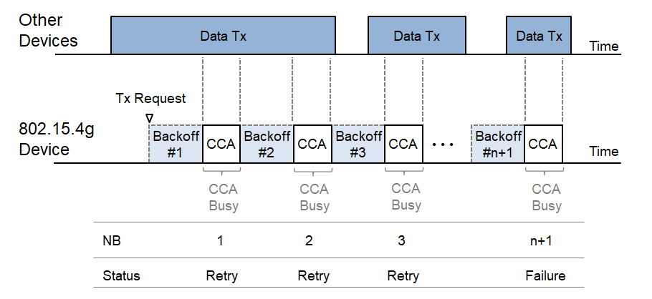
Abstract of Suspendable CAMA/CA
However, as the number of devices and communication frequency increase, packet loss becomes a serious problem caused by backoff failure.
To be more specific, when an IEEE 802.15.4 device detects busy channel during CCA period, the device increments Number of Backoffs (NB) by 1. When the NB exceeds the specified threshold macMaxCSMABackoffs, the device concludes a backoff failure.

Slide 14
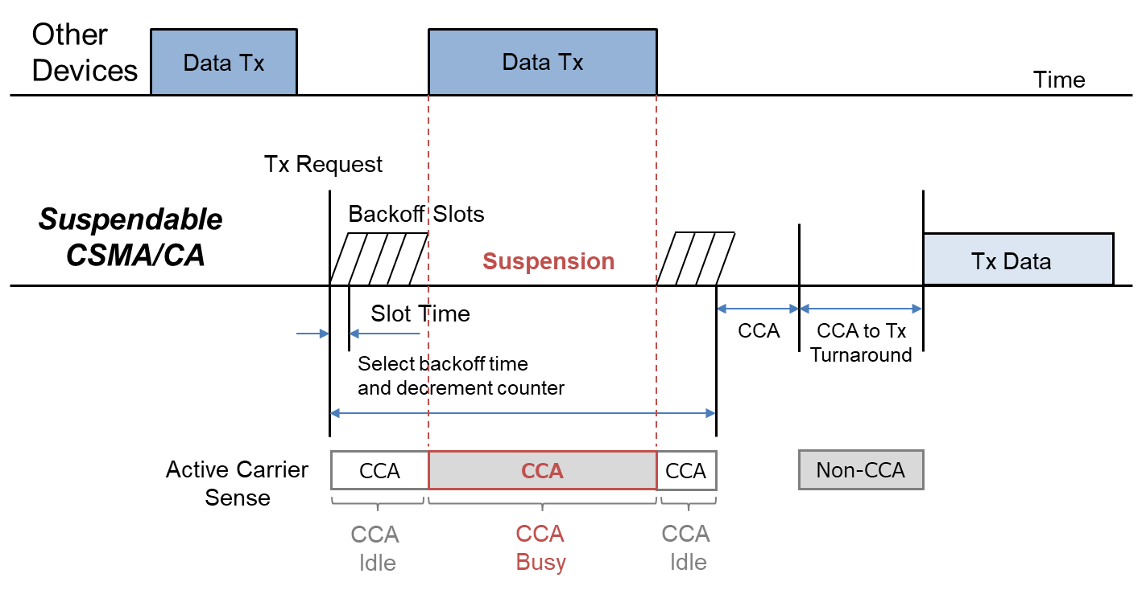
Abstract of Suspendable CAMA/CA
If CCA is busy during the backoff delay period, the backoff timer shall be suspended until sensing the channel indicates that the channel is clear or macSuspendedCsmaMaxTime is exceeded. Upon CCA detecting clear, the backoff time shall resume.
If macSuspendedCsmaMaxTime is exceed, backoff ends in ”Failure” and CSMA/CA algorithm terminates with a channel access failure.
The Suspendable CAMA/CA on IEEE802.15.4-2024 has the backward compatibility and interoperability with the legacy IEEE 802.15.4 CSMA/CA.

Slide 15
Simulation Result (Packet Delivery Rate)
IEEE 802.15.4g offered load: 20 kbps
IEEE 802.11ah: 1MHz PHY (TG(3), Case(1))
(1)
(1)
(2)
(2)
(3)
(3)
Normal CSMA/CA
with Suspendable CSMA/CA
(1) IEEE 802.11ah offered load:20kbps
PDR of 802.15.4g 2-FSK improves from 92.1% to 99.0%. PDR of 802.15.4g OFDM MCS4 and MCS5 are unchanged at 100%.
PDR of 802.11ah remains unchanged at 100%.
(2) IEEE 802.11ah offered load:60kbps
PDR of 802.15.4g 2-FSK improves from 39.7% to 42.8%.
PDR of 802.15.4g OFDM MCS4 improves from 66.2% to 72.2%.
PDR of 802.15.4g OFDM MCS5 improves from 71.1% to 74.7%.
PDR of 802.11ah remains unchanged at 100%.
(3) IEEE 802.11ah offered load: over 80kbps
PDR of 802.15.4g improves, but the PDR of IEEE 802.11ah decreases due to traffic saturation.
IEEE 802.11ah PDR Lines
IEEE 802.15.4g PDR Lines

Slide 16
Simulation Result (Packet Delivery Rate)
IEEE 802.15.4g offered load: 20 kbps
IEEE 802.11ah: 4MHz PHY (Case(2), Case(3))
(1)
(1)
(2)
(2)
Normal CSMA/CA
with Suspendable CSMA/CA
(1) IEEE 802.11ah offered load:20kbps
PDR of 802.15.4g 2-FSK improves from 96.5% to 98.7%.
PDR of 802.15.4g OFDM MCS4 and MCS5 improves from 99.3% to 99.6%.
PDR of 802.11ah remains unchanged at 100%.
(2) IEEE 802.11ah offered load:60kbps
PDR of 802.15.4g 2-FSK improves from 79.1% to 85.5%.
PDR of 802.15.4g OFDM MCS4 improves from 95.3% to 96.4%.
PDR of 802.15.4g OFDM MCS5 improves from 96.0% to 96.7%.
PDR of 802.11ah remains unchanged at 100%.
PDR of 802.11ah remains at 100% even when the offered load is 100kbps.
IEEE 802.11ah PDR Lines
IEEE 802.15.4g PDR Lines

Slide 17
Simulation Result (Latency)
IEEE 802.15.4g offered load: 20 kbps
IEEE 802.11ah: 1MHz PHY (TG(3), Case(1))
(3)
(3)
(2)
(2)
(1)
(1)
Normal CSMA/CA
with Suspendable CSMA/CA
(1) IEEE 802.11ah offered load:20kbps
The latency of IEEE 802.15.4g and IEEE 802.11ah hardly increases.
(2) IEEE 802.11ah offered load:60kbps
Latency of IEEE 802.15.4g FSK increases from 58ms to 91ms.
Meanwhile, latency of 802.11ah increases from 42ms to 48ms.
When using IEEE 802.15.4g with OFDM MCS4 and MCS5,
latency of 802.15.4g increases by only few milliseconds, and latency of IEEE 802.11ah unchanged.
(3) IEEE 802.11ah offered load:100kbps
Latency of IEEE 802.15.4g increases by 40 to 100ms, while the latency of IEEE 802.11ah only increases by 10 to 20ms.
IEEE 802.11ah PDR Lines
IEEE 802.15.4g PDR Lines

Slide 18
Simulation Result (Latency)
IEEE 802.15.4g offered load: 20 kbps
IEEE 802.11ah: 4MHz PHY (Case(2), Case(3))
(2)
(3)
(1)
(2)
(3)
(1)
Normal CSMA/CA
with Suspendable CSMA/CA
(1) IEEE 802.11ah offered load:20kbps
The latency of IEEE 802.15.4g and IEEE 802.11ah unchanged.
(2) IEEE 802.11ah offered load:60kbps
Latency of IEEE 802.15.4g FSK increases 47ms to 51ms and latency
of IEEE 802.15.4g OFDM MCS4 and MCS5 unchanged. Meanwhile,
latency of 802.11ah unchanged in any case.
(3) IEEE 802.11ah offered load:100kbps
Latency of IEEE 802.15.4g FSK increases 56ms to 68ms and latency of IEEE 802.15.4g OFDM MCS4 and MCS5 unchanged. Meanwhile, latency of 802.11ah unchanged in any case.
IEEE 802.11ah PDR Lines
IEEE 802.15.4g PDR Lines

Slide 19
Summary
New feature “Suspendable CAMA/CA” on IEEE 802.15.4-2024 improves the coexistence performance of IEEE 802.15.4g and IEEE 802.11ah.
We would propose Suspendable CAMA/CA as the one of the update candidate for IEEE 802.19.3a Recommended Practice.
Plan to make presentation(s) for other conditions, including ARIB STD-T108, etc., in March meeting as supplementary material.

