Slide 1
TG 19.3a Agenda and Meeting Slides Jan 2025
Date: 2025-01-11
Authors:
Name | Affiliations | email
Benjamin Rolfe | BCA, et al | Ben.rolfe @ ieee.org
Notice: This document has been prepared to assist IEEE 802.19. It is offered as a basis for discussion and is not binding on the contributing individual(s) or organization(s). The material in this document is subject to change in form and content after further study. The contributor(s) reserve(s) the right to add, amend or withdraw material contained herein.

Slide 2
Tg19.3a
802 Wireless Interim Session, January 2025
Kobe, Japan
And remotely world-wide

Slide 3
Project Overview
PAR approved: https://development.standards.ieee.org/myproject-web/app#viewpar/14995/11032
Scope of the project: This amendment updates and expands coexistence recommendations to address new market requirements, increasing data traffic, greater device density of devices, and increased potential for congestion based on both IEEE Std 802.11-2020 and IEEE Std 802.15.4 sub-1 GHz standards. This amendment includes recommendations with respect to new devices, as well as compatibility with deployed legacy devices.

Slide 4
TG Overview
1 | Task Group Chair | Benjamin Rolfe
2 | Task Group Technical Editor | Shoichi Kitazawa
3 | Task Group Vice Chair | Kazuto Yano
4 | Task Group Vice Chair | Joerg Robert
5 | Task Group Recording Secretary | Yukimasa Nagai

Slide 5
Agenda
 | Topic | Presenter | Time
 | Monday 11-November
1 | Intro and overhead | Chair | 00:10
1.1 | Agenda Review | Chair
1.2 | Approval of minutes | Chair
2 | Technical Contributions and Discussion |  | 00:30
2.1 | Draft outline and discussion |  | 00:10
3 | Schedule discussion
4 | Recess
5 | Thursday 14-November
6 | IEEE 802.11ah and IEEE 802.15.4g SUN OFDM PHY Coexistence Simulation | Takenori Sumi | 00:30
6 | Contribution on draft structure and content | Robert
7 | Next Steps | Chair | 00:10
8 | Aob | Chair
9 | Adjourn

Slide 6
Near Term Milestones
PAR Approval
Officer appointment
Call for contributions for May 2024 Wireless interim
Collect background information
Use cases
Technical constraints and characteristics
Supporting data (simulation, measurements)
Simulation planned
Empirical studies planned
Discuss and agree on initial project timeline
Develop technical content and Produce draft
Working group ballot

Slide 7
Recess

Slide 8
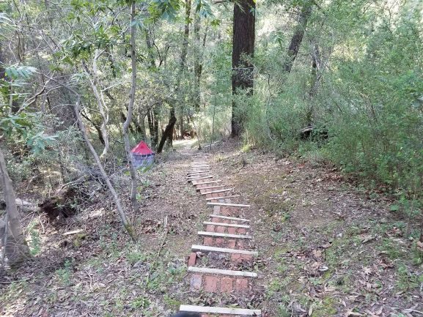
Next Steps

Slide 9
Proposed Focus for March
Continue information gathering and sharing
Review technical requirements and conditions driving new and updated recommendations
Significant changes in regulations and expected conditions
New features available in each standard
New coexistence methods
Consider technical proposals for recommendations
Recommendations to change
New recommendations
New coexistence strategies and methods

Slide 10
Any Other Business?

Slide 11
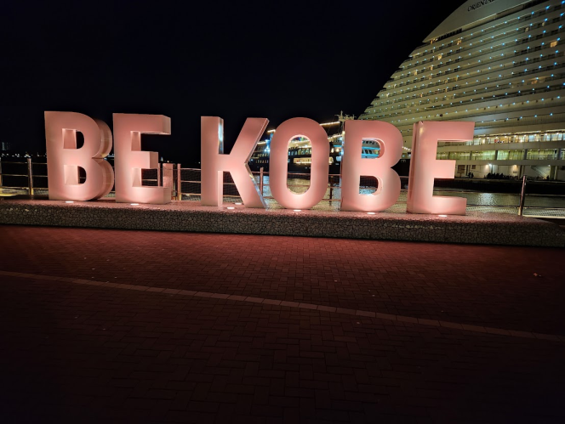
Adjourn

