Slide 1
IEEE 802.11ah and IEEE 802.15.4g SUN OFDM PHY
Coexistence Simulation for Case 1-3
Date: 2024-11-14
Authors:
Notice: This document has been prepared to assist IEEE 802.19. It is offered as a basis for discussion and is not binding on the contributing individual(s) or organization(s). The material in this document is subject to change in form and content after further study. The contributor(s) reserve(s) the right to add, amend or withdraw material contained herein.

Slide 2
Summary
Presentation to TG3a of simulation update for coexistence of IEEE 802.15.4g and IEEE 802.11ah using new simulation parameters for smart utility use cases.
This document gathers relevant material from 19-24/0018r0, 19-19/0019r1, 19-18/0056r3, 19-18/0039r1 and 19-19/0021r2 for simulation conditions and use cases.
Plan for January meeting.

Slide 3
Background: S1G Coexistence Simulations in TG3
Developed the coexistence simulator based on NS-3.23, which support IEEE 802.15.4g-FSK (400 KHz bandwidth) and IEEE 802.11ah (1 MHz bandwidth) for IEEE 802.19.3.
Extended this simulator to support IEEE 802.15.4-OFDM (400 KHz bandwidth) to evaluate IEEE 802.19.3a.
Simulation parameters and simulator deployment were discussed in TG3.
  [19-18/0039r1] Steve Shellhammer, “Sub-1GHz Coexistence Simulation Parameters”
  [19-19/0021r2] Yukimasa Nagai, “S1G Coexistence Simulation Profile”
  [19-18/0071r0] Takenori Sumi, “Sub-1GHz Coexistence Simulation Models Update”
Simulation parameters were updated in TG3a.
  [19-24/0018r0] Yukimasa Nagai, “Simulation Parameter Update for S1G Bands OFDM systems”
Simulation results were also shared in TG3.
  19-19/0019r1, 19-18/0056r3

Slide 4
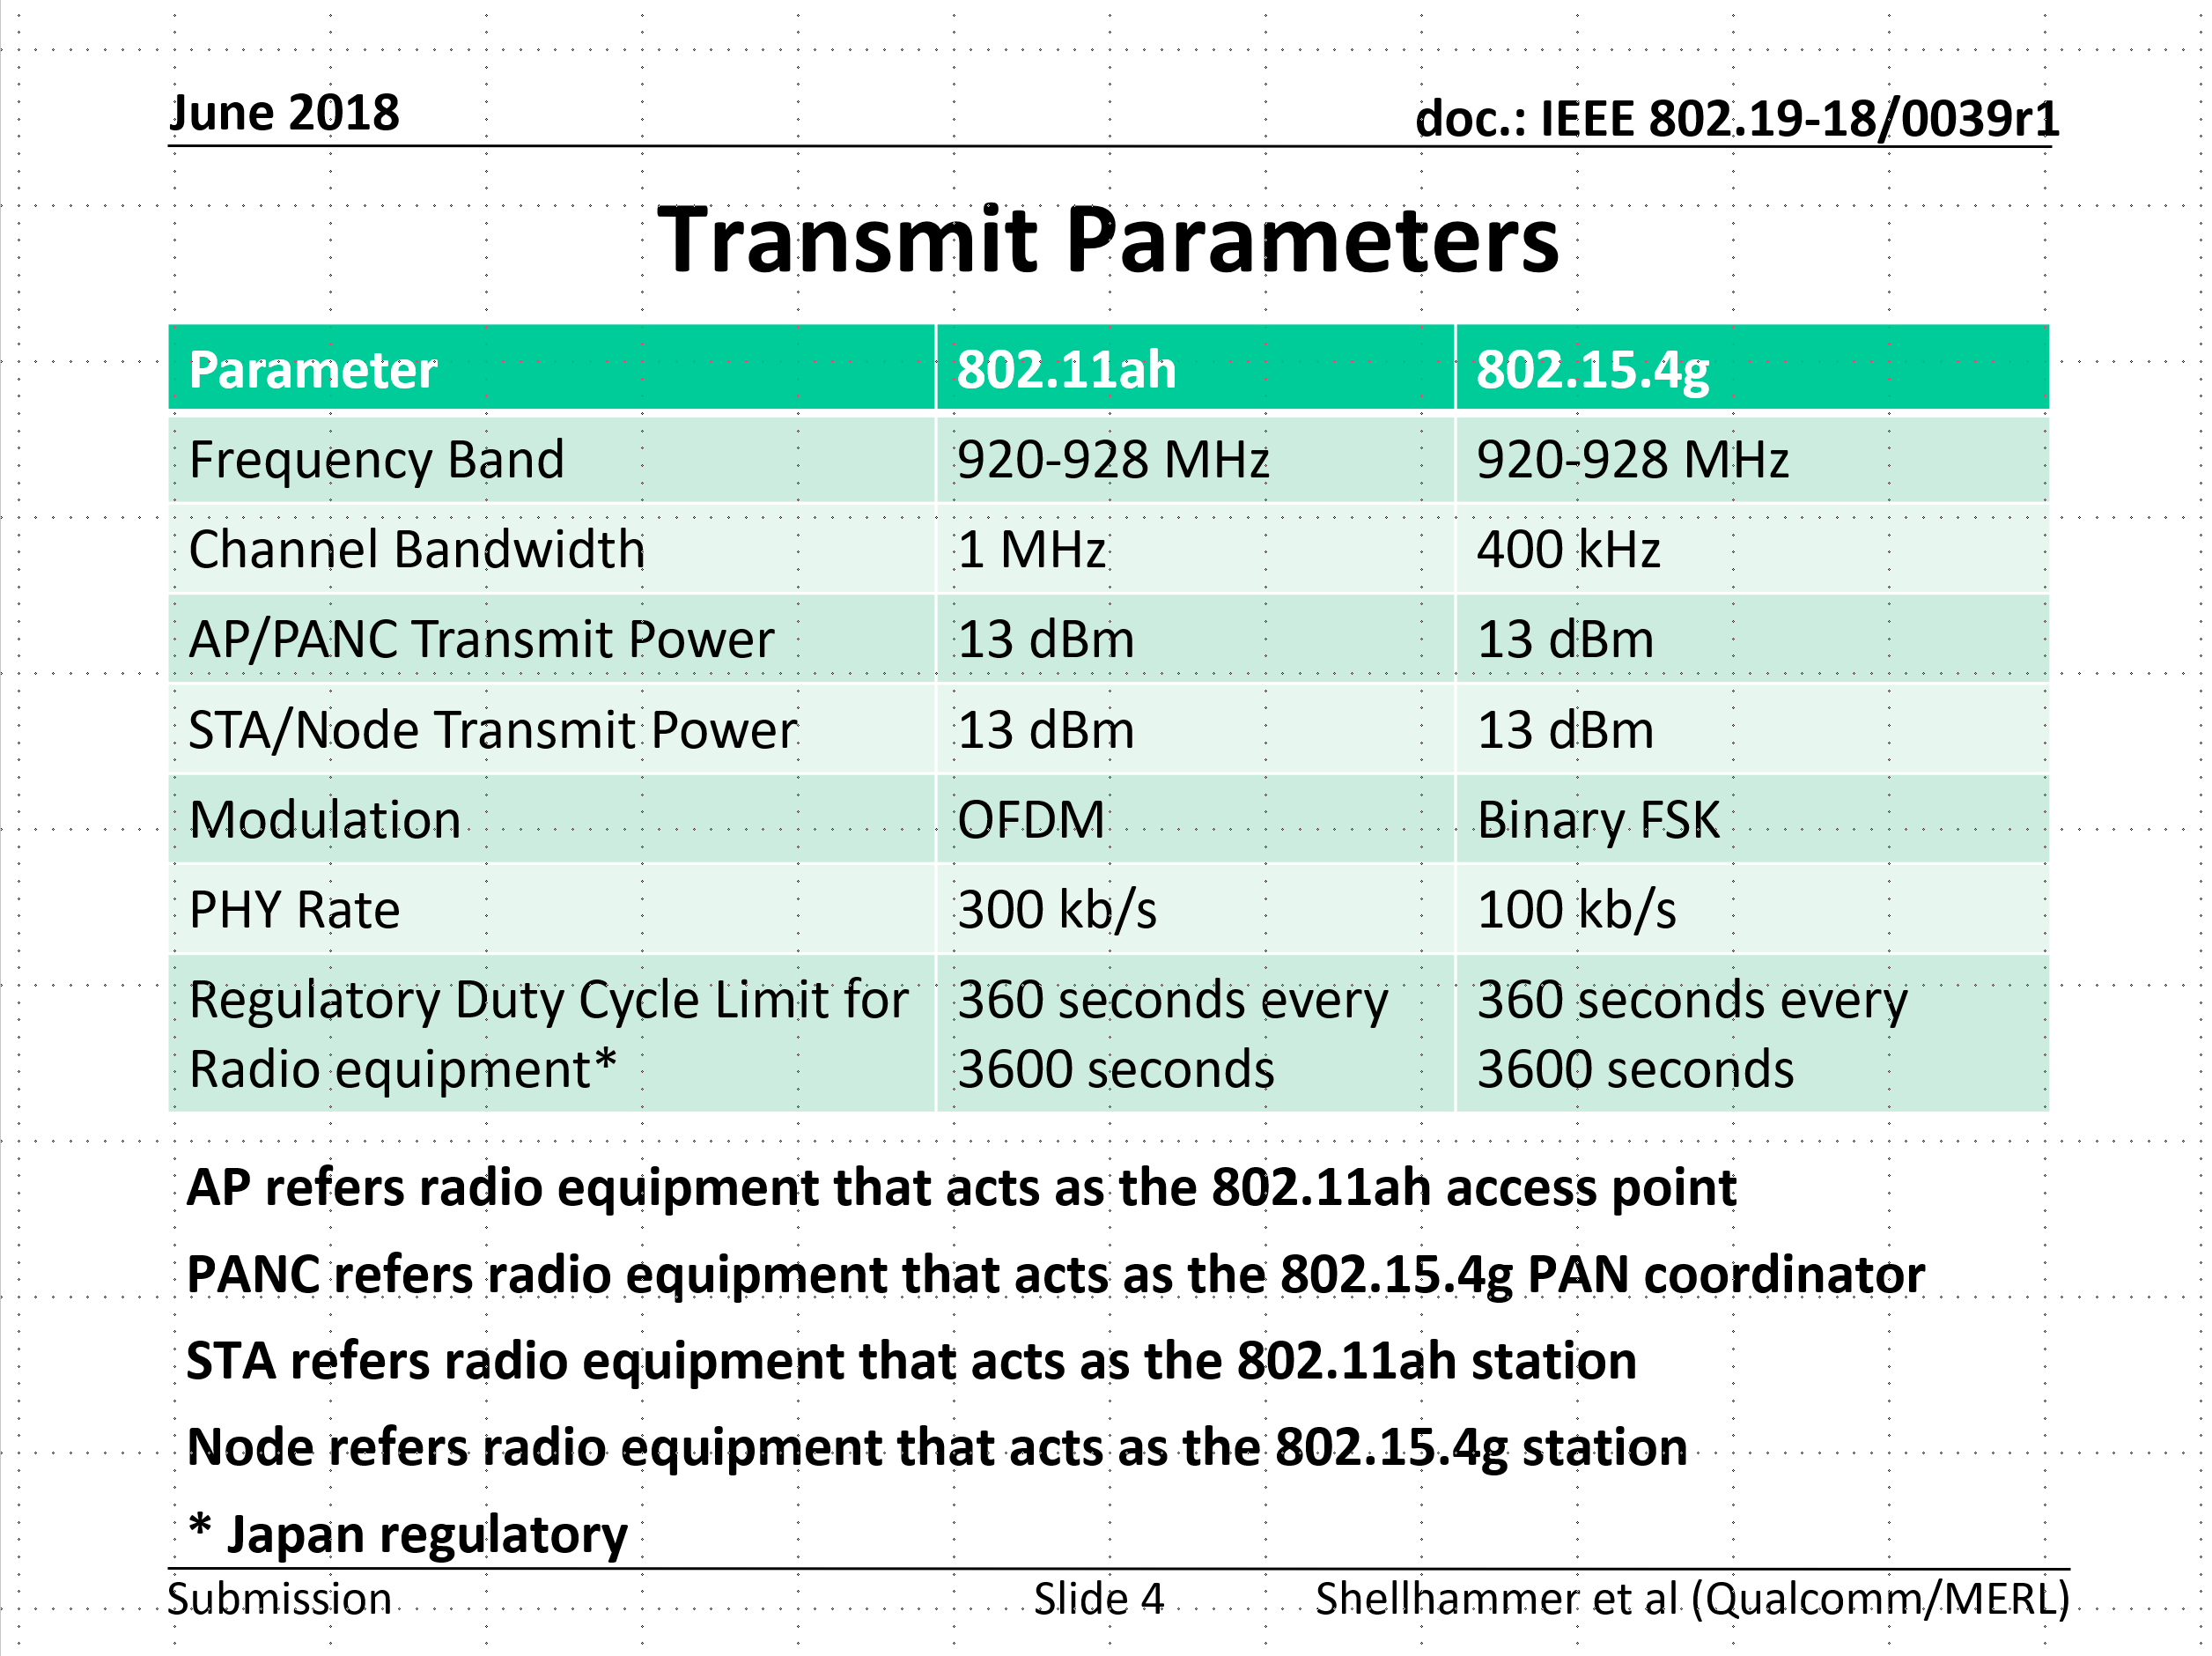
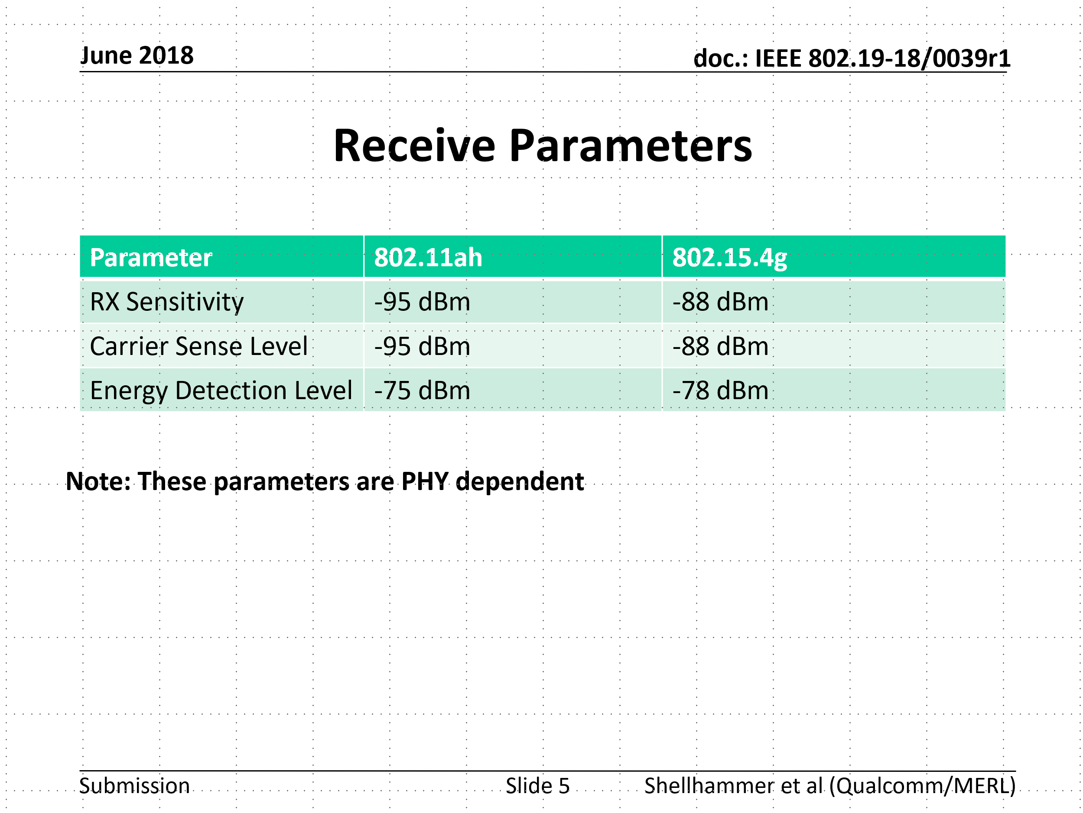
Simulation parameters discussed in TG3
Refer to 19-18/0039r1

Slide 5
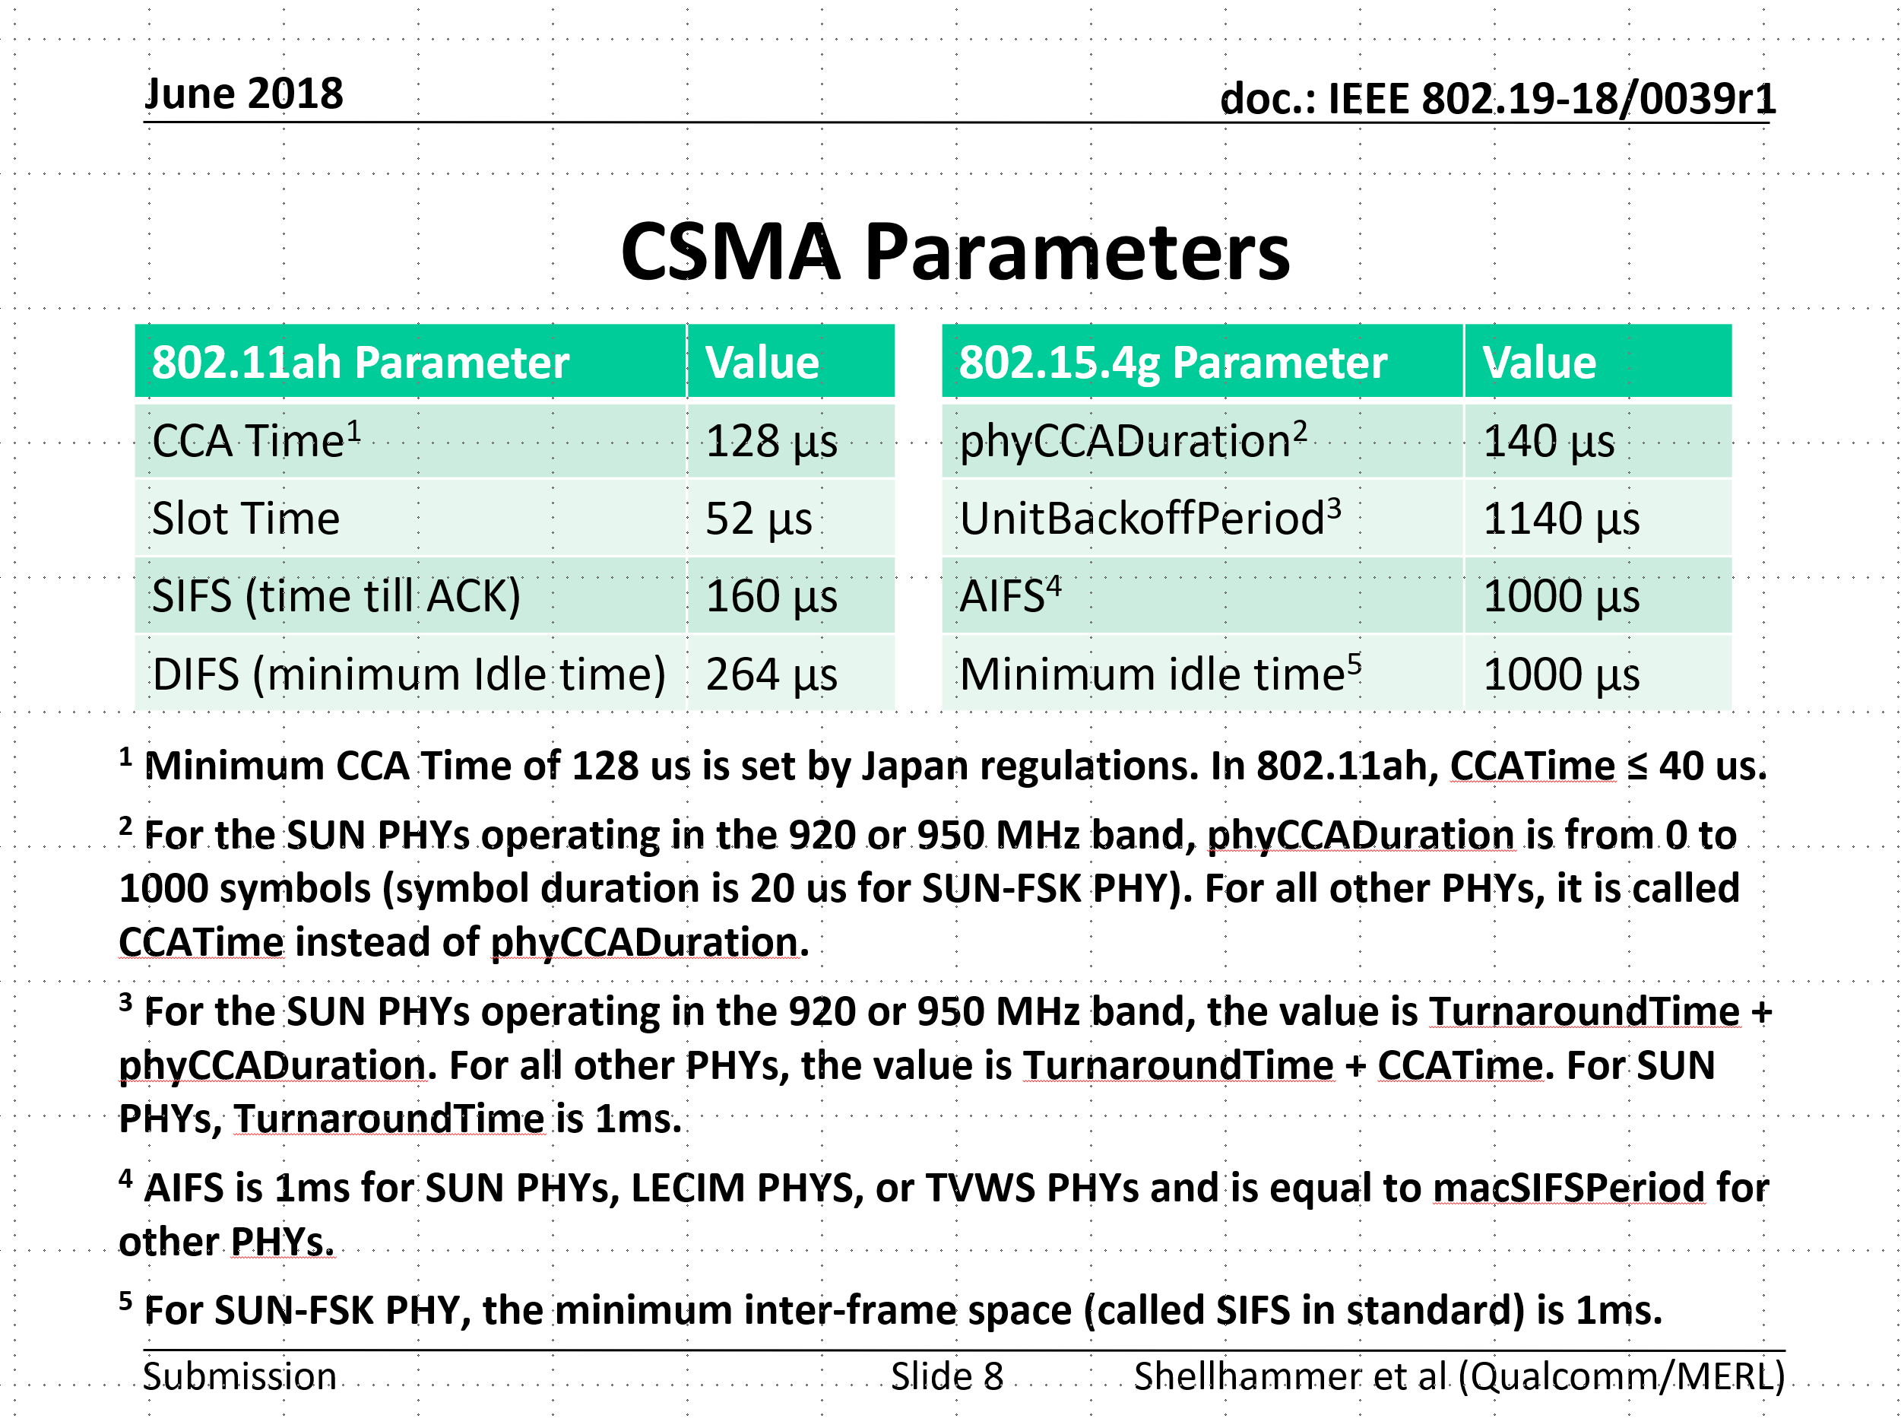
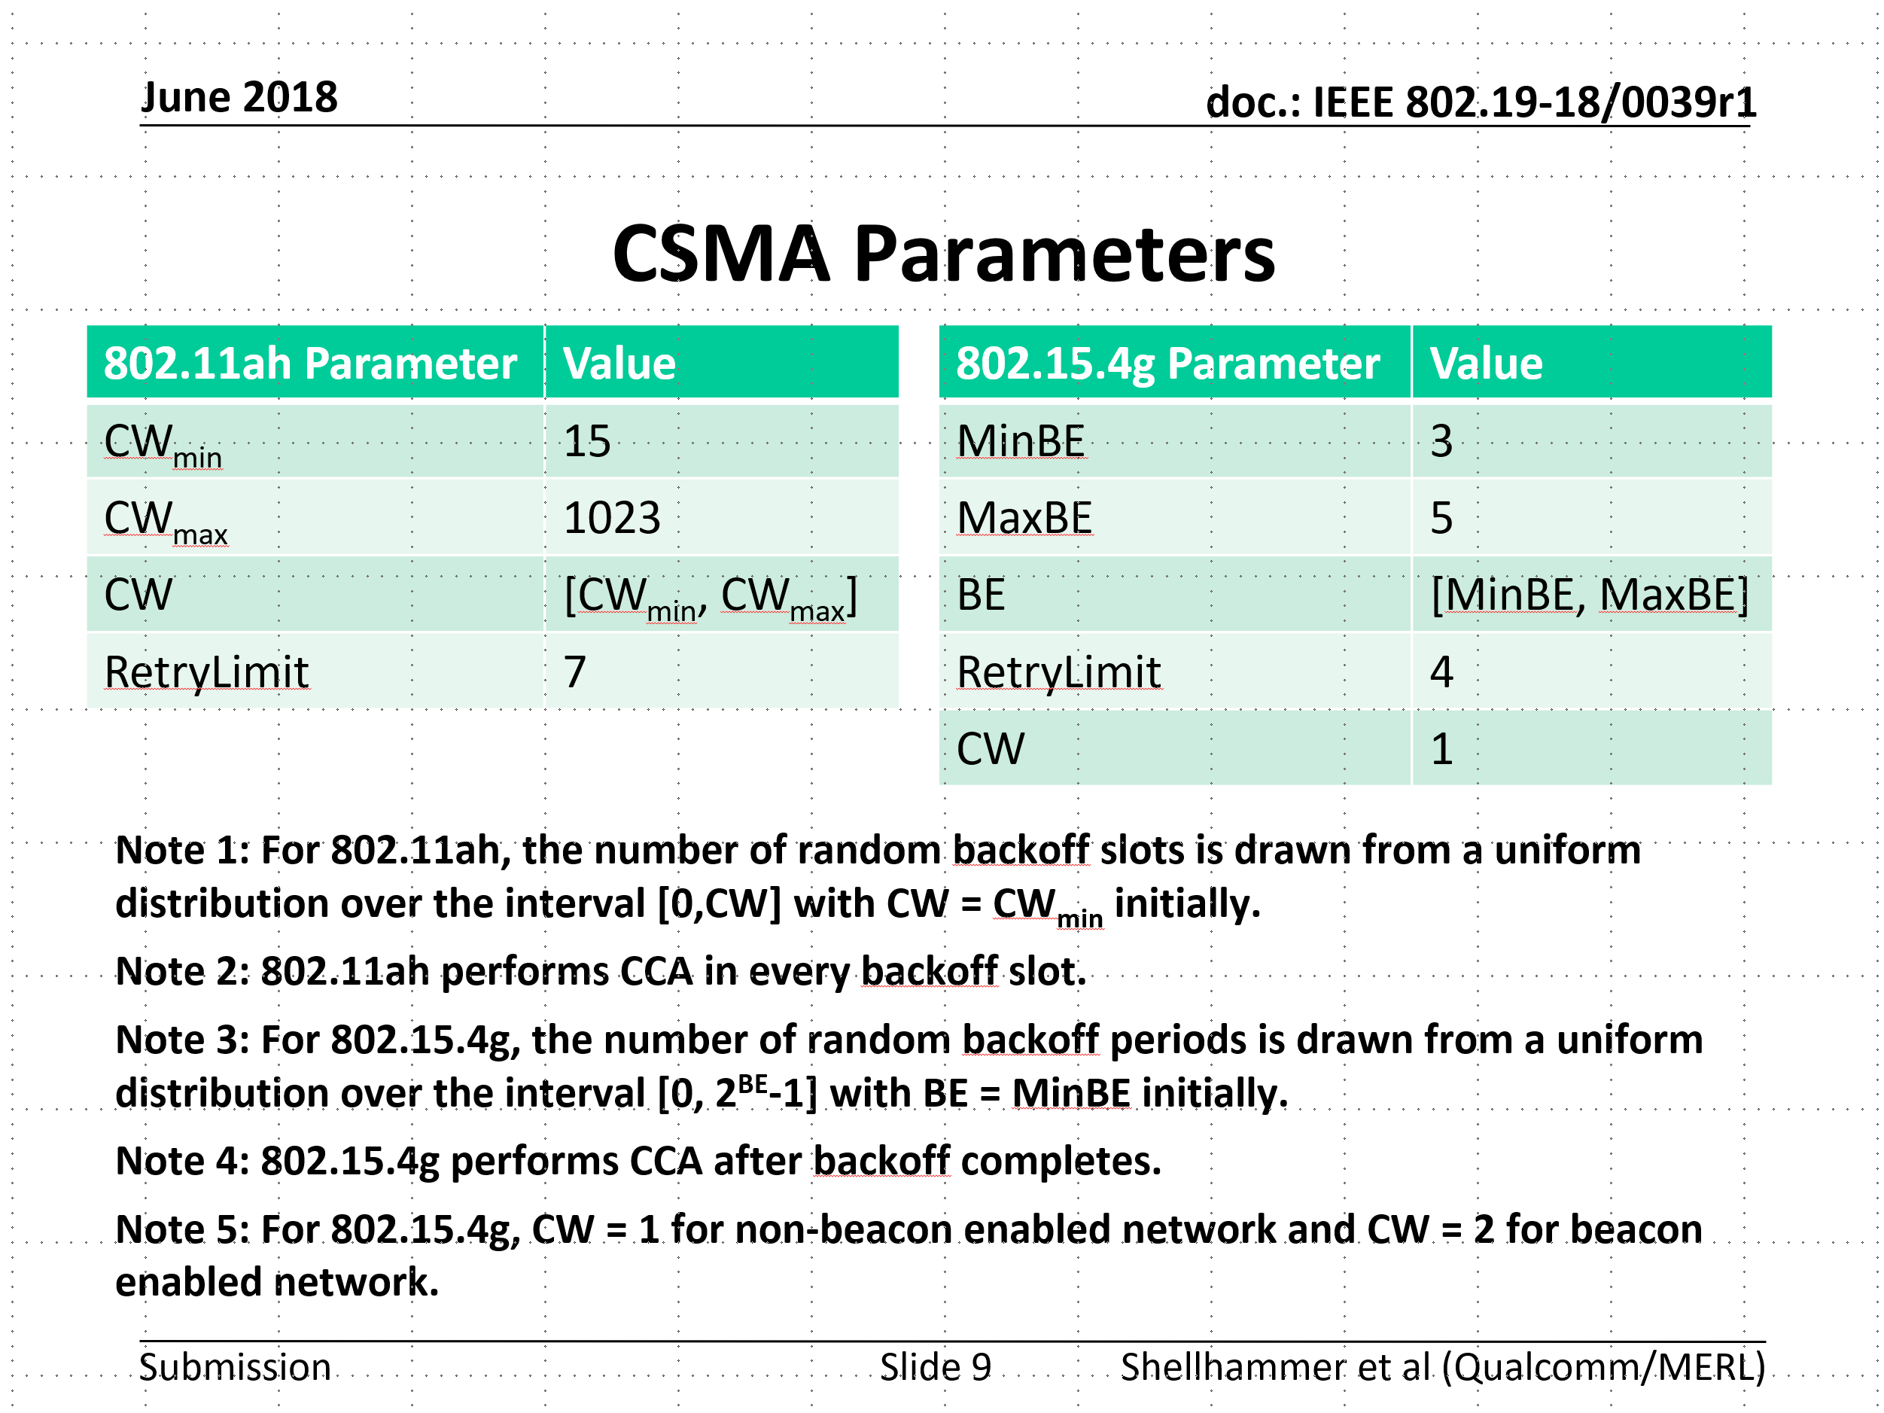
Simulation parameters discussed in TG3
Refer to 19-18/0039r1

Slide 6
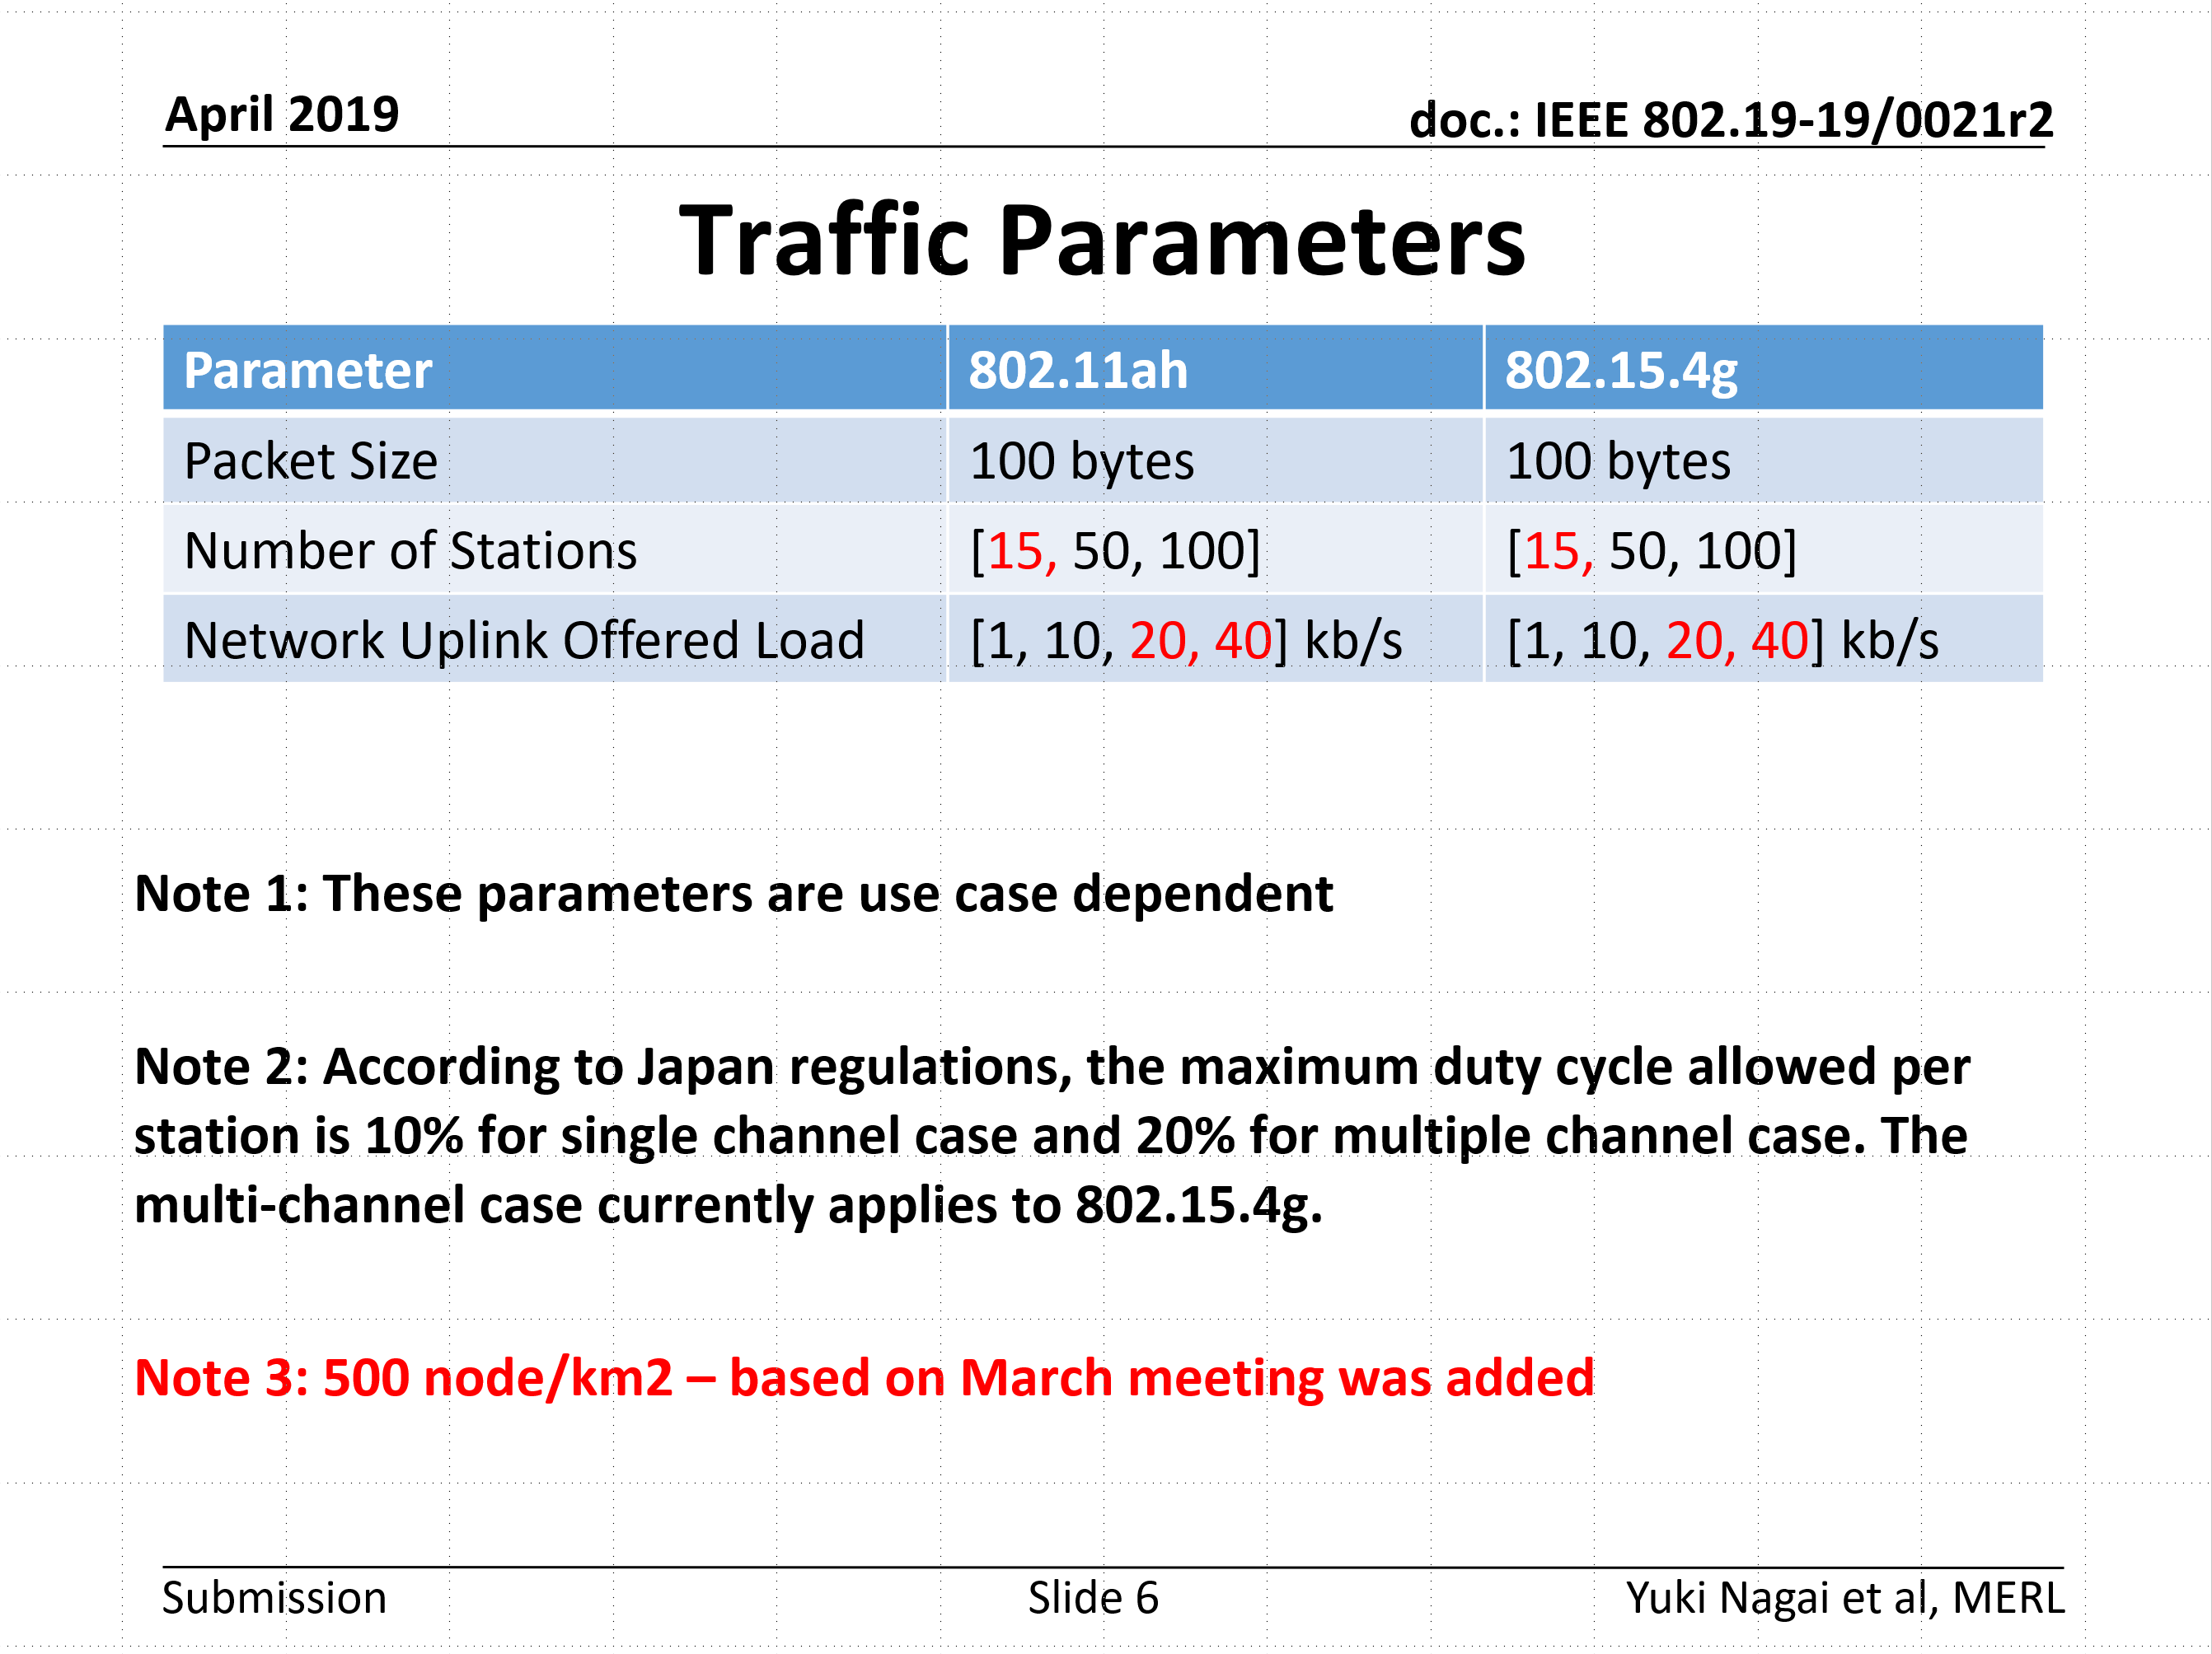
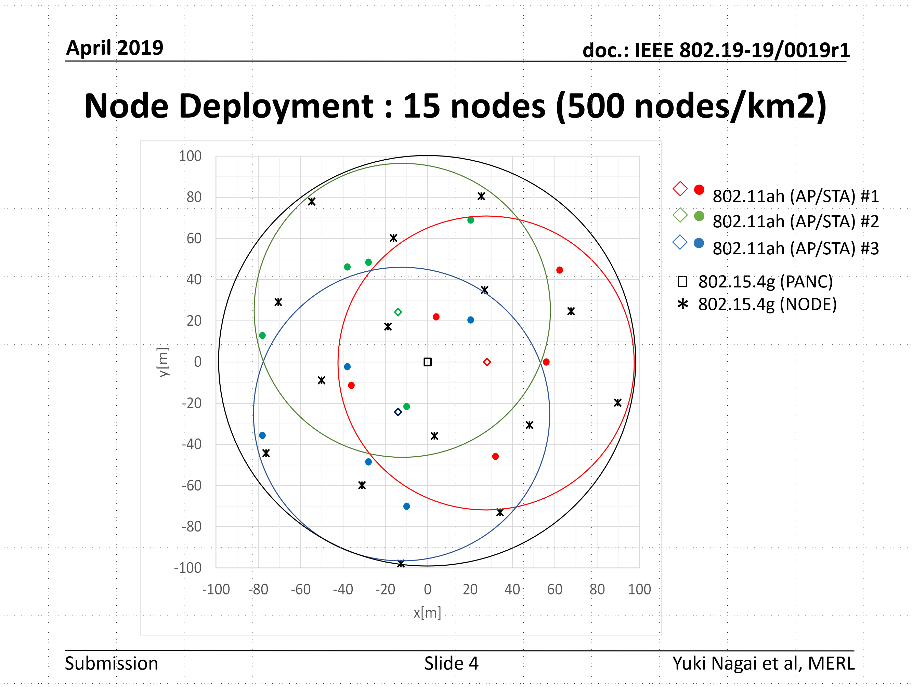
Simulation parameters discussed in TG3
Refer to 19-19/0021r2
Refer to 19-19/0019r1

Slide 7
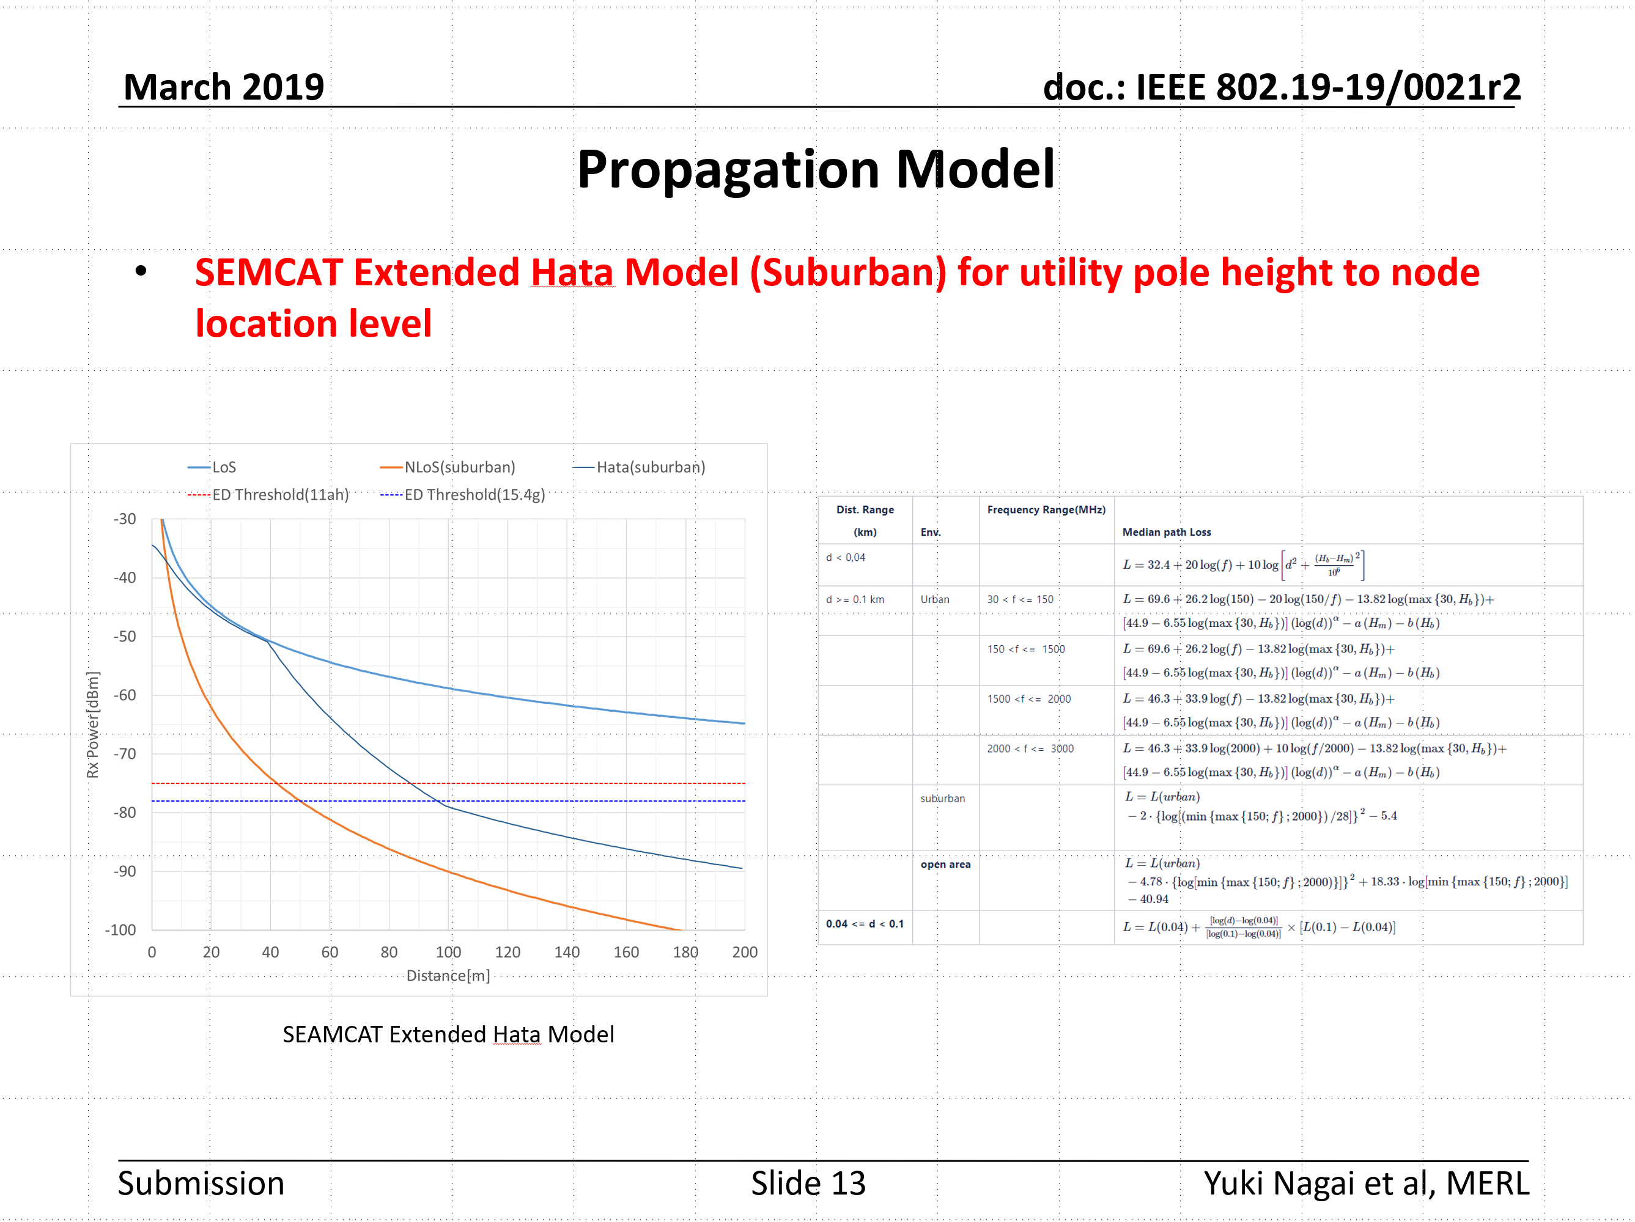
Simulation parameters discussed in TG3
Refer to 19-19/0021r2

Slide 8
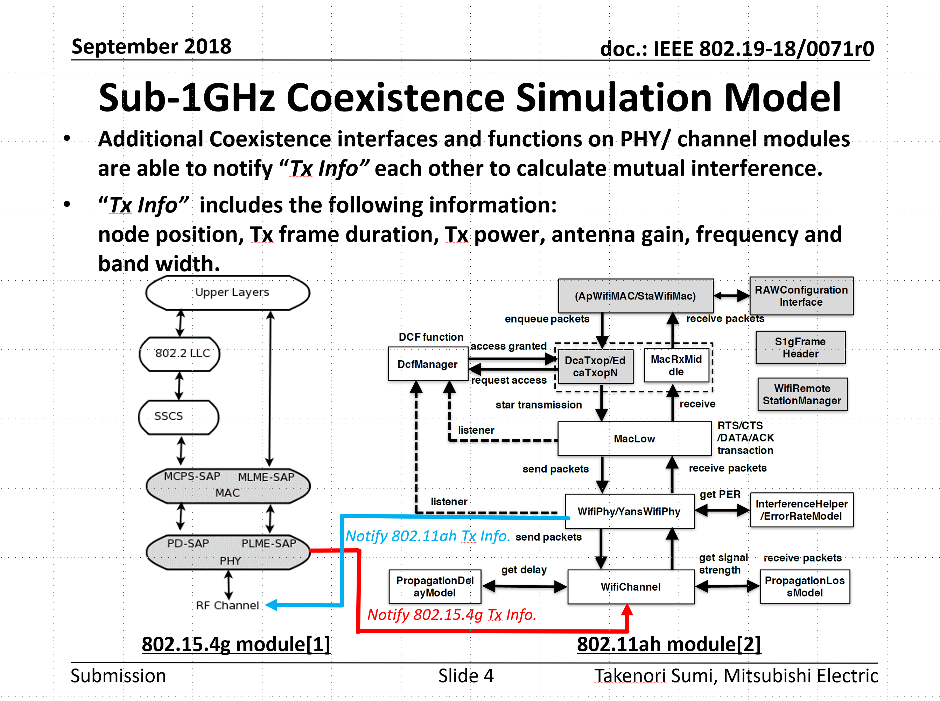
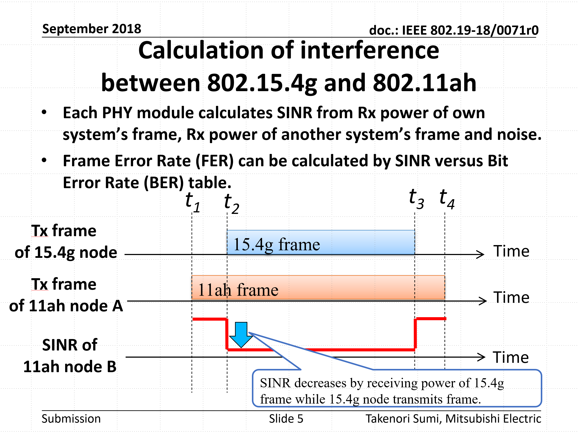
Simulation models discussed in TG3
Refer to 19-18/0071r0

Slide 9
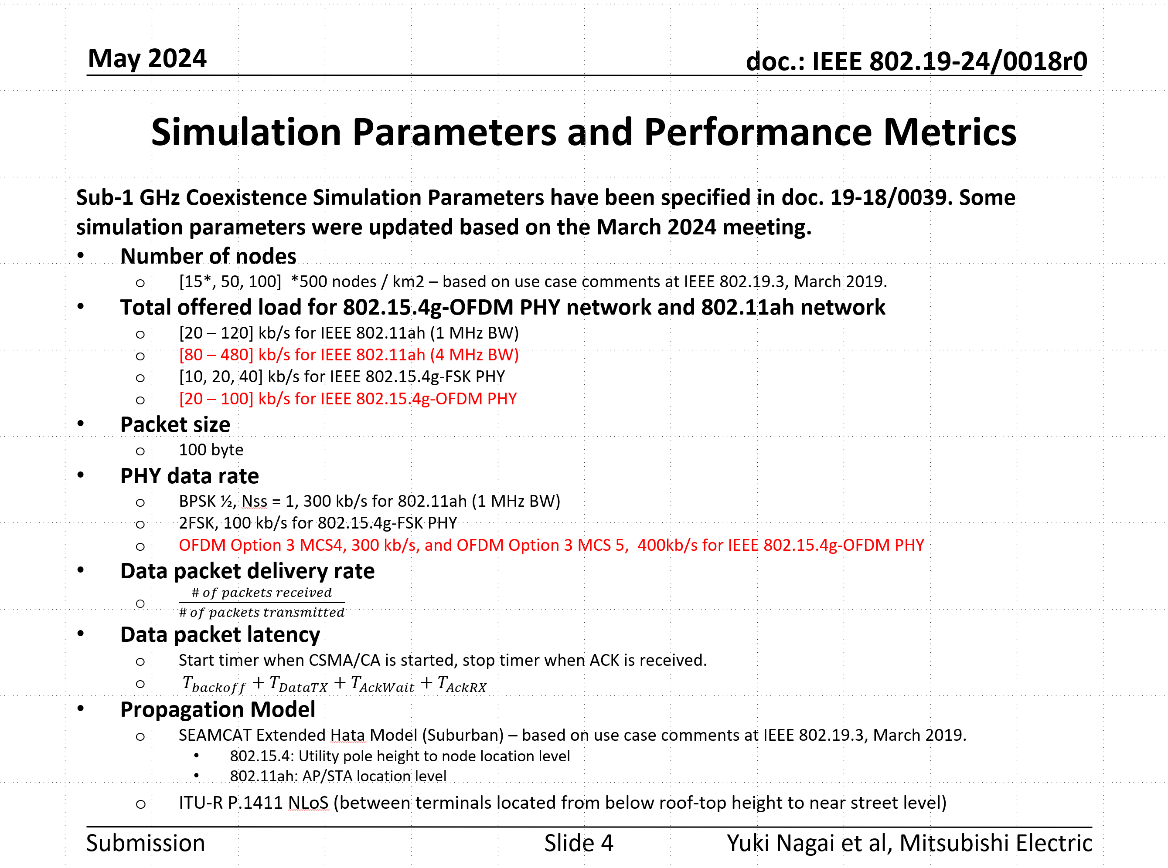
Simulation parameters updated in TG3a May meeting
Refer to 19-24/0018r0

Slide 10
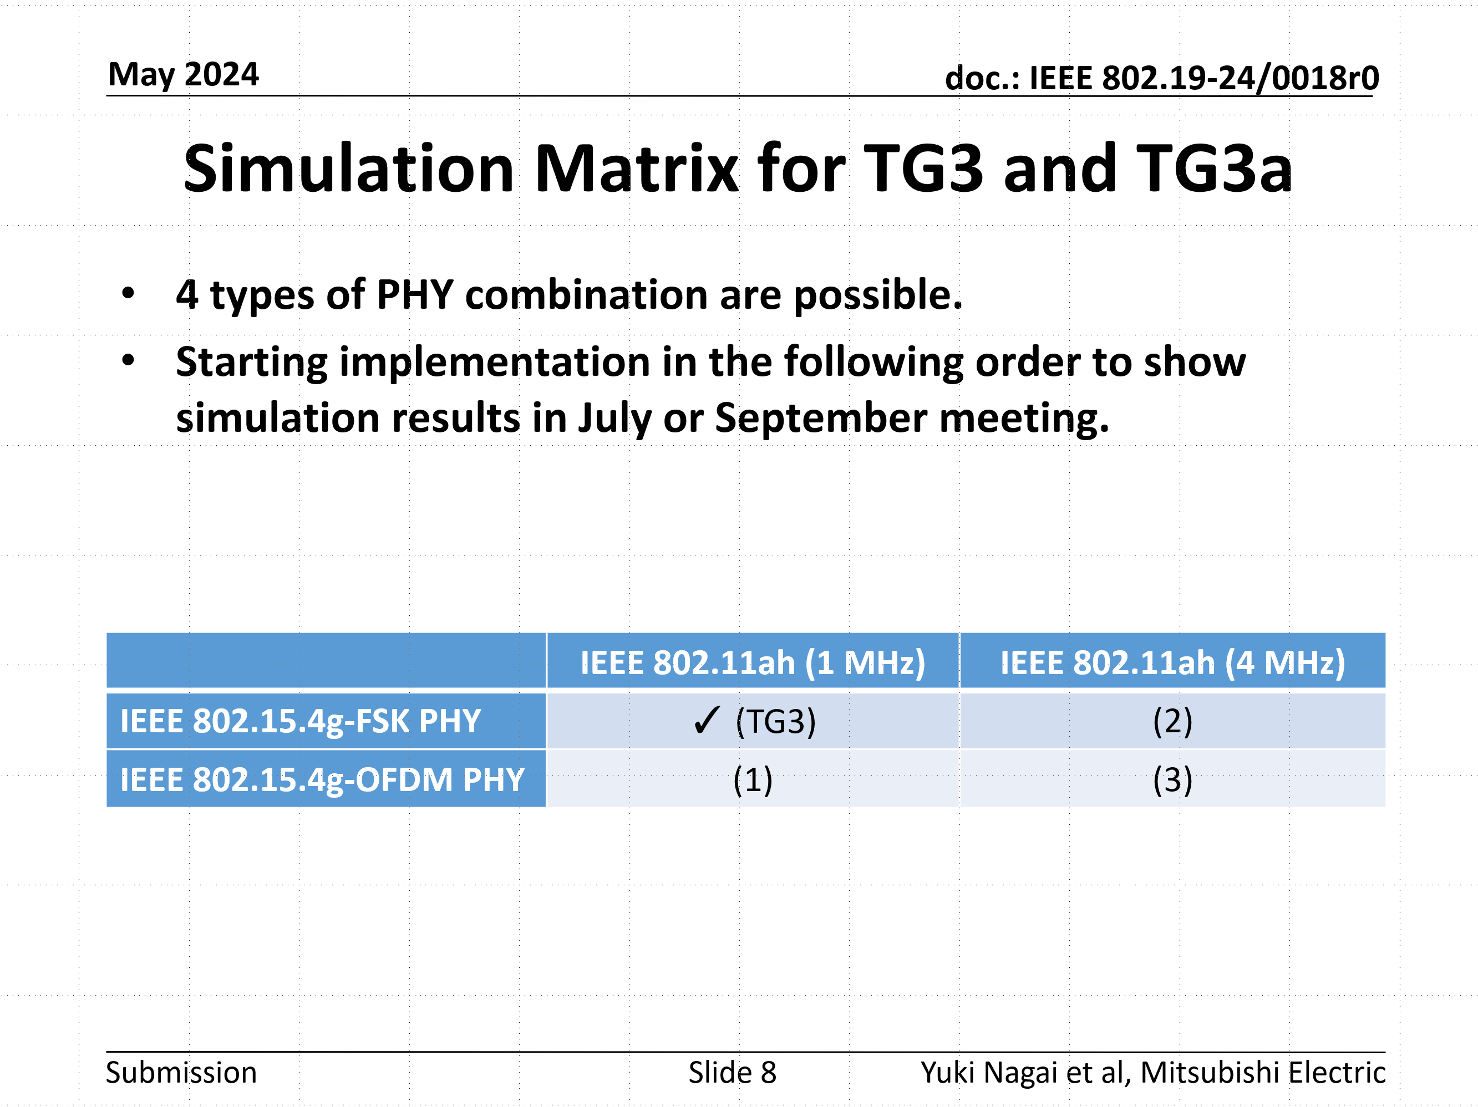
Simulation parameters updated in TG3a May meeting
From the next page, simulation results are shown for each combination of the simulation matrix.
Refer to 19-24/0018r0

Slide 11
Simulation Result (Packet Delivery Rate)
802.15.4g offered load: 10 kbps
(TG3), Case (1): IEEE 802.11ah 1MHz
Case (2), (3): IEEE 802.11ah 4MHz
IEEE 802.11ah PDR Lines
IEEE 802.15.4g PDR Lines
Case (1), (3)
Case (1), (3)
(TG3), Case (2)
(TG3), Case (2)

Slide 12
Simulation Result (Packet Delivery Rate)
802.15.4g offered load: 20 kbps
(TG3), Case (1): IEEE 802.11ah 1MHz
Case (2), (3): IEEE 802.11ah 4MHz
IEEE 802.11ah PDR Lines
IEEE 802.15.4g PDR Lines
Case (1), (3)
Case (1), (3)
(TG3), Case (2)
(TG3), Case (2)

Slide 13
Simulation Result (Packet Delivery Rate)
802.15.4g offered load: 40 kbps
(TG3), Case (1): IEEE 802.11ah 1MHz
Case (2), (3): IEEE 802.11ah 4MHz
IEEE 802.11ah PDR Lines
IEEE 802.15.4g PDR Lines
Case (1), (3)
Case (1), (3)
(TG3), Case (2)
(TG3), Case (2)

Slide 14
Simulation Result (Packet Delivery Rate)
802.15.4g offered load: 60 kbps
(TG3), Case (1): IEEE 802.11ah 1MHz
Case (2), (3): IEEE 802.11ah 4MHz
IEEE 802.11ah PDR Lines
IEEE 802.15.4g PDR Lines
Case (1), (3)
Case (1), (3)
(TG3), Case (2)
(TG3), Case (2)

Slide 15
Simulation Result (Packet Delivery Rate)
802.15.4g offered load: 100 kbps
(TG3), Case (1): IEEE 802.11ah 1MHz
Case (2), (3): IEEE 802.11ah 4MHz
IEEE 802.11ah PDR Lines
IEEE 802.15.4g PDR Lines
Case (1), (3)
Case (1), (3)
(TG3), Case (2)
(TG3), Case (2)

Slide 16
Simulation Result (Delay)
802.15.4g offered load: 10 kbps
(TG3), Case (1): IEEE 802.11ah 1MHz
Case (2), (3): IEEE 802.11ah 4MHz
IEEE 802.11ah Delay Lines
IEEE 802.15.4g Delay Lines
Case (1), (3)
Case (1), (3)
(TG3), Case (2)
(TG3), Case (2)

Slide 17
Simulation Result (Delay)
802.15.4g offered load: 20 kbps
(TG3), Case (1): IEEE 802.11ah 1MHz
Case (2), (3): IEEE 802.11ah 4MHz
IEEE 802.11ah Delay Lines
IEEE 802.15.4g Delay Lines
Case (1), (3)
Case (1), (3)
(TG3), Case (2)
(TG3), Case (2)

Slide 18
Simulation Result (Delay)
802.15.4g offered load: 40 kbps
(TG3), Case (1): IEEE 802.11ah 1MHz
Case (2), (3): IEEE 802.11ah 4MHz
IEEE 802.11ah Delay Lines
IEEE 802.15.4g Delay Lines
Case (1), (3)
Case (1), (3)
(TG3), Case (2)
(TG3), Case (2)

Slide 19
Simulation Result (Delay)
802.15.4g offered load: 60 kbps
(TG3), Case (1): IEEE 802.11ah 1MHz
Case (2), (3): IEEE 802.11ah 4MHz
IEEE 802.11ah Delay Lines
IEEE 802.15.4g Delay Lines
Case (1), (3)
Case (1), (3)
(TG3), Case (2)
(TG3), Case (2)

Slide 20
Simulation Result (Delay)
802.15.4g offered load: 100 kbps
(TG3), Case (1): IEEE 802.11ah 1MHz
Case (2), (3): IEEE 802.11ah 4MHz
IEEE 802.11ah Delay Lines
IEEE 802.15.4g Delay Lines
Case (1), (3)
Case (1), (3)
(TG3), Case (2)
(TG3), Case (2)

Slide 21
Summary
802.11ah impacts 802.15.4g SUN OFDM PHY packet delivery
802.15.4g SUN OFDM PHY impacts packet latency of 802.11ah 1MHz, but no much impact for 802.11ah 4MHz
802.11ah packet latency is unbounded
  CCA is required in each backoff slot
  Backoff counter decreases only if the channel is idle
802.15.4g packet latency is bounded
  CCA is not required during random backoff period
  CCA is performed after random backoff period
We would like the IEEE 802.19.3a to continue the discussion of simulation as inputs for Recommended Practice
  Future Plan (January):
    Simulation update with ARIB STD T-108 conditions for IEEE 802.11ah
    Simulation update with coexistence proposals

