Slide 1
TG 19.3a Agenda and Meeting Slides
Nov 2024
Date: 2024-11-11
Authors:
Name | Affiliations | email
Benjamin Rolfe | BCA, et al | Ben.rolfe @ ieee.org
Notice: This document has been prepared to assist IEEE 802.19. It is offered as a basis for discussion and is not binding on the contributing individual(s) or organization(s). The material in this document is subject to change in form and content after further study. The contributor(s) reserve(s) the right to add, amend or withdraw material contained herein.

Slide 2
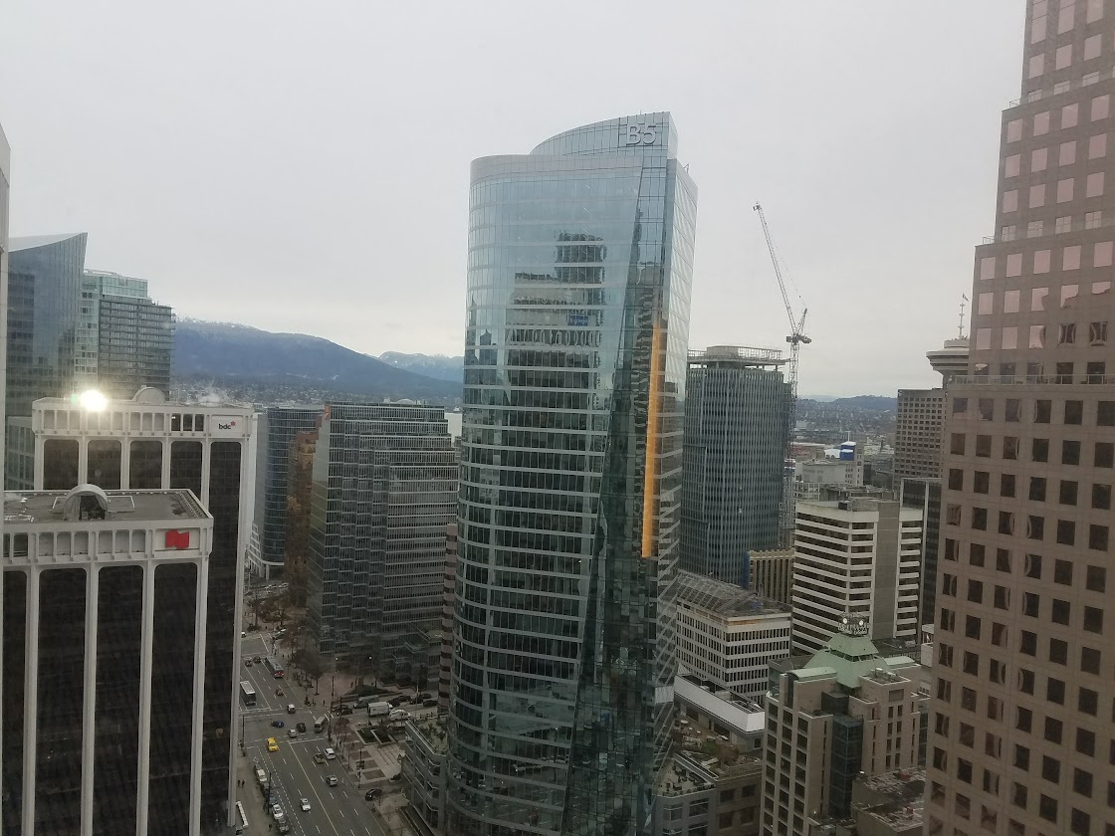
Tg19.3a
802 Plenary Session, November 2024
Vancouver, BC, Canada
And remotely world-wide

Slide 3
Project Overview
PAR approved: https://development.standards.ieee.org/myproject-web/app#viewpar/14995/11032
Scope of the project: This amendment updates and expands coexistence recommendations to address new market requirements, increasing data traffic, greater device density of devices, and increased potential for congestion based on both IEEE Std 802.11-2020 and IEEE Std 802.15.4 sub-1 GHz standards. This amendment includes recommendations with respect to new devices, as well as compatibility with deployed legacy devices.

Slide 4
TG Overview
1 | Task Group Chair | Benjamin Rolfe
2 | Task Group Technical Editor | Shoichi Kitazawa
3 | Task Group Vice Chair | Kazuto Yano
4 | Task Group Vice Chair | Joerg Robert
5 | Task Group Recording Secretary | Yukimasa Nagai

Slide 5
Agenda
 | Topic | Presenter | Time
 | Monday 11-November
1 | Intro and overhead | Chair | 00:10
1.1 | Agenda Review | Chair
1.2 | Approval of minutes | Chair
3 | Measurement results of radio noise over Sub-1 GHz band emitted from mini PC and laptop PC | Kazuto Yano | 00:30
4 | Recess |  | 00:00
 | Thursday 12-September
5 | IEEE 802.11ah and IEEE 802.15.4g SUN OFDM PHY Coexistence Simulation | Takenori Sumi | 00:30
6 | Call for Contributions for November | Chair | 00:05
6 | Aob | Chair
7 | Adjourn

Slide 6
Near Term Milestones
PAR Approval
Officer appointment
Call for contributions for May 2024 Wireless interim
Collect background information
  Use cases
  Technical constraints and characteristics
  Supporting data (simulation, measurements)
Discuss and agree on initial project timeline
  Develop technical content
  Produce draft
  Working group ballot
  SA Ballot

Slide 7
Next Steps

