Slide 1
July 2024 WG Closing Report
Date: 2024-07-17
Authors:
Name | Affiliations | email
Tuncer Baykas | Ofinno | tbaykas@ieee.org
Notice: This document has been prepared to assist IEEE 802.19. It is offered as a basis for discussion and is not binding on the contributing individual(s) or organization(s). The material in this document is subject to change in form and content after further study. The contributor(s) reserve(s) the right to add, amend or withdraw material contained herein.

Slide 2
Summary
IEEE 802.19 has 53 voting members
Group had one meeting on Monday PM2.

Slide 3
Working Group Leadership
Position | Person
Working Group Chair | Tuncer Baykas (Ofinno)
Working Group Vice Chair | Steve Shellhammer (Qualcomm)
Task Group 3a Chair | Ben Rolfe (Blind Creek Associates)
Liaison To/From 802.11 | Tuncer Baykas (Ofinno)
Liaison To/From 802.15 | Ben Rolfe (Blind Creek Associates)

Slide 4
Coexistence Assessment documents
The 802.19 ballot on the approval of 802.15.4ab Coexistence Assessment (CA) document closed on June 30. The results are:
Yes 11
No 10
Abstain 0
The CA document was not approved.
39 comments were received during the ballot.

Slide 5
Motion
To approve meeting minutes Mau 2024 WG Minutes (24/012r0)
Motion passed with unanimous consent

Slide 6
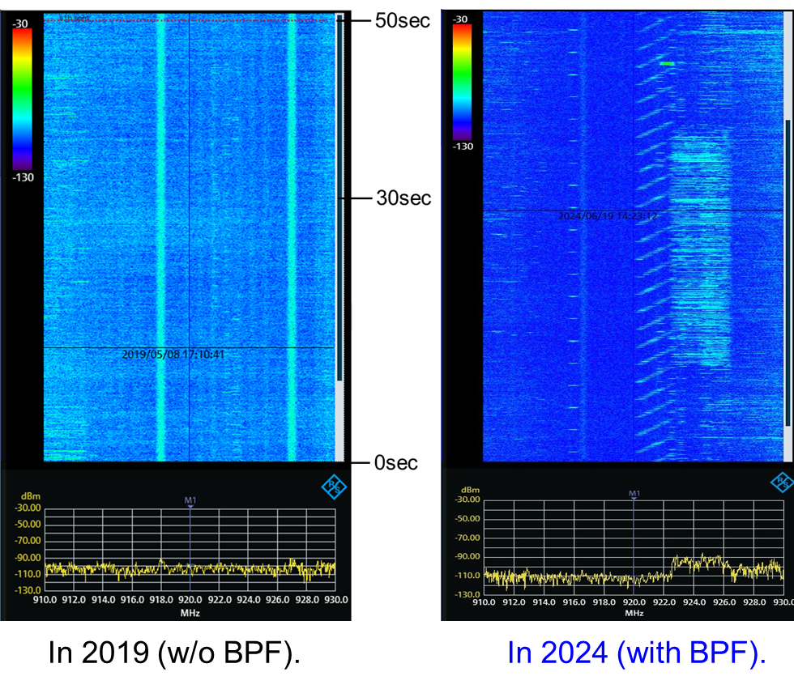
802.19 TG3a
Scope of the project: This amendment updates and expands coexistence recommendations to address new market requirements, increasing data traffic, greater device density of devices, and increased potential for congestion based on both IEEE Std 802.11-2020 and IEEE Std 802.15.4 sub-1 GHz standards.
19-24/0024, “Latest measured radio use over 920 MHz band in Kansai area of Japan ”
Kazuni Yato et. al.
https://mentor.ieee.org/802.19/dcn/24/19-24-0024-00-003a-latest-measured-radio-use-over-920-mhz-band-in-kansai-area-of-japan.pptx

Slide 7
Schedule

