Slide 1
Latest measured radio use over 920 MHz band in Kansai area of Japan
Date: 2024-07-12
Authors:
Notice: This document has been prepared to assist IEEE 802.19. It is offered as a basis for discussion and is not binding on the contributing individual(s) or organization(s). The material in this document is subject to change in form and content after further study. The contributor(s) reserve(s) the right to add, amend or withdraw material contained herein.

Slide 2
Introduction
The sub-1 GHz band is used by not only IEEE 802.11ah and IEEE 802.15.4, but also other radio systems. Moreover, several kinds of machinery emit powerful radio noise in this frequency band, and it may have a large impact on the system performance of wireless communication systems.
In 2019, we conducted some measurements of radio use in the 920 MHz band at several places in Kansai area of Japan [1, 2]. To capture the change of radio use from that time, we have conducted new measurements at the same places in this June.
This contribution shows the new measurement results, and compares the radio use in the 920 MHz band in Japan between in 2019 and in 2024.

Slide 3
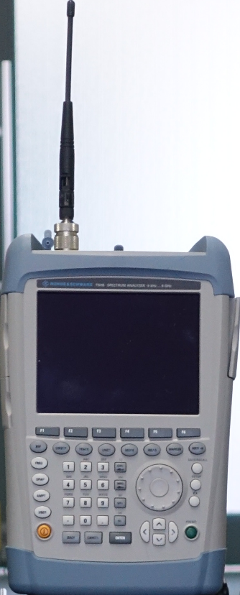

Measurement equipment
We measured spectrogram in the 920 MHz band by a handheld spectrum analyzer.
For easy comparison with the measurement results obtained in 2019, we use the same measurement equipment as in [1, 2] except for inserting a band-pass filter between the antenna and spectrum analyzer.
Whip antenna
(Pasternack PE51026)
Handheld spectrum analyzer
(Rohde & Schwarz FSH8)
RBW: 300 kHz
VBW: 300 kHz
Center freq.: 920 MHz
Span: 20 MHz
Band-pass filter
(Mini-Circuits VBFZ-925-S)
Passband: 800 – 1050 MHz

Slide 4
Measurement places
Measurements were conducted in Kansai area (west part) of Japan.
  Two railway terminal stations (located within 30 km from the venue of Wireless Interim in January 2025).
    One station (Station A) at the second floor (open space) in a downtown area.
    Another station (Station B) at the third floor (open space) in a downtown area. Station B is located at a distance of 3.5 km.
  Near by a shopping center in a suburban area.

Slide 5
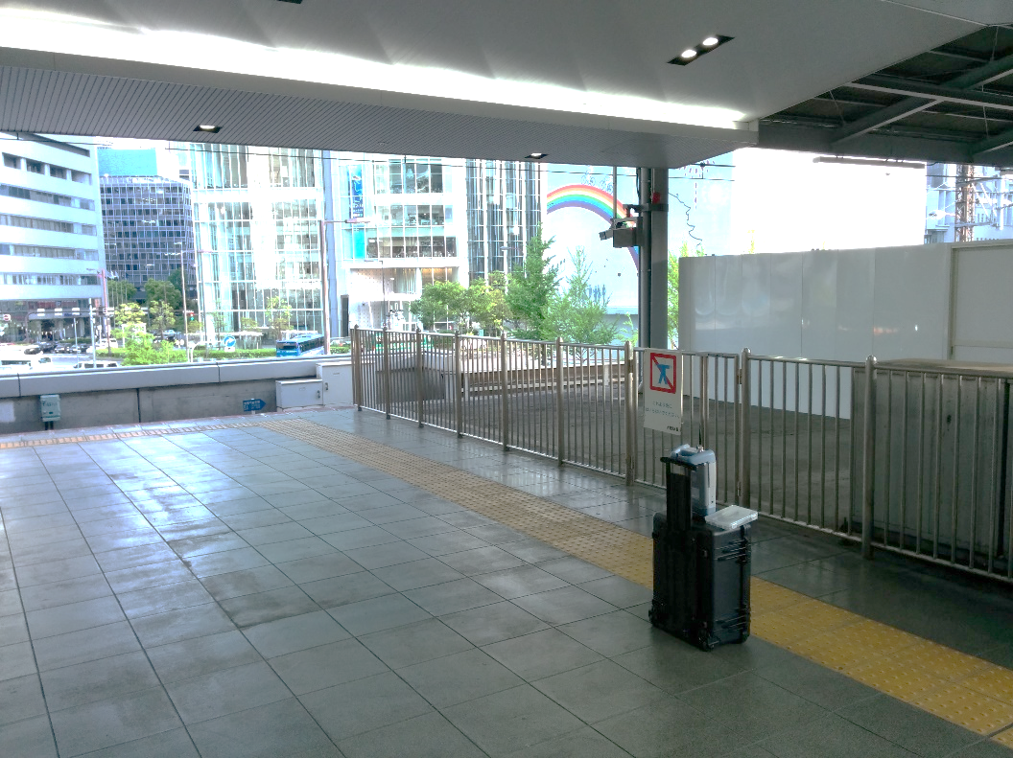
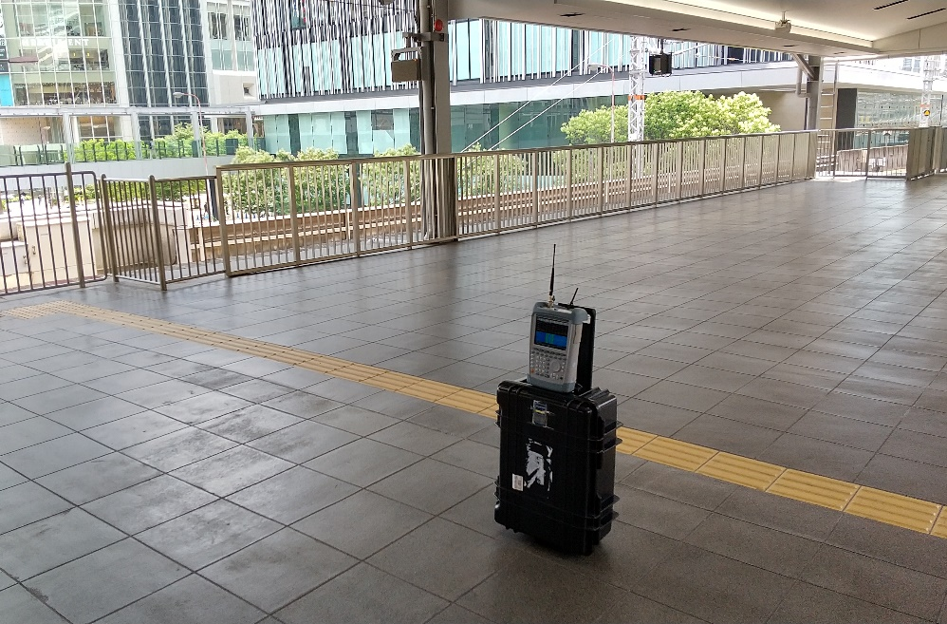
Measurement location (1)
Railway station (Station A) [1]
We conducted measurement at the end of a platform of a terminal station in downtown area. The platform is at the second floor, and there is no wall at the both (North and South) sides of this floor.
Train stops every several minutes.
A new passage has been created.
In 2019.
In 2024.
Measurement
equipment

Slide 6
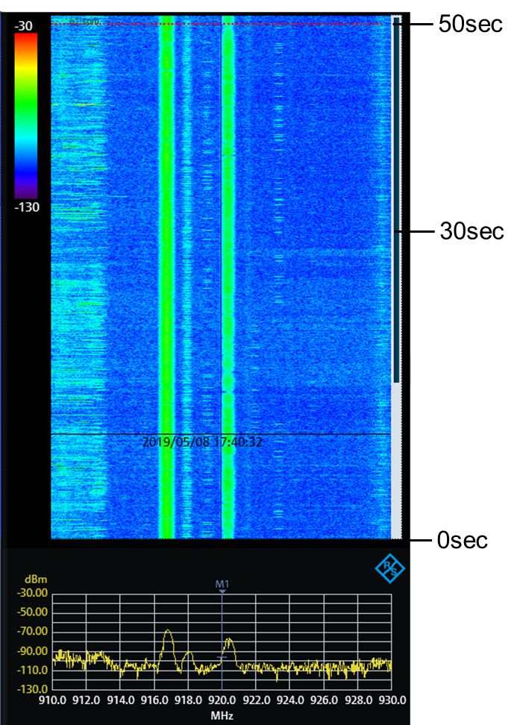
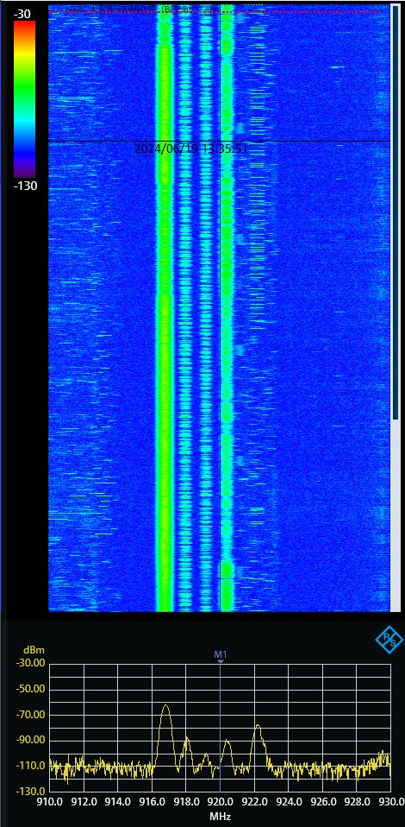
Measurement results at Station A
The trend of radio use is almost between in 2019 and in 2024.
Unknown multiple continuous signals are measured at 916.7 MHz and 920.5 MHz.
Frequent radio uses are found at 918 MHz and 919.5 MHz.
In 2019 (w/o BPF).
In 2024 (with BPF).

Slide 7
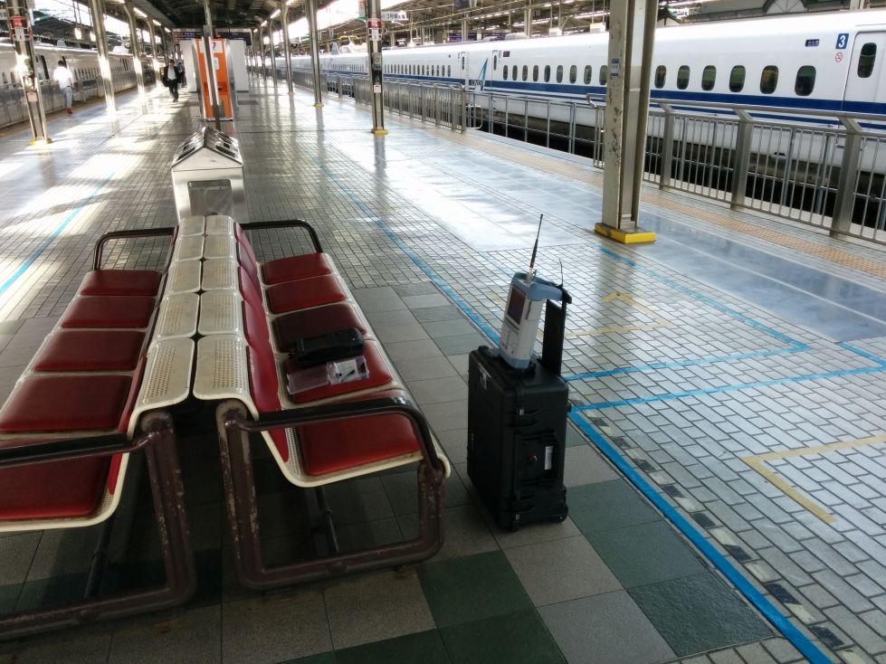
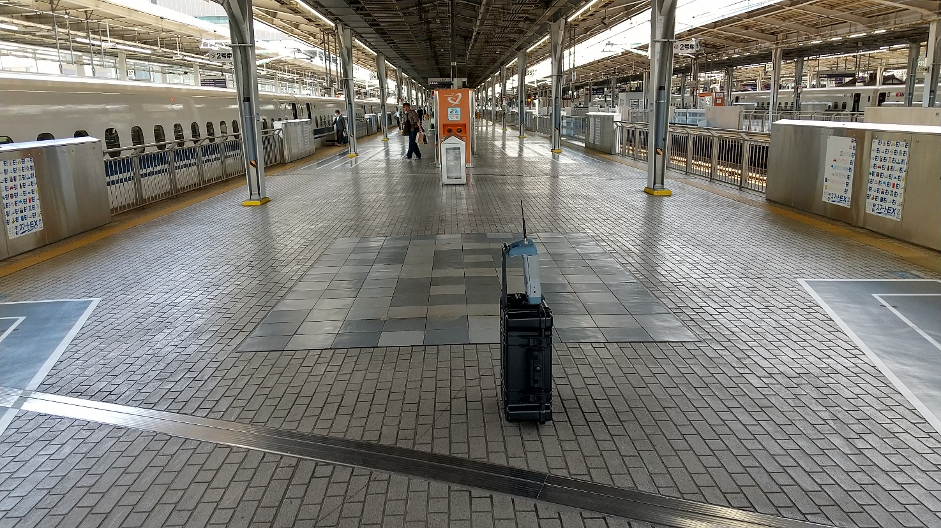
Measurement location (2)
Railway station (Station B)
We also conducted measurement near an edge of a platform of another terminal station in downtown area. This platform is at the third floor, and there are thin walls at the both (North and South) sides of this floor.
In 2019.
In 2024.
Measurement
equipment

Slide 8
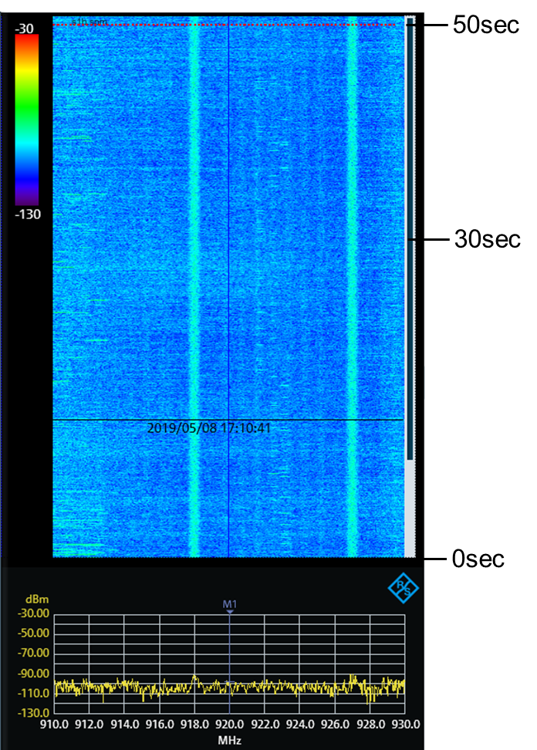
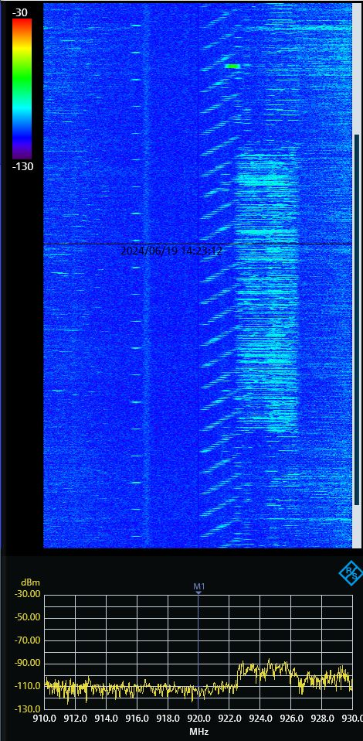
Measurement results at Station B
Chirp-like signals are found between 920.2 and 922.8 MHz. They were not found in 2019.
A radio use by a signal with a bandwidth of 4 MHz is also found between 922.4 and 926.4 MHz.
Other radio use by some narrow-band signals are found at some frequencies.
We can find that several wireless systems coexist in this frequency band.
In 2019 (w/o BPF).
In 2024 (with BPF).

Slide 9
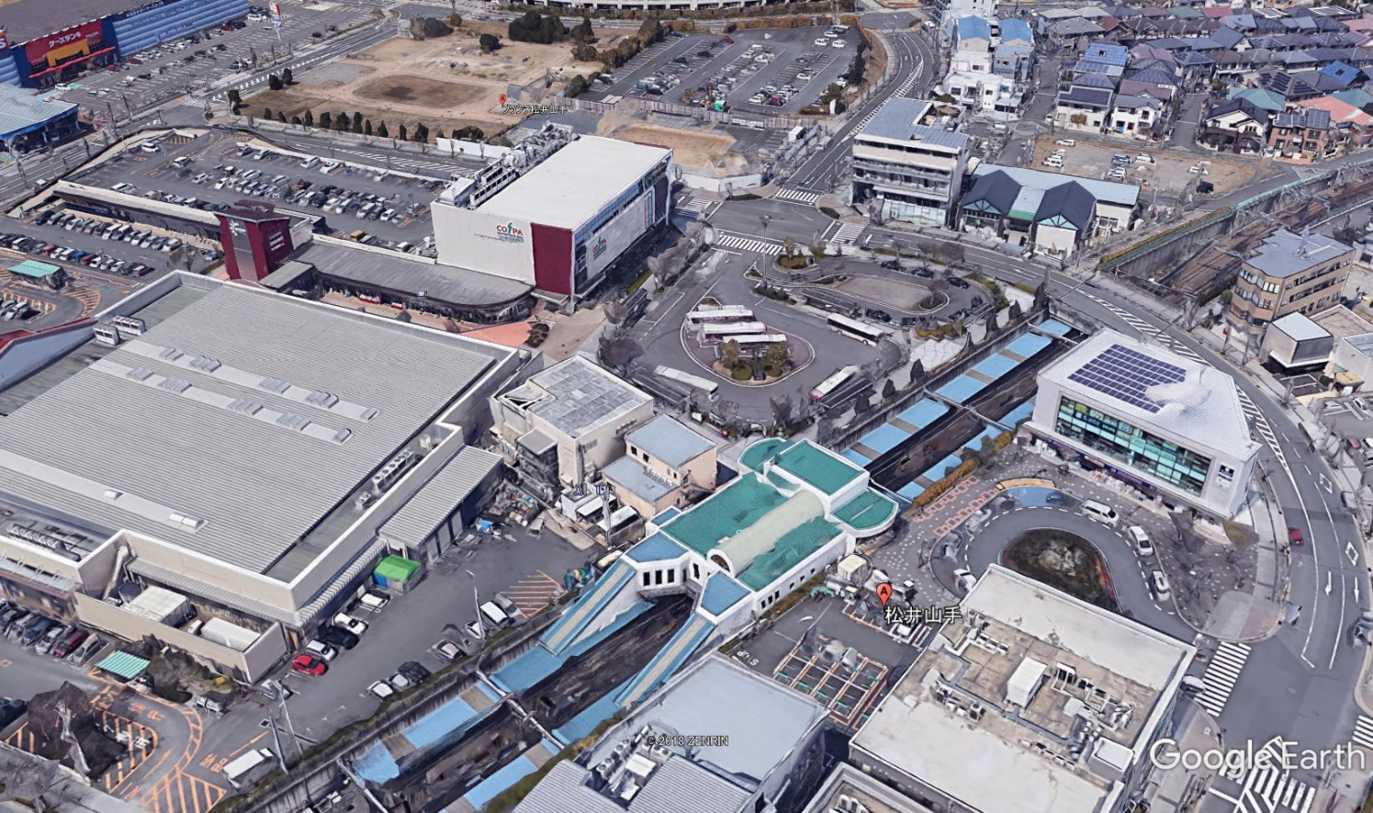
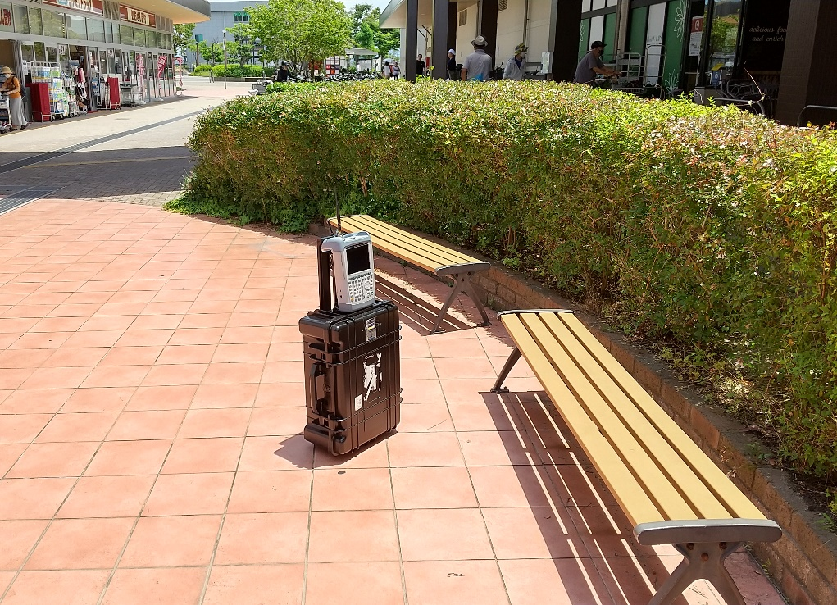
Measurement location (3)
Near by shopping center
We conducted measurement near by a shopping center in a suburban area.
This shopping center is near by a residential area.
Residential area
Measurement point

Slide 10
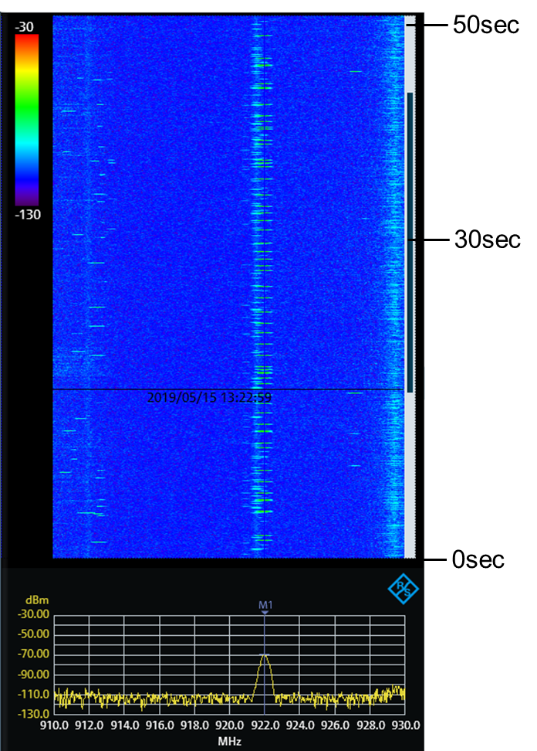
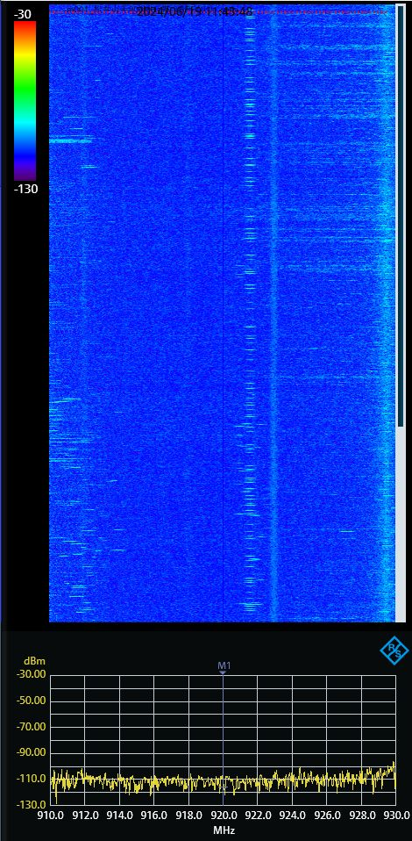
Measurement results near by shopping center
Channel is used by a narrow-band system at 922 MHz.
Even though near by a residential area, the channel use by smart meters is not found, different from [3]. This is because they mainly use the 2.4 GHz band in Kansai area.
There are regional trends of radio use even in the same country.
In 2019 (w/o BPF).
In 2024 (w/o BPF).

Slide 11
Summary
This contribution showed the new measurement results, and compares the radio use in the 920 MHz band in Kansai area of Japan between in 2019 and in 2024.
  Two railway terminal stations (Stations A and B).
  Near by a shopping center in a suburban area.
At Station A, multiple continuous signals were measured as in 2019.
At Station B, it was confirmed that several wireless systems using a charp-like signal, a signal with 4 MHz bandwidth, and a narrow-band signal coexist.
Near by a residential area, radio use by smart mater was not found, different from Tokyo area. There are regional trends of radio use even in the same country.

Slide 12
References
[1] “Measurement of Radio Noise and Interference over 920 MHz band in Japan,” IEEE 802.19-19/0043r1.
[2] “Measurement of Radio Noise and Interference over 920 MHz band in Japan (II),” IEEE 802.19-19/0060r2.
[3] “Update of 920MHz band Radio Environment in the Tokyo Area,” IEEE 802.19-24/0019r0.

