Slide 1
Simulation Parameter Update for S1G Bands OFDM systems
Date: 2024-05-16
Authors:
Notice: This document has been prepared to assist IEEE 802.19. It is offered as a basis for discussion and is not binding on the contributing individual(s) or organization(s). The material in this document is subject to change in form and content after further study. The contributor(s) reserve(s) the right to add, amend or withdraw material contained herein.

Slide 2
Summary
Simulation parameters for S1G Bands OFDM systems evaluation to compare IEEE 802.19.3 simulation results based on IEEE 802.15.4g FSK PHY and IEEE 802.11ah 1MHz channel (doc.: IEEE 802.19-19/0019) with IEEE 802.19.3a simulations based on IEEE 802.15.4g OFDM PHY and IEEE 802.11ah 4MHz channel.
New simulation parameters considers smart utility use cases of coexistence IEEE 802.15.4g-OFDM PHY and IEEE 802.11ah (4MHz BW)
This document gathers relevant material from 19-19/0019r1, 19-18/0056r3, 19-18/0039r1 and 19-19/0021r2.

Slide 3
Background: S1G Coexistence Simulations in TG3
Developed the coexistence simulator based on NS-3.23, which support IEEE 802.15.4g-FSK (400 KHz bandwidth) and IEEE 802.11ah (1 MHz bandwidth) for IEEE 802.19.3.
Simulation parameters and simulator deployment were discussed in TG3, and simulation results were also shared.
  19-19/0019r1, 19-18/0056r3, 19-18/0039r1 and 19-19/0019r2
Simulation Model by NS-3

Slide 4
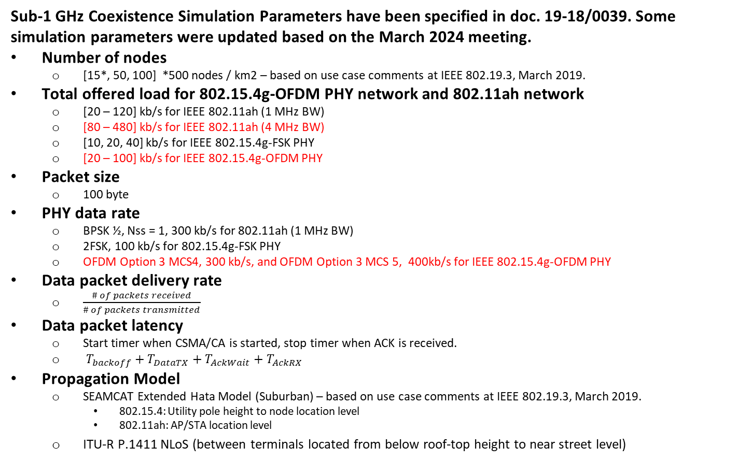
Simulation Parameters and Performance Metrics
Sub-1 GHz Coexistence Simulation Parameters have been specified in doc. 19-18/0039. Some simulation parameters were updated based on the March 2024 meeting.
Number of nodes
  [15*, 50, 100] *500 nodes / km2 – based on use case comments at IEEE 802.19.3, March 2019.
Total offered load for 802.15.4g-OFDM PHY network and 802.11ah network
  [20 – 120] kb/s for IEEE 802.11ah (1 MHz BW)
  [80 – 480] kb/s for IEEE 802.11ah (4 MHz BW)
  [10, 20, 40] kb/s for IEEE 802.15.4g-FSK PHY
  [20 – 100] kb/s for IEEE 802.15.4g-OFDM PHY
Packet size
  100 byte
PHY data rate
  BPSK ½, Nss = 1, 300 kb/s for 802.11ah (1 MHz BW)
  2FSK, 100 kb/s for 802.15.4g-FSK PHY
  OFDM Option 3 MCS4, 300 kb/s, and OFDM Option 3 MCS 5, 400kb/s for IEEE 802.15.4g-OFDM PHY
Data packet delivery rate
  $\frac{\# of packets received}{\# of packets transmitted}$
Data packet latency
  Start timer when CSMA/CA is started, stop timer when ACK is received.
  $T_{backoff}+T_{DataTX}+T_{AckWait}+T_{AckRX}$
Propagation Model
  SEAMCAT Extended Hata Model (Suburban) – based on use case comments at IEEE 802.19.3, March 2019.
    802.15.4: Utility pole height to node location level
    802.11ah: AP/STA location level
  ITU-R P.1411 NLoS (between terminals located from below roof-top height to near street level)

Slide 5
Node Deployment : 15 nodes (500 nodes/km2)*
802.11ah (AP/STA) #1
802.11ah (AP/STA) #2
802.11ah (AP/STA) #3
802.15.4g (PANC)
*
802.15.4g (NODE)
*Same condition discussed in TG3

Slide 6
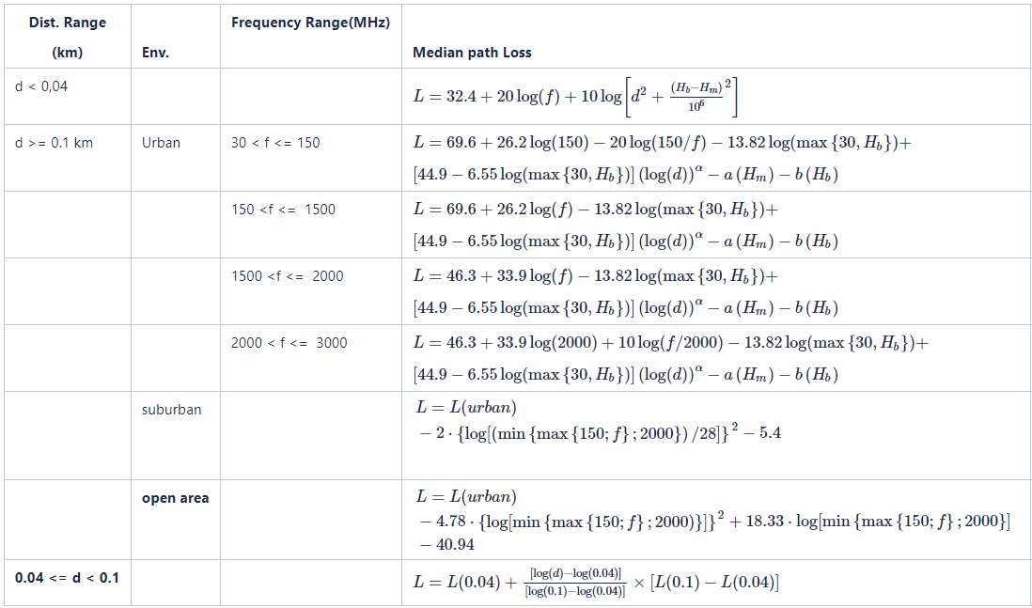

Propagation Model*
In consideration of device location, SEAMCAT Extended Hata Model (Suburban) was also added for simulation.
Device location
  802.15.4: Utility pole height to node location level
  802.11ah: AP/STA location level
SEAMCAT Extended Hata Model
ITU-R P.1411
Models for propagation between terminals located from below roof-top height to near street level
*Same condition discussed in TG3

Slide 7
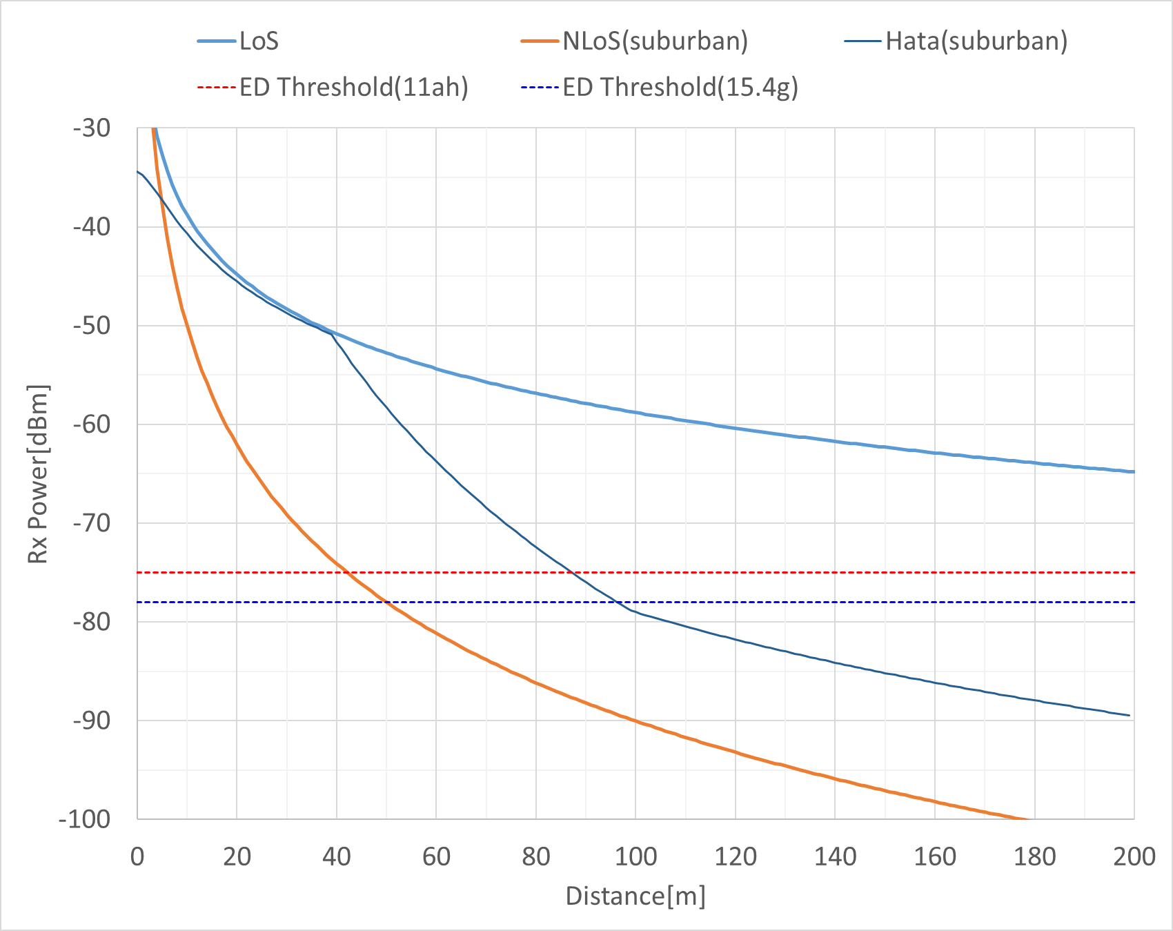
Propagation Model*
SEAMCAT Extended Hata Model (Suburban)
802.15.4g
*Same condition discussed in TG3

Slide 8
Simulation Matrix for TG3 and TG3a
4 types of PHY combination are possible.
Starting implementation in the following order to show simulation results in July or September meeting.
 | IEEE 802.11ah (1 MHz) | IEEE 802.11ah (4 MHz)
IEEE 802.15.4g-FSK PHY | ✓ (TG3) | (2)
IEEE 802.15.4g-OFDM PHY | (1) | (3)

Slide 9
Summary
Updated simulation parameters for coexistence evaluation between IEEE 802.15.4g-OFDM PHY and IEEE 802.11ah (4 MHz bandwidth) in consideration with past simulation parameters discussed in IEEE 802.19.3.
After feedbacks for simulation parameters, we would like to perform network simulation using the developed NS-3 simulator.

