Slide 1
Interference Spectrum Measurements
Date: 2024-05-13
Authors:
Notice: This document has been prepared to assist IEEE 802.19. It is offered as a basis for discussion and is not binding on the contributing individual(s) or organization(s). The material in this document is subject to change in form and content after further study. The contributor(s) reserve(s) the right to add, amend or withdraw material contained herein.

Slide 2
Abstract
This presentation show a way to measure interference in license-exempt bands
Spectrum measurements are encouraged to improve existing interference models
Further, a live demo show the spectral use in Warsaw

Slide 3
Measurement System Block Diagram
A low-loss filter (e.g. cavity filter) is required especially for US frequency bands (cellular bands in close proximity)
Complete frequency band is digitizes using SDR Device (e.g. with 10 Msamples/s) and stored to a hard disc (typical rates are 40 Mbyte/s)
SDR device has to offer sufficient resolution (e.g. 14 bit)
Automatic gain control should not be used

Slide 4
Example of Measurements
0 dBd measurement antenna located next to the window in the 9th floor or the Hyatt in Buckhead, view towards downtown Atlanta
A SAW filter (924.5 MHz, 5 MHz bandwidth, ~2 dB attenuation) below the antenna avoid non-linear effects of the pre-amplifiers (very strong cellular and broadcast signals)
Metallized window may reduce RX level by 30 dB
SAW-Filter

Slide 5
Exemplary SDR Frontend
An RSPduo Software-Defined Radio Frontend (~250$) equipped sampled the band width 14 bit A/D resolution and 10MS/s
The bandwidth for the later plot is limited to 5 MHz (SAW filter bandwidth of 5 MHz)
Levels are not calibrated yet

Slide 6
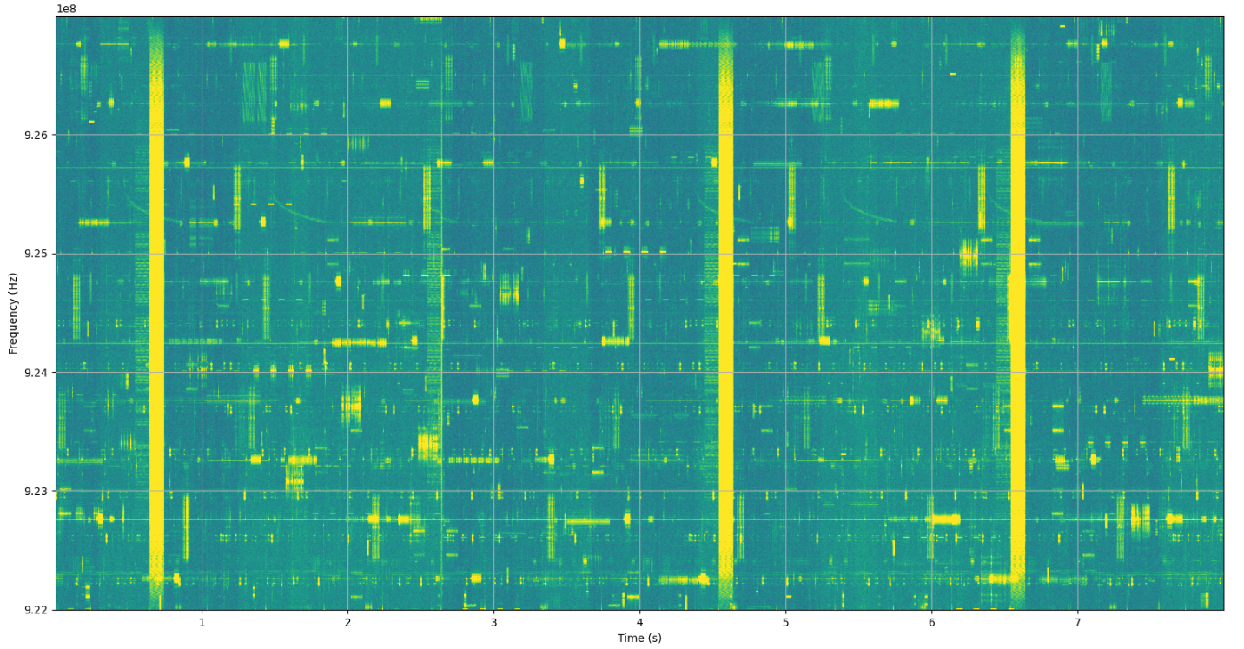
Example of Measured Spectrogram (922 … 927 MHz, length 8s)

Slide 7
Intension of Spectrum Measurements
Calibration of interference models for different environments
Example of such model: J. Robert, S. Rauh, H. Lieske and A. Heuberger, "IEEE 802.15 Low Power Wide Area Network (LPWAN) PHY Interference Model," 2018 IEEE International Conference on Communications (ICC), Kansas City, MO, USA, 2018
The different access patterns for the model are obtained by image analyses

Slide 8
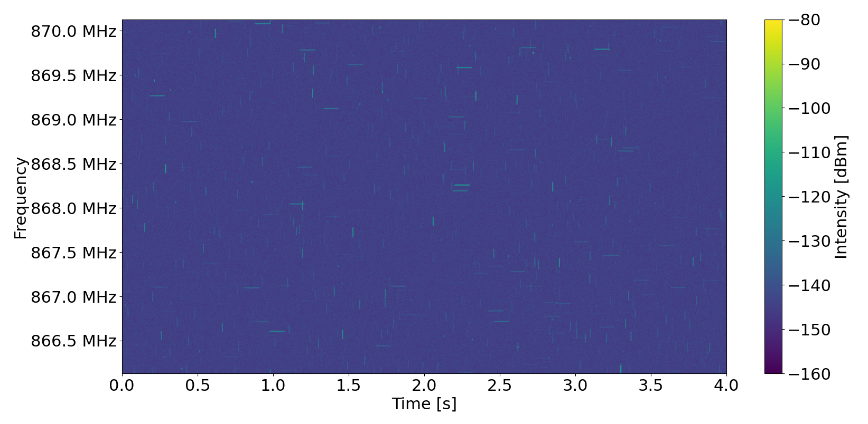
Example of Simulated Interference
Example of data generated by the interference model
Antenna 140m
1 active device in an area of 1km² per second per MHz

Slide 9
Demo of Measurements

Slide 10
Thank You!
Time for some demonstrations.

