Slide 1
920 MHz Regulation Update in Japan
Date: 2024-01-15
Authors:
Notice: This document has been prepared to assist IEEE 802.19. It is offered as a basis for discussion and is not binding on the contributing individual(s) or organization(s). The material in this document is subject to change in form and content after further study. The contributor(s) reserve(s) the right to add, amend or withdraw material contained herein.

Slide 2
Abstract
Share the new 920MHz regulation (Issued: Sep. 2022) [5][6] status in Japan towards Recommended Practice in IEEE 802.19.3a
This document gathers relevant material from 19-18/0053r0, 19-18/0084r0 and 19-19/0018.

Slide 3
Channelization in Japan
Several wireless systems operate on same frequency band which were standardized as ARIB STD-T106, T107 and T108
ARIB STD-T108 (20mW) on 920.5 ~ 928.1MHz (7.6MHz) includes 802.15.4g system, but coexistence operation with Passive System (250mW) and STD-T108 (250mW) is required for 920.5 ~ 923.5MHz (3.0MHz). So, 923.5 ~ 928.1MHz (4.6MHz) is only channels
Coexistence Operation
Passive System (RFID, etc)
①
1W ARIB STD-T106 Licensed/Registered
②
250mW ARIB STD-T107 Unlicensed
MCA
916.0
919.2
920.6
923.4
928.0
929.65
MHz
③
1mW ARIB STD-T108 Unlicensed
④
20mW ARIB STD-T108 Unlicensed
⑤
250mW ARIB STD-T108 Licensed/Registered
IEEE802.15.4g, etc
Active System (LPWA, 802.15.4g, etc)
Ch: 200KHz
Channels for sensor networks
Ch: 100KHz
MCA: Multi-Channel Access Radio System

Slide 4
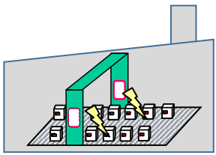
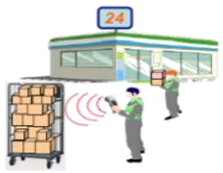

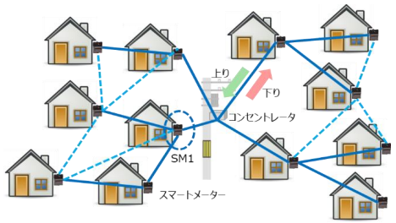
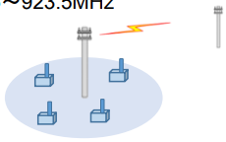
Current Use Cases
[1][2][3]
Current use cases in the market for each wireless system^{*1}.
Specified Low-Power Radio Station use case is the most likely one to require 802.15.4g and 802.11ah^{*2} coexistence measures
① Indoor Radio Station
(Licensed/Registered, Passive System)
Tx Power: 1W
Frequency: 916.7~920.9MHz
Use Cases: RFID for Logistics Management, etc
ARIB STD-T106
② Specified Low-Power Radio Station (Unlicensed, Passive System)
Tx Power: 250mW
Frequency: 916.7~923.5MHz
Use Cases: RFID for inside/outside
ARIB STD-T107
③ Specified Low-Power Radio Station
(Unlicensed, Active System)
Tx Power: 1mW
Frequency: 915.9 ~ 929.7MHz
Use Cases: Home Security, Remote Control
ARIB STD-T108
④ Specified Low-Power Radio Station
(Unlicensed, Active System)
Tx Power: 20mW
Frequency: 920.5 ~ 928.1MHz
Use Cases: Smart Mater (Electric, Gas, Water), etc
ARIB STD-T108
⑤ Land Mobile Station
(Licensed/Registered, Active System)
Tx Power: 250mW
Frequency: 920.5 ~ 923.5MHz
Use Cases: LPWA for sensors (forest, bridge, etc)
ARIB STD-T108
*1: MIC is going to deregulate the current standard to meet the future use cases (Inside/Outside, Tx Time, Duty Cycle, etc)[3]
*2: IEEE 802.11ah is not specified on ARIB STD-T108 at this moment [2]

Slide 5
ARIB STD-T108 (20mW)
[3][4]
Specified Low-Power Radio Station (Unlicensed, Active System)*
Item |  | Parameters and functionality
Frequency Band |  | 920.5MHz ~ 928.1MHz (7.6MHz) 920.5 ~ 923.5 MHz (3.0MHz) --- Coexistence with others 923.5 ~ 928.1 MHz (4.6MHz) --- Channel for STD-T108
Channel bandwidth |  | 200KHz
Maximum aggregated channels |  | 5 CHs (1MHz) → 920.5 – 923.5 MHz: 15 CHs (4MHz) with CS and Duty Cycle rule [5][6] 920.5 – 928.1 MHz: 20 CHs (4MHz) with CS and Duty Cycle rule [5][6]
Transmission Power |  | 20mW (13dBm)
Transmission method | Contents | Data signal
 | Modulation | Not specified
Antenna Gain |  | 3dBi or less (absolute gain). However, in case EIRP is less than the value of 3dBi plus 1mW or 20mW of antenna power, it is allowed to fill in the gap by the antenna gain
Carrier Sense (CS) and Duty Cycle | CS ≧ 5msec, 920.5 ~ 923.4 MHz | Tx Time ≦ 4sec, Wait ≧ 50ms
 | 5msec > CS ≧ 128us 920.5 ~ 928.1 MHz | Tx Time ≦ 400ms, Wait ≧ 2ms, Total Tx Time ≦ 360s/h/station
Note |  | Refer IEEE 802.15.4g for PHY parameters
*: MIC is going to deregulate the current standard to meet the future use cases [3]
[5][6] define new channel bandwidth up to 4 MHz which issued in Sep. 2022.

Slide 6
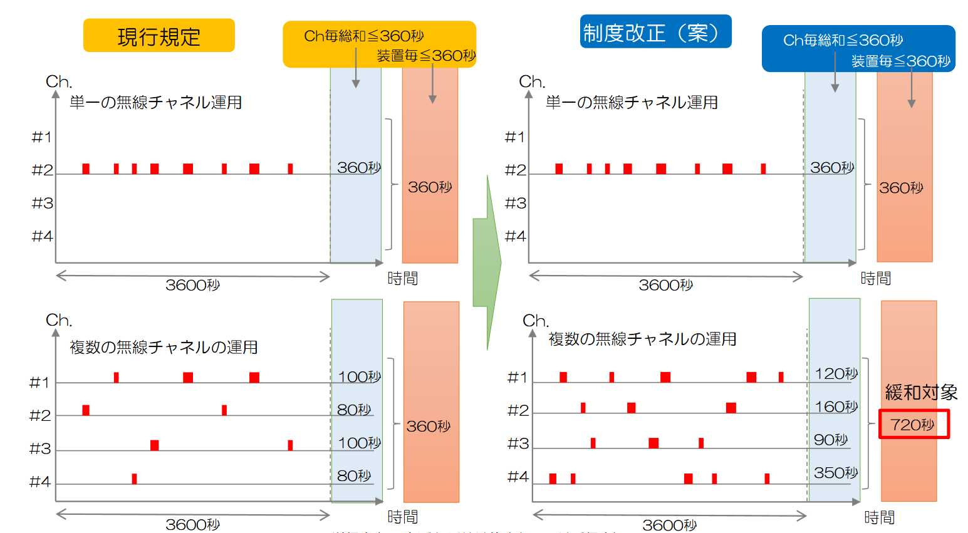
Duty Cycle for Active System
[3]
Each specified low-power radio station can transmit radio signal for at most 360 seconds/hour in the current 920MHz regulation.
MIC (Ministry of Internal Affairs and Communications) is considering relaxing the current duty cycle regulation:
  When a specified low-power radio station use multiple channels in time division,
  duty cycle is 720 seconds/hour.
  Duty cycle of each channel is 360 seconds/hour/station.
Current regulation
Total Tx Time ≦ 360sec.
Per station ≦ 360sec.
Deregulation of Duty Cycle
Total Tx Time ≦ 360sec.
Per station ≦ 360sec.
Using single channel
Using single channel
360sec.
360sec.
360sec.
360sec.
3600 seconds
Time
3600 seconds
Time
Using multiple channels
100sec.
Using multiple channels
120sec.
80
360sec.
160
720
sec.
100
90
80
350
3600 seconds
Time
3600 seconds
Time

Slide 7
Summary
802.15.4g specified on ARIB STD-T108 (20mW) can operate on
  920.5 ~ 928.1MHz (7.6MHz) , but
    920.5 ~ 923.5MHz (3.0MHz) --- Coex. with Passive Systems and LPWA
    923.5 ~ 928.1MHz (4.6MHz) --- Channel for sensor nets
MIC had extended the maximum channel numbers from 5 CHs (1MHz) to 20 CHs (4MHz) to support IEEE 802.11ah in 2022
We would like the IEEE 802.19.3a to consider coexistence between 802.15.4g and 802.11ah under the conditions and operational constraints noted above on Recommended Practice.

Slide 8
References
MIC, http://www.soumu.go.jp/main_content/000544861.pdf, 2018/04/10
MIC, http://www.soumu.go.jp/main_content/000550848.pdf, 2018/05/14
MIC, http://www.soumu.go.jp/main_content/000551143.pdf, 2018/05/15
https://www.arib.or.jp/english/html/overview/doc/5-STD-T108v1_0-E1.pdf
MIC, https://www.soumu.go.jp/main_content/000833183.pdf
MIC, https://www.soumu.go.jp/main_content/000833184.pdf
MIC (Ministry of Internal Affairs and Communications)

