Slide 1
July 2023 WG Opening Report
Date: 2023-09-07
Authors:
Name | Affiliations | email
Takenori Sumi, Philip Orlik, Jianlin Guo, Yukimasa Nagai, Kieran Parsons, Perry Wang, Benjamin Rolfe | Mitsubishi Electric | Ben.Rolfe@ieee.org
Notice: This document has been prepared to assist IEEE 802.19. It is offered as a basis for discussion and is not binding on the contributing individual(s) or organization(s). The material in this document is subject to change in form and content after further study. The contributor(s) reserve(s) the right to add, amend or withdraw material contained herein.

Slide 2
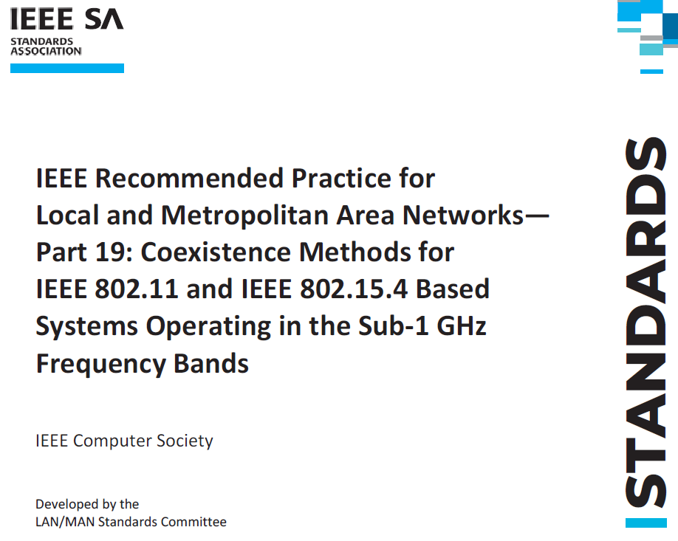
Purpose
Review some things that have changed
Consider the need to update 802.19.3

Slide 3
Summary
Changes in the markets and rules in Japan have occurred since 2019
The needs of next generation metering systems have evolved
Some issues are unique to Japanese Sub-1 GHz frequency regulations while others may be more general
Activity in 802.15 has resulted in changes to 802.15.4 Channel Access options to address new requirements for metering systems in Japan
802.11-S1G (802.11ah) and 802.15.4-S1G (802.15.4g) coexistence continues to increase in importance
Updates to 802.19.3 will promote good coexistence

Slide 4
Background of Japanese Utility Systems
Japanese utility systems operate in Sub-1 GHz frequency band
More specifically in 920 MHz band with limited frequency bandwidth
Japanese electric utilities are now updating their 1st generation smart metering infrastructure
New requirements are coming to light
  Meter reporting duty cycles are expected to decrease from 30 minutes to 5 minutes (At least a 6x increase in data volume)
  Likely need for multi-metering functionality on single radio
  Over-the-air (OTA) firmware/software capability are needed
This means more data traffic and more channel access

Slide 5
Challenges in Japanese Utility Systems
In Japan, Sub-1 GHz spectrum is scarce
  At most 2.9 MHz* is optimized for metering applications using CSMA
  leads to congestion and interference issues as more devices with different protocols exists in narrower bandwidth
Channel access has been enhanced in IEEE Std 802.15.4 to better support utility applications in Japan by adding flexibility and alternate backoff procedure
Propose to update 802.19.3 to provide recommendations on using the new flexibility

Slide 6
Recommendations
While evaluating channel access changes determined that performance enhancement
  See for example https://mentor.ieee.org/802.15/dcn/23/15-23-0268-00-js1g-simulation-update-about-csma-gap-between-ieee-802-15-4-and-japanese-utility-standard-jj-300.pptx For technical background and simulation results
New features will change how 802.15.4 and 802.11 S1G systems interact
  Backoff suspension option has been added to 802.15.4 CSMA (included in the current revision that is underway)
  Backoff suspension feature will allow 802.15.4 systems to better coexist with other systems such as 802.11 systems.
  802.15.4 coexistence methods that are based on backoff suspension should be incorporated into 802.19.3 standard

Slide 7
Recommendation and Request
Request 802.19 WG Chair request 802 EC form a study group to consider amendment to 802.19.3

