Slide 1
The CSMA Gap Analysis Between IEEE STD 802.15.4 and Japanese Standard JJ-300.10
Date: 2023-03-13
Authors:
Notice: This document has been prepared to assist IEEE 802.19. It is offered as a basis for discussion and is not binding on the contributing individual(s) or organization(s). The material in this document is subject to change in form and content after further study. The contributor(s) reserve(s) the right to add, amend or withdraw material contained herein.

Slide 2
Abstract
This document describes the CSMA gap (or difference) between IEEE STD 802.15.4 and Japanese Standard JJ-300.10
It also discusses issues unique to Japanese Sub-1 GHz frequency regulations and existing metering systems
Purpose of this document is to discuss concerns about the ability of existing 802.15.4 standards to support the expected metering application needs in Japan’s Sub-1 GHz frequency bands and congested situation

Slide 3
Background of Japanese Utility Systems
Japanese utility systems operate in Sub-1 GHz frequency band
  More specifically in 920 MHz band, and limited frequency bandwidth
Japanese electric utilities are now updating their 1st generation smart metering infrastructure
New requirements are coming to light
  Meter reporting duty cycles are expected to decrease from 30 minutes to 5 minutes
    At least a 6x increase in throughput will be needed, latency reduced by factor of 6 as well
  Likely need for multi-metering functionality on single radio
  Over-the-air (OTA) firmware/software capability are needed
This means more data traffic and more channel access

Slide 4
Background of IEEE 802 Sub-1 GHz Band Standardization
Sub-1 GHz standard development continue to grow
  802.15.4g, 802.11ah, 802.19.3, …
802.11 WG is working on the enhancement of Sub-1 GHz band operations
  802.11ah was developed based on 802.11ac
  Newer PHYs have been introduced since, e.g., 1024 QAM was added in IEEE 802.11ax
  Newer PHYs have introduced functionality that would be beneficial to Sub 1 GHz operation, e.g., to improve throughput
Again, this means more data traffic and more channel access

Slide 5
Issues in Japanese Utility Systems
Japanese utility systems support ECHONET protocols, which are based on a Japanese communication standard JJ-300.10
  CSMA/CA in JJ-300.10 is different from CSMA/CA in 802.15.4
In Japan, Sub-1 GHz spectrum is scarce
  At most 2.9 MHz* is optimized for metering applications using CSMA
  leads to congestion and interference issues as more devices with different protocols exists in narrower bandwidth
  See IEEE802.19.3 for issues arising from limited spectrum availability and protocol differences among 802.15.4g and 802.11ah
For 802.15.4 to better support utility applications in Japan, more enhancements are needed
  Consider the support for JJ-300.10
  Coexistence with more aggressive channel access protocols such as 802.11
In addition, 802.15.4 needs to take advantage of devices without power constraints such as grid powered smart meters
* See pg. 113: 920MHz-BAND TELEMETER, TELECONTROL AND DATA TRANSMISSION RADIO EQUIPMENT ARIB STANDARD

Slide 6
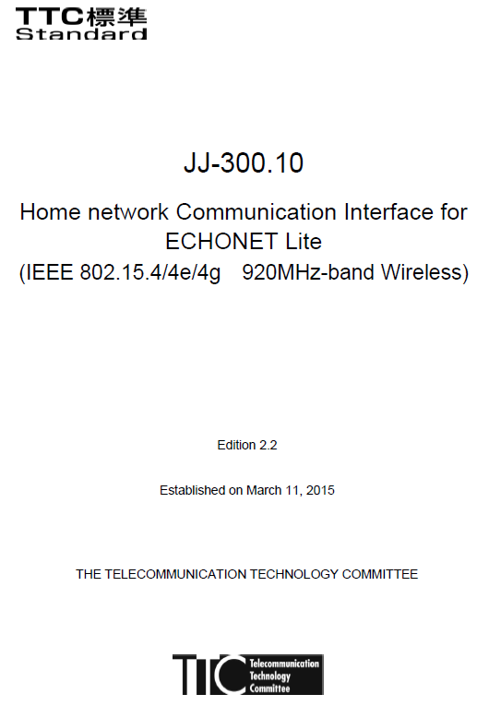
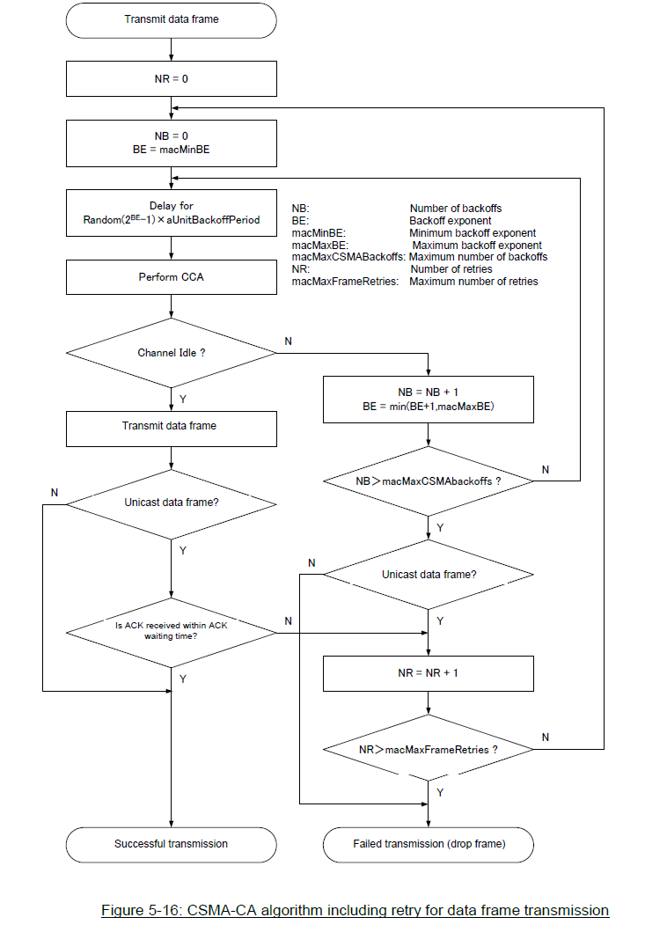
CSMA/CA in JJ-300.10
Includes Number of Retries
Key differences reside inside of this box
Distinguishes unicast and multicast

Slide 7
CSMA Differences Between JJ-300.10 and 802.15.4
802.15.4-2011
JJ-300.10 CSMA/CA differences
  Consider non-slotted scenario
  Consider data frame
  Incorporate number of retries (NR)
  Distinguish unicast and multicast
  Wait for LIFS time before backoff starts
  Backoff suspension
Differences 1-2 make JJ-300.10 a special case of 802.15.4
Differences 3-4 provide more details
However, differences 5-6 make JJ-300.10 channel access different from 802.15.4

Slide 8
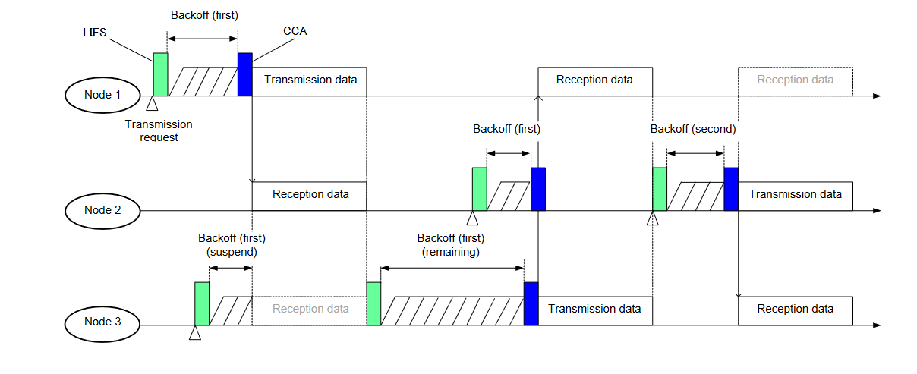
CSMA Differences Between JJ-300.10 and 802.15.4
JJ-300.10 backoff operation specified in Figure 5-17
Expected impact of wait
  Increase latency due to the delayed backoff start
Expected impact of backoff suspension
  Improve packet delivery reliability due to less frame drop caused by backoff failure
  Increase latency due to longer backoff time
  Reduce number of backoffs
    JJ-300.10 performs re-backoff only if busy channel starts in CCA period
    802.15.4 performs re-backoff if channel is busy in CCA period
Wait
Backoff suspension

Slide 9
Re-Backoff Difference Between JJ-300.10 and 802.15.4
Scenario-1:Other TX starts before CCA
Other devices
TX
TX request
Time
∇
802.15.4 backoff
Backoff
CCA
Re-Backoff
Time
TX request
∇
JJ-300.10 backoff
LIFS
Backoff
Suspension
LIFS
Backoff
CCA
TX
Time
Scenario-2: Other TX starts during CCA
Time
Other devices
TX
TX request
Time
∇
802.15.4 backoff
Backoff
CCA
Re-Backoff
Time
TX request
∇
JJ-300.10 backoff
LIFS
Backoff
CCA
Re-Backoff
Time

Slide 10
Simulation Parameters
Parameter | Value | Note
Nodes | 10 – 100
Offered load(Network)[kbps] | 10, 20, 30 , 40, 50
Packet size[Byte] | 100 | MAC payload
MAC parameters (JJ 300.10 v2.2, Table 5-28, 5-29)
LIFS[us] | 1000
phyCCADuration[us] | 130
aTurnaroundTime[us] | 1000
aUnitBackoffPeriod[us] | 1130
Rx-to-Tx Turnaround time[us] | 300 | 300 us or more, 1000 us or less
Tx-to-Rx Turnaround time[us] | 300 | Less than 300 us
macMaxBE | 8
macMinBE | 8
macMaxCsmaBackoffs | 4
macMaxFrameRetries | 3

Slide 11
Illustration of 20 Node Deployment
PANC was placed at the center of a 100 m circle.
Each node was placed using the sunflower algorithm.
Each node sends packets to PANC.

Slide 12
Simulation Results (Packet delivery rate)
JJ-300.10
Standard CSMA/CA
 | Offered load[kbps]
Nodes | 10 | 20 | 30 | 40 | 50
10 | 0.999679 | 0.999679 | 0.990308 | 0.759237 | 0.606747
20 | 0.999679 | 0.999599 | 0.998691 | 0.95008 | 0.773403
30 | 0.999759 | 0.999719 | 0.999679 | 0.999398 | 0.931797
40 | 1 | 0.999639 | 0.999732 | 0.999297 | 0.987357
50 | 0.999839 | 0.999839 | 0.999839 | 0.999257 | 0.995454
60 | 0.999759 | 0.99984 | 0.999759 | 0.999338 | 0.997641
70 | 0.999839 | 0.99992 | 0.999679 | 0.999398 | 0.994458
80 | 1 | 0.999679 | 0.999625 | 0.999478 | 0.99698
90 | 0.99992 | 0.999679 | 0.999786 | 0.999619 | 0.99793
100 | 0.999759 | 0.9998 | 0.999733 | 0.999419 | 0.997756
 | Offered load[kbps]
Nodes | 10 | 20 | 30 | 40 | 50
10 | 0.999759 | 0.998474 | 0.965114 | 0.729096 | 0.579261
20 | 0.99984 | 0.998477 | 0.989579 | 0.955691 | 0.804072
30 | 0.999519 | 0.998676 | 0.990746 | 0.958252 | 0.880011
40 | 0.999839 | 0.998474 | 0.990575 | 0.962129 | 0.902296
50 | 0.999679 | 0.998273 | 0.98929 | 0.959699 | 0.89351
60 | 0.999599 | 0.998355 | 0.990424 | 0.957193 | 0.893793
70 | 0.999759 | 0.998755 | 0.98921 | 0.959076 | 0.89688
80 | 1 | 0.998675 | 0.989024 | 0.959516 | 0.896718
90 | 0.999759 | 0.998195 | 0.989568 | 0.957172 | 0.897407
100 | 0.999679 | 0.998597 | 0.98899 | 0.959619 | 0.898301
Difference (JJ-300.10 - Standard)
 | Offered load[kbps]
Nodes | 10 | 20 | 30 | 40 | 50
10 | -8E-05 | 0.001205 | 0.025194 | 0.030141 | 0.027486
20 | -0.00016 | 0.001122 | 0.009112 | -0.00561 | -0.03067
30 | 0.00024 | 0.001043 | 0.008933 | 0.041146 | 0.051786
40 | 0.000161 | 0.001165 | 0.009157 | 0.037168 | 0.085061
50 | 0.00016 | 0.001566 | 0.010549 | 0.039558 | 0.101944
60 | 0.00016 | 0.001485 | 0.009335 | 0.042145 | 0.103848
70 | 8E-05 | 0.001165 | 0.010469 | 0.040322 | 0.097578
80 | 0 | 0.001004 | 0.010601 | 0.039962 | 0.100262
90 | 0.000161 | 0.001484 | 0.010218 | 0.042447 | 0.100523
100 | 8E-05 | 0.001203 | 0.010743 | 0.0398 | 0.099455
(1)
(2)
(3)
(1) Approximately 1% improvement on packet delivery rate when offered load is 30 kbps and 10 - 100 nodes.
(2) Approximately 4% improvement on packet delivery rate when offered load is 40 kbps and 40 – 100 nodes.
(3) Approximately 10% improvement on packet rate when offered load is 50 kbps and 40 -100 nodes.

Slide 13
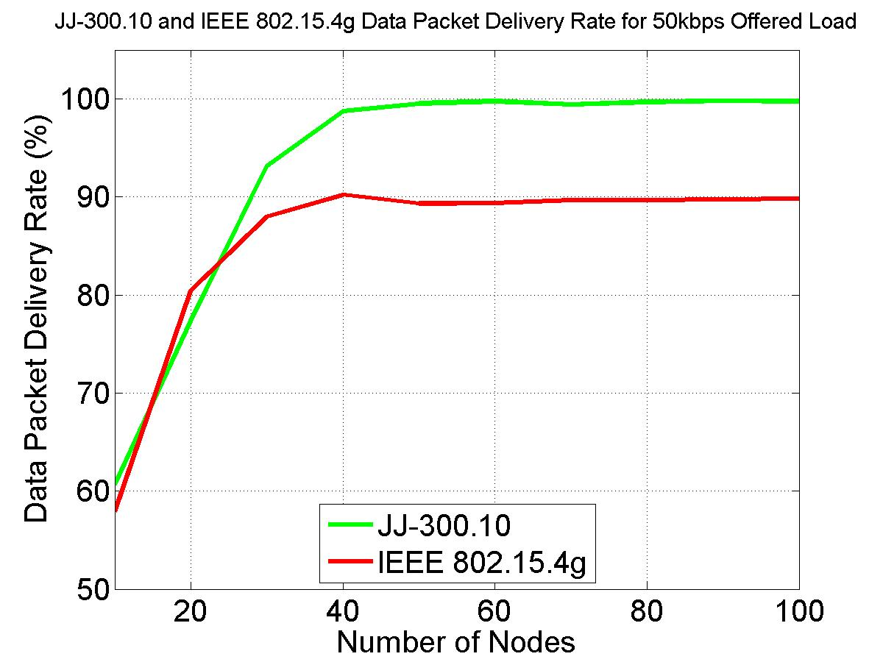
Packet Delivery Rate Curve for 50 kbps Offered Load
Result summary
  For light traffic load, JJ-300.10 and 802.15.4g have similar performance
  For heavier traffic load, JJ-300.10 outperforms 802.15.4g, e.g., 10% improvement for 50 kbps offered load
  When network size (number of nodes) is smaller, each node has higher offered load and so more packets are dropped due to protocol efficiency for both JJ-300.10 and 802.15.4g

Slide 14
Consideration of IEEE 802.15.4 CSMA/CA on Devices without power constraint
Power consumption has been a key consideration in 802.15.4 protocol design
  Battery power devices dominate 802.15.4 market
However, new market sectors are emerging, where power supply is not a constraint
  E.g., grid powered smart meters
  Such devices are typically deployed outdoor and may coexist with other systems such as 802.11, LoRa, SigFox, …
    These coexisting devices are either use aggressive CSMA or Aloha
    Therefore, they can significantly degrade performance of 802.15.4 based systems (see 802.19.3)
Therefore, when power supply is not an issue, 802.15.4 may upgrade its CSMA/CA mechanism to increase channel access opportunity
  Especially while coexisting with other systems and the poor performance present

Slide 15
Consideration of IEEE 802.15.4 CSMA/CA on Devices without power constraint
Perform CCA during backoff can increase channel access probability
…
Other devices
TX
TX
TX
TX
TX
Time
This time period is an opportunity for IEEE 802.15.4 device to transmit
802.15.4 device would TX here
Channel Idle
Transmission request
Had 802.15.4 device continue CCA
∇
…
CCA
TX
802.15.4 device
Backoff
CCA
Backoff
CCA
Backoff
CCA
Backoff
CCA
Time
Channel Busy
Channel Busy
Channel Busy
Channel Busy
802.15.4 NB
…
0
1
2
M
M+1
M = macMaxCSMABackoffs

Slide 16
Summary
This document describes the CSMA gap (or difference) between IEEE STD 802.15.4 and Japanese Standard JJ-300.10.
It provides simulations for the gap analysis.
It aims to discuss concerns about the ability of existing 802.15.4 standards to support the expected metering application needs in Japan’s Sub-1 GHz frequency bands and congested situation.
Comments and feedback from 802.19 WG are welcome!

