Slide 1
July 2022 WG Opening Report
Date: 2022-07-01
Authors:
Name | Affiliations | email
Steve Shellhammer | Qualcomm | shellhammer@ieee.org
Notice: This document has been prepared to assist IEEE 802.19. It is offered as a basis for discussion and is not binding on the contributing individual(s) or organization(s). The material in this document is subject to change in form and content after further study. The contributor(s) reserve(s) the right to add, amend or withdraw material contained herein.

Slide 2
Voter Summary
IEEE 802.19 has 53 voting members

Slide 3
Registration for the July IEEE 802 Plenary Session
This meeting is part of the July IEEE 802 Plenary session
You must pay the registration fee in order to attend
If you have not already done so, you can register at:
http://802world.org/plenary/
If you do not intend to register for this session you must leave this meeting and, if you have logged attendance on IMAT, email the 802.19 chair or vice chair to have your attendance cancelled

Slide 4
IEEE 802 Wireless Standards Table of Frequency Ranges
Comment collection on the Wireless Standards Table of Frequency Ranges document completed in April
12 comments were received
The link to the comment spreadsheet is,
https://mentor.ieee.org/802.18/dcn/22/18-22-0050-00-0000-comment-spreadsheet-of-ieee-802-wireless-standards-table-of-frequency-ranges.xlsx
The Ad Hoc group met in May to start addressing comments. Some tentative resolutions are available in the meeting minutes
https://mentor.ieee.org/802.18/dcn/22/18-22-0057-00-0000-frequency-table-ad-hoc-minutes-24-may-2022.docx
There was no meeting in June due to schedule issues
Comment resolutions will be performed on the Wireless Frequency Table Ad Hoc, which meets on the fourth Tuesday of the month, at 3 PM Eastern Time
Webex info can be found on the 802.18 Calendar

Slide 5
Ballot on 802.11be Coexistence Assessment Document
The 802.19 WG voted on the 802.11be CA document
The ballot closed on June 30
The results were (Y/N/A) = 26/2/0
The document was approved
Nine comments were received, and were forwarded to the 802.11 WG

Slide 6
Discussion on 802.15.4ab and 802.11 Coexistence
There will be a discussion on coexistence between 802.15.4ab and 802.11 during the 802.11 WNG meeting
Tuesday July 12, 7:30 PM (ET)

Slide 7
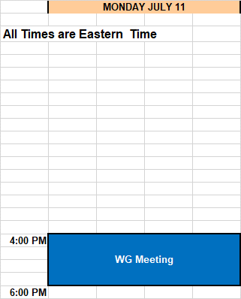
Schedule

