Slide 1
Sub 1 GHz Task Group Agenda and Meeting Slides
Date: 2021-03-09
Authors:
Notice: This document has been prepared to assist IEEE 802.19. It is offered as a basis for discussion and is not binding on the contributing individual(s) or organization(s). The material in this document is subject to change in form and content after further study. The contributor(s) reserve(s) the right to add, amend or withdraw material contained herein.

Slide 2
Sub-1GHz Coexistence Task Group
Recommended Practice for Local and Metropolitan Area Networks - Part 19: Coexistence Methods for 802.11 and 802.15.4 based systems operating in the Sub-1 GHz Frequency Bands
Scope:
This recommended practice provides guidance on the implementation, configuration and commissioning of systems sharing spectrum between IEEE Std 802.11ah-2016 and IEEE Std 802.15.4 Smart Utility Networking (SUN) Frequency Shift Keying (FSK) Physical Layer (PHY) operating in Sub-1 GHz frequency bands.

Slide 3
Meeting Objectives
Address any comments from RevCom (if any comments are received)

Slide 4
Agenda
March 9 2021 (18:00 ET)
Call to order
Meeting preamble
Review and resolve RevCom comments
Recess
March 10 2021 (10:00 ET)
Call to order
Continue to resolve RevCom comments
Review next steps
Any other business.
Adjourn

Slide 5
Recap:
SA Ballot:
The Second SA Recirculation Ballot on IEEE 802.19.3 closed on January 5
Approve = 59, Disapprove = 1, Abstain = 3
Approval Rate = 98%
Ballot Passed
Submission to RevCom:
Two electronic WG motions were held in January
Approve sending P802.19.3-D08 to RevCom
WG Results (Y/N/A) = 30/0/1
Confirm the CSD
WG Results (Y/N/A) = 28/0/2
On the February 802 Executive Committee call the EC approved sending the draft to RevCom
The draft is on the March 22-26 RevCom agenda

Slide 6
RevCom Comments
No comments received as of 03-March
We have allocated time to resolve comments if any are received
Stay tuned to the reflector for news updates

Slide 7
Next Steps
RevCom approval expected
SASB approval there after (March 28)
Once approved, it goes to IEEE editors for publication
Any support needed by IEEE editors will be provided by TG3 chair and Technical Editor
Publication follows (time depends on IEEE staff workload)

Slide 8
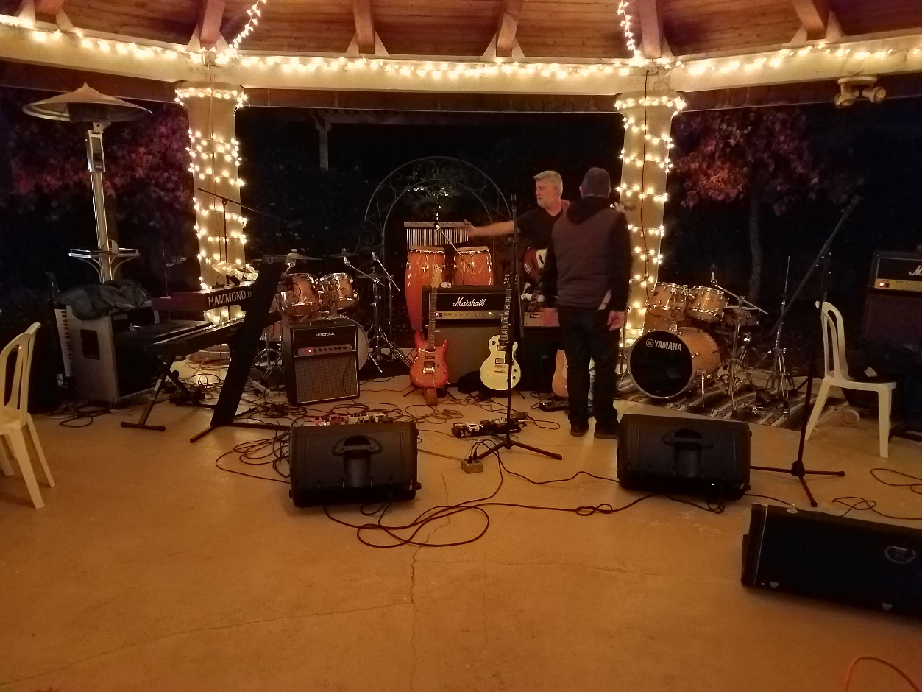
Meeting Adjourned
Celebration!

