Slide 1
March 2021 WG Opening Report
Date: 2021-03-05
Authors:
Notice: This document has been prepared to assist IEEE 802.19. It is offered as a basis for discussion and is not binding on the contributing individual(s) or organization(s). The material in this document is subject to change in form and content after further study. The contributor(s) reserve(s) the right to add, amend or withdraw material contained herein.

Slide 2
Electronic Plenary
Please remember to enter your attendance in IMAT
Attendance does count towards voting rights
Someone who has met the requirements for gaining voting rights will receive voting rights if they record their attendance in at least one 802.19 meeting during the March Electronic Plenary Session

Slide 3
Voter Summary
IEEE 802.19 has 50 voting members

Slide 4
IEEE 802.19.3 SA Ballot
The Second SA Recirculation Ballot on IEEE 802.19.3 closed on January 5
Approve = 59
Disapprove = 1
Abstain = 3
Approval Rate = 98%
Ballot Passed

Slide 5
Submission to RevCom
Two electronic WG motions were held in January
Approve sending P802.19.3-D08 to RevCom
WG Results (Y/N/A) = 30/0/1
Confirm the CSD
WG Results (Y/N/A) = 28/0/2
On the February 802 Executive Committee call the EC approved sending the draft to RevCom
The draft is on the March 22-26 RevCom agenda

Slide 6
CA Documents
There have been no 802.19 ballots on Coexistence Assessment document since the November Plenary session

Slide 7
802 Coexistence Process
The Executive Committee approved the Chair’s Guidelines and the Operations Manual updates that includes the new text on the 802 Coexistence process
The updated Chair’s Guidelines is posted on Mentor
https://mentor.ieee.org/802-ec/dcn/17/ec-17-0120-30-0PNP-ieee-802-lmsc-chairs-guidelines.pdf
The updated Operations Manual has been posted on Mentor
https://mentor.ieee.org/802-ec/dcn/17/ec-17-0090-24-0PNP-ieee-802-lmsc-operations-manual.pdf

Slide 8
IEEE 802 Frequency Tables – Activity
It was suggested by the 802 Chair (Paul N.) that it would be good to have a Table of Frequencies specified for use by IEEE 802 wireless standards
A discussion was held in November at the 802 Executive Committee
https://mentor.ieee.org/802-ec/dcn/20/ec-20-0245-01-00EC-frequency-tables-of-ieee-802-wireless-standards.pptx
It was decided to have a joint activity in 802.18 and 802.19 to develop such a document
Jay Holcomb (802.18 chair) has been hosting these meetings, once a month
Steve Shellhammer has been the 802.19 representative
Anyone who wants to participate please reach out to Jay or Steve

Slide 9
IEEE 802 Frequency Tables – Activity (cont.)
The group is focusing initially on the format of the Frequency Tables
A few presentations have been given and are posted in the 802.18 area on Mentor
https://mentor.ieee.org/802.18/dcn/21/18-21-0005-00-0000-freq-table-802-15-work.xlsx
https://mentor.ieee.org/802.18/dcn/21/18-21-0020-01-0000-proposed-frequency-table-format.pptx
It looks like the initial document will be a Spreadsheet though there have been some discussions of a database
Minutes of the meetings are available also in the 802.18 area on Mentor

Slide 10
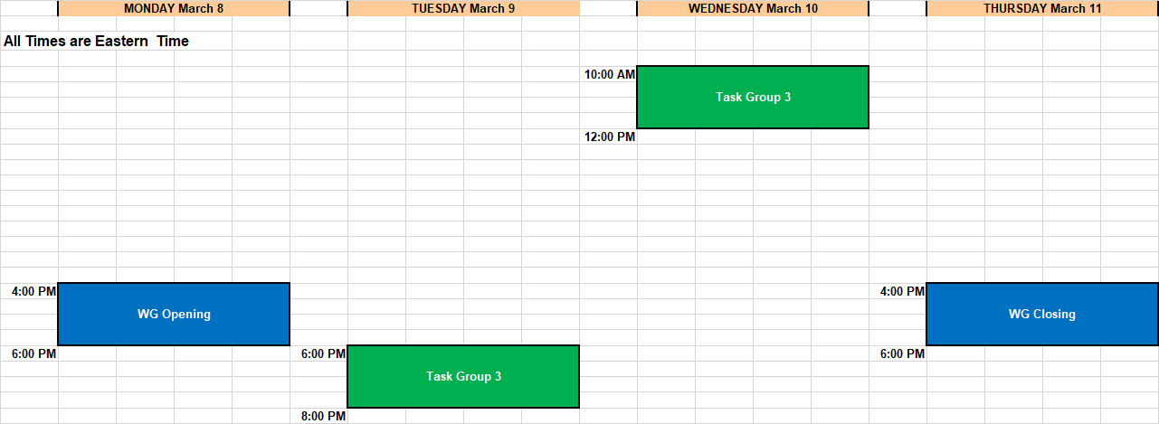
Schedule

