Slide 1
Sub 1 GHz Task Group Closing Report
Date: 2020-11-5
Authors:
Notice: This document has been prepared to assist IEEE 802.19. It is offered as a basis for discussion and is not binding on the contributing individual(s) or organization(s). The material in this document is subject to change in form and content after further study. The contributor(s) reserve(s) the right to add, amend or withdraw material contained herein.

Slide 2
Sub-1GHz Coexistence Task Group
Recommended Practice for Local and Metropolitan Area Networks - Part 19: Coexistence Methods for 802.11 and 802.15.4 based systems operating in the Sub-1 GHz Frequency Bands
Scope:
This recommended practice provides guidance on the implementation, configuration and commissioning of systems sharing spectrum between IEEE Std 802.11ah-2016 and IEEE Std 802.15.4 Smart Utility Networking (SUN) Frequency Shift Keying (FSK) Physical Layer (PHY) operating in Sub-1 GHz frequency bands.

Slide 3
Meeting Objectives
Complete SA ballot comment resolution
Prepare draft for SA recirculation ballot

Slide 4
Comment Status
Proposed Resolutions
Total comments | 88
Accepted | 40
Revised | 40
Rejected | 8
Comment resolutions: Document 19-20-0036r7
https://mentor.ieee.org/802.19/dcn/20/19-20-0036-07-0003-p802-19-3-initial-ballot-comments.xlsx

Slide 5
Task Group Motion
(Tuesday)
Move to accept comment resolutions in document 19-20-0036r07 and direct the technical editor to apply the changes to produce P802.19.3 Draft 07.
Moved by: Jianlin Guo
Second by: Michael Cowan
Discussion: None
Approved by unanimous consent

Slide 6
Task Group Motion
(Wed)
Move to start a Standards Association Recirculation ballot for draft P802-19-3-D07.
Moved by: Jianlin Guo
Second by: Shoichi Kitazawa
Discussion: None
Approved by unanimous consent

Slide 7
Working Group Motion
Move to start a Standards Association Recirculation ballot for draft P802-19-3-D07.
Moved by: Benjamin Rolfe
Second by: Jianlin Guo

Slide 8
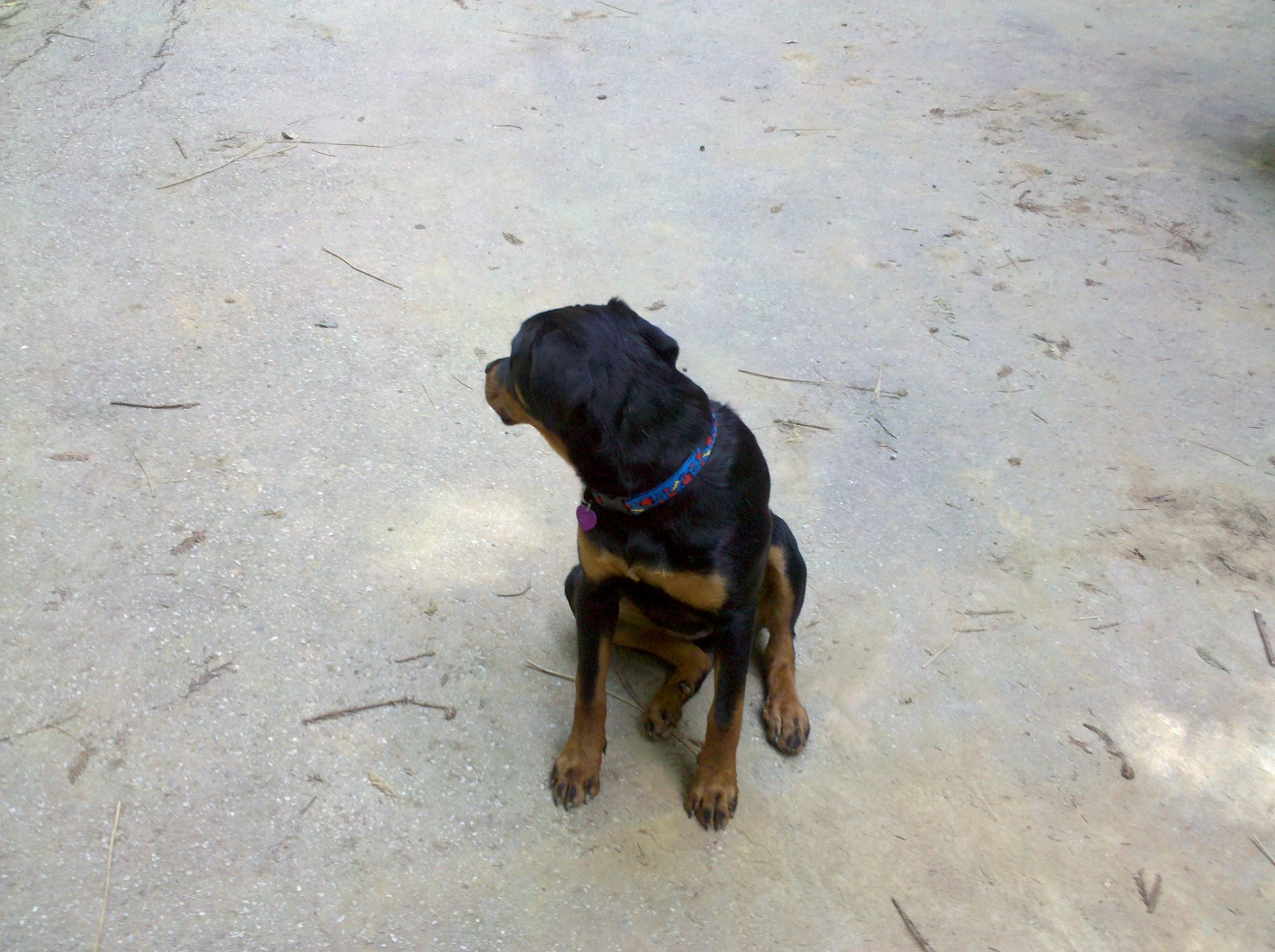
Thank You

