Slide 1
Sub 1 GHz Task Group Opening Report
Date: 2020-10-28
Authors:
Notice: This document has been prepared to assist IEEE 802.19. It is offered as a basis for discussion and is not binding on the contributing individual(s) or organization(s). The material in this document is subject to change in form and content after further study. The contributor(s) reserve(s) the right to add, amend or withdraw material contained herein.

Slide 2
Sub-1GHz Coexistence Task Group
Recommended Practice for Local and Metropolitan Area Networks - Part 19: Coexistence Methods for 802.11 and 802.15.4 based systems operating in the Sub-1 GHz Frequency Bands
Scope:
This recommended practice provides guidance on the implementation, configuration and commissioning of systems sharing spectrum between IEEE Std 802.11ah-2016 and IEEE Std 802.15.4 Smart Utility Networking (SUN) Frequency Shift Keying (FSK) Physical Layer (PHY) operating in Sub-1 GHz frequency bands.

Slide 3
Meeting Objectives
Complete SA ballot comment resolution
Prepare draft for SA recirculation ballot

Slide 4
Agenda
November 3 (18:00 ET)
Call to order
Continue Comment Resolution
Review and Approve comment resolutions
Recess
November 04 (10:00 ET)
Call to order
Draft review
Review next steps
Any other business.
Adjourn

Slide 5
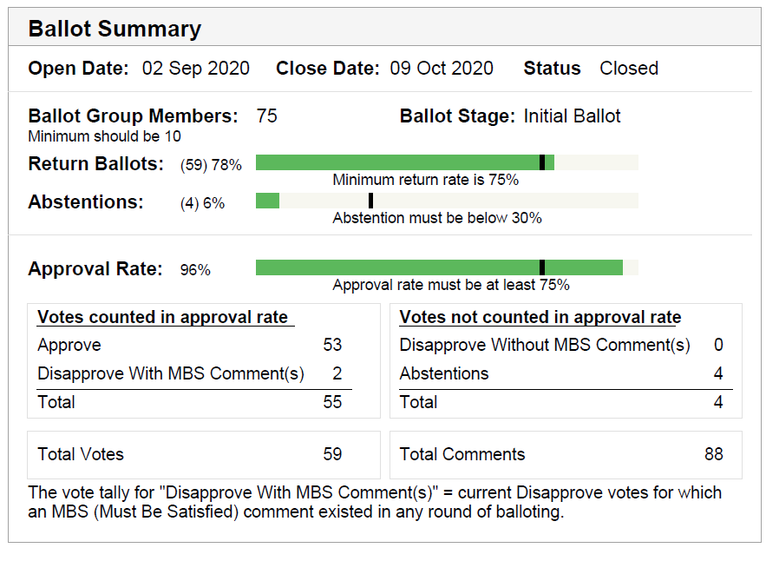
Ballot Results

Slide 6
Comment Summary
Total comments | 88
General | 21
Technical | 20
Editorial | 47
Technical MBS | 11

Slide 7
Comment Status
Proposed Resolutions
Total comments | 88
Assigned: | 88
Accepted | 42
Revised | 38
Rejected | 8
Resolution blank | 0
Proposed comment resolutions:
https://mentor.ieee.org/802.19/dcn/20/19-20-0036-06-0003-p802-19-3-initial-ballot-comments.xlsx

Slide 8
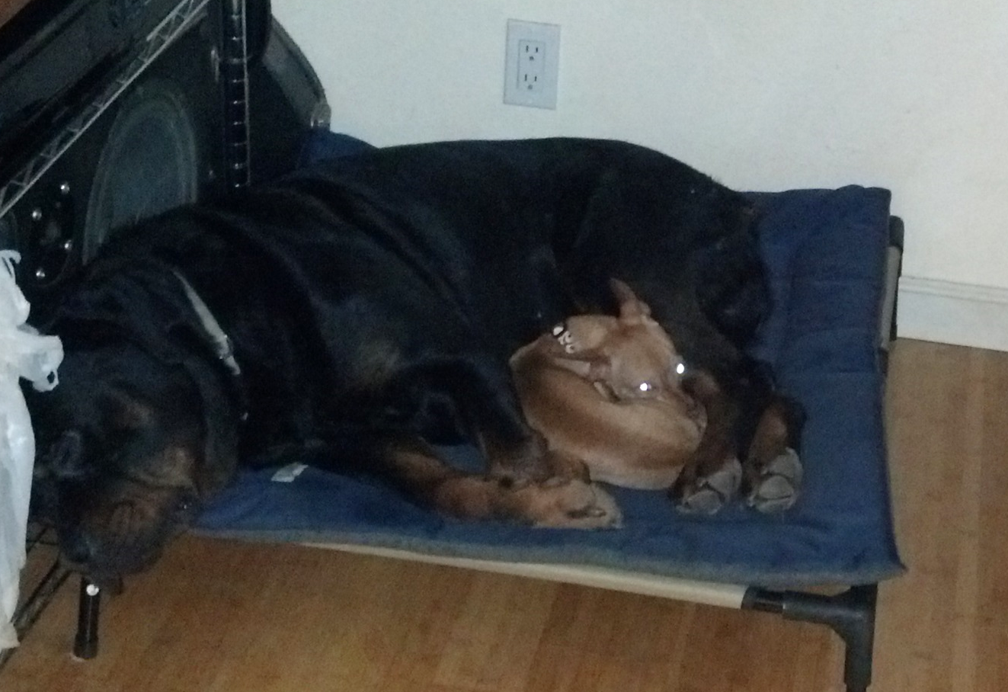
Coexistence Example
Cooperative Coexistence combined with Low Activity Factor

