Slide 1
November 2020 WG Opening Report
Date: 2020-10-26
Authors:
Notice: This document has been prepared to assist IEEE 802.19. It is offered as a basis for discussion and is not binding on the contributing individual(s) or organization(s). The material in this document is subject to change in form and content after further study. The contributor(s) reserve(s) the right to add, amend or withdraw material contained herein.

Slide 2
Electronic Plenary
Please remember to enter your attendance in IMAT
Attendance does count towards voting rights
Someone who has met the requirements for gaining voting rights will receive voting rights if they record their attendance in at least one 802.19 meeting during the November Electronic Plenary Session

Slide 3
Voter Summary
IEEE 802.19 has 51 voting members

Slide 4
TG2 PAR Withdrawal
Given that Task Group 2 has not been making progress toward development of a Draft the working group requested that the Executive Committee request NesCom to withdraw the PAR
PAR withdrawal was approved by Executive Committee on July 7
PAR withdrawal was approved by NesCom in September 2020

Slide 5
IEEE 802.19.3 SA Ballot
The initial SA Ballot on IEEE 820.19.3 closed on Oct 9
Return Rate = 78% (Met the 75% Return Rate)
Approve = 53
Disapprove = 2
Approval Rate = 96% (Met 75% Approval Rate)
Ballot Passed
Number of Comment = 88
Comment Resolution Committee (CRC) is currently working on comment resolution

Slide 6
Electronic Motion
Move that the Working Group approve the formation of a Comment Resolution Committee (CRC) for the Standards Association balloting of P802.19.3 drafts with the following membership:
Yukimasa Nagai (Mitsubishi Electric), Kazuto Yano (ATR), Shoichi Kitazawa (Muroran), Jianlin Guo (MERL), Joerg Robert (FAU), Benjamin Rolfe (BCA) as Chair.
The 802.19.3 CRC is authorized by the Working Group to approve comment resolutions, edit the draft according to the comment resolutions, and to approve the start of recirculation ballot ballots of the revised draft on behalf of the 802.19 WG. Comment resolution on recirculation ballots between sessions will be conducted via reflector email, via teleconferences and face to face meeting(s) announced to the reflector as per the LMSC 802 WG P&P.
Moved by: Ben Rolfe
Second by: Jianlin Guo
Electronic Motion closed on October 22
Results = 29/0/1
Motion Passed

Slide 7
Recommended Text on the 802 Coexistence Process
The Executive Committee approved a rules change based on document “Recommended Changes to the 802 Operations Manual,” doc. IEEE 802.19-19/77r0, on the August EC Conference call
The Executive Committee considered the document “Recommended New Section to the Chairs Guidelines,” doc. IEEE 802.19-19/78r0 on the August EC Conference call, but deferred a decision on that recommendation
It will be considered at the October 29 Rules meeting
11 AM Eastern Time

Slide 8
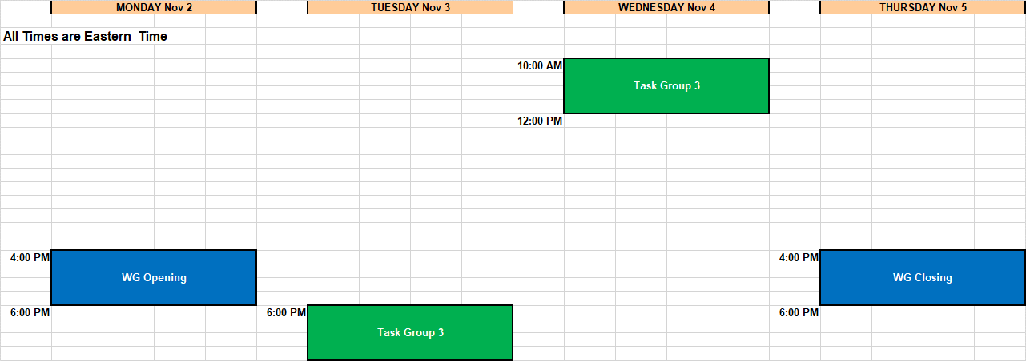
Schedule

