Slide 1
July 2020 Sub 1 GHz Task Group
Date: 2020-07-13
Authors:
Notice: This document has been prepared to assist IEEE 802.19. It is offered as a basis for discussion and is not binding on the contributing individual(s) or organization(s). The material in this document is subject to change in form and content after further study. The contributor(s) reserve(s) the right to add, amend or withdraw material contained herein.

Slide 2
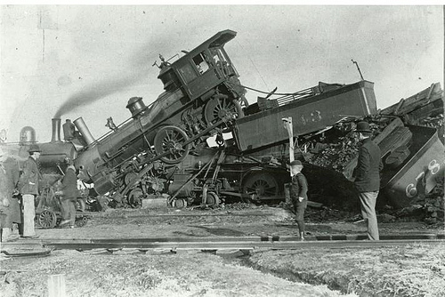
Coexistence: The ability of one system to perform a task in a given shared environment where other systems have an ability to perform their tasks and may or may not be using the same set of rules.
Good Coexistence => rapidly growing opportunity
Poor Coexistence => missed opportunity

Slide 3
Task Group Organization
Chair: Ben Rolfe
Recording secretary: Harry Bims
Vice Chair: Shoichi Kitazawa
Technical Editor: Jianlin Guo

Slide 4
Opening
Review and Approve Agenda
Review Objectives
Plan for the week

Slide 5
Sub-1GHz Coexistence Task Group
Recommended Practice for Local and Metropolitan Area Networks - Part 19: Coexistence Methods for 802.11 and 802.15.4 based systems operating in the Sub-1 GHz Frequency Bands
Scope:
This recommended practice provides guidance on the implementation, configuration and commissioning of systems sharing spectrum between IEEE Std 802.11ah-2016 and IEEE Std 802.15.4 Smart Utility Networking (SUN) Frequency Shift Keying (FSK) Physical Layer (PHY) operating in Sub-1 GHz frequency bands.

Slide 6
Agenda
TG3 Agenda:
https://mentor.ieee.org/802.19/dcn/20/19-20-0026-01-0003-july-agenda-tg3.xlsx
Discussion
Approval of agenda

Slide 7
January Minutes
Minutes from January
Discussion
Approval

Slide 8
Meeting Goals
Any updates on external activities
Working Group Business
Prepare for SA ballot
WG comment resolution
Next steps

Slide 9
Overview and Schedule
January 2019 TG organization and first technical input, outline for RP content, issue Call for Proposals
March 2019 Review contributions and prepare call for proposals
May 2019 Initial call for proposals
July 2019 Hear technical proposals – start drafting process
Sept 2019 more proposals, draft development
Nov 2019 Draft Ready for WG Ballot
Jan 2020 Comment resolution and recirculate draft
March 2020 EC approval for Standards Association Ballot
April 2020 SA Ballot Comment Resolution, Recirculation
May 2020 SA Ballot Comment Resolution
June 2020 Final recirculation(s) (Stable Draft)
July 2020 EC approval to RevCom
COVID Happened

Slide 10
Overview and Schedule
January 2019 TG organization and first technical input, outline for RP content, issue Call for Proposals
March 2019 Review contributions and prepare call for proposals
May 2019 Initial call for proposals
July 2019 Hear technical proposals – start drafting process
Sept 2019 more proposals, draft development
Nov 2019 Draft Ready for WG Ballot
Jan 2020 Comment resolution and recirculate draft
August 2020 EC approval for Standards Association Ballot
Sept 2020 SA Ballot Comment Resolution, Recirculation
October 2020 SA Ballot Recirculation, comment Resolution
November 2020 Final recirculation(s) (Stable Draft)
November 2020 EC approval to RevCom
COVID Happened – No Plenary or Interim March, May but work went on

Slide 11
Draft Development
Review and resolve recirculation ballot comments
Plan SA balloting
Begin WG ballot as soon as practical

