Slide 1
Jan 2020 Sub 1 GHz Task Group
Date: 2020-01-16
Authors:
Notice: This document has been prepared to assist IEEE 802.19. It is offered as a basis for discussion and is not binding on the contributing individual(s) or organization(s). The material in this document is subject to change in form and content after further study. The contributor(s) reserve(s) the right to add, amend or withdraw material contained herein.

Slide 2
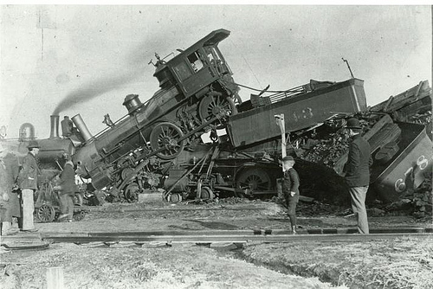
Coexistence: The ability of one system to perform a task in a given shared environment where other systems have an ability to perform their tasks and may or may not be using the same set of rules.
Good Coexistence => rapidly growing opportunity
Poor Coexistence => missed opportunity

Slide 3
Task Group Organization
Chair: Ben Rolfe
Recording secretary: Harry Bims
Vice Chair: Shoichi Kitazawa
Technical Editor: Jianlin Guo

Slide 4
Sub-1GHz Coexistence Task Group
Recommended Practice for Local and Metropolitan Area Networks - Part 19: Coexistence Methods for 802.11 and 802.15.4 based systems operating in the Sub-1 GHz Frequency Bands
Scope:
This recommended practice provides guidance on the implementation, configuration and commissioning of systems sharing spectrum between IEEE Std 802.11ah-2016 and IEEE Std 802.15.4 Smart Utility Networking (SUN) Frequency Shift Keying (FSK) Physical Layer (PHY) operating in Sub-1 GHz frequency bands.

Slide 5
Goals
Complete Draft
Resolve comments from informal review
Update draft

Slide 6
Agenda
TG3 Agenda:
https://mentor.ieee.org/802.19/dcn/20/19-20-0004-00-0003-tg3-agenda-jan-2020.xlsx
Meetings
Had normal 3
Finished in 2

Slide 7
Motion
Move to kindly ask the WG chair to start a 30-day WG Letter Ballot on Draft P802-19-3-D02.
Moved by: Benjamin Rolfe
Second by: Shoichi Kitazawa
Count:
Note: Task group approved to start WG ballot by unanimous consent

Slide 8
Motion
Move that the Working Group approve the formation of a Comment Resolution Group (CRG) for the WG balloting of the P802.19.3-D2 with the following membership:
Yuki (Merl), Yano (ATR), Shoichi (Muroran), Jianlin (MERL), Ruben (L+G), Yasuhiko (NTT), Ben Rolfe (BCA) as Chair.
The 802.19.3 CRG is authorized by the Working Group to approve comment resolutions, edit the draft according to the comment resolutions, and to approve the start of recirculation ballots of the revised draft on behalf of the 802.19 WG. Comment resolution on recirculation ballots between sessions will be conducted via reflector email, via teleconferences and face to face meeting(s) announced to the reflector as per the LMSC 802 WG P&P.
Moved by: Benjamin Rolfe
Second by: Shoichi Kitazawa

Slide 9
Conference Call Schedule
Weekly on Wed commence on Feb 19th 2020 at 3pm Pacific Time

Slide 10
Overview and Schedule
January 2019 TG organization and first technical input, outline for RP content, issue Call for Proposals
March 2019 Review contributions and prepare call for proposals
May 2019 Initial call for proposals
July 2019 Hear technical proposals – start drafting process
Sept 2019 more proposals, draft development
Nov 2019 Draft Ready for WG Ballot
Jan 2020 Comment resolution and recirculate draft
March 2020 EC approval for Standards Association Ballot
April 2020 SA Ballot Comment Resolution, Recirculation
May 2020 SA Ballot Comment Resolution
June 2020 Final recirculation(s) (Stable Draft)
July 2020 EC approval to RevCom

