Slide 1
Frequency Diversity with 802.15.4 SUN FSK
Date: 2019-09-16
Authors:
Notice: This document has been prepared to assist IEEE 802.19. It is offered as a basis for discussion and is not binding on the contributing individual(s) or organization(s). The material in this document is subject to change in form and content after further study. The contributor(s) reserve(s) the right to add, amend or withdraw material contained herein.

Slide 2
Frequency Diversity

Slide 3
Diversity is…
A good thing
As a coexistence mechanism
As a reliability enhancing mechanism
Popular
Commonly used with 802.15.4 SUN FSK (15.4g) PHYs and other PHYs
  Various kinds but we will talk (mostly) about spreading information across multiple well defined frequency channels in some time varying pattern (aka hopping).

Slide 4
Frequency Hopping Overview
Popular with 802.15.4 SUN FSK use
Primary goal is to improve reliability
  Mitigate interference impacts
  Adapt to environment
Tradeoffs between reliability and latency
  Can add significant latency depending on implementation choices
  Popular in low data volume applications
More channels == more benefits
  SUN FSK relatively narrow channels
  More popular where there are more channels
  “enough” channels can be a few MHz

Slide 5
Impact of a few channels
1% duty cycle
500 competing nodes
  Single channel
  10 channels
  16 channels (50kbps)
More is better but a few is still better than one (a lot better)

Slide 6
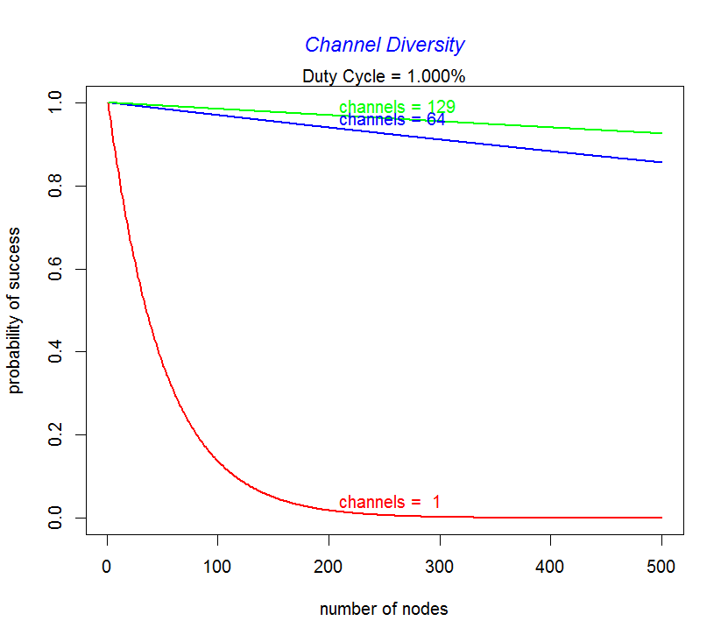
With typical SUN FSK channelization
802.15.4 SUN FSK
902-928MHz band
1% duty cycle
500 competing nodes
  Single channel
  64 channels (150,200, kbps)
  129 channels (50kbps)

Slide 7
Channel (slow) Hopping
Some characteristics of popular schemes:
Relatively long loiter time (dwell) on channel
  Full packet or multiple packet transfers per dwell
Fixed dwell duration
  If transmission cannot complete by end of dwell interval, wait for next dwell interval
  Predictable timing
Dynamic dwell duration
  Nominal dwell interval set
  Dwell may extend to complete packet and/or packet-ack exchange
Many ways to determine channel sequence
  Some degree of randomness essential (more generally better)

Slide 8
“Fast” Hopping
Short loiter time (dwell) on channel
  Fragment of a packet transferred per dwell
  Full packet spread over multiple channels
  May combine with coding and spreading (e.g. 15.4w)
Fixed Fragment size and dwell duration
  A fixed number of bits sent per burst on a channel
  Predictable timing
Dynamic fragment size and dwell duration
  Adapted based on channel condition estimates
  Change fragment size and dwell varying by channel, over time, etc.
Many ways to determine channel sequence
  Some degree of randomness essential (more generally better)

Slide 9
Typical Features
Pseudo random channel sequences
Unique sequences per participating device
Designed to achieve balanced distribution across usable channels
May have limits on maximum duty cycle per channel
  US FCC 15.247 400ms per within a 20 second period per channel;
  EU duty cycle % capped based on band, power allowed
Ability to avoid “bad” channels (blacklisting)
  Measurement of channel condition e.g. packet failure rates, channel access failure rates, channel sounding

Slide 10
Control
Listener directed (listening schedule)
  Each device has a listening schedule –which channel it will receive on at a given time
  To transmit, sender learns listening schedule of destination
  Determines channel at time of desired transmission
Transmitter directed
  Transmitter has a schedule of which channel it may transmit on at a given time
  To receive, must learn the transmit schedule of source
  Sets receive channel according to schedule
Often see both for different uses in the same system

Slide 11
Control
Distributed sequence control
  Device determines it’s sequence and schedule independently
  Peer-wise synchronization instead of global time base
  “learning” about peers can take time (tradeoffs) through advertisement and discovery
Consolidated control
  Nodes share a common schedule
  With global synchronization or “zone-wise” synchronization
  May or may not be allowed by regulations

Slide 12
Channel Diversity Benefits
Increase reliability
Mitigate interference through collision avoidance
  Improve “luck” by reduced effective loading per channel
  Mitigate frequency selective impairments
  Mitigate frequency specific interference
Randomness is good
  Ideal sequence generates a large number of unique sequences
  Good Randomness in timing avoids unintended synchronization

Slide 13
Channel Access
Can use CSMA-CA, ALOHA, hybrid techniques
With low effective channel expectation, ALOHA often selected
With higher channel load CSMA-CA can improve performance
  If some channels are more likely to exceed ALOHA threshold, such as when transmission channel is not random and/or when multiple nodes share transmission schedules
  E. g. when multiple transmitters expected to target the same channel/time
Benefits of frequency diversity either way

Slide 14
Classic ALOHA curve: successful occupancy vs attempted occupancy

Slide 15
Example:
802.15.4 SUN FSK
902-928MHz band
10% duty cycle
500 competing nodes
  Single channel
  64 channels (150,,200, kbps)
  129 channels (50kbps)

Slide 16
Example:
802.15.4 SUN FSK
902-928MHz band
0.2% duty cycle
5000 competing nodes
  Single channel
  64 channels (150,200, kbps)
  129 channels (50kbps

Slide 17
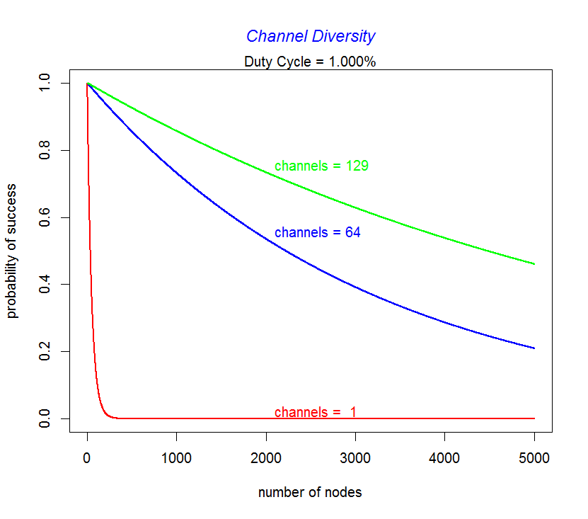
Example:
802.15.4 SUN FSK
902-928MHz band
0.1% duty cycle
5000 competing nodes
  Single channel
  64 channels (150,200, kbps)
  129 channels (50kbps

Slide 18
Example:
802.15.4 SUN FSK
902-928MHz band
1% duty cycle
500 competing nodes
  Single channel
  64 channels (150,200, kbps)
  129 channels (50kbps)

Slide 19
Channel diversity calculations
Basic probability of success per transmission attempt
Assumes low duty cycle, pure ALOHA channel access. The probability of transmission of each node is proportional to the duty cycle.
Probability of success per attempt = px/p where:
px = (p * (1-p)^(2*(n-1)))/p;
P= P(success by given node) =
P(node transmits) * P(no other node transmits in [t0-1,t0]
* P(no ohter node transmits in [t0,t0+1]
= p * (1-p)^(n-1) * (1-p)^(n-1)
= p * (1-p)^(2*(n-1))
P(Success of any N nodes) = Np * (1-p)^(2*(n-1))

