Slide 1
Hybrid CSMA/CA for 802.15.4g to Achieve Better Coexistence with 802.11ah
Date: 2019-11-02
Authors:
Notice: This document has been prepared to assist IEEE 802.19. It is offered as a basis for discussion and is not binding on the contributing individual(s) or organization(s). The material in this document is subject to change in form and content after further study. The contributor(s) reserve(s) the right to add, amend or withdraw material contained herein.

Slide 2
Introduction
802.15.4g was published in 2012
With smart utility network (SUN) as original application
Designed to work for homogeneous devices
Using conventional channel access mechanism (CSMA/CA) defined in baseline standard 802.15.4-2011
802.11ah was published in 2016
Designed for outdoor IoT applications
Considered coexistence with non-802.11 systems
More aggressive channel access
To compete with 802.11ah, 802.15.4g CSMA/CA needs to be enhanced
This document proposes hybrid CSMA/CA for 802.15.4g to achieve better coexistence with 802.11ah
Goal is to improve 802.15.4g performance without degrading 802.11ah performance
This document focuses on coexistence of 802.15.4g and 802.11ah

Slide 3
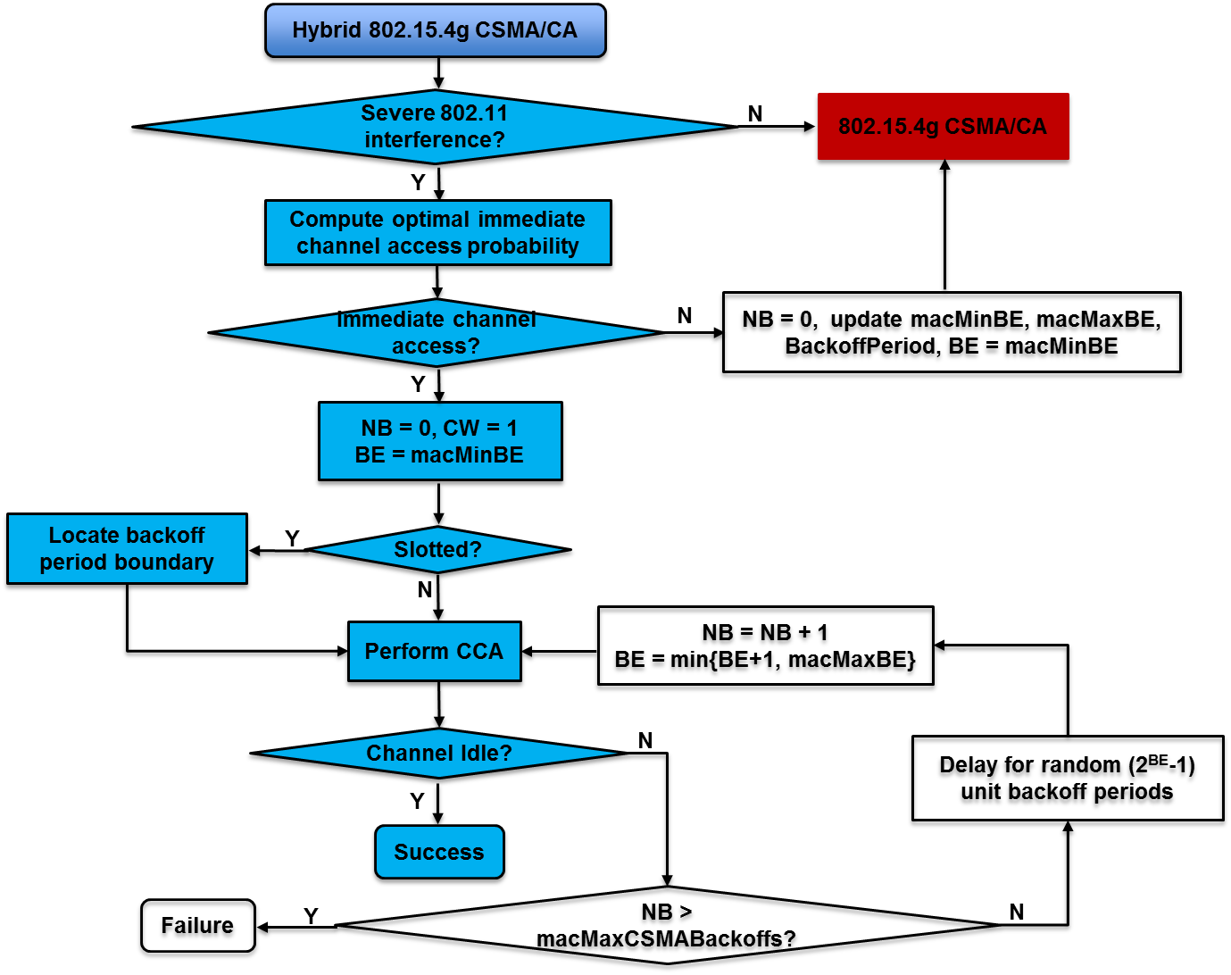
Hybrid CSMA/CA for 802.15.4g
Immediate channel access capability
Dynamic backoff parameter adjustment

Slide 4
Key Features in Hybrid CSMA/CA
Immediate channel access capability
Allows 802.15.4g device to transmit without random backoff while severe 802.11ah interference is detected
Prevent multiple 802.15.4g devices within a neighborhood performing immediate channel access
Compute an optimal probability for immediate channel access
Statistically only one 802.15.4g device perform immediate channel access within a neighborhood
Only one CCA operation is required for 802.15.4g device performing immediate channel access
Allow 802.15.4g device to grab channel as early as possible
802.15.4g devices that do not perform immediate channel access increase their backoff parameters
Do not interfere with the transmission of the immediate channel access
Limit 802.11ah channel access delay

Slide 5
Hybrid CSMA/CA Implementation
It is easy to implement 802.15.4g hybrid CSMA/CA
No protocol modification is needed
For device that performs immediate channel access
Set macMinBE = macMaxBE = 0
For devices that do not perform immediate channel access
Increasing macMinBE or
Increasing macMaxBE or
Increasing both macMinBE and macMaxBE

Slide 6
802.11ah Interference Severity
Key for hybrid CSMA/CA
How to determine the severity of 802.11ah interference
Problem
802.15.4g device and 802.11ah device can not talk to each other
No cooperative coexistence without modification of protocols
Coexistence coordinator is not always available
This document proposes distributed self-estimation methods for 802.15.4g node to estimate the severity of 802.11ah interference
Method 1
802.11ah energy detection ratio
Method 2
802.15.4g channel access failure caused by 802.11ah
Method 3
802.11ah channel occupancy probability

Slide 7
802.11ah Energy Detection (ED) Ratio
Using energy detection mechanism, an 802.15.4g device can detect energy that is higher than or equal to 802.15.4g ED threshold
Let ED_{total} be the total number of such detections by an 802.15.4g device within a time period T
Using carrier sensing mechanism, an 802.15.4g device can determine if the detected signal is 802.15.4g signal or not
For 802.15.4g and 802.11ah coexistence, if the signal is not 802.15.4g signal, it is either 802.11ah signal or collided signal
Let ED_{ah} be the number of non 802.15.4g signal detected
802.11ah energy detection ratio R_{ed}^{h} can be estimated as
$$R_{ed}^{h}=\frac{{ED}_{ah}}{{ED}_{total}}$$

Slide 8
802.15.4g Channel Access Failure Caused by 802.11ah
Let N_{caf} be the total number of channel access failure observed by an 802.15.4g device for total N_{tx} transmission attempts
N_{caf} can be decomposed into N_{caf} = N^{h}_{caf} + N^{g}_{caf}
N^{h}_{caf} is number of channel access failure caused by 802.11ah
N^{g}_{caf} is the number of channel access failure caused by 802.15.4g
An IEEE 802.15.4g device is able to compute N^{g}_{caf} by using carrier sense mechanism
To guarantee packet header sensing, 802.15.4g device may start carrier sense early, e.g., start channel sense before backoff period ends.
Therefore, channel access failure rate R^{h}_{caf} caused by IEEE 802.11ah can be estimated as
$R_{caf}^{h}=\frac{N_{caf}^{h}}{N_{tx}}=\frac{N_{caf}−N_{caf}^{g}}{N_{tx}}$

Slide 9
802.11ah Channel Occupancy Probability
An 802.15.4g device can estimate the channel busy time T_{b} by continuously sensing channel for a time period T
Its transmission time and reception time are considered as busy time
Its turnaround time is considered as idle time
An 802.15.4g device is able to determine the busy time T^{g}_{b} consumed by 802.15.4g transmissions using carrier sense
Therefore, 802.11ah channel occupancy probability P^{h}_{tx} can be estimated as
$$P_{tx}^{h}=\frac{T_{b}−T_{b}^{g}}{T}$$

Slide 10
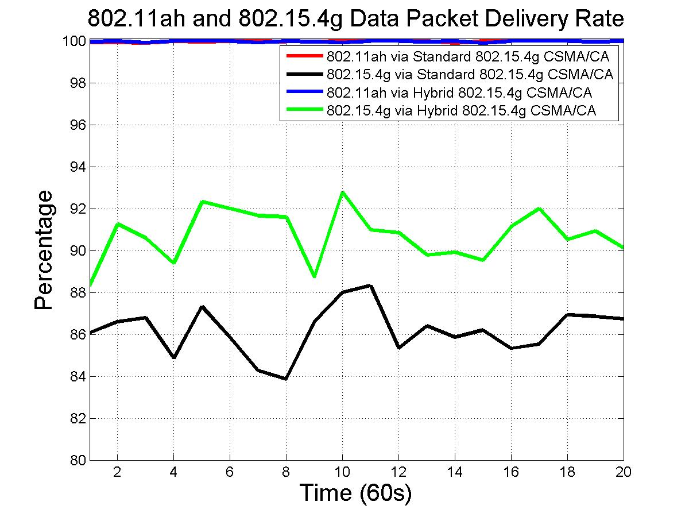
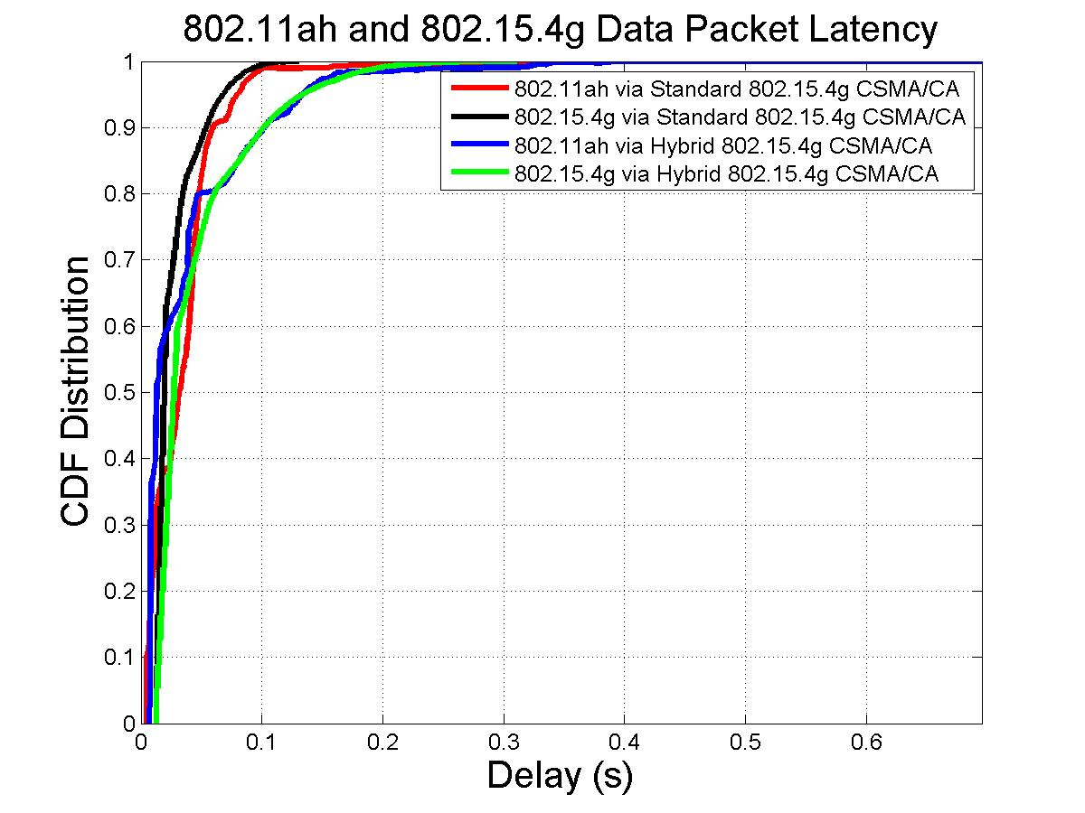
50 Node Performance of Hybrid CSMA/CA
Offered load for 802.15.4g node is 400 bps, i.e., 0.4% duty cycle
Offered load for 802.11ah node is 800 bps, i.e., 0.27% duty cycle
Hybrid CSMA/CA improves 802.15.4g packet delivery rate from 86.2% to 90.7%
Hybrid CSMA/CA does not degrade 802.11ah packet delivery rate
Hybrid CSMA/CA slightly increases 802.15.4g packet latency and 802.11ah packet latency

Slide 11
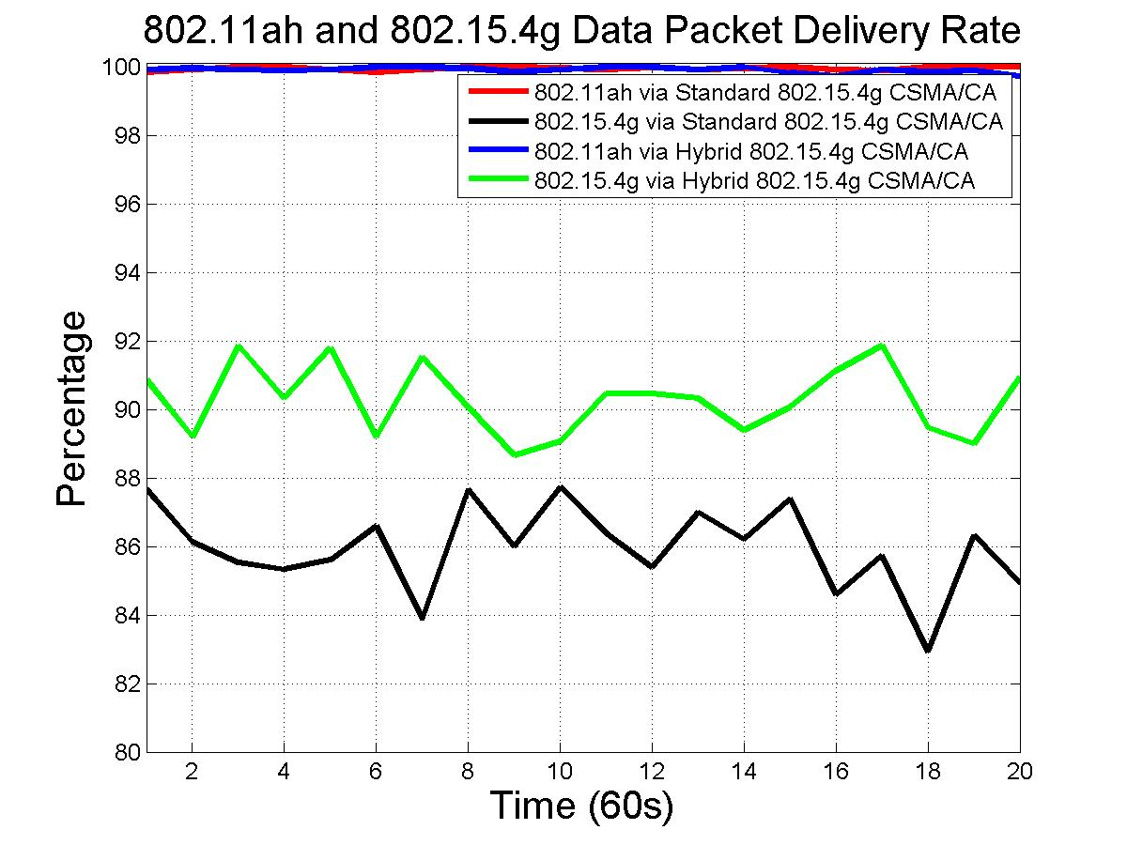
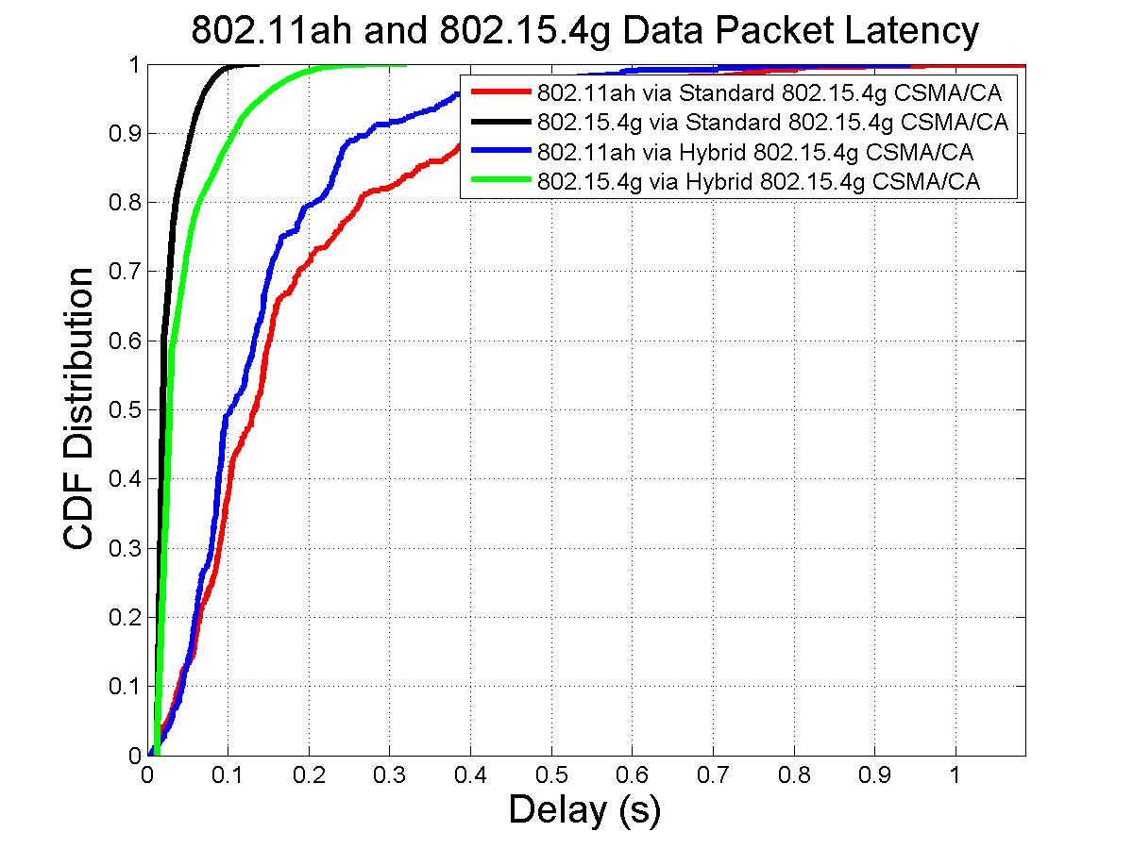
100 Node Performance of Hybrid CSMA/CA
Offered load for 802.15.4g node is 200 bps, i.e., 0.2% duty cycle
Offered load for 802.11ah node is 400 bps, i.e., 0.13% duty cycle
Hybrid CSMA/CA improves 802.15.4g packet delivery rate from 85.96% to 90.29%
Hybrid CSMA/CA does not degrade 802.11ah packet delivery rate
Hybrid CSMA/CA increases 802.15.4g packet latency
Hybrid CSMA/CA decreases 802.15.4g packet latency

Slide 12
802.15.4g Hybrid CSMA/CA Simulation Summary
Hybrid CSMA/CA can improve 802.15.4g reliability without degrading 802.11ah reliability
Hybrid CSMA/CA slightly increases 802.15.4g packet latency
In some cases, Hybrid CSMA/CA can also reduce 802.11ah packet latency

