Slide 1
Impact of Network Profiles on 802.11ah and 802.15.4g Coexistence Performance
Date: 2019-11-12
Authors:
Notice: This document has been prepared to assist IEEE 802.19. It is offered as a basis for discussion and is not binding on the contributing individual(s) or organization(s). The material in this document is subject to change in form and content after further study. The contributor(s) reserve(s) the right to add, amend or withdraw material contained herein.

Slide 2
Introduction
This document summarizes impact of network profiles on 802.11ah and 802.15.4g coexistence behavior
The observations from simulation results intend to be used as reference to provide coexistence suggestions in the Recommend Practice
The simulated network profiles include
  Network load
  Network size
  802.11ah packet size
  802.15.4g packet size
  802.11ah CSMA/CA parameters
  802.15.4g CSMA/CA parameters
This document is divided into 5 parts

Slide 3
Part 1: Network Load and Network Size
Network load
  20 kbps offered load for 802.11ah network
  40 kbps offered load for 802.11ah network
  20 kbps offered load for 802.15.4g network
  40 kbps offered load for 802.15.4g network
Network size
  50 nodes for 802.11ah network
  100 nodes for 802.11ah network
  50 nodes for 802.15.4g network
  100 nodes for 802.15.4g network

Slide 4
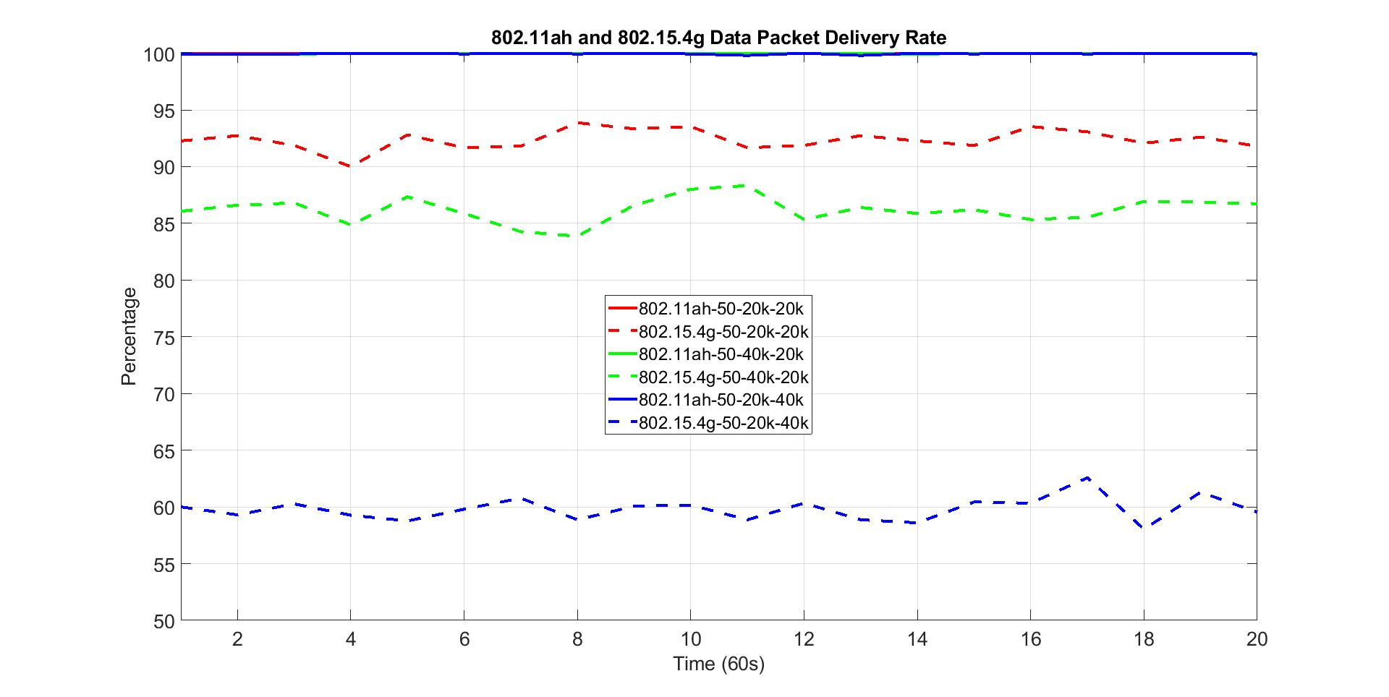
Network Load Impact on Packet Delivery Rate
Solid lines are 802.11ah packet delivery rate
Dash lines are 802.15.4g packet delivery rate
50-20-20 indicates
  50 nodes for each network
  20 kbps offered load for 802.11ah network
  20 kbps offered load for 802.15.4g network
The highest duty cycle is 0.8%, which is less than 1%
802.11ah packet delivery rate
802.15.4g packet delivery rate

Slide 5
Observations from 802.11ah and 802.15.4g Data Packet Delivery Rate
For all scenarios, 802.11ah network delivers near 100% of the packet
  Indicate that network load has little impact on 802.11ah packet delivery rate for lower duty cycle network load, e.g., duty cycle < 1%
802.11ah network load has impact on 802.15.4g packet delivery rate
  802.15.4g network packet delivery rate decreases as 802.11ah network traffic increases
802.15.4g network load affects more on its packet delivery rate
  802.15.4g network packet delivery rate decreases significantly as its network traffic doubles

Slide 6
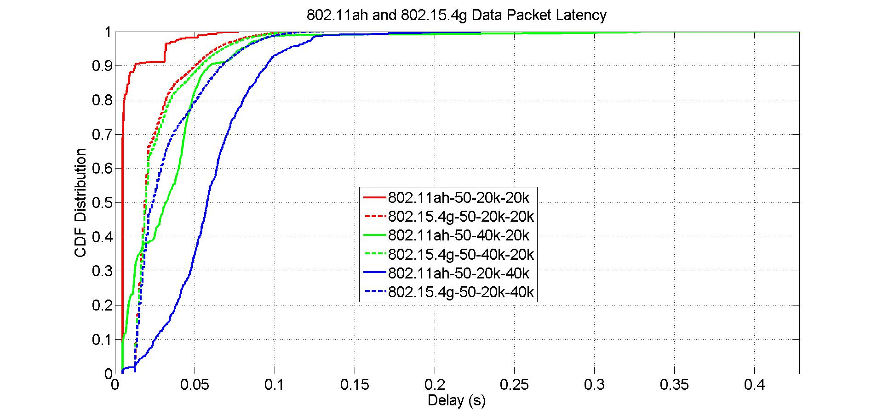
Network Load Impact on Packet Latency
Solid lines are 802.11ah packet latency
Dash lines are 802.15.4g packet latency
50-20-20 indicates
  50 nodes for each network
  20 kbps offered load for 802.11ah network
  20 kbps offered load for 802.15.4g network

Slide 7
Observations from 802.11ah and 802.15.4g Packet Latency
For different 802.11ah load scenarios, 802.15.4g network achieves similar packet latency
  802.11ah network load has little impact on 802.15.4g packet latency
802.15.4g network load slightly impacts on its packet latency
  802.15.4g packet latency increases slightly as its network load increases from 20 kbps to 40 kbps
802.11ah network load has impact on its packet latency
  802.11ah packet latency increases as its network traffic increases
802.15.4g network load has more impact on 802.11ah packet latency
  802.11ah network packet latency increases more as 802.15.4g network traffic doubles

Slide 8
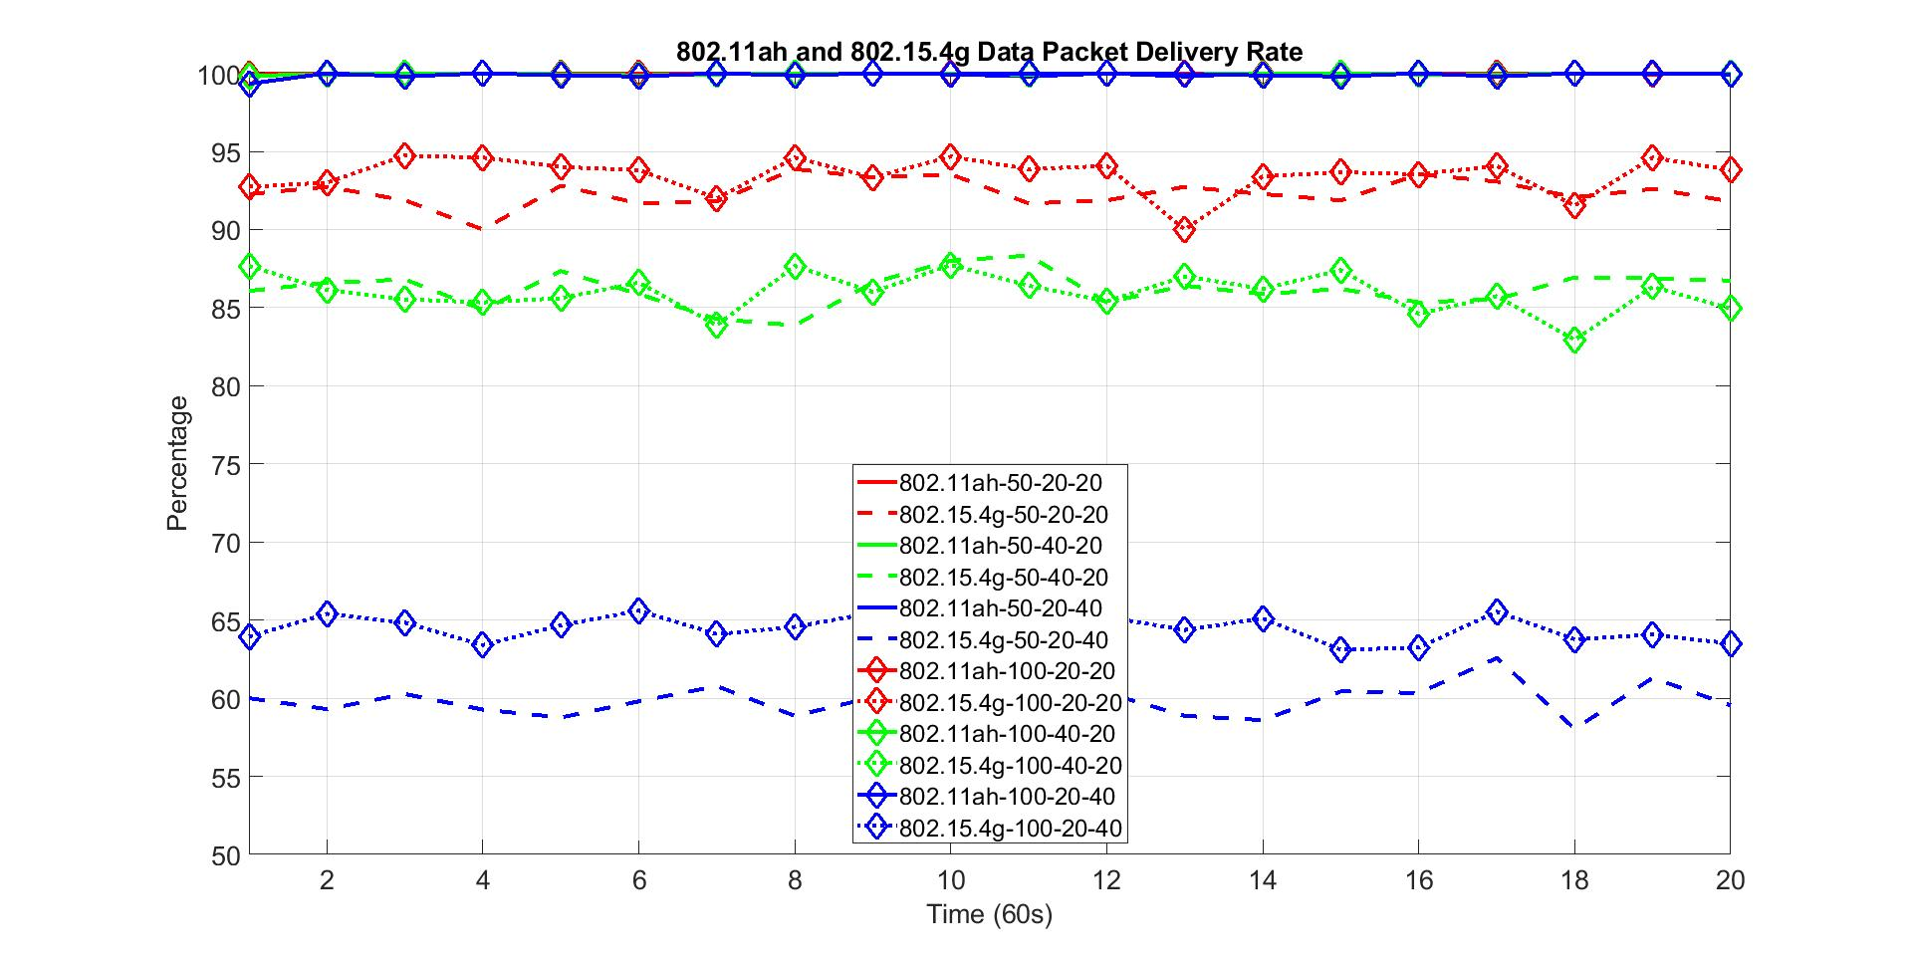
Network Size Impact on Packet Delivery Rate
802.11ah packet delivery rate
Solid lines for 802.11ah with 50 nodes
Dash lines for 802.15.4g with 50 nodes
Solid diamond lines for 802.11ah with 100 nodes
Dash diamond lines for 802.15.4g with 100 nodes
802.15.4g packet delivery rate
What is contributor to improvement?

Slide 9
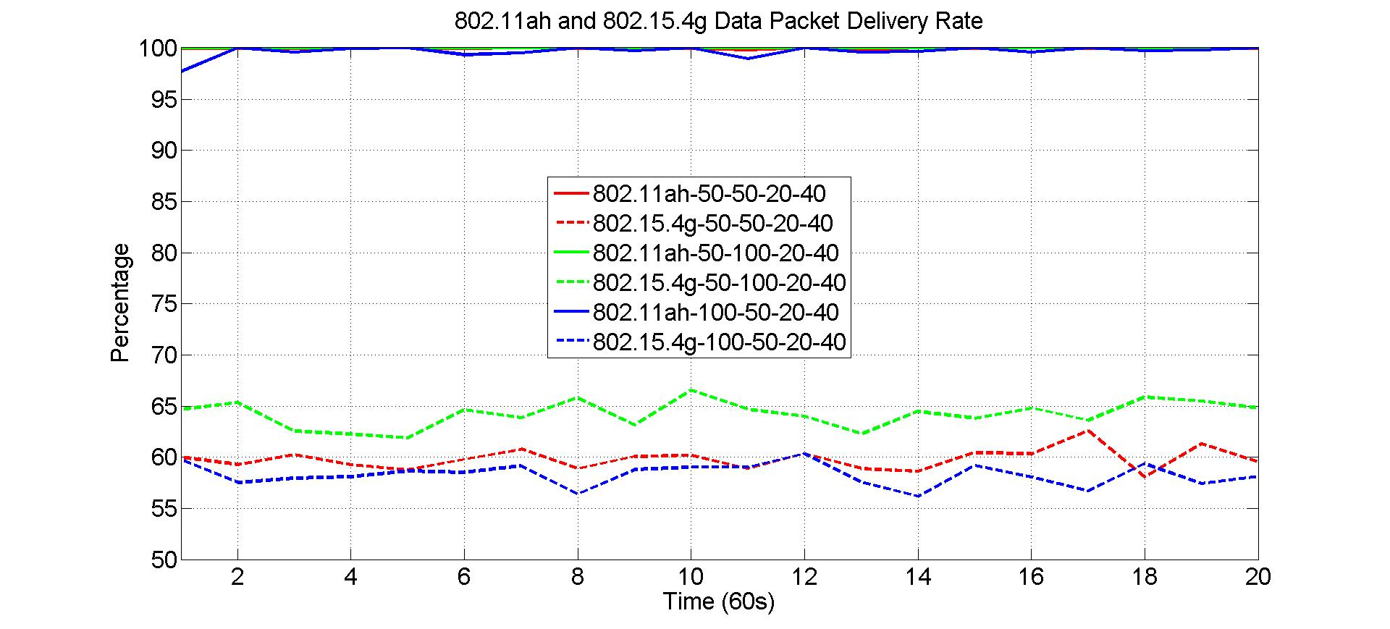
Network Size Impact on Packet Delivery Rate
Results show that major contributor to 802.15.4g packet delivery rate is the increase of 802.15.4g network size
  Increase of 802.11ah network size slightly degrades 802.15.4g packet delivery rate
802.11ah packet delivery rate
802.11ah and 802.15.4g network size variation
802.15.4g packet delivery rate

Slide 10
Observations from 802.11ah and 802.15.4g Packet Delivery Rate
For all scenarios, 802.11ah network delivers near 100% of the packet
  Indicate that network size have little impact on 802.11ah packet delivery rate for lower duty cycle network load, e.g., duty cycle < 1%
Network size has little impact on 802.15.4g packet delivery rate for lower 802.15.4g network load
The 802.15.4g network size has positive effect on 802.15.4g network packet delivery rate for higher 802.15.4g network load
  Network size increases, load of each node decreases.

Slide 11
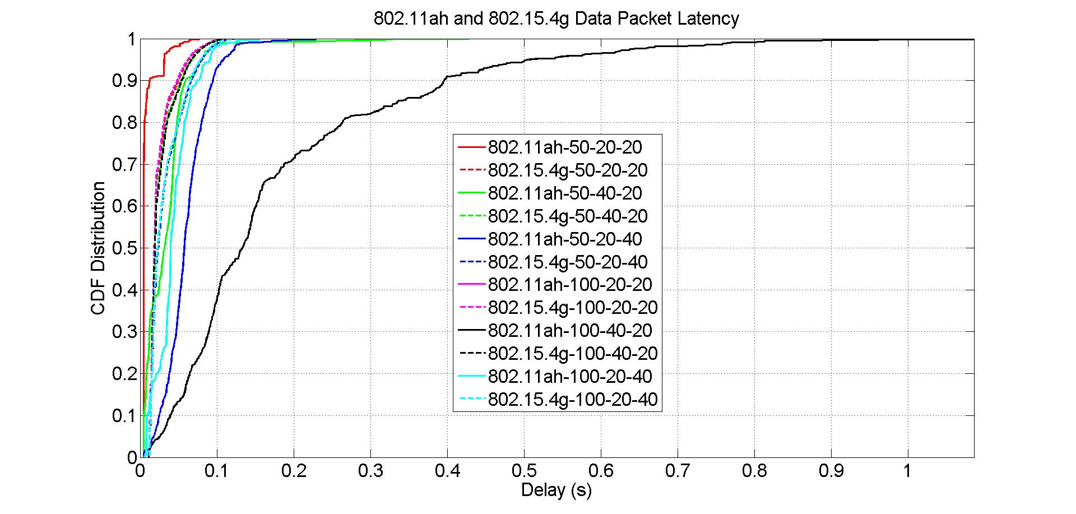
Network Size Impact on Packet Latency
Solid lines are 802.11ah packet latency
Dash lines are 802.15.4g packet latency

Slide 12
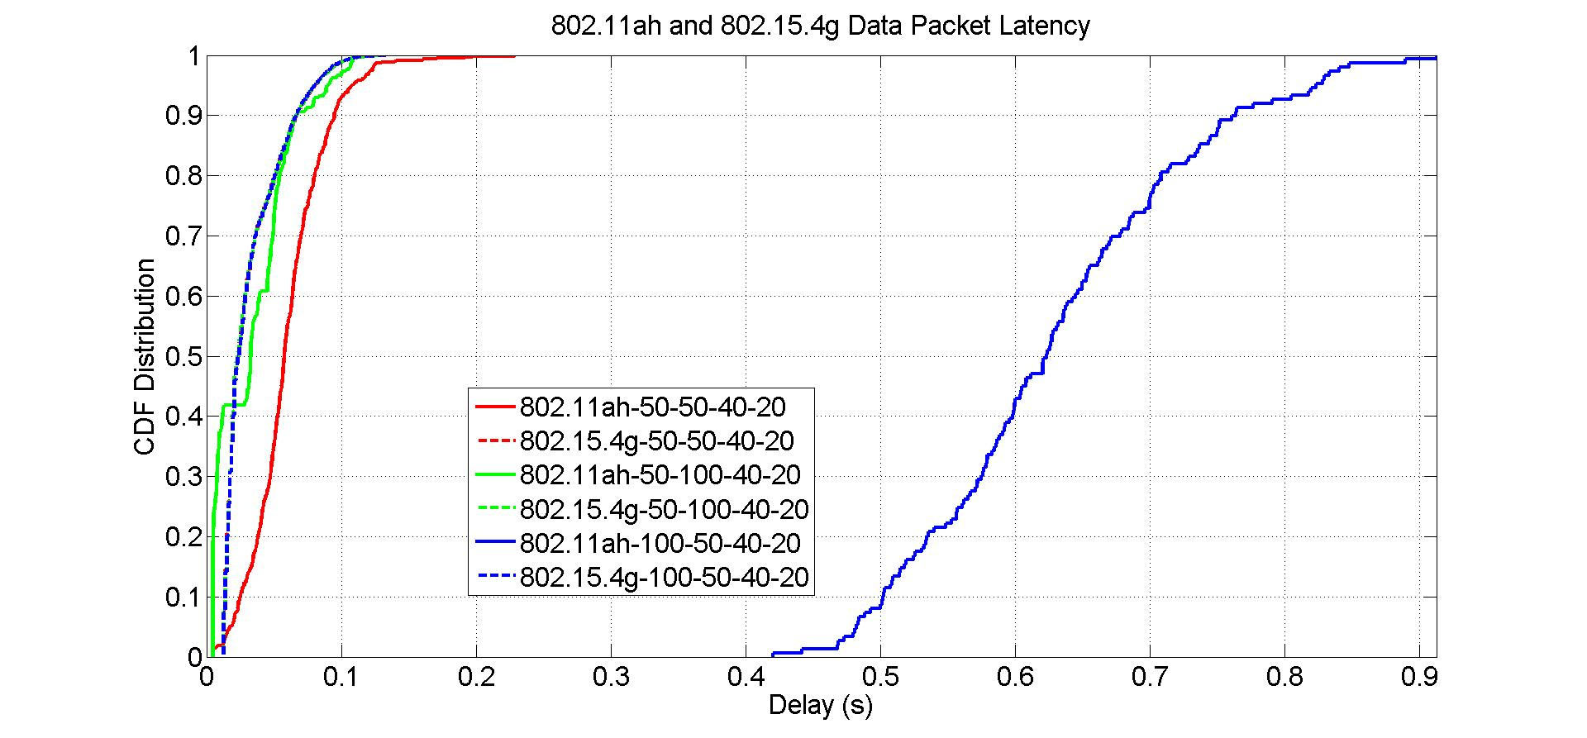
Network Size Impact on Data Packet Latency
Results show that the increase of 802.15.4g network size reduces 802.11ah packet latency
Increase of 802.11ah network size increases 802.11ah packet latency

Slide 13
Observations from 802.11ah and 802.15.4g Packet Latency
For all scenarios, 802.15.4g network achieves similar packet latency
  Network size has little impact on 802.15.4g packet latency
  Indicate that 802.15.4g packet is either delivered with the bounded delay or dropped
Network size has major influence on 802.11ah packet latency if 802.11ah network load is higher
  802.11ah packet latency increases significantly as the number of 802.11ah nodes doubles, which verifies that 802.11ah packet can be infinitely delayed

Slide 14
Summary on Network Load and Network Size Impact
As expected, network load has major impact on 802.11ah and 802.15.4g coexistence performance
  As network load increases, network performance decreases
  However, in practice, network load is determined by application, indicating that lower layer technology is not able to adjust network load
  Therefore, there is no much to be recommended for network load
Network size also impacts 802.11ah and 802.15.4g coexistence performance
  In fact, number of deployed devices can be adjusted, indicating that application developer can adjust network size
  Recommendations
    For lower network load application, network size does not impact network performance very much, therefore, deploy as less devices as possible
    For higher 802.11ah network load, deploy as less 802.11ah device as possible, especially for latency critical applications
    For higher 802.15.4g network load, deploy as more 802.15.4g device as possible if device is cheap, especially for reliability critical applications

Slide 15
Part 2: Frame Size and Backoff Parameter
Network load
  40 kbps offered load for 802.11ah network
  20 kbps offered load for 802.15.4g network
Network size
  50 nodes for both 802.11ah network and 802.15.4g network

Slide 16
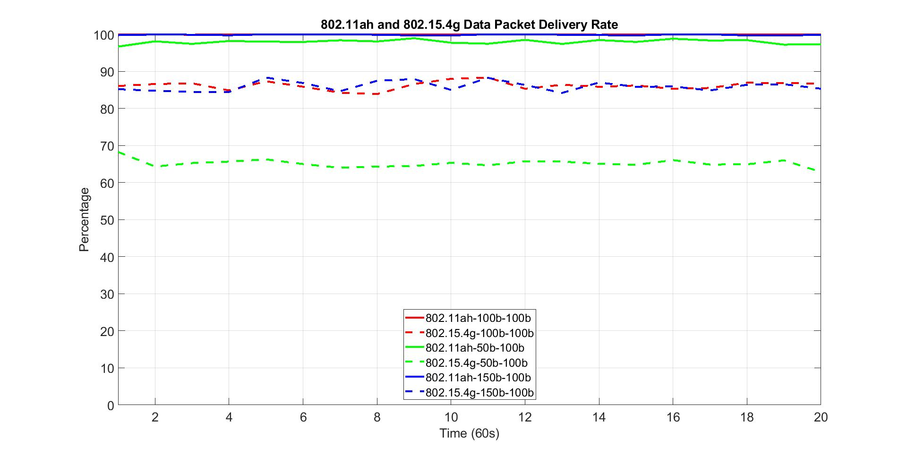
802.11ah Packet Size Impact on Packet Delivery Rate
Solid lines are 802.11ah packet delivery rate
Dash lines are 802.15.4g packet delivery rate
802.11ah packet delivery rate
802.15.4g packet delivery rate
802.11ah packet size
802.15.4g packet size

Slide 17
Observations from Packet Delivery Rate w.r.t 802.11ah Packet Size
802.11ah packet size has impact on 802.11ah packet delivery rate
  For 50-byte packet, 802.11ah network delivers 97% of the packet
802.11ah packet size also has impact on 802.15.4g packet delivery rate
  For 50-byte packet, 802.15.4g packet delivery rate decreases about 15%
From perspective of packet delivery rate, 802.11ah node should not send data with smaller packet size

Slide 18
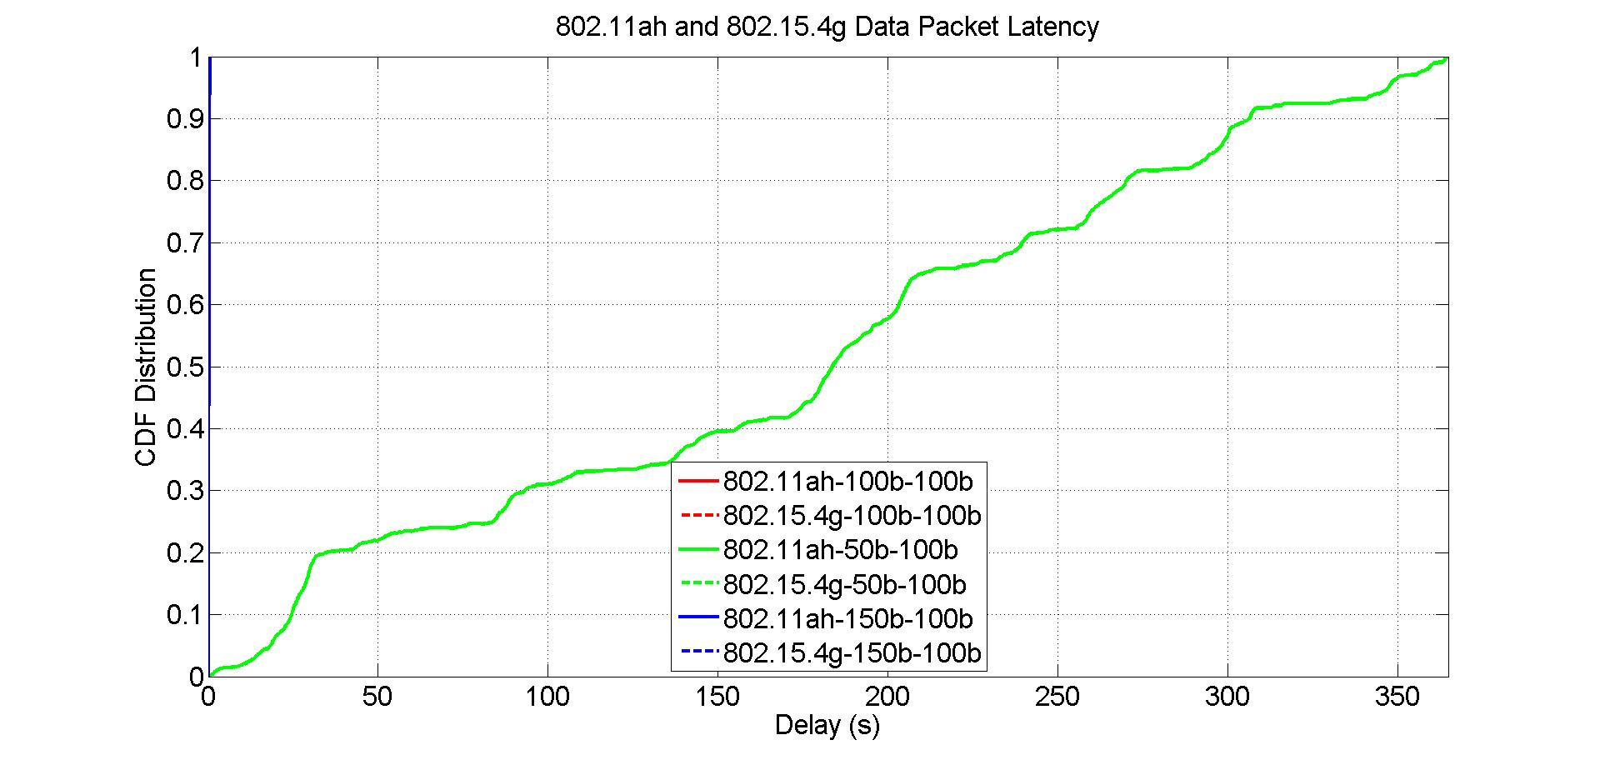
802.11ah Packet Size Impact on Packet Latency
Solid lines are 802.11ah packet latency
Dash lines are 802.15.4g packet latency
802.11ah packet latency for 50-byte packet

Slide 19
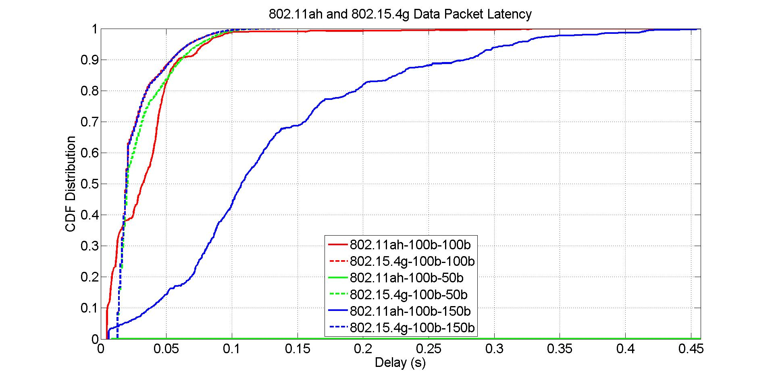
802.11ah Packet Size Impact on Packet Latency
Solid lines are 802.11ah packet latency
Dash lines are 802.15.4g packet latency
Zoom in view
802.11ah packet latency for 50-byte packet

Slide 20
Observations from Packet Latency w.r.t 802.11ah Packet Size
802.11ah packet size has little impact on 802.15.4g packet latency
802.11ah packet size has major impact on 802.11ah packet latency
  50 bytes packet has significant longer latency than 100 bytes packet does
  150 bytes packet has more latency than 100 bytes packet do
From perspective of packet latency, 802.11ah should send data with medium size packet

Slide 21
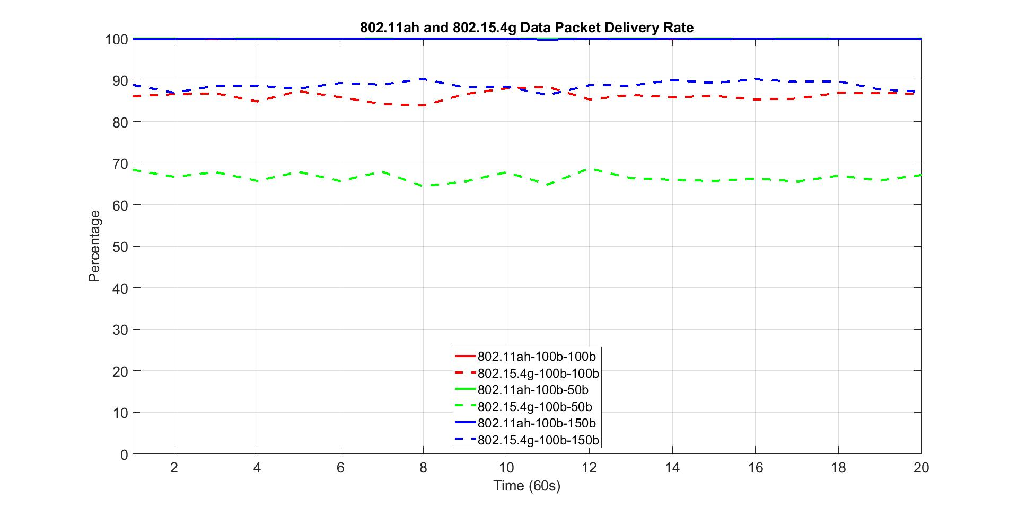
802.15.4g Packet Size Impact on Packet Delivery Rate
Solid lines are 802.11ah packet delivery rate
Dash lines are 802.15.4g packet delivery rate
802.11ah packet delivery rate
802.15.4g packet delivery rate

Slide 22
Observations from Packet Delivery Rate w.r.t 802.15.4g Packet Size
802.15.4g packet size has no impact on 802.11ah packet delivery rate
  For all cases, 802.11ah network delivers near 100% of the packet
802.15.4g packet size affects 802.15.4g packet delivery rate
  802.15.4g packet delivery rate decreases as its packet size decreases
  802.15.4g packet delivery rate increases slightly as its packet size increases
From perspective of packet delivery rate, 802.15.4g node should send data with larger packet

Slide 23
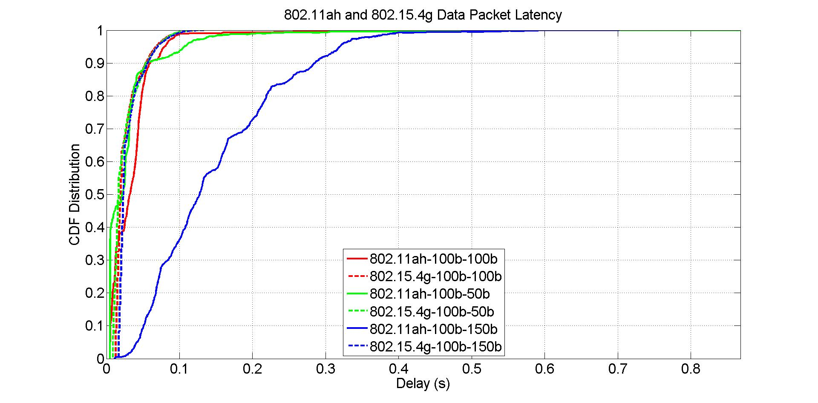
802.15.4g Packet Size Impact on Packet Latency
Solid lines are 802.11ah packet latency
Dash lines are 802.15.4g packet latency

Slide 24
Observations from Packet Latency w.r.t 802.15.4g Packet Size
802.15.4g packet size has little impact on 802.15.4g packet latency
802.15.4g packet size has more impact on 802.11ah packet latency
  802.11ah packet latency decreases slightly as 802.15.4g packet decreases
  802.11ah packet latency increases as 802.15.4g packet increases
From perspective of packet latency, 802.15.4g should send data with medium packet size

Slide 25
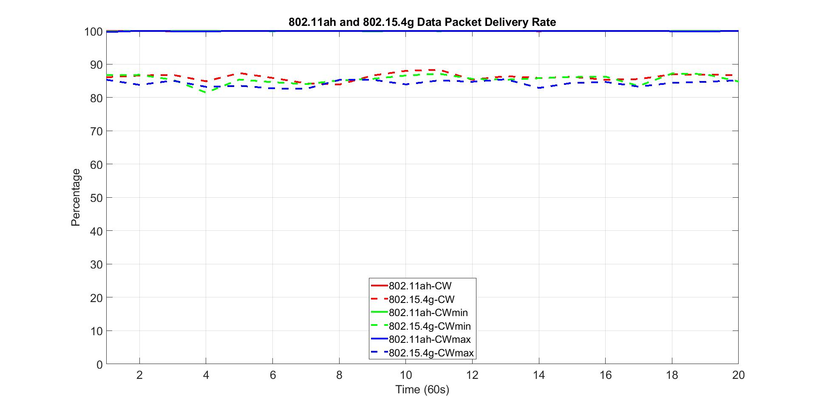
802.11ah Contention Window Impact on Packet Delivery Rate
Solid lines are 802.11ah packet delivery rate
Dash lines are 802.15.4g packet delivery rate
802.11ah packet delivery rate
802.15.4g packet delivery rate

Slide 26
Observations from Packet Delivery Rate w.r.t 802.11ah Contention Window
802.11ah backoff contention window has no impact on 802.11ah packet delivery rate
  For all cases, 802.11ah network delivers near 100% of the packet
802.11ah backoff contention window also has little impact on 802.15.4g packet delivery rate
From perspective of packet delivery rate, 802.11ah node does not need to adjust its backoff contention window, it should follow standard contention window configuration procedure

Slide 27
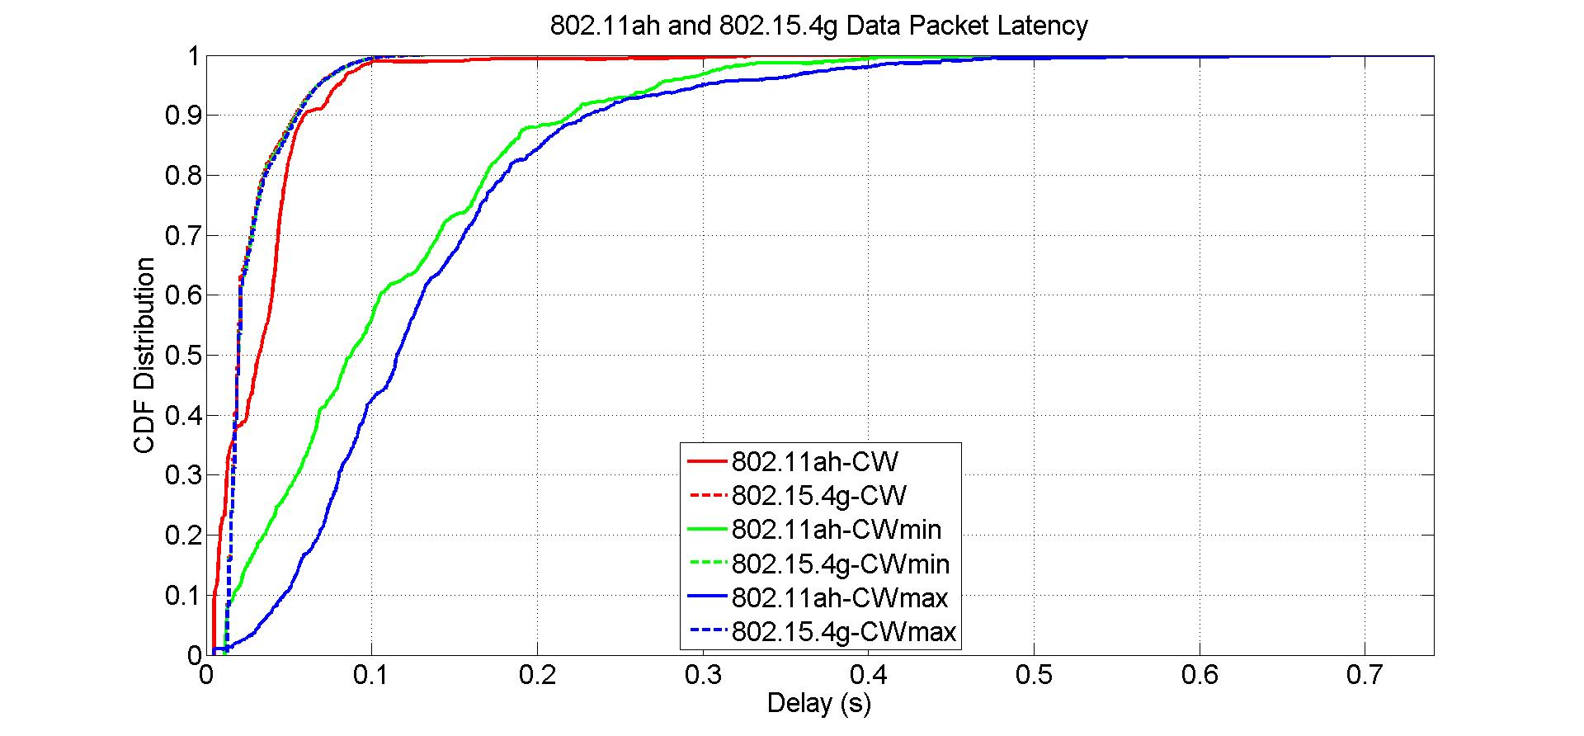
802.11ah Contention Window Impact on Packet Latency
Solid lines are 802.11ah packet latency
Dash lines are 802.15.4g packet latency

Slide 28
Observations from Packet Latency w.r.t 802.11ah Contention Window
802.11ah backoff contention window has no impact on 802.15.4g packet latency
802.11ah backoff contention window has impact on 802.11ah packet latency
  802.11ah packet latency increases for both smaller and larger contention window size
From perspective of packet latency, 802.11ah should follow standard backoff contention window configuration

Slide 29
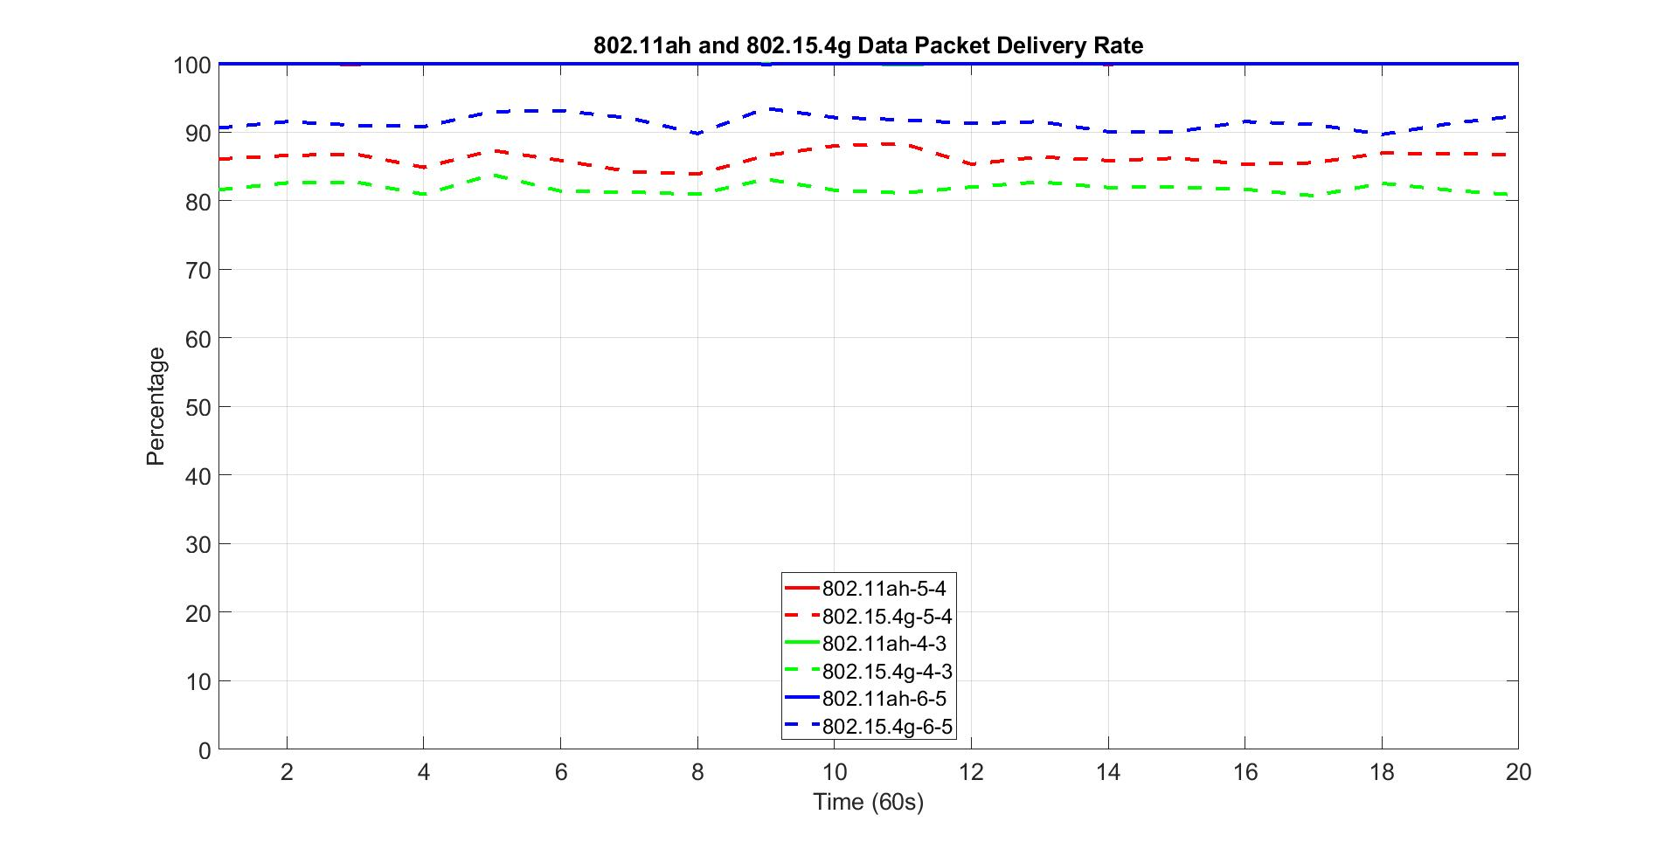
802.15.4g Backoff Parameter Impact on Packet Delivery Rate
Solid lines are 802.11ah packet delivery rate
Dash lines are 802.15.4g packet delivery rate
802.15.4g macMinBE = 2
macMaxBE and macMaxCSMABackoffs are variables
802.11ah packet delivery rate
802.15.4g packet delivery rate
macMaxBE
macMaxCSMABackoffs

Slide 30
Observations from Packet Delivery Rate w.r.t 802.15.4g Backoff Parameter
802.15.4g backoff parameters have no impact on 802.11ah packet delivery rate
  For all cases, 802.11ah network delivers near 100% of the packet
802.15.4g backoff parameters affect 802.15.4g packet delivery rate
  802.15.4g packet delivery rate decreases as its backoff parameters decrease
  802.15.4g packet delivery rate increases as its backoff parameters increase
From perspective of packet delivery rate, 802.15.4g node should send data with larger backoff parameters

Slide 31
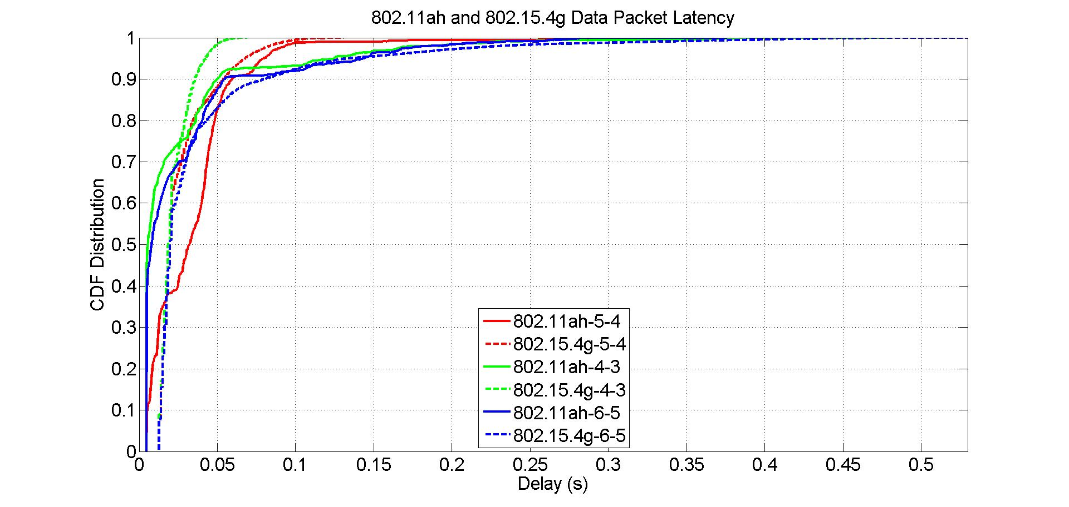
802.15.4g Backoff Parameter Impact on Packet Latency
Solid lines are 802.11ah packet latency
Dash lines are 802.15.4g packet latency
802.15.4g macMinBE = 2
macMaxBE and macMaxCSMABackoffs are variables

Slide 32
Observations from Packet Latency w.r.t 802.15.4g Backoff Parameter
802.15.4g backoff parameters slightly impact on 802.15.4g packet latency
  Smaller backoff parameters decrease 802.15.4g packet latency
  Larger backoff parameters increase 802.15.4g packet latency
802.15.4g backoff parameters have small impact on 802.11ah packet latency
From perspective of packet latency, 802.15.4g should send data with smaller backoff parameters

Slide 33
Summary of Packet Size and Backoff Parameter Impact
802.11ah packet size
  has impact on 802.15.4g packet delivery rate
  has impact on 802.11ah packet delivery rate
  has major impact on 802.11ah packet latency
  802.11ah node should send packet with medium size packet
802.15.4g packet size
  has impact on 802.11ah packet delivery rate and has little impact on 802.15.4g packet latency
  has impact on 802.11ah packet latency and has no impact on 802.11ah packet delivery rate
  802.15.4g node should send packet with medium packet size
802.11ah backoff contention window
  has little impact on 802.15.4g performance and 802.11ah packet delivery rate
  has impact on 802.11ah packet latency
  802.11ah node should follow standard backoff contention window configuration
802.15.4g backoff parameters
  have no impact on 802.11ah packet delivery
  have impact on 802.15.4g packet delivery rate
  has small impact on 802.11ah packet latency and 802.15.4g packet latency
  802.15.4g node should send packet with larger backoff parameters if packet delivery rate is critical and send packet with smaller backoff parameters if packet latency is critical

Slide 34
Part 3: Frame Size and Backoff Parameter
Network load
  20 kbps offered load for 802.11ah network
  40 kbps offered load for 802.15.4g network
Network size
  50 nodes for both 802.11ah network and 802.15.4g network

Slide 35
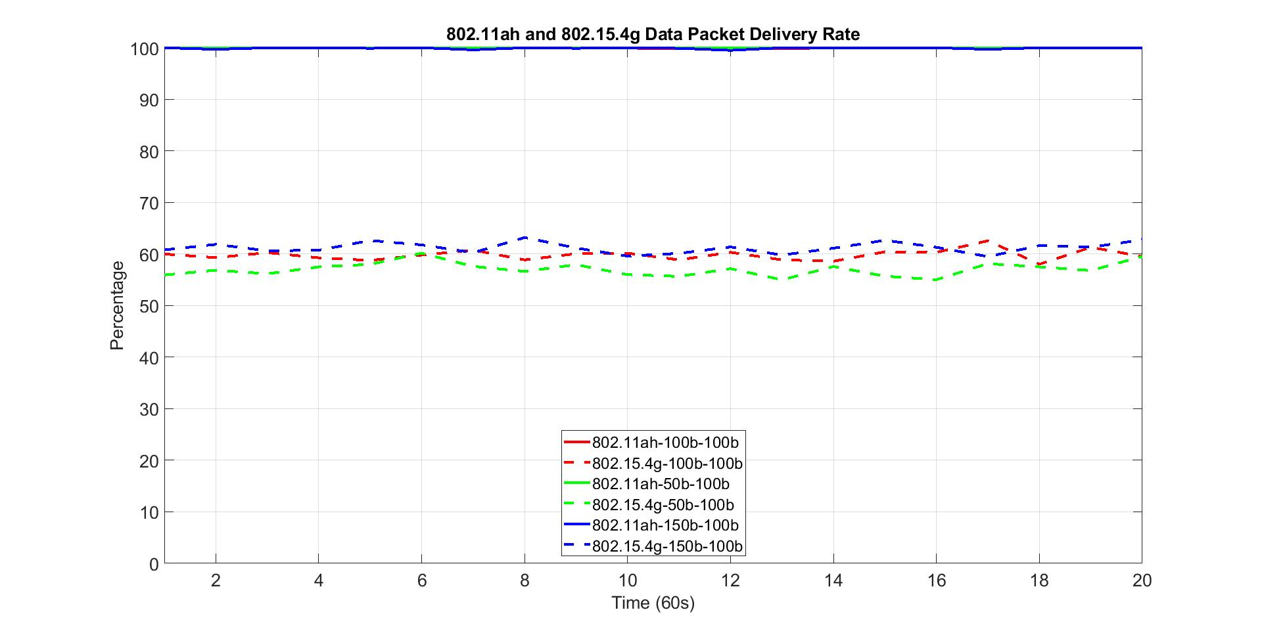
802.11ah Packet Size Impact on Packet Delivery Rate
Solid lines are 802.11ah packet delivery rate
Dash lines are 802.15.4g packet delivery rate
802.11ah packet delivery rate
802.15.4g packet delivery rate
802.11ah packet size
802.15.4g packet size

Slide 36
Observations from Packet Delivery Rate w.r.t 802.11ah Packet Size
802.11ah packet size has no impact on 802.11ah packet delivery rate
  For all cases, 802.11ah network delivers near 100% of the packet
802.11ah packet size also has little impact on 802.15.4g packet delivery rate
  802.15.4g packet delivery rate decreases slightly as 802.11ah packet size decreases
  802.15.4g packet delivery rate increases slightly as 802.11ah packet size increases
From perspective of packet delivery rate, 802.11ah node should send data with larger packet size

Slide 37
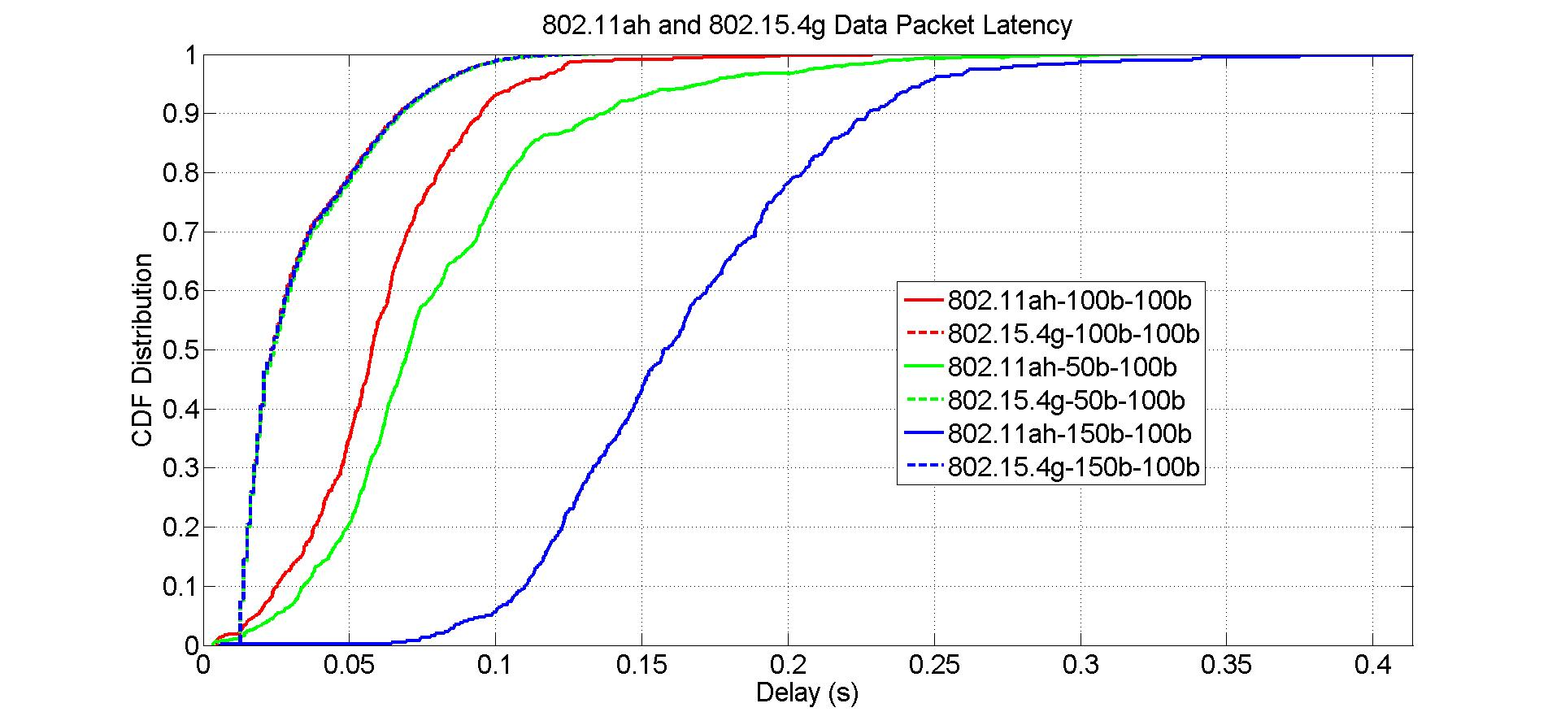
802.11ah Packet Size Impact on Packet Latency
Solid lines are 802.11ah packet latency
Dash lines are 802.15.4g packet latency
802.15.4g packet latency
802.11ah packet latency

Slide 38
Observations from Packet Latency w.r.t 802.11ah Packet Size
802.11ah packet size has no impact on 802.15.4g packet latency
802.11ah packet size has impact on 802.11ah packet latency
  50 bytes packet has more latency than 100 bytes packet does
  150 bytes packet has more latency than both 50 bytes packet and 100 bytes packet do
From perspective of packet latency, 802.11ah node should send data with medium packet size

Slide 39
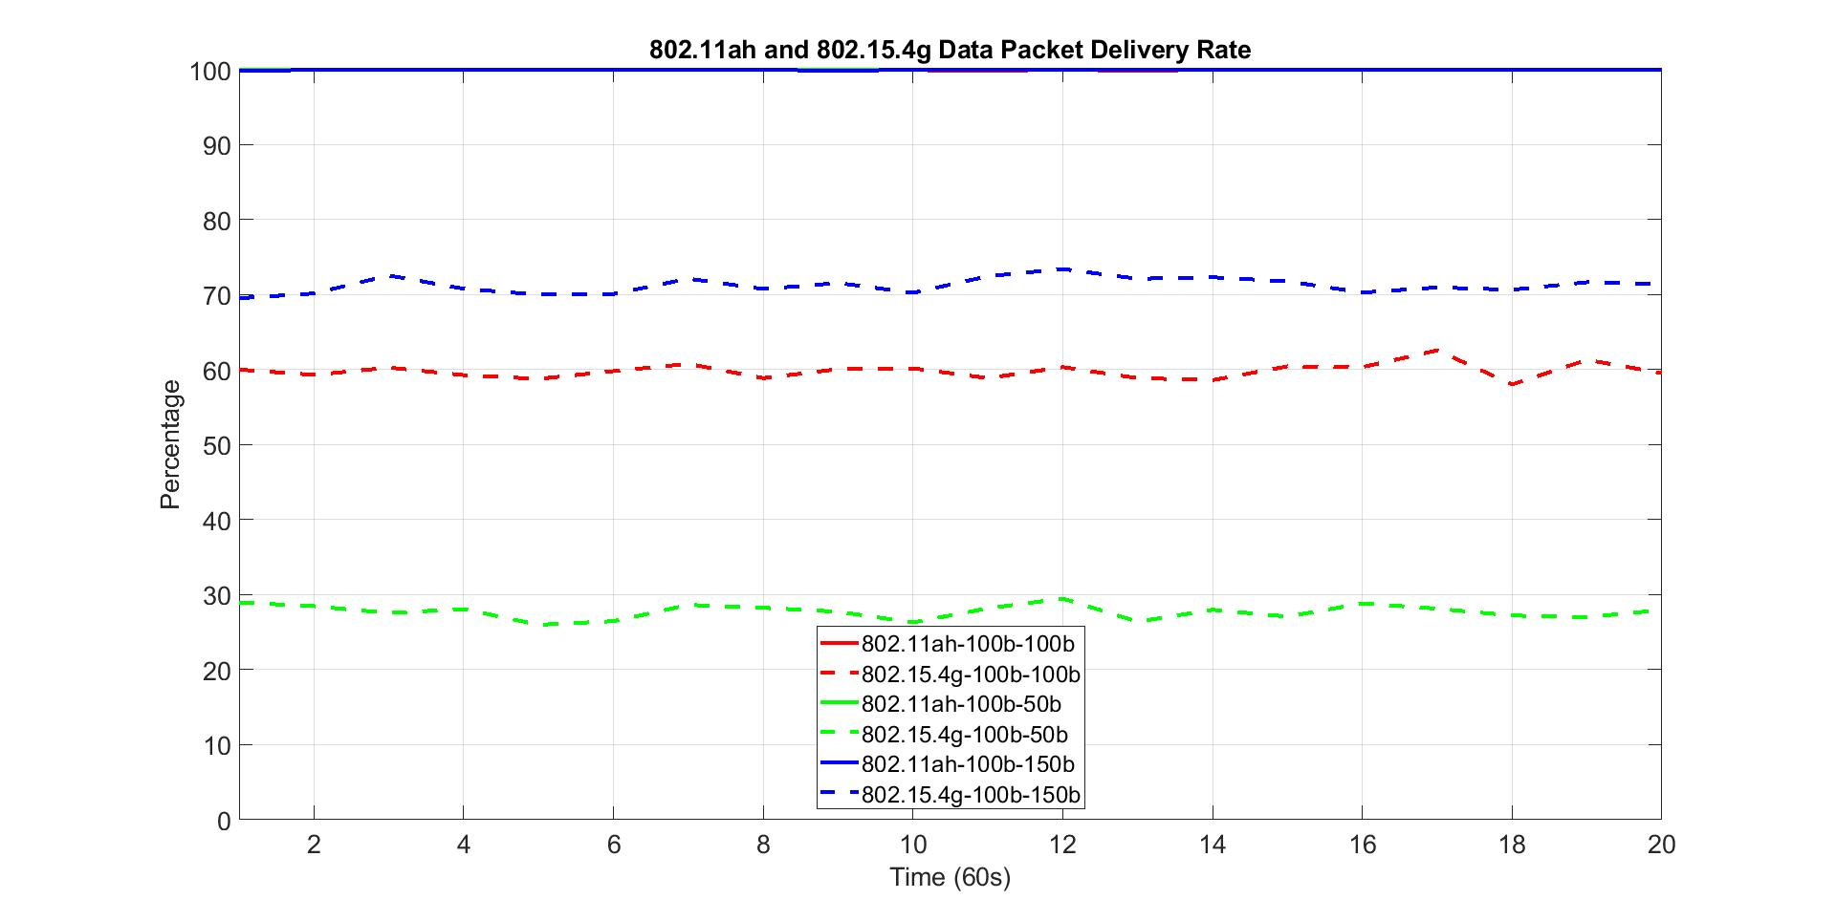
802.15.4g Packet Size Impact on Packet Delivery Rate
Solid lines are 802.11ah packet delivery rate
Dash lines are 802.15.4g packet delivery rate
802.11ah packet delivery rate
802.15.4g packet delivery rate

Slide 40
Observations from Packet Delivery Rate w.r.t 802.15.4g Packet Size
802.15.4g packet size has no impact on 802.11ah packet delivery rate
  For all cases, 802.11ah network delivers near 100% of the packet
802.15.4g packet size affects 802.15.4g packet delivery rate
  802.15.4g packet delivery rate decreases as its packet size decreases
  802.15.4g packet delivery rate increases as its packet size increases
From perspective of packet delivery rate, 802.15.4g node should send data with larger packet

Slide 41
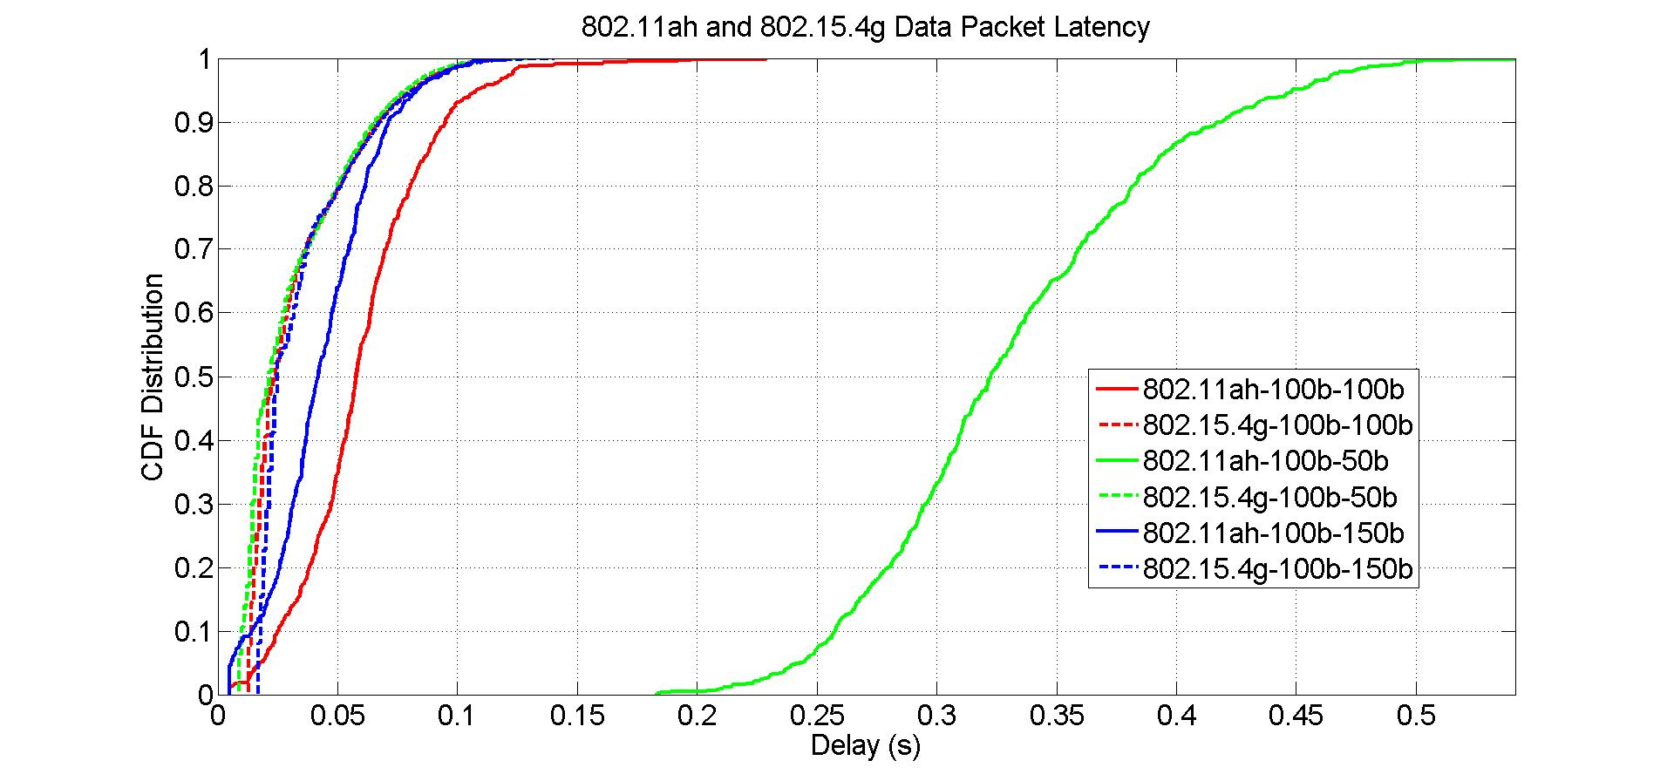
802.15.4g Packet Size Impact on Packet Latency
Solid lines are 802.11ah packet latency
Dash lines are 802.15.4g packet latency

Slide 42
Observations from Packet Latency w.r.t 802.15.4g Packet Size
802.15.4g packet size has little impact on 802.15.4g packet latency
802.15.4g packet size has more impact on 802.11ah packet latency
  802.11ah packet latency increases as 802.15.4g packet size decreases
  802.11ah packet latency decreases as 802.15.4g packet size increases
From perspective of packet latency, 802.15.4g should send data with larger packet size

Slide 43
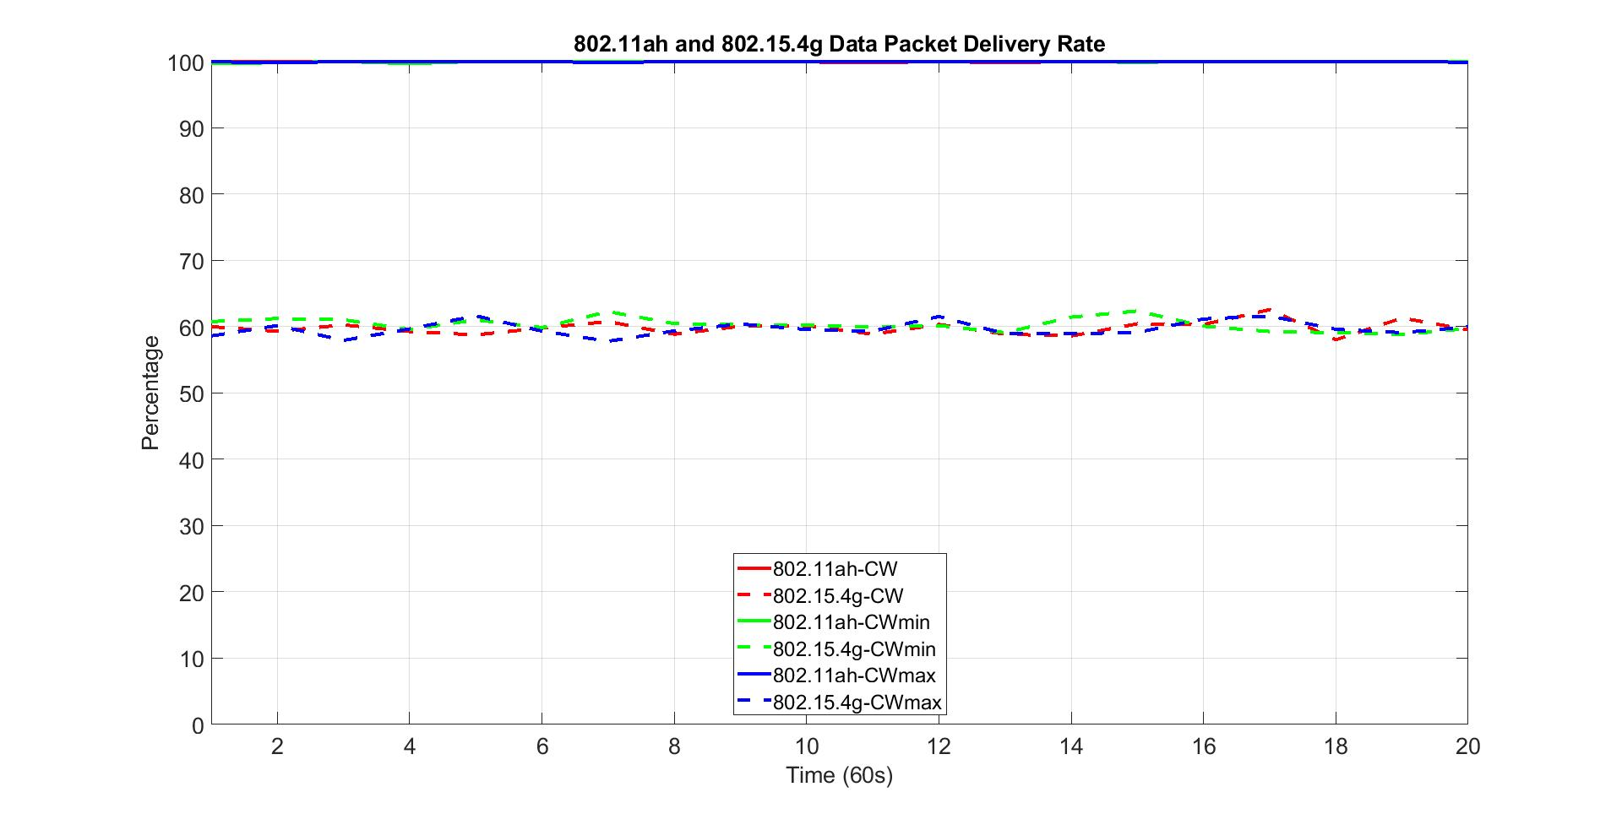
802.11ah Contention Window Impact on Packet Delivery Rate
Solid lines are 802.11ah packet delivery rate
Dash lines are 802.15.4g packet delivery rate
802.11ah packet delivery rate
802.15.4g packet delivery rate
802.11ah backoff contention window

Slide 44
Observations from Packet Delivery Rate w.r.t 802.11ah Contention Window
802.11ah backoff contention window has no impact on 802.11ah packet delivery rate
  For all cases, 802.11ah network delivers near 100% of the packet
802.11ah backoff contention window also has little impact on 802.15.4g packet delivery rate
From perspective of packet delivery rate, 802.11ah node does not need to adjust its backoff contention window, it should follow standard contention window configuration procedure

Slide 45
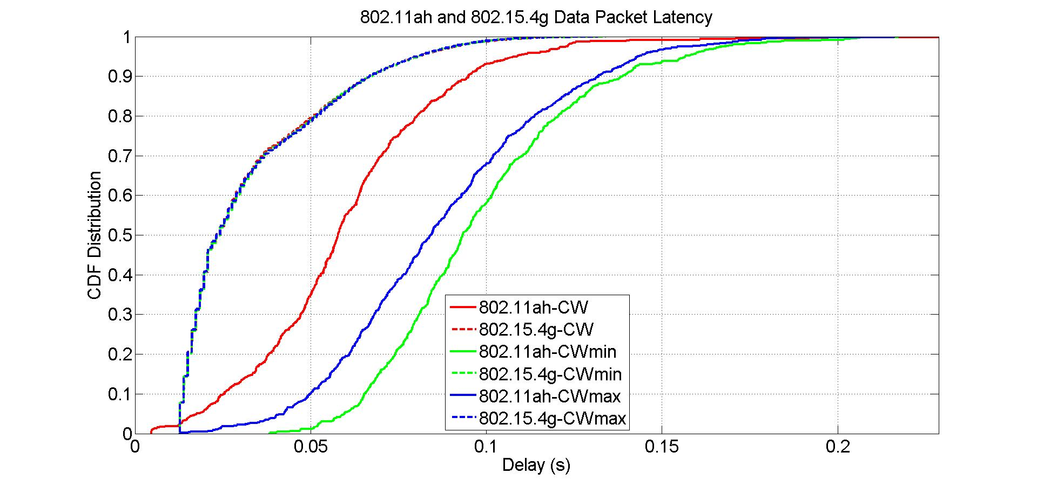
802.11ah Contention Window Impact on Packet Latency
Solid lines are 802.11ah packet latency
Dash lines are 802.15.4g packet latency

Slide 46
Observations from Packet Latency w.r.t 802.11ah Contention Window
802.11ah backoff contention window has no impact on 802.15.4g packet latency
802.11ah backoff contention window has impact on 802.11ah packet latency
From perspective of packet latency, 802.11ah should follow standard backoff contention window configuration

Slide 47
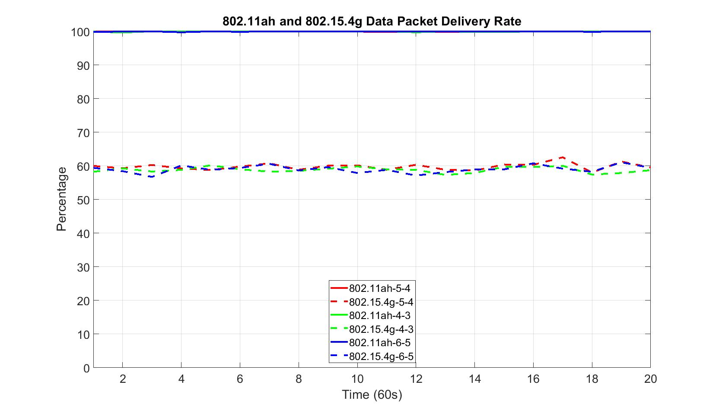
802.15.4g Backoff Parameter Impact on Packet Delivery Rate
Solid lines are 802.11ah packet delivery rate
Dash lines are 802.15.4g packet delivery rate
802.15.4g macMinBE = 2
macMaxBE and macMaxCSMABackoffs are variables
802.11ah packet delivery rate
802.15.4g packet delivery rate
802.15.4g macMaxBE and macMaxCSMABackoffs

Slide 48
Observations from Packet Delivery Rate w.r.t 802.15.4g Backoff Parameter
802.15.4g backoff parameters have no impact on 802.11ah packet delivery rate
  For all cases, 802.11ah network delivers near 100% of the packet
802.15.4g backoff parameters impact on 802.15.4g packet delivery rate
  For all cases, 802.15.4g network delivers near 60% of the packet
From perspective of packet delivery rate, 802.15.4g node should send data with larger backoff parameters

Slide 49
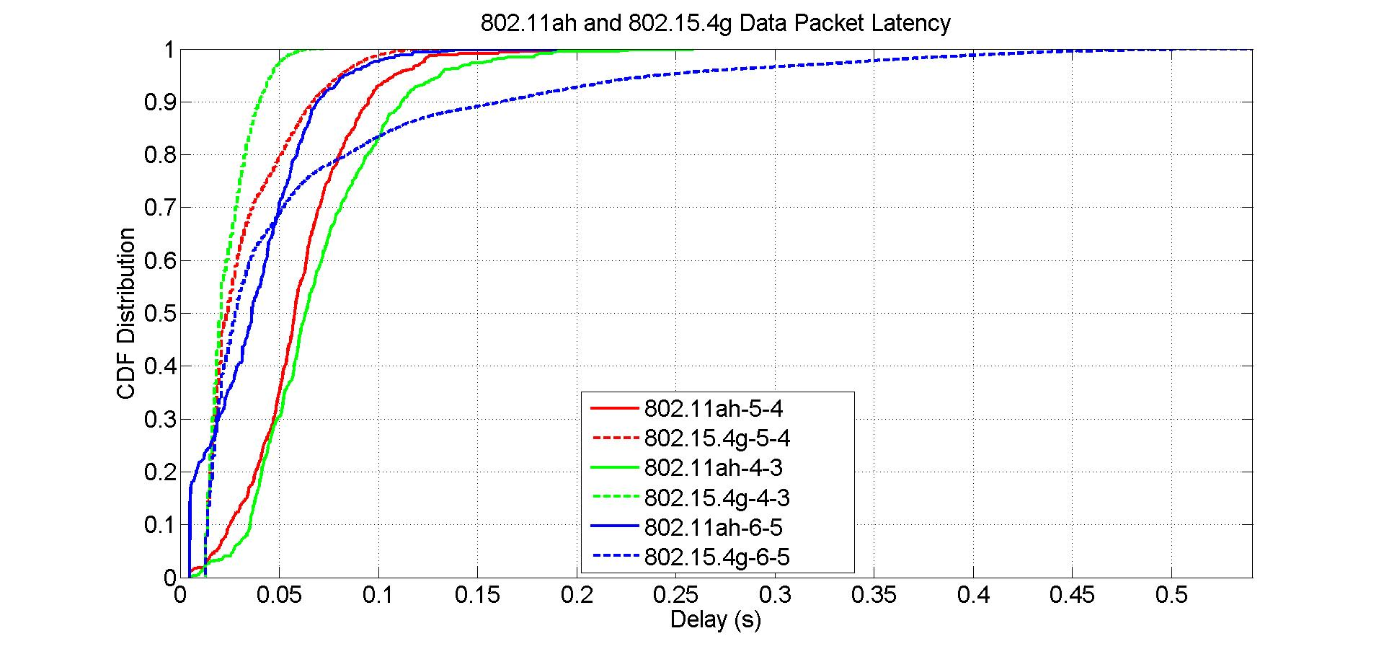
802.15.4g Backoff Parameter Impact on Packet Latency
Solid lines are 802.11ah packet latency
Dash lines are 802.15.4g packet latency
802.15.4g macMinBE = 2
macMaxBE and macMaxCSMABackoffs are variables

Slide 50
Observations from Packet Latency w.r.t 802.15.4g Backoff Parameter
802.15.4g backoff parameters have impact on 802.15.4g packet latency
  Smaller backoff parameters decrease 802.15.4g packet latency
  Larger backoff parameters increase 802.15.4g packet latency
802.15.4g backoff parameters have impact on 802.11ah packet latency
  Smaller backoff parameters increase 802.11ah packet latency
  Larger backoff parameters decrease 802.11ah packet latency
From perspective of 802.15.4g packet latency, 802.15.4g should send data with smaller backoff parameters
From perspective of 802.11ah packet latency, 802.15.4g should send data with larger backoff parameters

Slide 51
Summary of Packet Size and Backoff Parameter Impact
802.11ah packet size
  has little impact on 802.15.4g performance and 802.11ah packet delivery rate
  has major impact on 802.11ah packet latency
  802.11ah node should send packet with medium packet size
802.15.4g packet size
  has little impact on 802.11ah packet delivery rate and 802.15.4g packet latency
  has major impact on 802.11ah packet latency and 802.15.4g packet delivery rate
  802.15.4g node should send packet with larger packet size
802.11ah backoff contention window
  has little impact on 802.15.4g performance and 802.11ah packet delivery rate
  has major impact on 802.11ah packet latency
  802.11ah node should follow standard backoff contention window configuration
802.15.4g backoff parameters
  have little impact on 802.11ah packet delivery rate
  have impact on 802.15.4g packet delivery rate
  has opposite impact on 802.11ah packet latency and 802.15.4g packet latency
  802.15.4g node should send packet with larger backoff parameters if packet delivery rate is critical and send packet with smaller backoff parameters if packet latency is critical

Slide 52
Part 4: Frame Size and Backoff Parameter
Network load
  40 kbps offered load for 802.11ah network
  20 kbps offered load for 802.15.4g network
Network size
  100 nodes for both 802.11ah network and 802.15.4g network

Slide 53
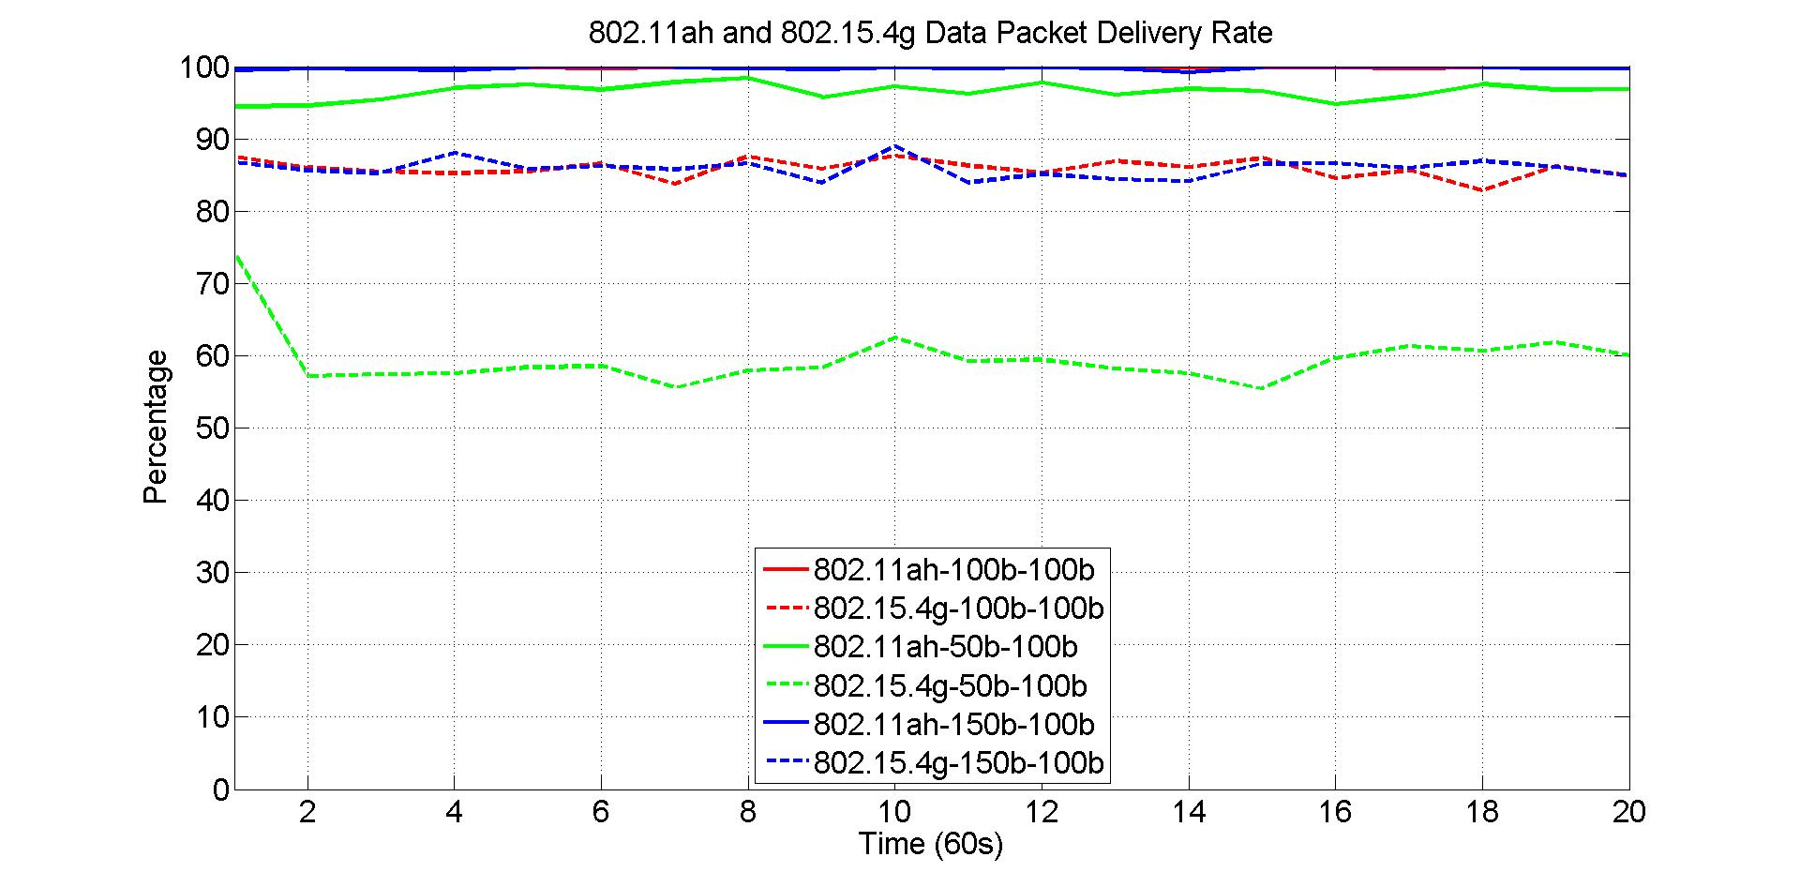
802.11ah Packet Size Impact on Packet Delivery Rate
Solid lines are 802.11ah packet delivery rate
Dash lines are 802.15.4g packet delivery rate
802.11ah packet delivery rate
802.15.4g packet delivery rate
802.11ah packet size
802.15.4g packet size

Slide 54
Observations from Packet Delivery Rate w.r.t 802.11ah Packet Size
802.11ah packet size has impact on 802.11ah packet delivery rate
  For 50-byte packet, 802.11ah network delivers 96.66% of the packet
  For 150-byte packet, 802.11ah network delivers 99.89% of the packet
802.11ah packet size also has impact on 802.15.4g packet delivery rate
  For 50-byte packet, 802.15.4g packet delivery rate decreases about 27%
From perspective of packet delivery rate, 802.11ah node should send data with larger packet size

Slide 55
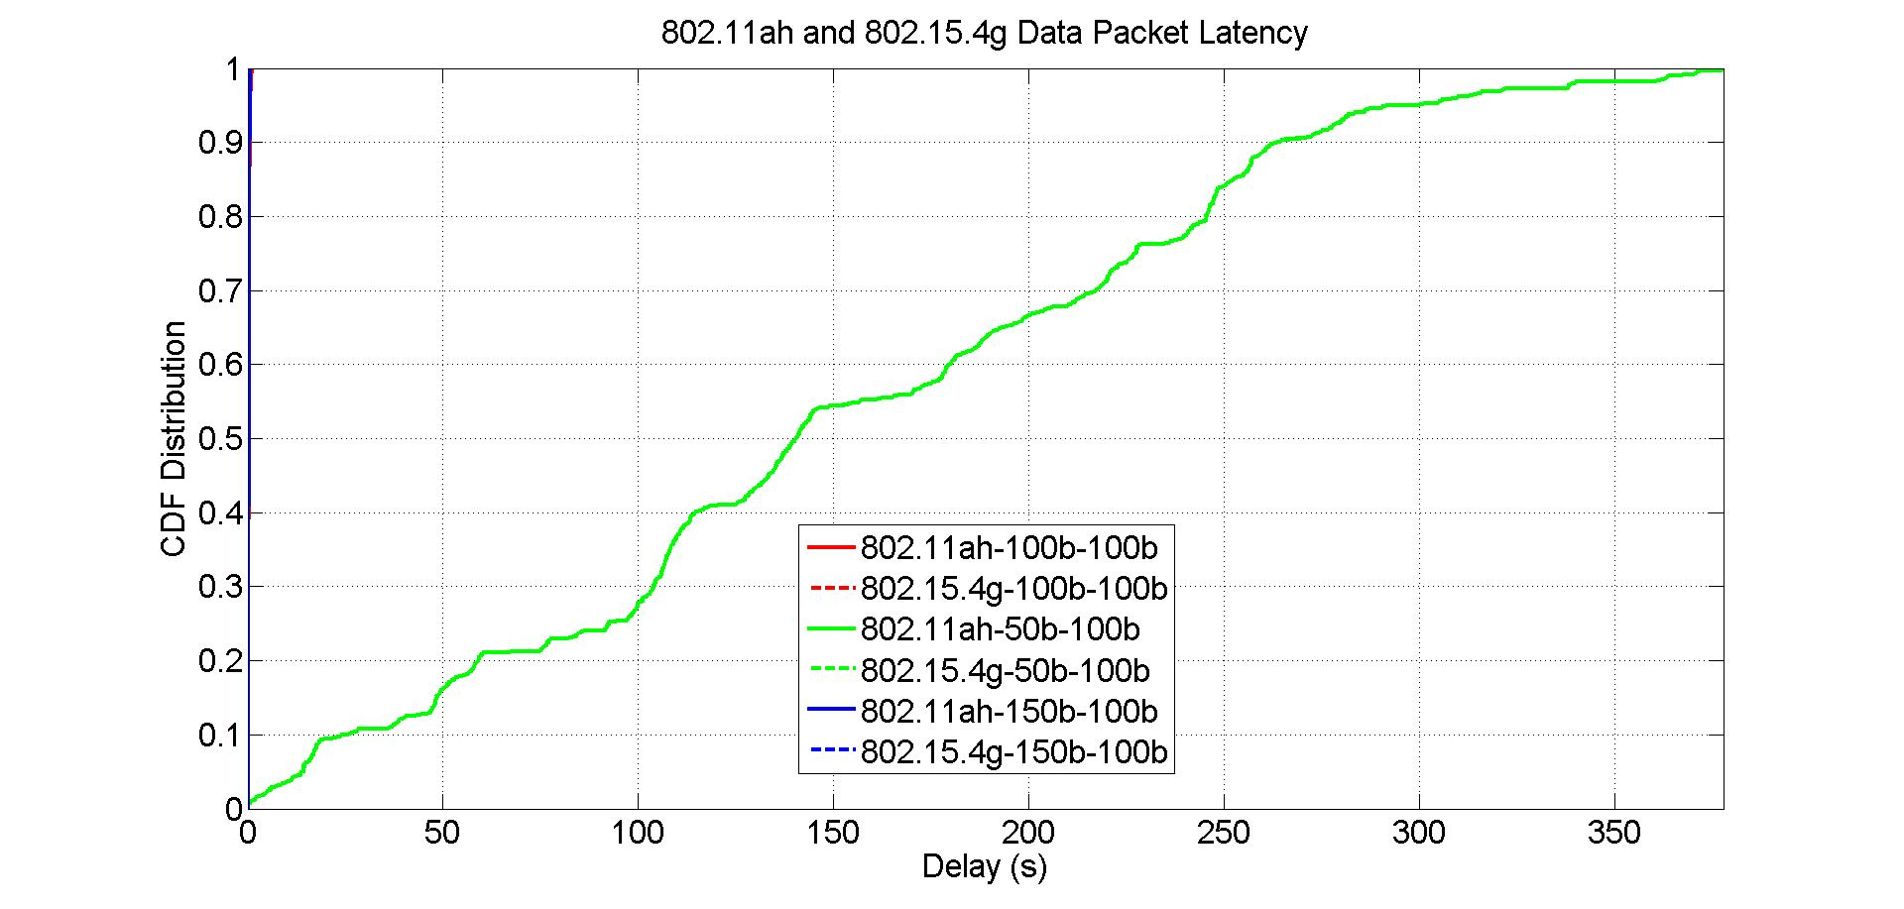
802.11ah Packet Size Impact on Packet Latency
Solid lines are 802.11ah packet latency
Dash lines are 802.15.4g packet latency
802.11ah packet latency for 50-byte packet

Slide 56
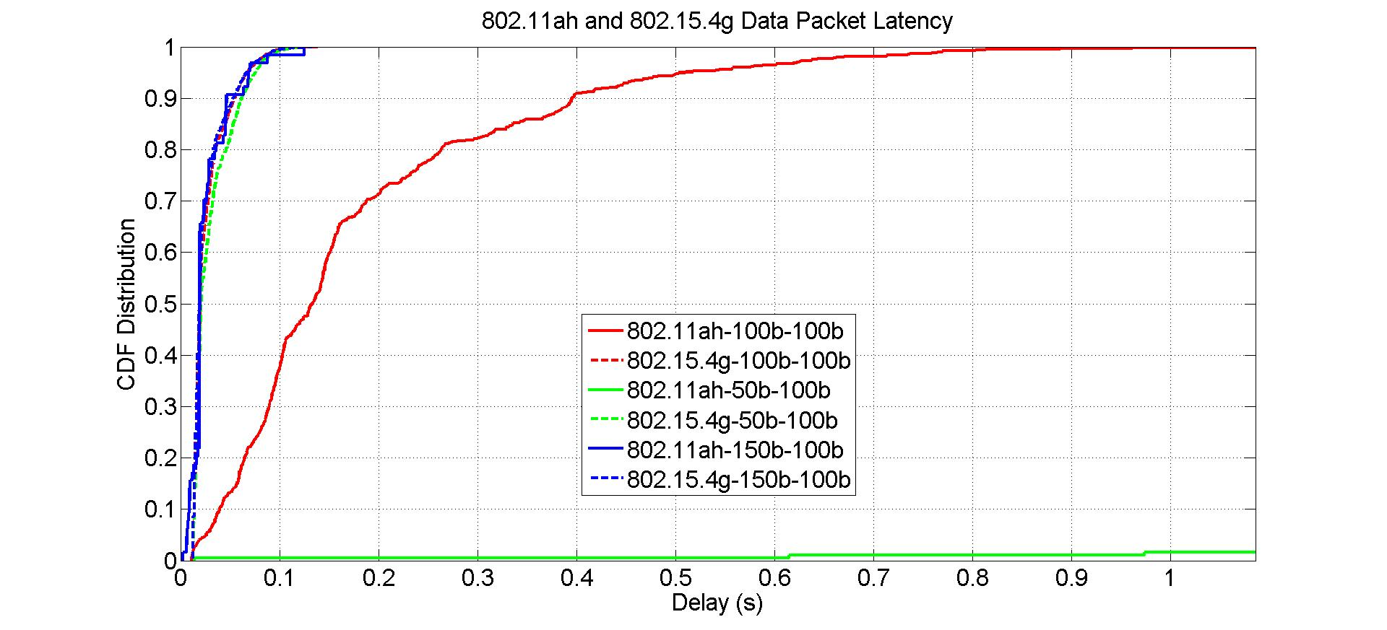
802.11ah Packet Size Impact on Packet Latency
Solid lines are 802.11ah packet latency
Dash lines are 802.15.4g packet latency
Zoom in view
802.11ah packet latency for 50-byte packet

Slide 57
Observations from Packet Latency w.r.t 802.11ah Packet Size
802.11ah packet size has little impact on 802.15.4g packet latency
802.11ah packet size has significant impact on 802.11ah packet latency
  50-byte packet significantly increases packet latency
  150-byte packet has shorter latency than 100-byte packet does
From perspective of packet latency, 802.11ah node should send data with larger packet size

Slide 58
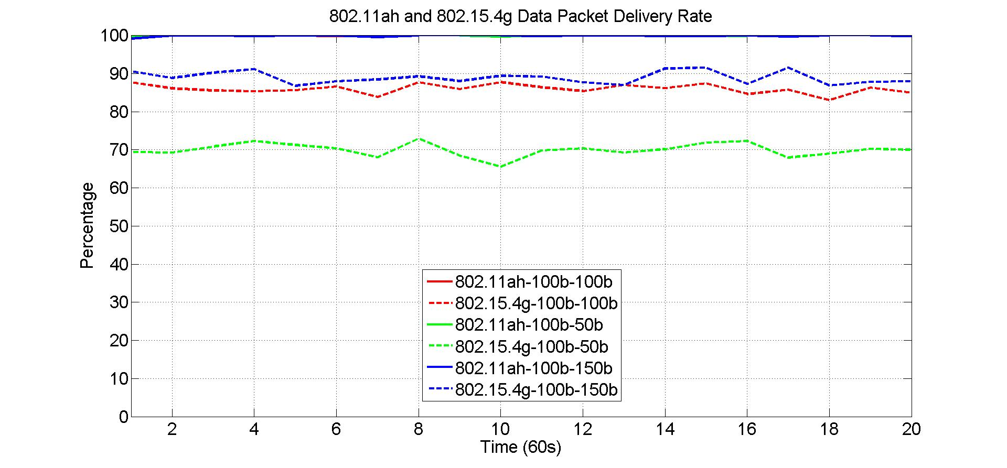
802.15.4g Packet Size Impact on Packet Delivery Rate
Solid lines are 802.11ah packet delivery rate
Dash lines are 802.15.4g packet delivery rate
802.11ah packet delivery rate

Slide 59
Observations from Packet Delivery Rate w.r.t 802.15.4g Packet Size
802.15.4g packet size has no impact on 802.11ah packet delivery rate
  For all cases, 802.11ah network delivers near 100% of the packet
802.15.4g packet size affects 802.15.4g packet delivery rate
  802.15.4g packet delivery rate decreases as its packet size decreases
  802.15.4g packet delivery rate increases slightly as its packet size increases
From perspective of packet delivery rate, 802.15.4g node should send data with larger packet size

Slide 60
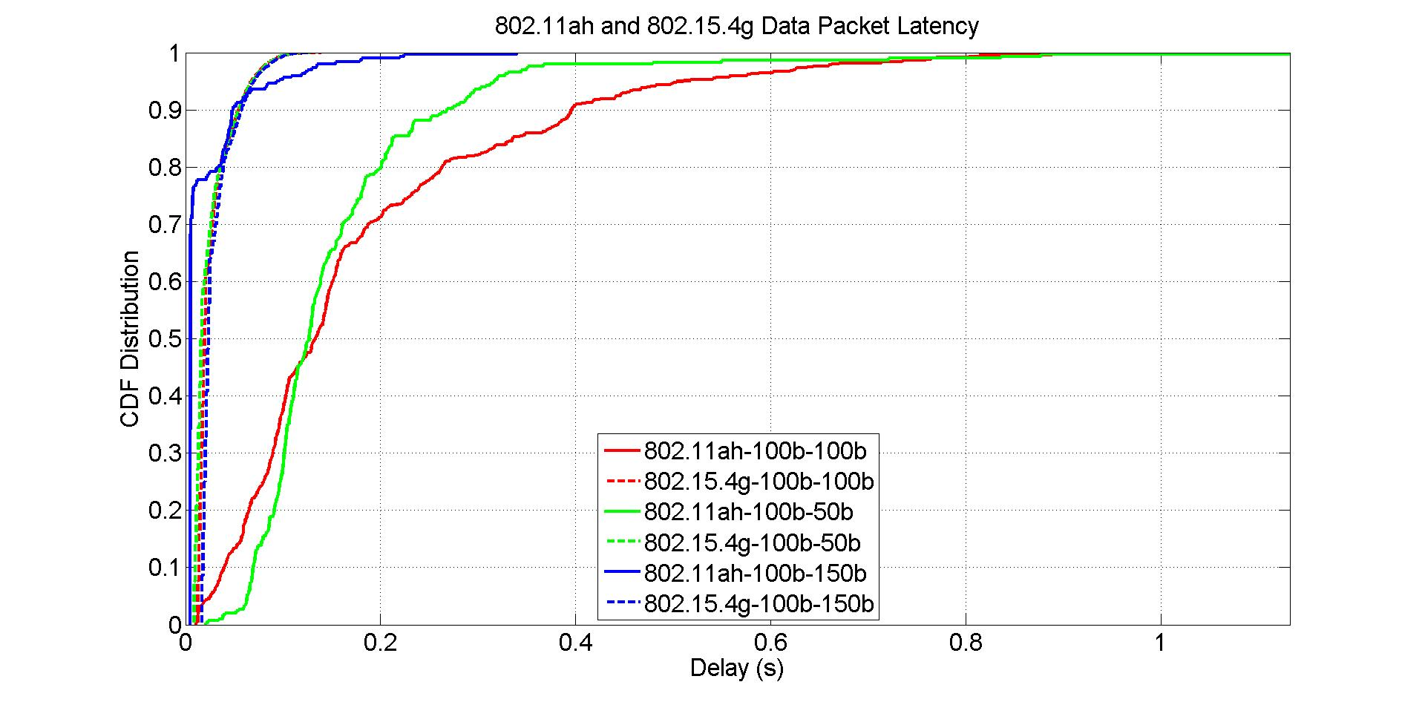
802.15.4g Packet Size Impact on Packet Latency
Solid lines are 802.11ah packet latency
Dash lines are 802.15.4g packet latency

Slide 61
Observations from Packet Latency w.r.t 802.15.4g Packet Size
802.15.4g packet size has little impact on 802.15.4g packet latency
802.15.4g packet size has more impact on 802.11ah packet latency
  802.11ah packet latency decreases slightly as 802.15.4g packet decreases
  802.11ah packet latency decreases more as 802.15.4g packet increases
From perspective of 802.15.4g packet latency, 802.15.4g should send data with larger packet size

Slide 62
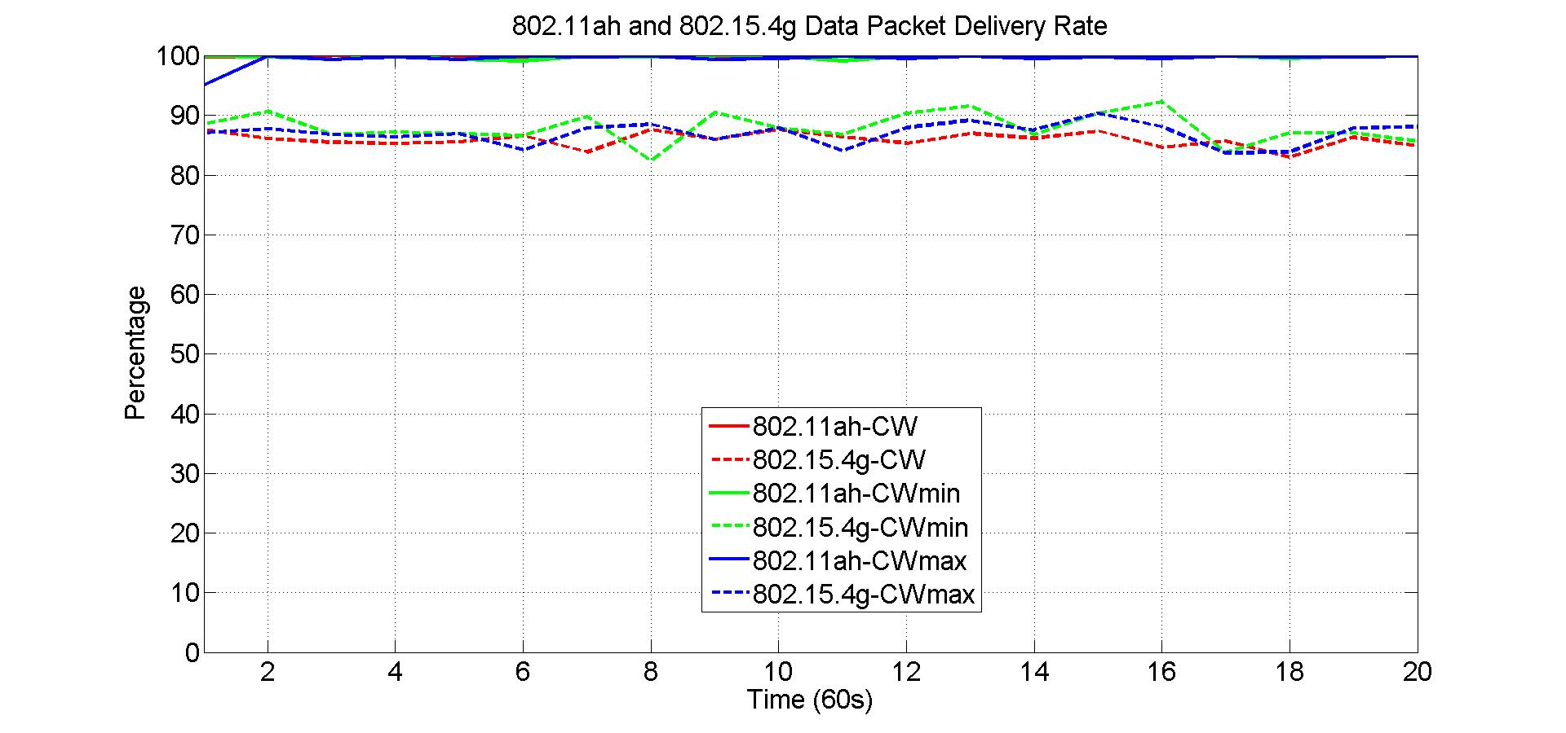
802.11ah Contention Window Impact on Packet Delivery Rate
Solid lines are 802.11ah packet delivery rate
Dash lines are 802.15.4g packet delivery rate
802.11ah packet delivery rate

Slide 63
Observations from Packet Delivery Rate w.r.t 802.11ah Contention Window
802.11ah backoff contention window has no impact on 802.11ah packet delivery rate
  For all cases, 802.11ah network delivers near 100% of the packet
802.11ah backoff contention window also has no impact on 802.15.4g packet delivery rate
From perspective of packet delivery rate, 802.11ah node does not need to adjust its backoff contention window, it should follow standard contention window configuration procedure

Slide 64
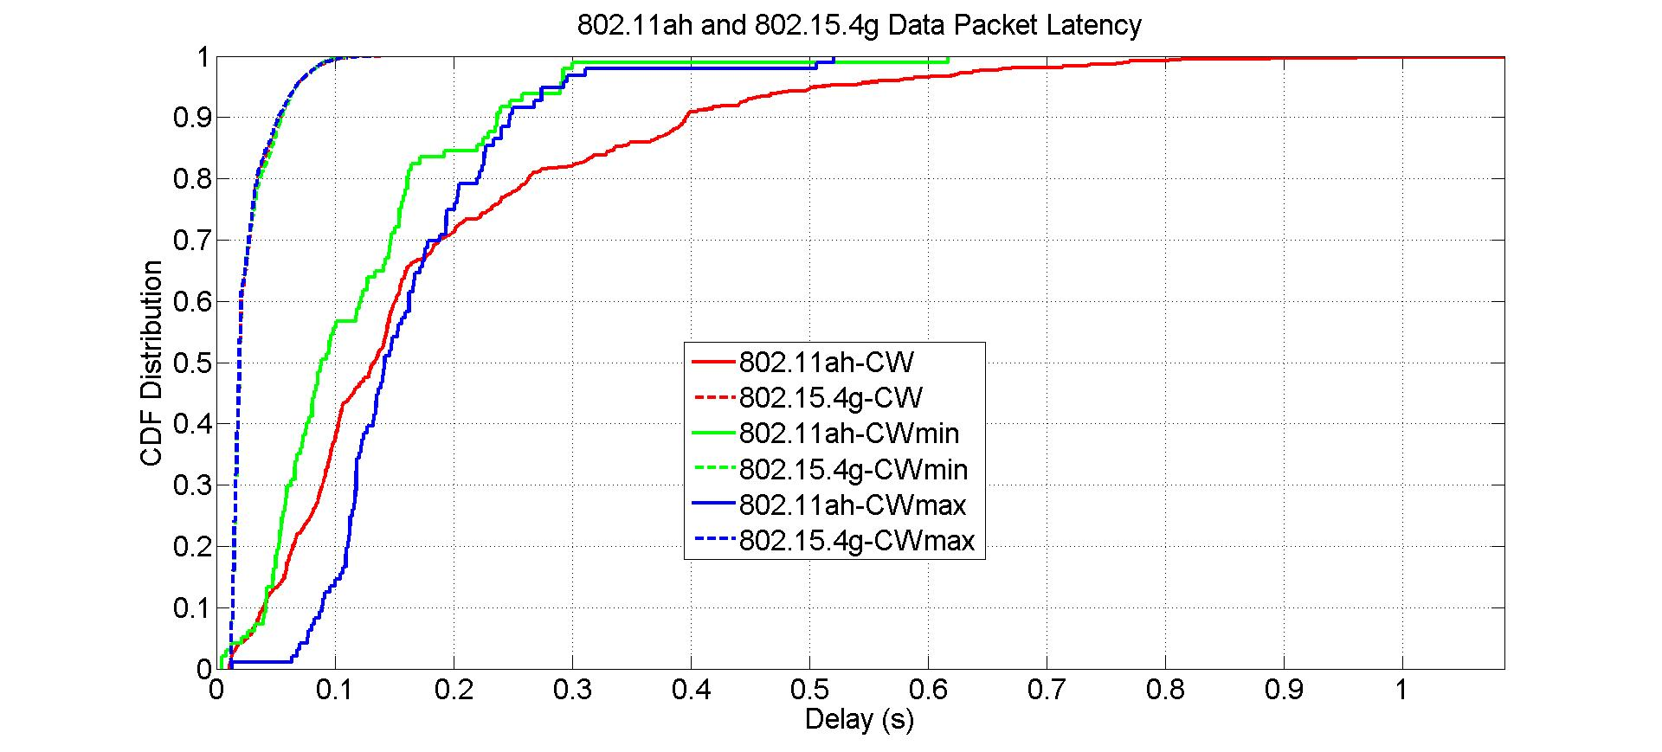
802.11ah Contention Window Impact on Packet Latency
Solid lines are 802.11ah packet latency
Dash lines are 802.15.4g packet latency

Slide 65
Observations from Packet Latency w.r.t 802.11ah Contention Window
802.11ah backoff contention window has no impact on 802.15.4g packet latency
802.11ah backoff contention window has impact on 802.11ah packet latency
  802.11ah packet latency is shorter for both smaller contention window size
From perspective of packet latency, 802.11ah node should send data with smaller backoff contention window size

Slide 66
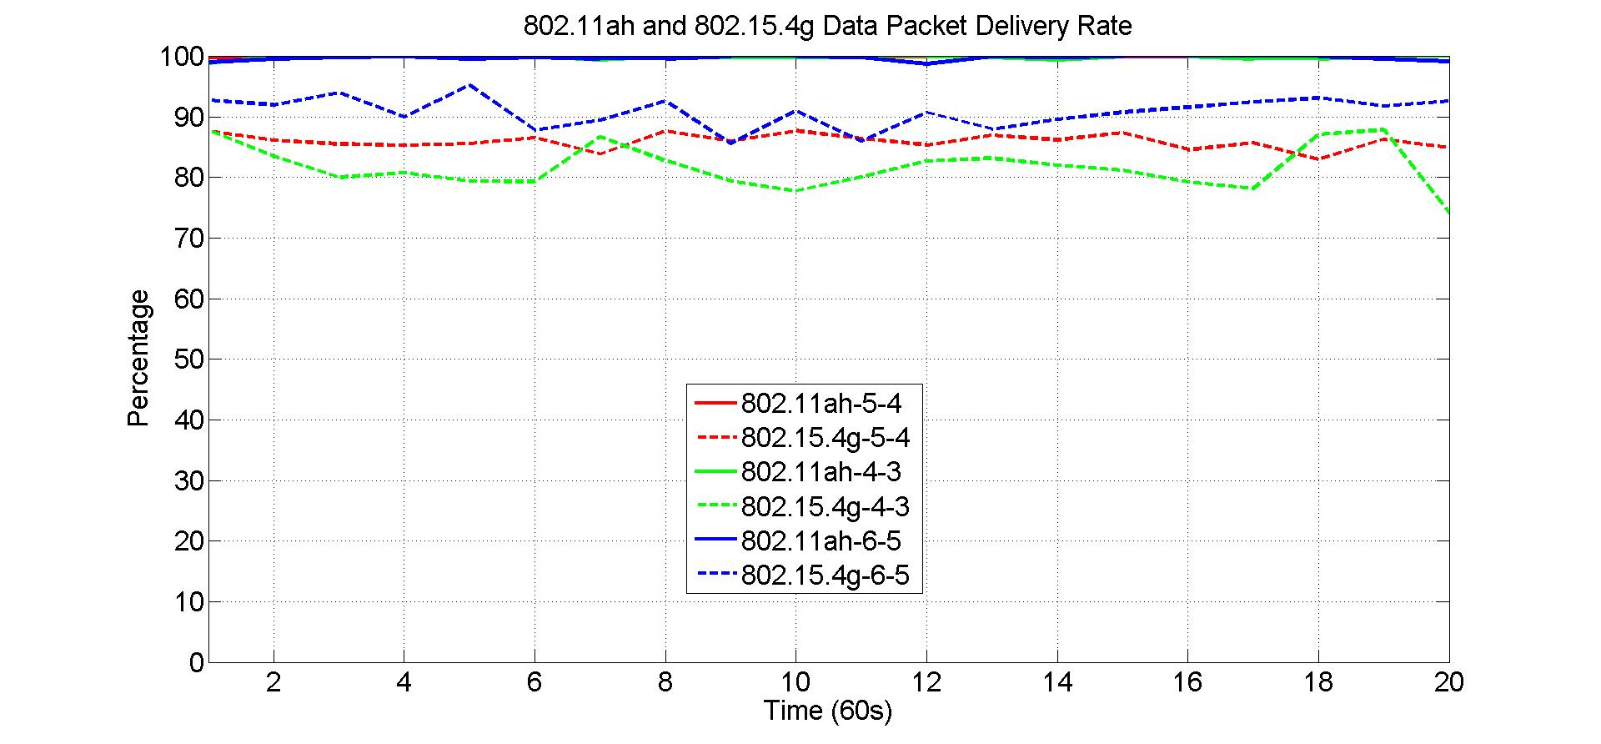
802.15.4g Backoff Parameter Impact on Packet Delivery Rate
Solid lines are 802.11ah packet delivery rate
Dash lines are 802.15.4g packet delivery rate
802.15.4g macMinBE = 2
macMaxBE and ReTry are variables
802.11ah packet delivery rate

Slide 67
Observations from Packet Delivery Rate w.r.t 802.15.4g Backoff Parameter
802.15.4g backoff parameters have no impact on 802.11ah packet delivery rate
  For all cases, 802.11ah network delivers near 100% of the packet
802.15.4g backoff parameters have small impact on 802.15.4g packet delivery rate
  802.15.4g packet delivery rate decreases as its backoff parameters decrease
  802.15.4g packet delivery rate increases as its backoff parameters increase
From perspective of packet delivery rate, 802.15.4g node should send data with larger backoff parameters

Slide 68
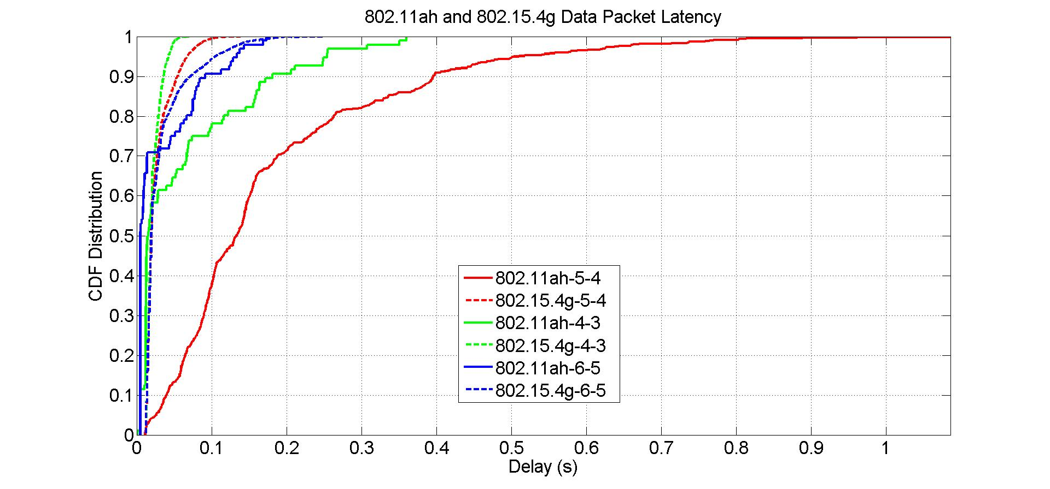
802.15.4g Backoff Parameter Impact on Packet Latency
Solid lines are 802.11ah packet latency
Dash lines are 802.15.4g packet latency
802.15.4g macMinBE = 2
macMaxBE and macMaxCSMABackoffs are variables

Slide 69
Observations from Packet Latency w.r.t 802.15.4g Backoff Parameter
802.15.4g backoff parameters have little impact on 802.15.4g packet latency
802.15.4g backoff parameters have small impact on 802.11ah packet latency
  802.11ah packet latency is longer for medium size 802.15.4g backoff parameters
From perspective of packet latency, 802.15.4g should send data with larger backoff parameters

Slide 70
Summary of Packet Size and Backoff Parameter Impact
802.11ah packet size
  has impact on 802.15.4g packet delivery rate and has little impact on 802.15.4g packet latency
  has impact on 802.11ah packet delivery rate
  has major impact on 802.11ah packet latency
  802.11ah node should send packet with larger size packet
802.15.4g packet size
  has impact on 802.15.4g packet delivery rate and has little impact on 802.15.4g packet latency
  has impact on 802.11ah packet latency and has no impact on 802.11ah packet delivery rate
  802.15.4g node should send packet with larger packet size
802.11ah backoff contention window
  has little impact on 802.15.4g performance and 802.11ah packet delivery rate
  has impact on 802.11ah packet latency
  802.11ah node should use smaller backoff contention window size
802.15.4g backoff parameters
  have no impact on 802.11ah packet delivery rate
  have small impact on 802.15.4g packet delivery rate
  has impact on 802.11ah packet latency and has little 802.15.4g packet latency
  802.15.4g node should send packet with larger backoff parameters

Slide 71
Part 5: Frame Size and Backoff Parameter
Network load
  20 kbps offered load for 802.11ah network
  40 kbps offered load for 802.15.4g network
Network size
  100 nodes for both 802.11ah network and 802.15.4g network

Slide 72
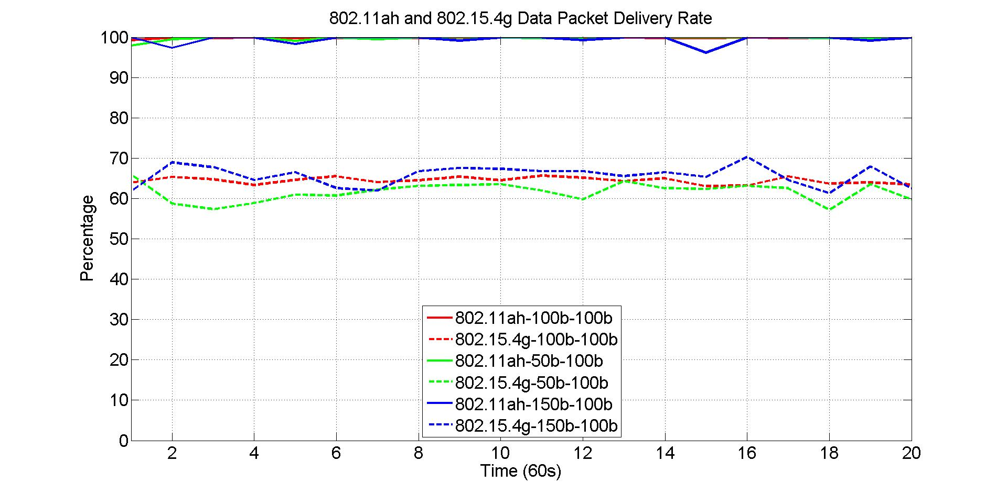
802.11ah Packet Size Impact on Packet Delivery Rate
Solid lines are 802.11ah packet delivery rate
Dash lines are 802.15.4g packet delivery rate
802.11ah packet delivery rate
802.15.4g packet delivery rate
802.11ah packet size
802.15.4g packet size

Slide 73
Observations from Packet Delivery Rate w.r.t 802.11ah Packet Size
802.11ah packet size has little impact on 802.11ah packet delivery rate
  For all cases, 802.11ah network delivers near 100% of the packet
802.11ah packet size also has little impact on 802.15.4g packet delivery rate
  802.15.4g packet delivery rate changes slightly as 802.11ah packet size changes
From perspective of packet delivery rate, 802.11ah node should send data with larger packet size

Slide 74
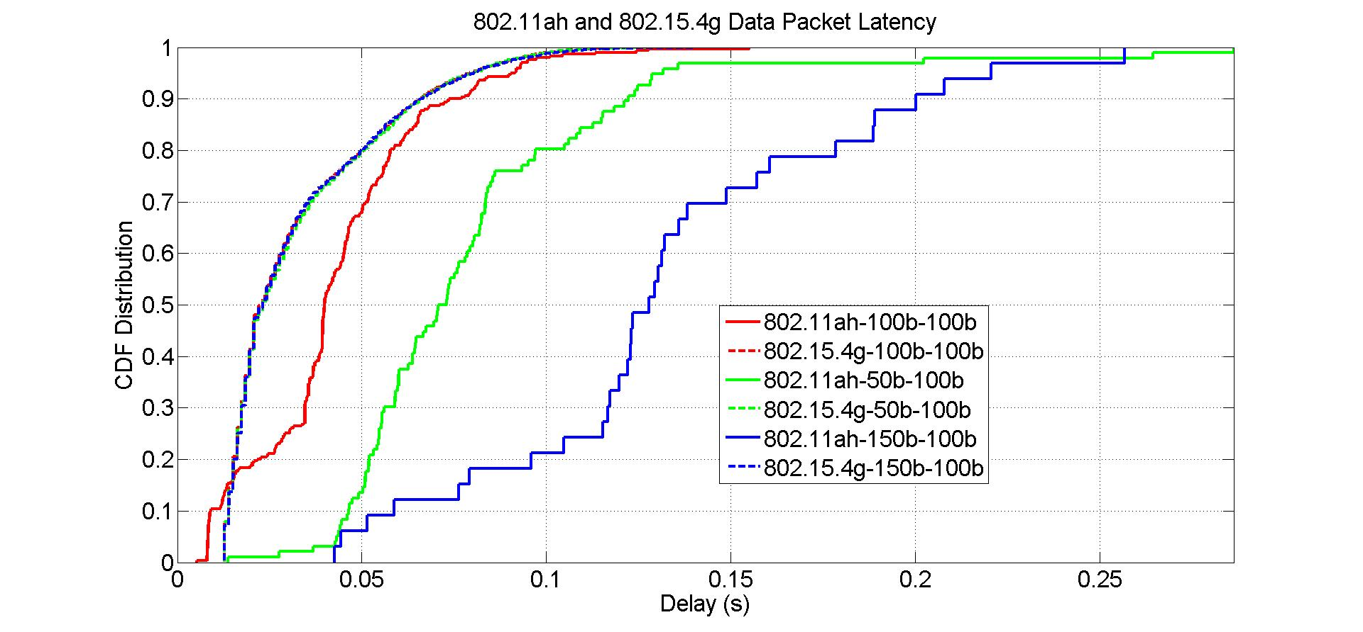
802.11ah Packet Size Impact on Packet Latency
Solid lines are 802.11ah packet latency
Dash lines are 802.15.4g packet latency
802.15.4g packet latency
802.11ah packet latency

Slide 75
Observations from Packet Latency w.r.t 802.11ah Packet Size
802.11ah packet size has no impact on 802.15.4g packet latency
802.11ah packet size has impact on 802.11ah packet latency
  50 bytes packet has more latency than 100 bytes packet does
  150 bytes packet has more latency than both 50 bytes packet and 100 bytes packet do
From perspective of packet latency, 802.11ah should send data with medium packet size

Slide 76
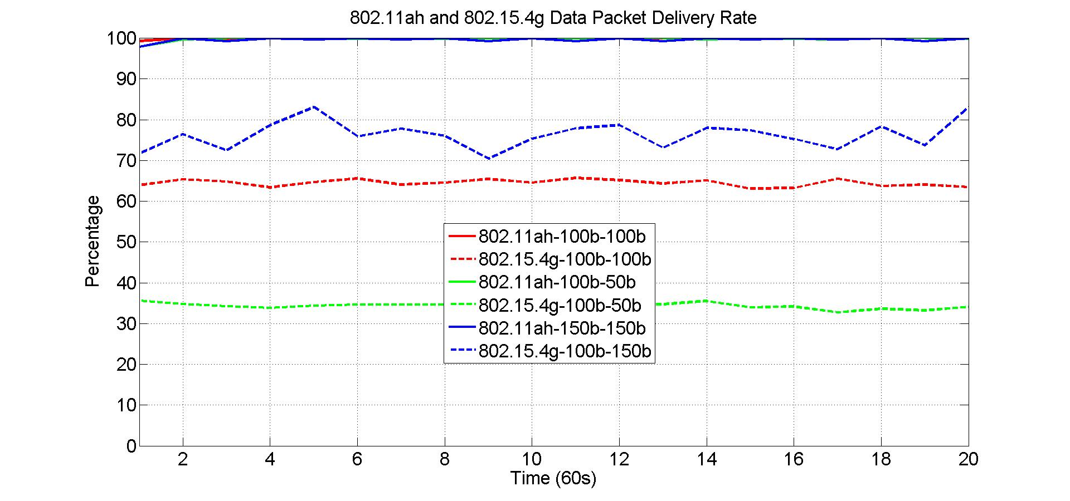
802.15.4g Packet Size Impact on Packet Delivery Rate
Solid lines are 802.11ah packet delivery rate
Dash lines are 802.15.4g packet delivery rate
802.11ah packet delivery rate

Slide 77
Observations from Packet Delivery Rate w.r.t 802.15.4g Packet Size
802.15.4g packet size has no impact on 802.11ah packet delivery rate
  For all cases, 802.11ah network delivers near 100% of the packet
802.15.4g packet size affects 802.15.4g packet delivery rate
  802.15.4g packet delivery rate decreases as its packet size decreases
  802.15.4g packet delivery rate increases as its packet size increases
From perspective of packet delivery rate, 802.15.4g node should send data with larger packet

Slide 78
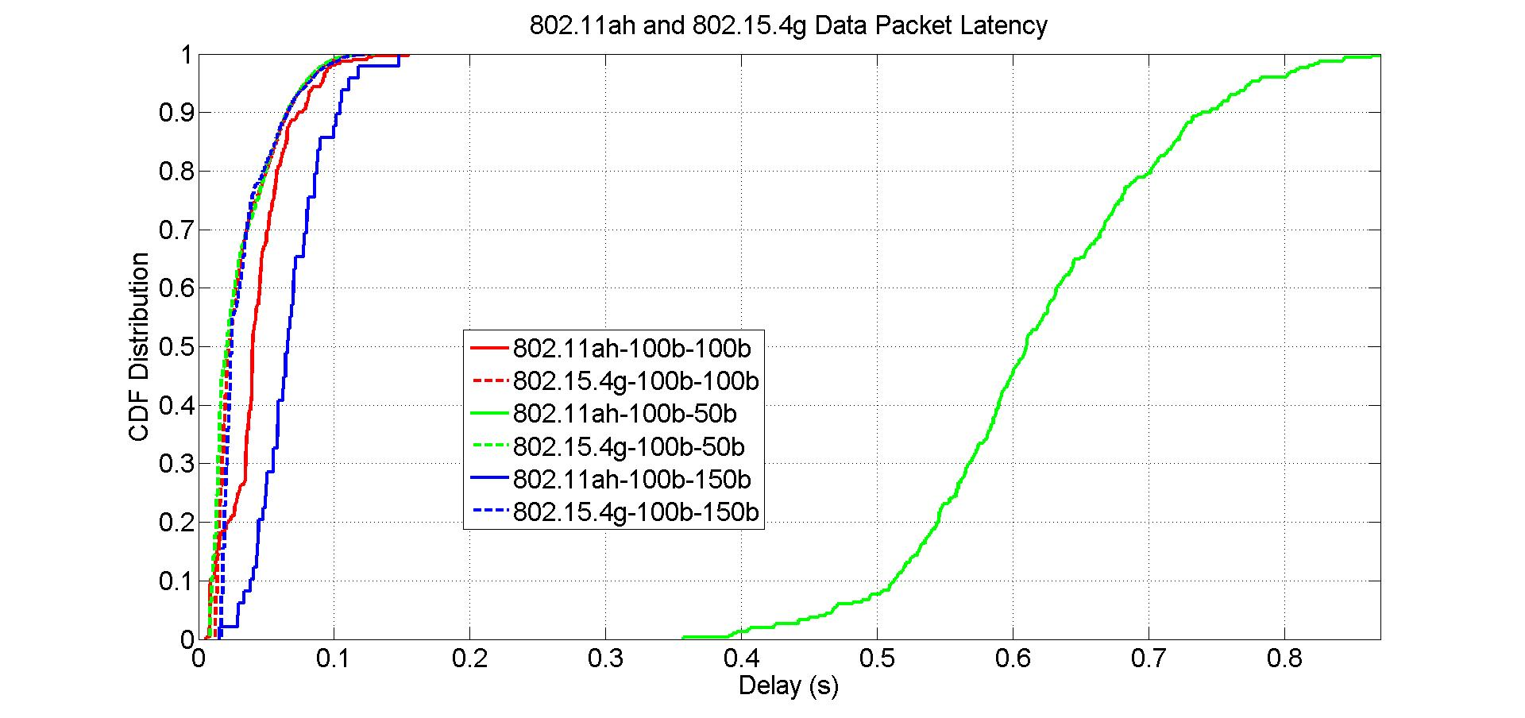
802.15.4g Packet Size Impact on Packet Latency
Solid lines are 802.11ah packet latency
Dash lines are 802.15.4g packet latency

Slide 79
Observations from Packet Latency w.r.t 802.15.4g Packet Size
802.15.4g packet size has little impact on 802.15.4g packet latency
802.15.4g packet size has impact on 802.11ah packet latency
  802.11ah packet latency increases as 802.15.4g packet decreases
  802.11ah packet latency increases slightly as 802.15.4g packet increases
From perspective of packet latency, 802.15.4g node should send data with medium packet size

Slide 80
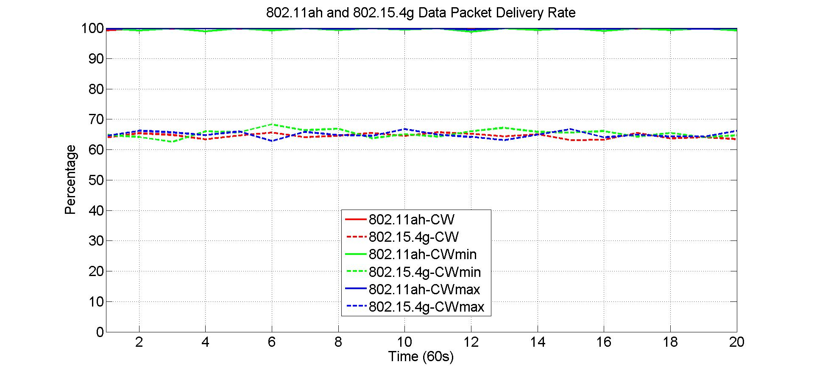
802.11ah Contention Window Impact on Packet Delivery Rate
Solid lines are 802.11ah packet delivery rate
Dash lines are 802.15.4g packet delivery rate
802.11ah packet delivery rate
802.15.4g packet delivery rate
802.11ah backoff contention window

Slide 81
Observations from Packet Delivery Rate w.r.t 802.11ah Contention Window
802.11ah backoff contention window has little impact on 802.11ah packet delivery rate
  For all cases, 802.11ah network delivers near 100% of the packet
802.11ah backoff contention window also has little impact on 802.15.4g packet delivery rate
From perspective of packet delivery rate, 802.11ah node does not need to adjust its backoff contention window, it should follow standard contention window configuration procedure

Slide 82
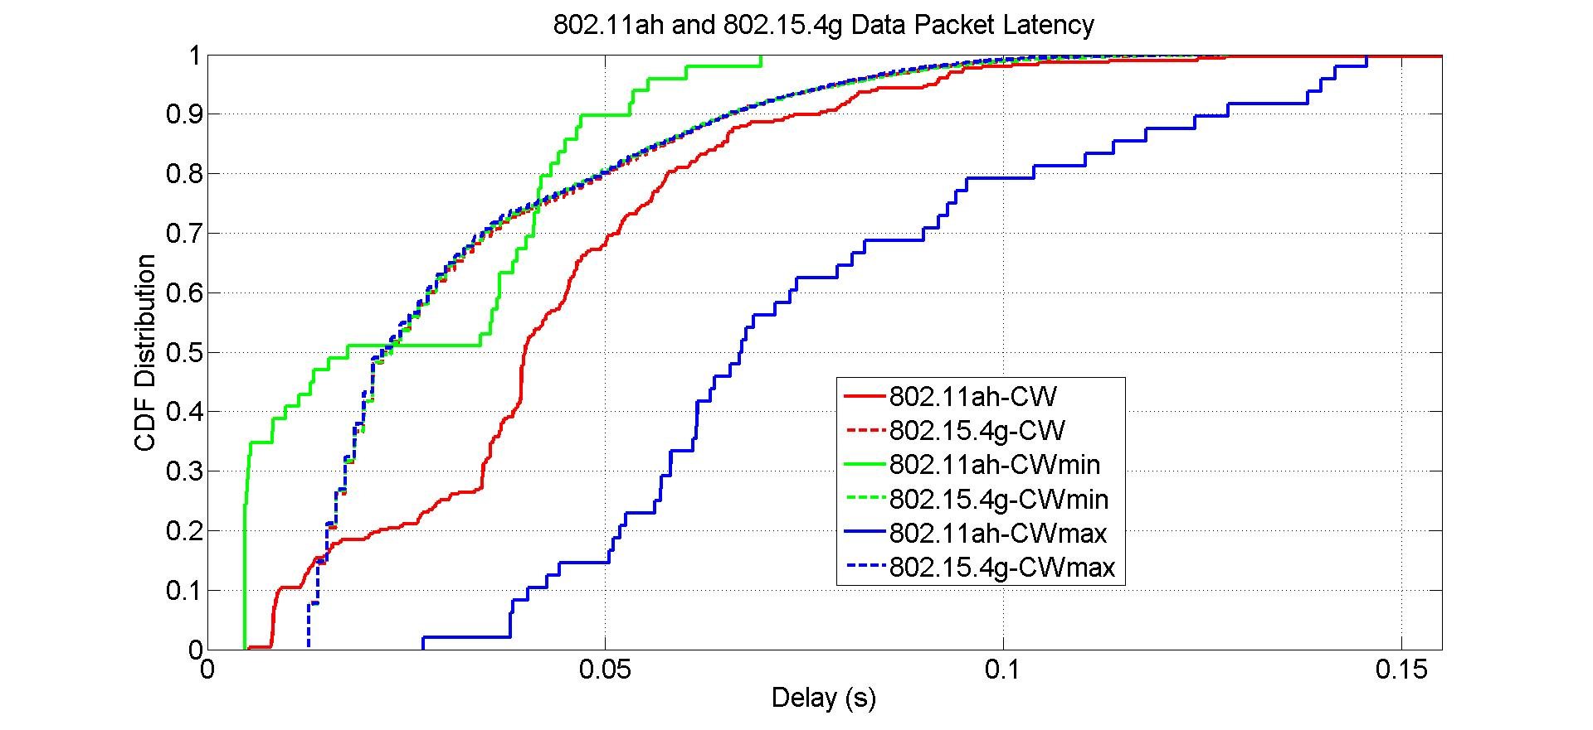
802.11ah Contention Window Impact on Packet Latency
Solid lines are 802.11ah packet latency
Dash lines are 802.15.4g packet latency

Slide 83
Observations from Packet Latency w.r.t 802.11ah Contention Window
802.11ah backoff contention window has no impact on 802.15.4g packet latency
802.11ah backoff contention window has impact on 802.11ah packet latency
  802.11ah packet latency is proportional to 802.11ah contention window size
From perspective of packet latency, 802.11ah should send packet with smaller backoff contention window size

Slide 84
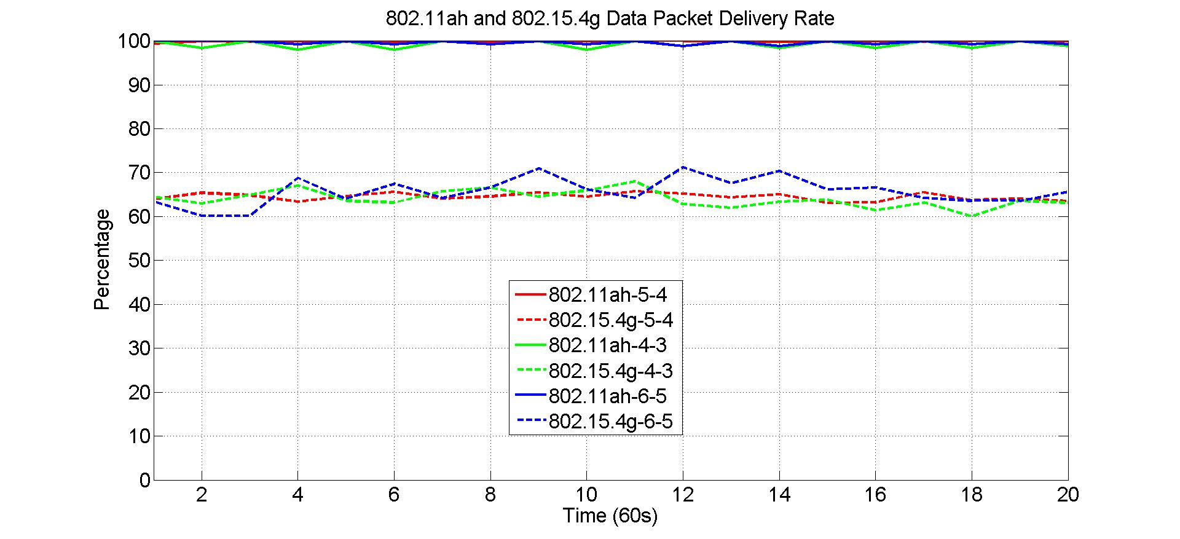
802.15.4g Backoff Parameter Impact on Packet Delivery Rate
Solid lines are 802.11ah packet delivery rate
Dash lines are 802.15.4g packet delivery rate
802.15.4g macMinBE = 3
macMaxBE and macMaxCSMABackoffs are variables
802.11ah packet delivery rate

Slide 85
Observations from Packet Delivery Rate w.r.t 802.15.4g Backoff Parameter
802.15.4g backoff parameters have no impact on 802.11ah packet delivery rate
  For all cases, 802.11ah network delivers near 100% of the packet
802.15.4g backoff parameters have little impact on 802.15.4g packet delivery rate
From perspective of packet delivery rate, 802.15.4g node should send data with larger backoff parameters

Slide 86
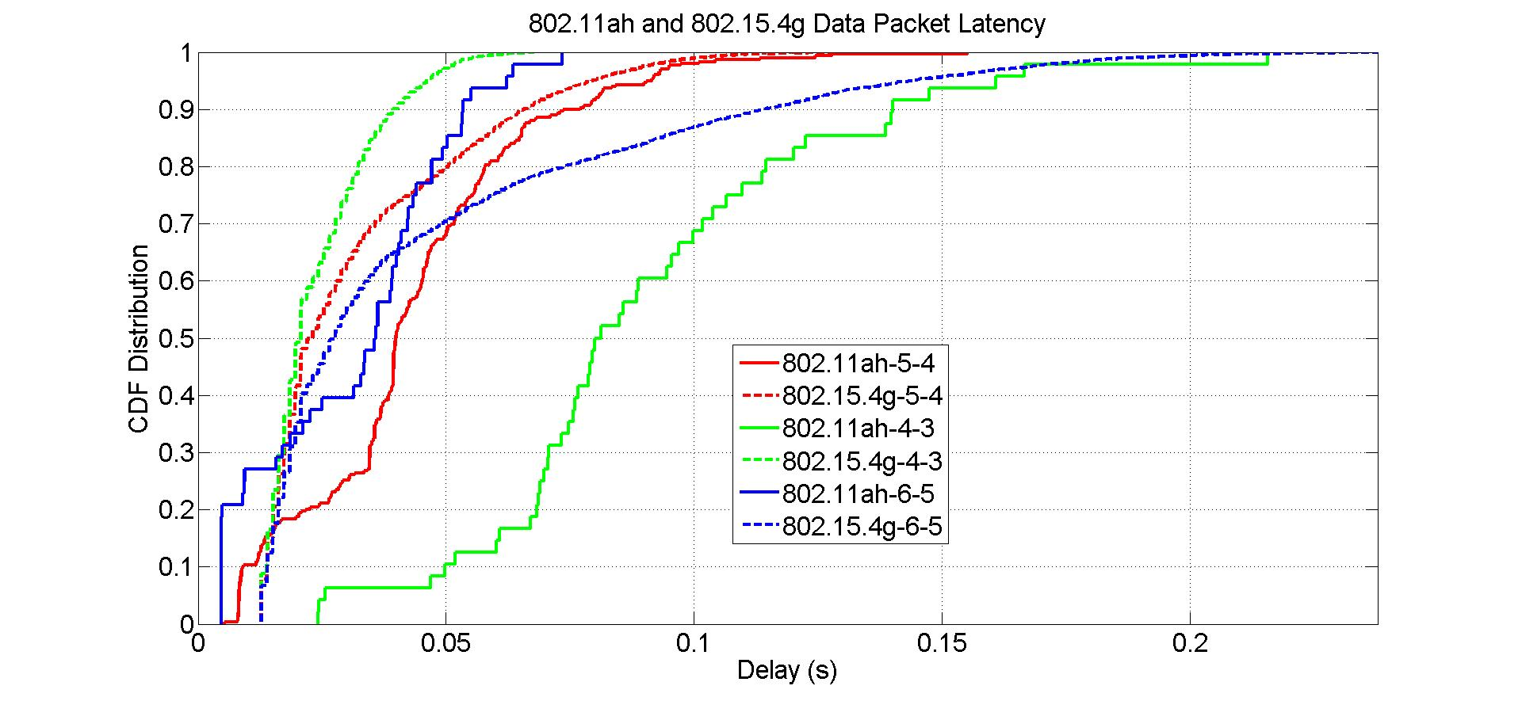
802.15.4g Backoff Parameter Impact on Packet Latency
Solid lines are 802.11ah packet latency
Dash lines are 802.15.4g packet latency
802.15.4g macMinBE = 3
macMaxBE and macMaxCSMABackoffs are variables

Slide 87
Observations from Packet Latency w.r.t 802.15.4g Backoff Parameter
802.15.4g backoff parameters have impact on 802.15.4g packet latency
  Smaller backoff parameters decrease 802.15.4g packet latency
  Larger backoff parameters increase 802.15.4g packet latency
802.15.4g backoff parameters have impact on 802.11ah packet latency
  Smaller backoff parameters increase 802.11ah packet latency
  Larger backoff parameters decrease 802.11ah packet latency
From perspective of 802.15.4g packet latency, 802.15.4g should send data with smaller backoff parameters
From perspective of 802.11ah packet latency, 802.15.4g should send data with larger backoff parameters

Slide 88
Summary of Packet Size and Backoff Parameter Impact
802.11ah packet size
  has little impact on 802.15.4g performance and 802.11ah packet delivery rate
  has major impact on 802.11ah packet latency
  802.11ah node should send packet with medium packet size
802.15.4g packet size
  has little impact on 802.11ah packet delivery rate and 802.15.4g packet latency
  has impact on 802.11ah packet latency and 802.15.4g packet delivery rate
  802.15.4g node should send packet with larger packet size
802.11ah backoff contention window
  has little impact on 802.15.4g performance and 802.11ah packet delivery rate
  has impact on 802.11ah packet latency
  802.11ah node should send packet with smaller backoff contention window size
802.15.4g backoff parameters
  have little impact on 802.11ah packet delivery rate
  have little impact on 802.15.4g packet delivery rate
  has opposite impact on 802.11ah packet latency and 802.15.4g packet latency
  802.15.4g node should send packet with larger backoff parameters if 802.11ah packet latency is critical and send packet with smaller backoff parameters if 802.15.4g packet latency is critical

