Slide 1
Sept 2019 Sub 1 GHz Task Group
Date: 2019-09-16
Authors:
Notice: This document has been prepared to assist IEEE 802.19. It is offered as a basis for discussion and is not binding on the contributing individual(s) or organization(s). The material in this document is subject to change in form and content after further study. The contributor(s) reserve(s) the right to add, amend or withdraw material contained herein.

Slide 2
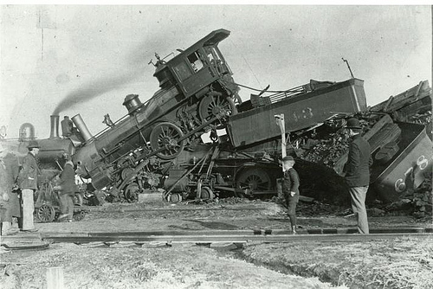
coexistence
noun
the state or fact of living or existing at the same time or in the same place.
Good Coexistence => rapidly growing opportunity
Poor Coexistence => missed opportunity

Slide 3
Task Group Organization
Chair: Ben Rolfe
Recording secretary: TBD
Vice Chair: Shoichi Kitazawa
Technical Editor: Jianlin Guo
Notes:
1. Secretary volunteer: Harry Bims

Slide 4
Opening
Meeting Preamble
Review and Approve Agenda
Review Objectives
Plan for the week

Slide 5
Sub-1GHz Coexistence Task Group
Recommended Practice for Local and Metropolitan Area Networks - Part 19: Coexistence Methods for 802.11 and 802.15.4 based systems operating in the Sub-1 GHz Frequency Bands
Scope:
This recommended practice provides guidance on the implementation, configuration and commissioning of systems sharing spectrum between IEEE Std 802.11ah-2016 and IEEE Std 802.15.4 Smart Utility Networking (SUN) Frequency Shift Keying (FSK) Physical Layer (PHY) operating in Sub-1 GHz frequency bands.

Slide 6
Meeting Preamble
Be aware of:
https://development.standards.ieee.org/myproject/Public/mytools/mob/slideset.pdf
Any questions or disclosures?

Slide 7
Agenda
TG3 Agenda:
https://mentor.ieee.org/802.19/dcn/19/19-19-0057-01-0003-september-agenda.xlsx
Discussion
Approved of agenda

Slide 8
July Minutes
Minutes from May
https://mentor.ieee.org/802.19/dcn/19/19-19-0053-01-0003-july-minutes.docx
Discussion
Approval

Slide 9
Meeting Goals
Draft Development
Review contributions so far
Review draft outline and drafting plan
More Usage scenarios discussion
Report on outreach efforts
Hear contributions on use cases
Updates on situation in Japan
Update on simulation tools and results
Next steps

Slide 10
Overview and Schedule
January 2019 TG organization and first technical input, outline for RP content, issue Call for Proposals
March 2019 Review contributions and prepare call for proposals
May 2019 Initial call for proposals
July 2019 Hear technical proposals – start drafting process
Sept 2019 more proposals, draft development
Nov 2019 Draft Ready for WG Ballot
Jan 2020 Comment resolution and recirculate draft
March 2020 EC approval for Standards Association Ballot
April 2020 SA Ballot Comment Resolution, Recirculation
May 2020 SA Ballot Comment Resolution
June 2020 Final recirculation(s) (Stable Draft)
July 2020 EC approval to RevCom

Slide 11
Technical Presentations
Coexistence Simulation and Coexistence Issues
Coexistence Architecture Recommendation
Simulation Updates
EU bands
802.15.4w overview and status
Coordinated Coexistence Methods
Distributed Coexistence Methods
Measurement of Radio Noise and Interference over 920 MHz band in Japan
Document Framework Discussion

