Slide 1
Measurement of Radio Noise and Interference over 920 MHz band in Japan (II)
Date: 2019-09-17
Authors:
Notice: This document has been prepared to assist IEEE 802.19. It is offered as a basis for discussion and is not binding on the contributing individual(s) or organization(s). The material in this document is subject to change in form and content after further study. The contributor(s) reserve(s) the right to add, amend or withdraw material contained herein.

Slide 2
Abstract
In sub-1-GHz band, not only IEEE 802.11ah and IEEE 802.15.4 SUN, but also other radio system such as RFID coexist.
Moreover, several kinds of machinery emit powerful radio noise in this frequency band, and it may have a large impact on the system performance of wireless communication systems.
The previous contribution showed measurement results of radio noise and interference over the 920 MHz band at two railway stations, a university and an exhibition site in Japan [1].
This contribution shows additional measurement results of radio noise and interference over the 920 MHz band at a football stadium and another university in Japan.

Slide 3
Spectrum measurement over 920 MHz band in Japan
We measured the spectrum utilization in 920 MHz band at several places in Japan to survey the current spectrum use in this frequency band.
A football stadium with a game (August 2019).
A building in a University in a suburban area (different from [1], June 2019).

Slide 4
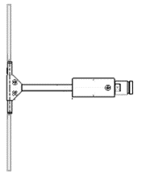
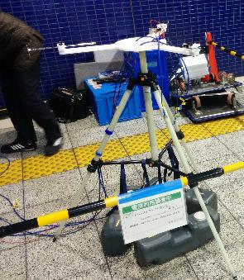
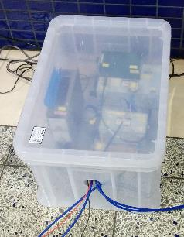
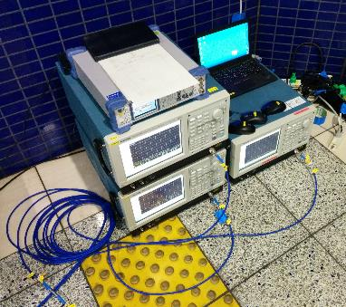
Measurement system
Spectrogram in the 920 MHz band is obtained using a real-time spectrum analyzer.
Dipole antenna
Band pass
filter
Low noise
amplifier
Real time
spectrum analyzer

Slide 5
Measurement location (1) Football stadium
We conducted measurement at multiple places in a football stadium when a game with 35,000 audiences was held. Measurement was conducted multiple times for each place.
Measurement place
Stand on the 3rd floor (P1)
Isle on the 3rd floor, near shops (P2)
Press section on 5th floor (P3)
Measurement time
Before the game
During the game
Halftime

Slide 6
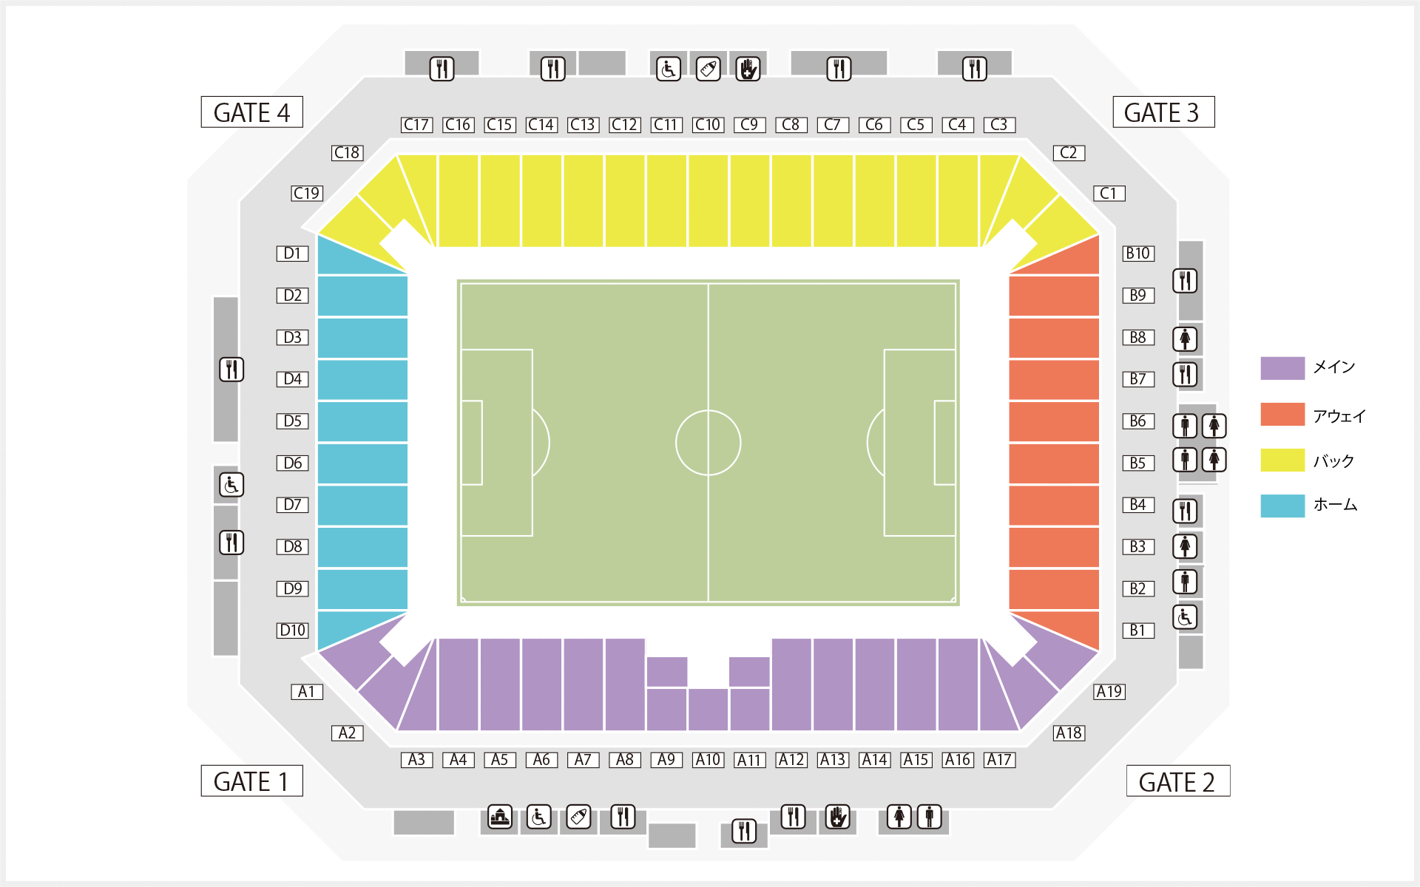
Measurement location (3rd floor) Football stadium
P1 (3rd floor)
P2 (3rd floor)
[a] Retrieved from https://www2.suitacityfootballstadium.jp/c/seat/images/img_seatmap_3f.gif

Slide 7
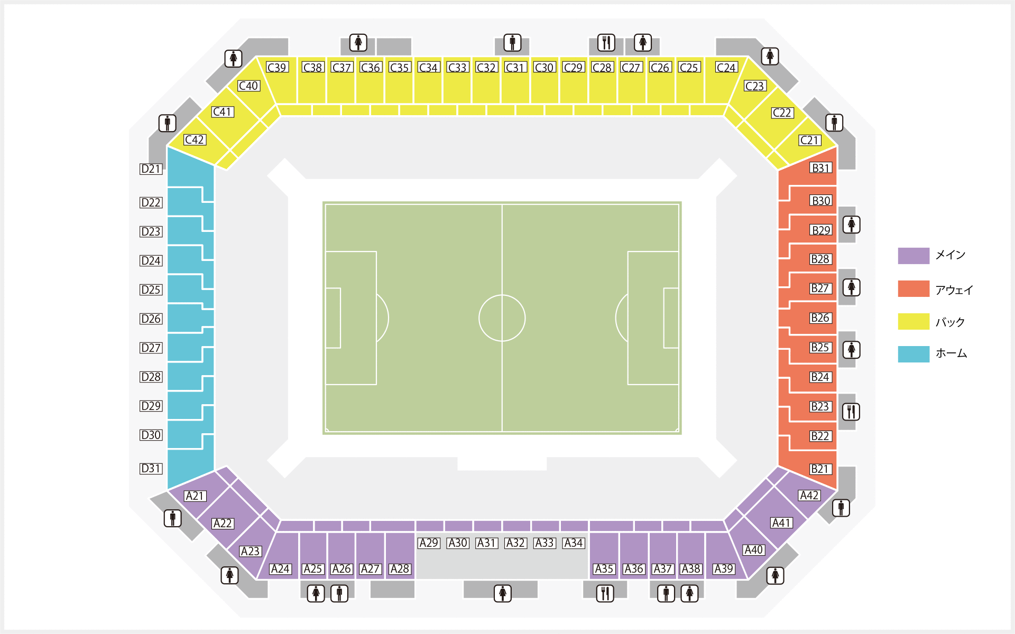
Measurement location (5th floor) Football stadium
P3 (5th floor)
[b] Retrieved from https://www2.suitacityfootballstadium.jp/c/seat/images/img_seatmap_5f.gif

Slide 8
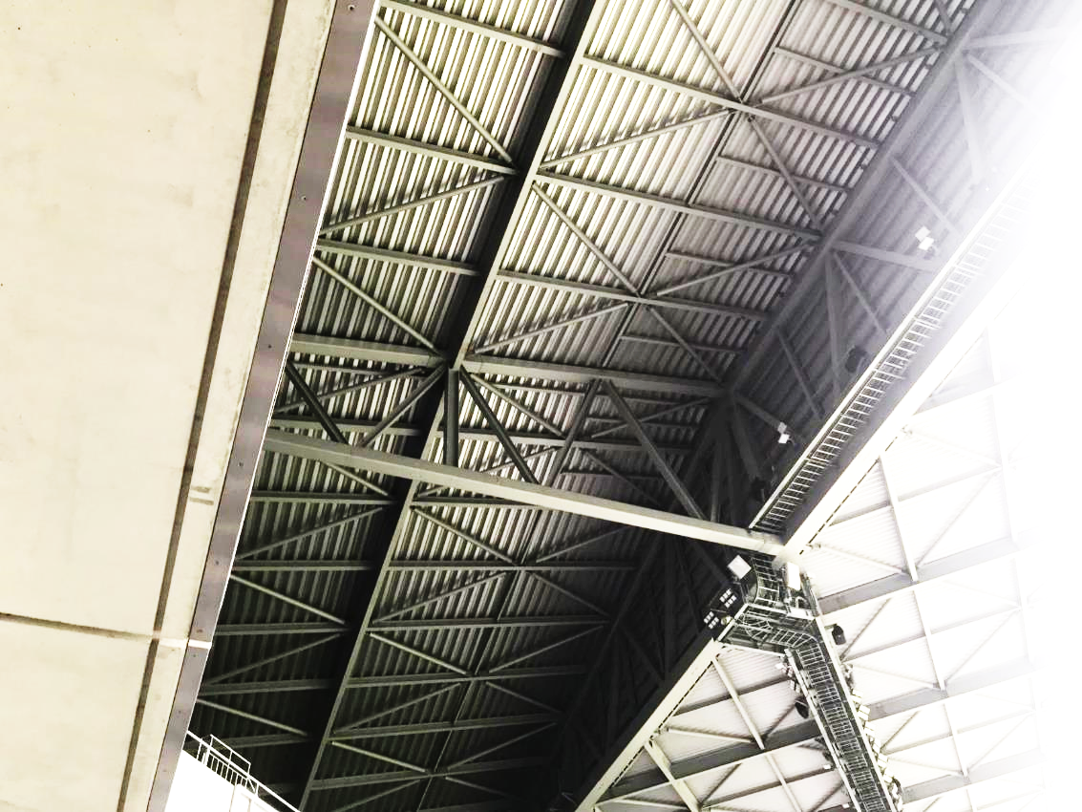
Measurement site (ceil of stand)
Access point of wireless LAN
(200 in total)
Loudspeaker

Slide 9
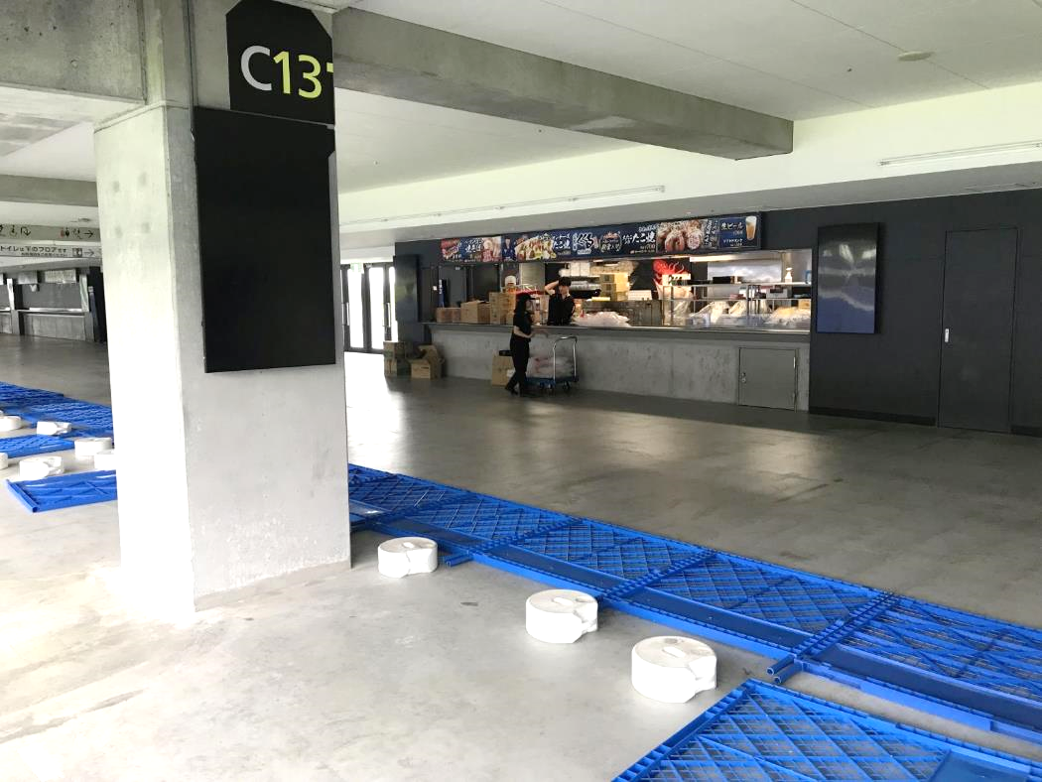
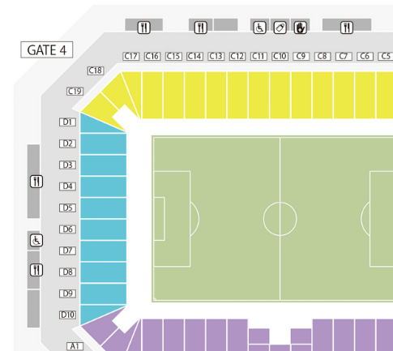
Measurement place (P1, third floor)
P1
Measurement place

Slide 10
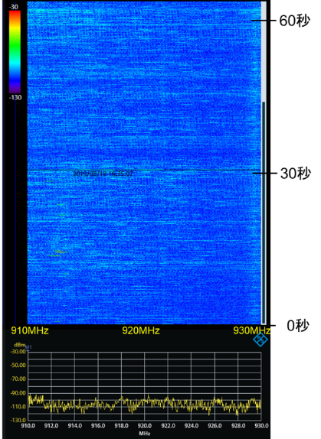
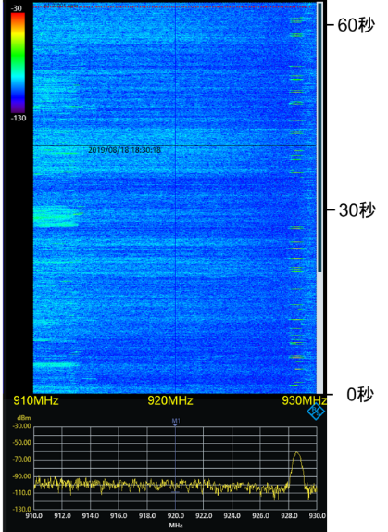
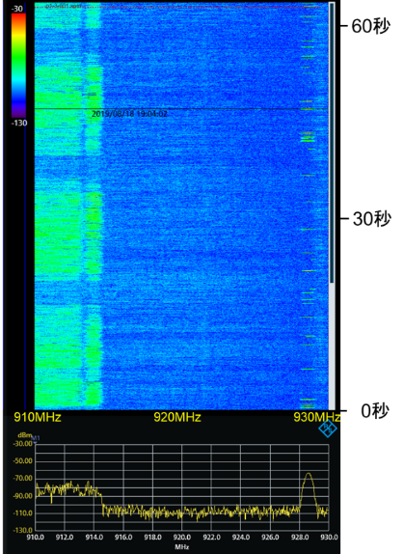
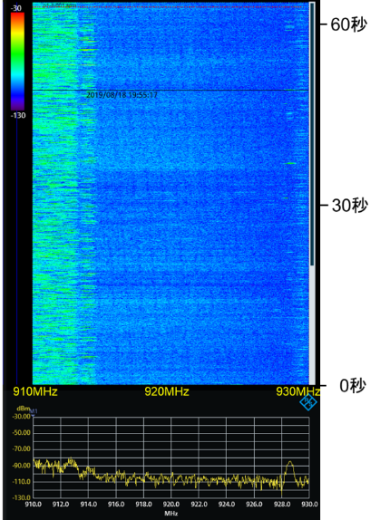
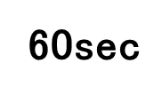
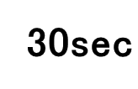
Measurement result at P1
Many cellular signals emitted in a game and the halftime (when many audiences are in the stadium). Sidelobe of such signals may interfere the systems in the 920 MHz band.
-30dBm
-80dBm
-130dBm per 300 kHz
2 hour before the game
30 minutes before the game
During the game (first half)
In the half time
Cellular
system
-30 dBm
-30 dBm
-30 dBm
-30 dBm
-70 dBm
-70 dBm
-70 dBm
-70 dBm
-110 dBm
-110 dBm
-110 dBm
-110 dBm

Slide 11
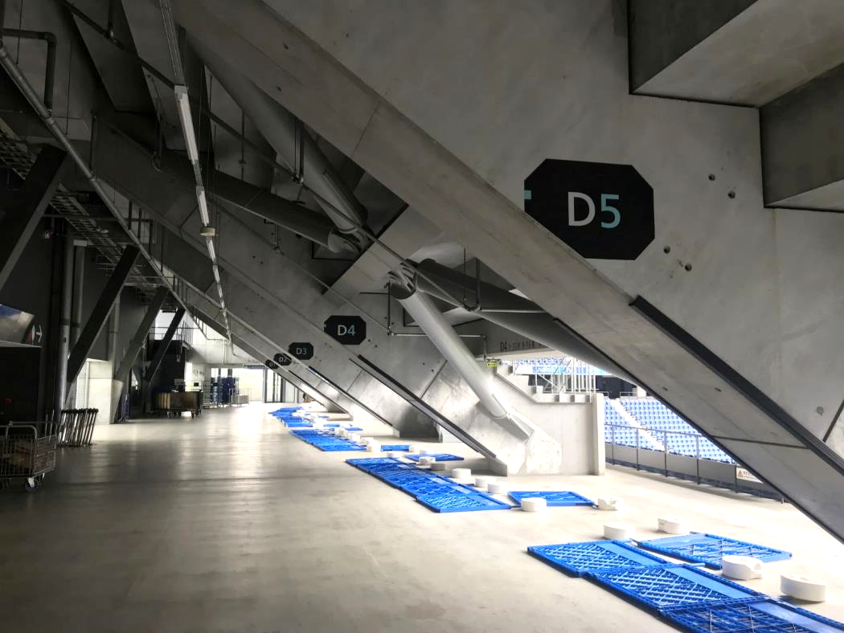
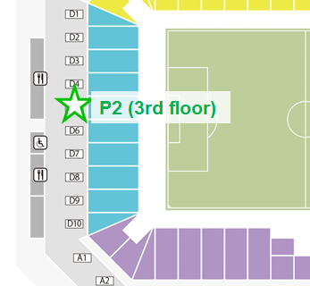
Measurement place (P2, third floor)
Measurement place

Slide 12
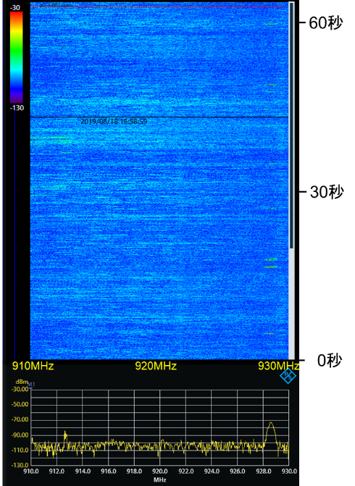
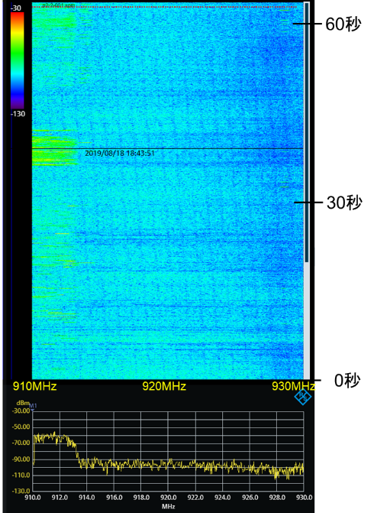
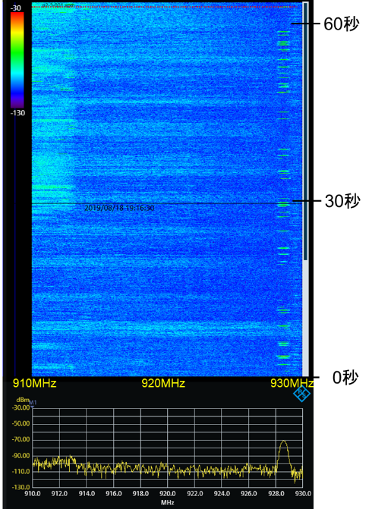
Measurement result at P2
Noise level is raised as audiences increases before the game. This would be due to sidelobe of cellular signals.
A wireless system for referee is employed in the game.
2 hour before the game
30 minutes before the game
During the game (first half)
Wireless system for football referee at 928.6 MHz
-30 dBm
-30 dBm
-30 dBm
-70 dBm
-70 dBm
-70 dBm
-110 dBm
-110 dBm
-110 dBm

Slide 13
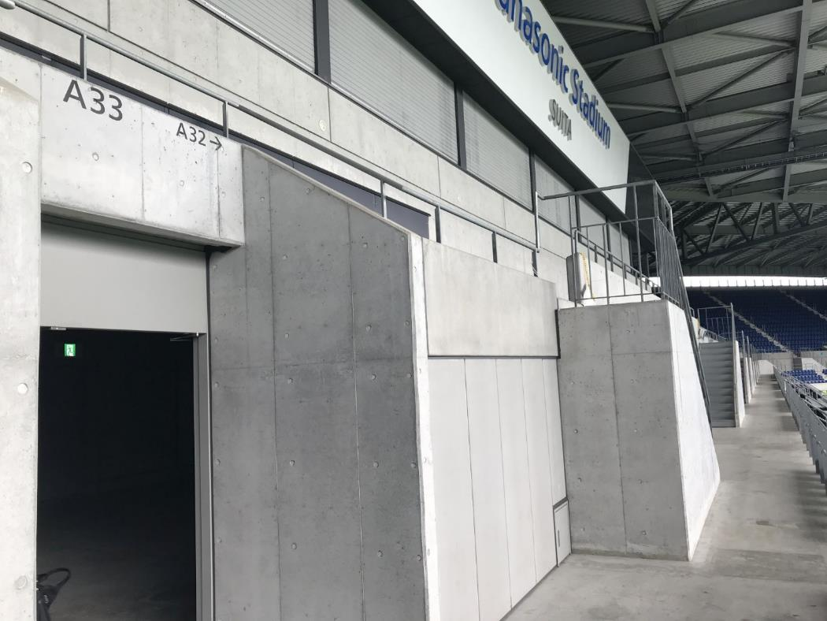
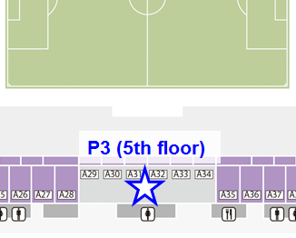
Measurement place (P3, fifth floor)
Measurement place

Slide 14
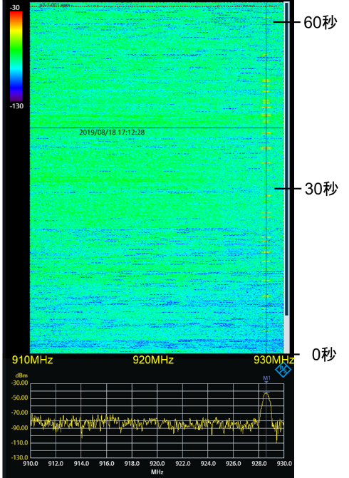
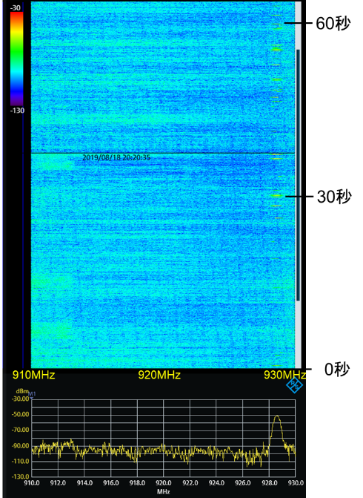
Measurement result at P3
Noise level is higher than the 3rd floor (P1 and P2). It is expected to be due to spurious from loudspeakers placed at the ceil of the stand.
2 hour before the game
During the game (second half)
-30 dBm
-30 dBm
-70 dBm
-70 dBm
-110 dBm
-110 dBm

Slide 15
Measurement location (2) Building of University
We also conducted measurement at multiple floors in a same building for R&D section in a university.
Measurement place
Space for relaxation on the 4th floor
Event space on the 1st floor

Slide 16
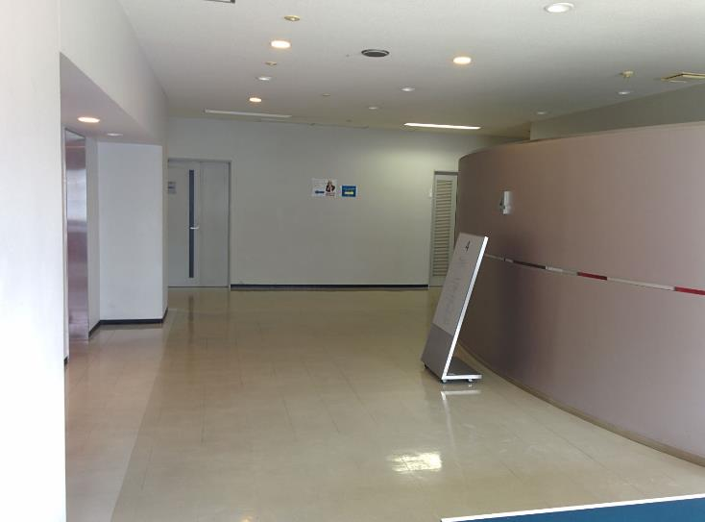
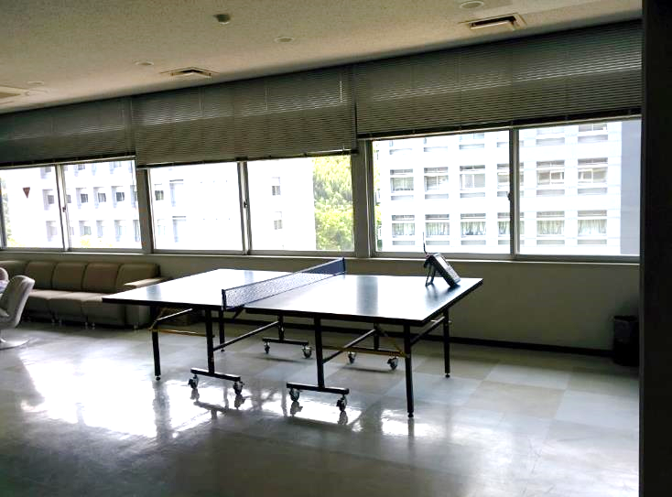
Measurement place (relaxation area)
Located at the 4th floor.
With a size of about 15 m x 15 m.
There are several laboratories in the same floor.
The measurement was conducted at 11 am.

Slide 17
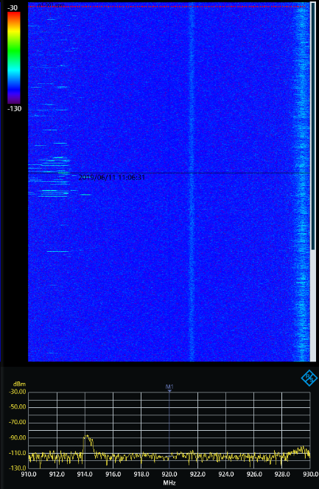
Measurement result at relaxation area
The channel is quiet and specific interference was not observed.
System noise of the measurement equipment at 921.6 MHz
910 MHz
920 MHz
930 MHz
-30 dBm
-70 dBm
-110 dBm

Slide 18
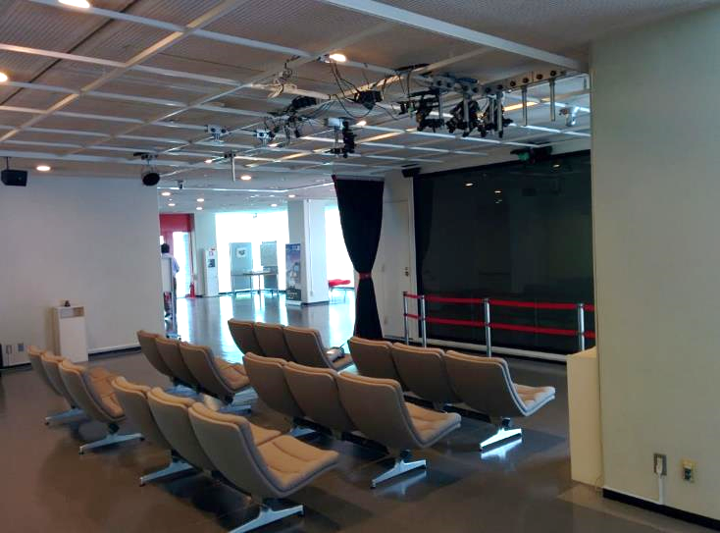
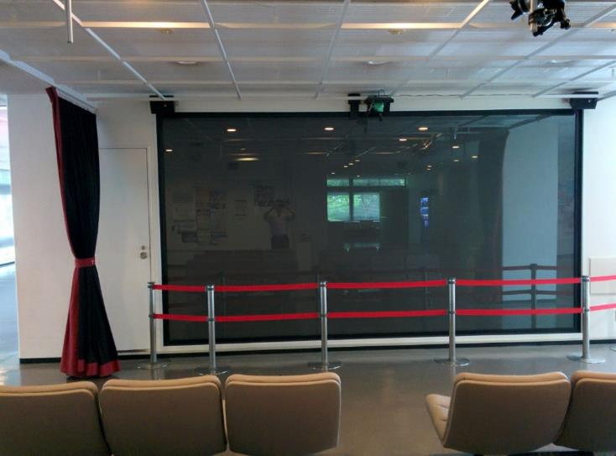
Measurement place (event space)
Located at the 1st floor.
With a size of about 10 m x 10 m.
There are many audio and visual equipment such as video cameras and loudspeakers.
Audio and visual equipment
(Video cameras and loudspeakers)
Measurement place

Slide 19
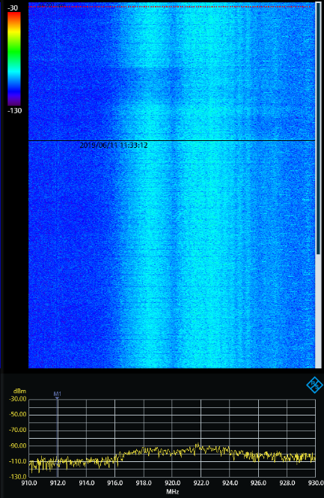
Measurement result at event space
Wideband noise was observed. It is assumed to be the spurious from video cameras and loudspeakers because the noise level becomes higher as the received antenna got closer to them.
Noise from audio and visual equipment.
910 MHz
920 MHz
930 MHz
-30 dBm
-70 dBm
-110 dBm

Slide 20
Summary
This contribution showed measurement results of radio noise and interference at a football station and in a building of a university over the 920 MHz band in Japan.
In the football stadium, interference from a cellular system was observed especially when there are many audiences.
In addition, wideband noise was observed both at the football stadium and the event space in a university, where many loudspeakers and video cameras are employed.
These noise may give a severe impact on the performance of both IEEE 802.11ah and IEEE 802.15.4 SUN.

Slide 21
References
[1] doc.: IEEE 802.19-19/0043r1

