Slide 1
Distributed Coexistence Methods Recommended for 802.11ah and 802.15.4g in Sub-1 GHz Band
Date: 2019-10-02
Authors:
Notice: This document has been prepared to assist IEEE 802.19. It is offered as a basis for discussion and is not binding on the contributing individual(s) or organization(s). The material in this document is subject to change in form and content after further study. The contributor(s) reserve(s) the right to add, amend or withdraw material contained herein.

Slide 2
Introduction
This document aims to propose distributed coexistence mechanisms for 802.11ah and 802.15.4g
This document assumes that no coordination between 802.11ah network and 802.15.4g network, each network or device performs distributed coexistence control
Network level
Device level, with or without network assistance
These methods are intended for Section 8 of the Recommended Practice being developed by 802.19.3 TG
Based on Table of Content in document #19-19/0035r3

Slide 3
How To Identify Existence of Other Network
Without a coordinator, it is not obvious for an 802.11ah network/802.15.4g network to be aware of existence of 802.15.4g network/802.11ah network
However, using energy detection, an 802.11ah STA/802.15.4g node can detect if a non-802.11ah/non-802.15.4g system exist
There might be other method for this purpose, e.g.,
The ratio of channel occupancy time by its own network and total channel busy time
Input from network
???

Slide 4
Channel Switching by 802.11ah/802.15.4g Network
802.11ah STAs/802.15.4g nodes report their observation to AP/PANC, e.g.,
Number of ED detection above ED threshold in a time period (for 802.15.4g, if ED is employed)
Packet delivery ratio (# of ACK/# of TX attempts)
Packet latency (from TX process start time to ACK receiving time)
802.11ah AP/802.15.4g PANC makes assessment based on reports and decides if channel switching is necessary
If decision is YES, 802.11ah AP/802.15.4g PANC scans other channels to assess the feasibility
If better channel is available, 802.11ah AP/802.15.4g PANC informs its network for channel switching
802.11ah STAs/802.15.4g nodes may also do channel scanning and report information to 802.11ah AP/802.15.4g PANC

Slide 5
Distributed Beamforming and TX Delay by 802.11ah
Sectorized beamforming
An 802.11ah STA can perform this operation if it knows 802.15.4g network deployment
Defer transmission for a particular interval
This is the most practical method to be executed by individual 802.11ah STA
If an 802.11ah STA is certain existence of non-802.11ah system, it can use this approach for coexistence control.

Slide 6
α-Fairness based ED-CCA by 802.11ah
α-Fairness based ED-CCA was presented in document #19-18/0027r1
Mitigate interference by higher ED threshold of 802.11ah
If the energy level detected by 802.11ah falls in [802.15.4g Receiver Sensitivity, 802.11ah ED Threshold]
Should 802.11ah ED-CCA report idle or busy?
From 802.15.4g perspective, it should report busy if the energy source is 802.15.4g and reports idle otherwise
Problem is that 802.11ah may not be able to identify the source of the energy, which could be
802.15.4g node, far away 802.11an STA or other device
α-Fairness based ED-CCA
If the detected energy level is within [802.15.4g Receiver Sensitivity, 802.11ah ED Threshold], 802.11ah ED-CCA reports channel status based on a probability generated by the α-Fairness technique.

Slide 7
Q-Learning based CSMA/CA by 802.11ah
Q-Learning based CSMA/CA was presented in document #19-18/0027r1
Mitigate interference by faster CSMA/CA of 802.11ah
When backoff counter (BC) reaches to 0 and 802.11ah ED-CCA reports idle channel, should 802.11ah transmit or not?
Problem
802.11ah does not know if an 802.15.4g transmission process is in progress
In addition, the channel is idle according to 802.11ah standard
Q-Learning based CSMA/CA
If BC > 0 or ED-CCA reports busy channel, the backoff process continues as specified by 802.11ah
If BC = 0 and ED-CCA reports idle channel, apply Q-Learning to make decision, i.e, transmit or re-backoff or defer some time

Slide 8
Prediction Based Transmission Control by 802.11ah
The prediction based transmission control was presented in document #19-18/0085r2
802.11ah predicts upcoming 802.15.4g transmission time and suspends its transmission within a potential time period to avoid the predicted 802.15.4g transmission
Each 802.11ah device
Records all detected transmission starting time
Delete the time corresponding to successful 802.11ah transmissions and collided 802.11ah transmissions
Store transmission time of 802.15.4g transmission
Using recorded 802.15.4g transmission time history to predict the upcoming 802.15.4g transmission time
Current time
Predicted 802.15.4g transmission time
Predicted Time
Time
802.11ah transmission suspension period

Slide 9
Distributed Coexistence by 802.15.4g
Change backoff parameters
Change transmission power
Change frame size
Channel hopping
???

Slide 10
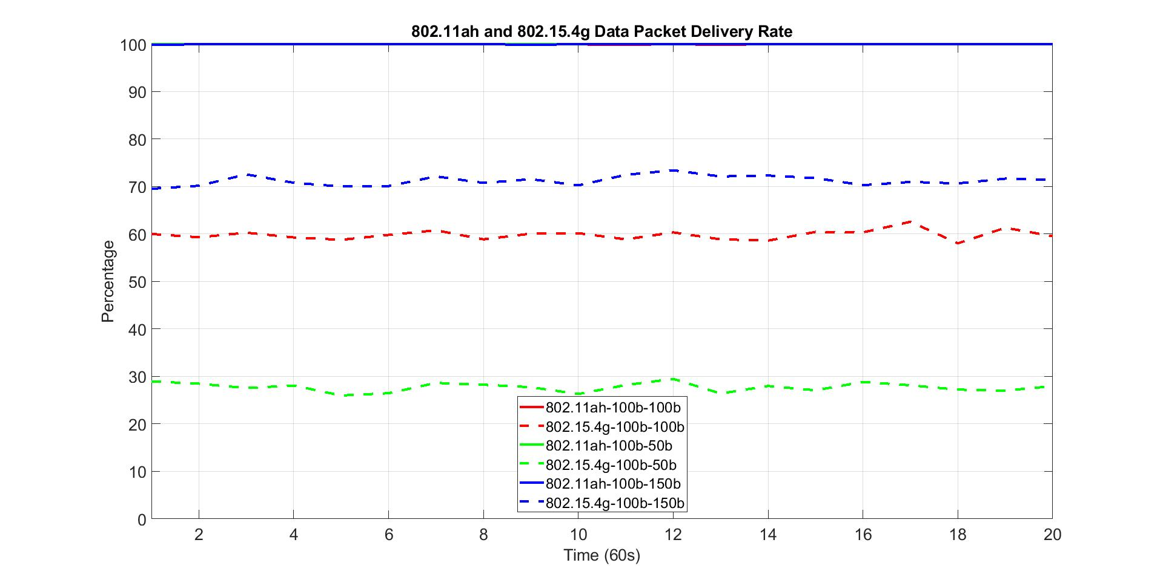
Impact of 802.15.4g Packet Size on Packet Delivery Rate
50 nodes for both 802.11ah and 802.15.4g networks
20 kbps offered load for 802.11ah network
40 kbps offered load for 802.15.4g network
Solid lines for 802.11ah, and dash lines for 802.15.4g
100b-50b indicates that 100 bytes payload for 802.11ah packet and 50 bytes payload for 802.15.4g packet

Slide 11
Observations on Packet Delivery Rate w.r.t 802.15.4g Packet Size Variation
802.15.4g packet size has no impact on 802.11ah packet delivery rate
For all cases, 802.11ah network delivers near 100% of the packet
802.15.4g packet size affects 802.15.4g packet delivery rate
802.15.4g packet delivery rate decreases as its packet size decreases
802.15.4g packet delivery rate increases as its packet size increases
From perspective of packet delivery rate, 802.15.4g node should send data with larger packet

Slide 12
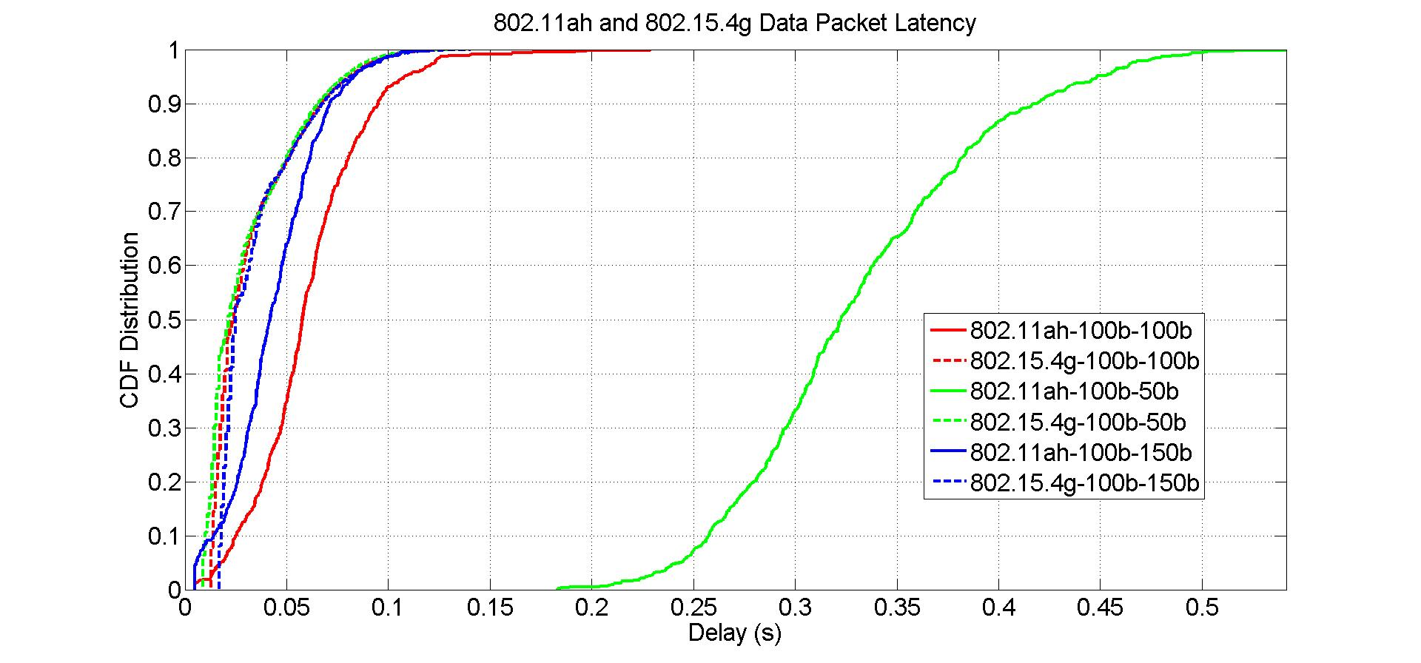
Impact of 802.15.4g Packet Size on Packet Latency
50 nodes for both 802.11ah and 802.15.4g networks
20 kbps offered load for 802.11ah network
40 kbps offered load for 802.15.4g network
Solid lines for 802.11ah, and dash lines for 802.15.4g
100b-50b indicates that 100 bytes payload for 802.11ah packet and 50 bytes payload for 802.15.4g packet

Slide 13
Observations on Packet Latency w.r.t 802.15.4g Packet Size Variation
802.15.4g packet size has little impact on 802.15.4g packet latency
802.15.4g packet size has more impact on 802.11ah packet latency
802.11ah packet latency increases as 802.15.4g packet decreases
802.11ah packet latency decreases as 802.15.4g packet increases
From perspective of packet latency, 802.15.4g should send data with larger packet size

Slide 14
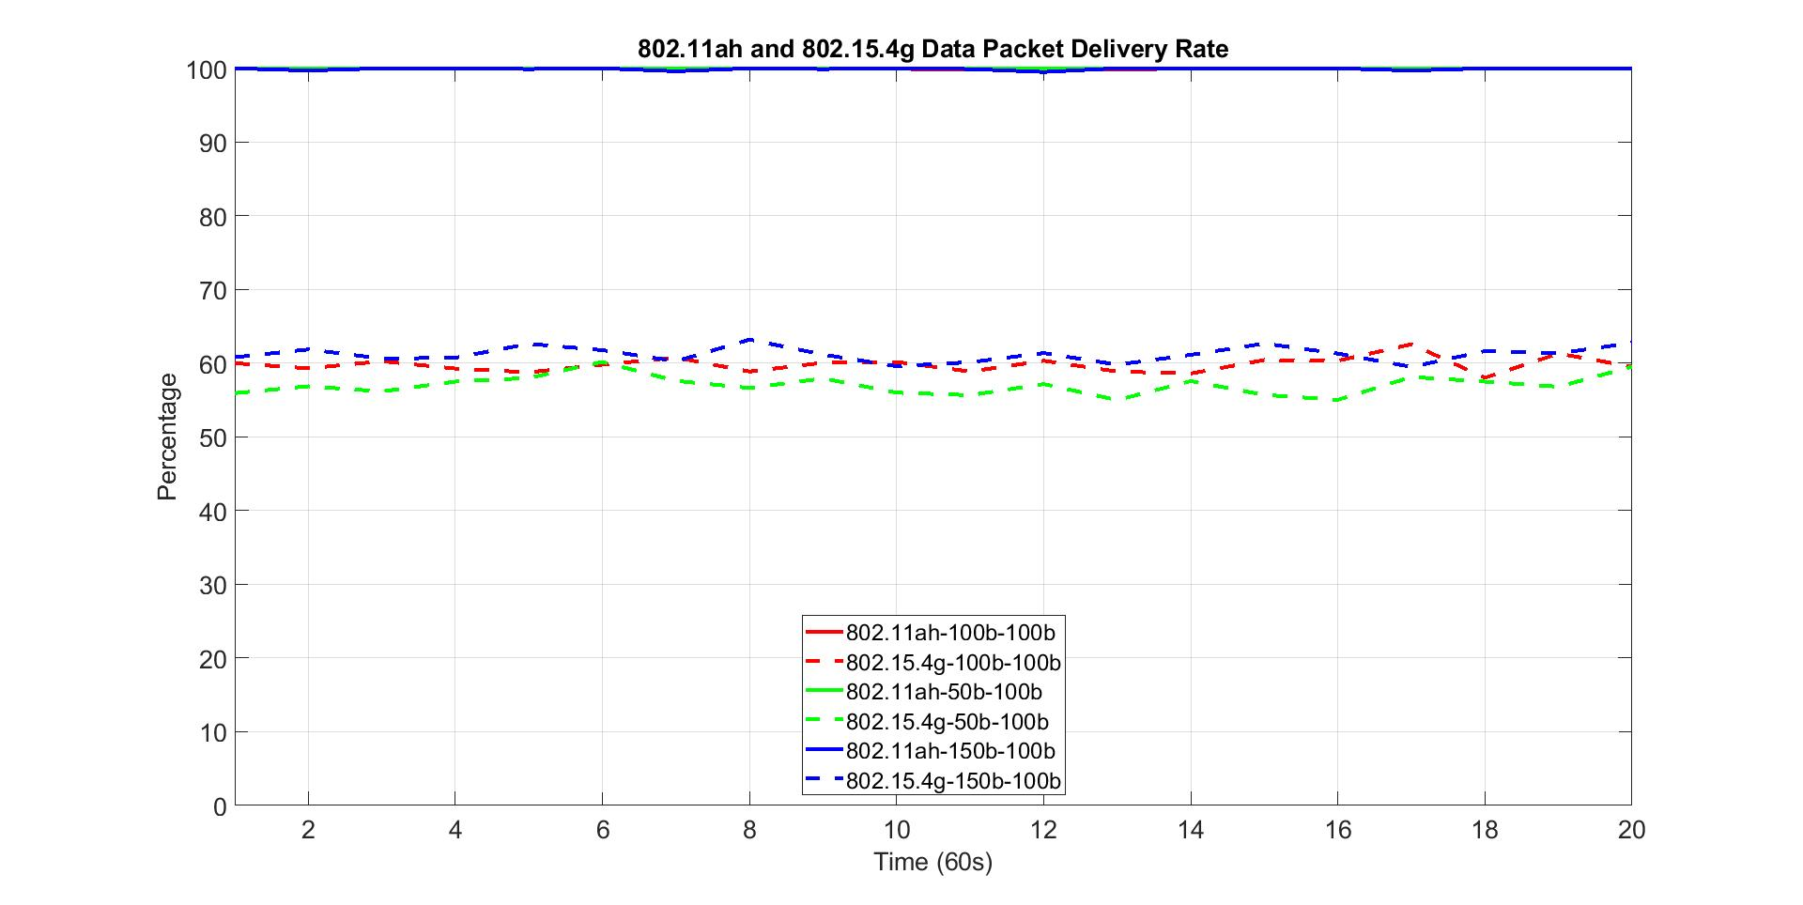
Impact of 802.11ah Packet Size on Packet Delivery Rate
50 nodes for both 802.11ah and 802.15.4g networks
20 kbps offered load for 802.11ah network
40 kbps offered load for 802.15.4g network
Solid lines for 802.11ah, and dash lines for 802.15.4g
100b-50b indicates that 100 bytes payload for 802.11ah packet and 50 bytes payload for 802.15.4g packet

Slide 15
Observations on Packet Delivery Rate w.r.t 802.11ah Packet Size Variation
802.11ah packet size has no impact on 802.11ah packet delivery rate
For all cases, 802.11ah network delivers near 100% of the packet
802.11ah packet size also has little impact on 802.15.4g packet delivery rate
802.15.4g packet delivery rate decreases slightly as 802.11ah packet size decreases
802.15.4g packet delivery rate increases slightly as 802.11ah packet size increases
From perspective of packet delivery rate, 802.11ah node prefers send data with larger packet size

Slide 16
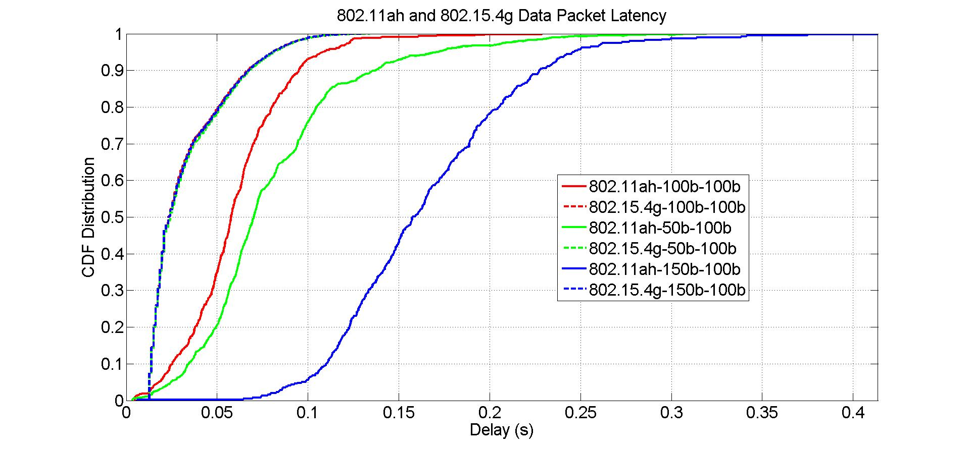
Impact of 802.11ah Packet Size on Packet Latency
50 nodes for both 802.11ah and 802.15.4g networks
20 kbps offered load for 802.11ah network
40 kbps offered load for 802.15.4g network
Solid lines for 802.11ah, and dash lines for 802.15.4g
100b-50b indicates that 100 bytes payload for 802.11ah packet and 50 bytes payload for 802.15.4g packet

Slide 17
Observations on Packet Latency w.r.t 802.11ah Packet Size Variation
802.11ah packet size has no impact on 802.15.4g packet latency
802.11ah packet size has impact on 802.11ah packet latency
50 bytes packet has more latency than 100 bytes packet does
150 bytes packet has more latency than both 50 bytes packet and 100 bytes packet do
From perspective of packet latency, 802.11ah should send data with appropriate packet size

Slide 18
Summary on Packet size
802.15.4g packet size should be larger than 100 bytes
802.11ah packet size should be around 100 bytes

