Slide 1
May 2019 Sub 1 GHz Task Group
Date: 2019-05-13
Authors:
Notice: This document has been prepared to assist IEEE 802.19. It is offered as a basis for discussion and is not binding on the contributing individual(s) or organization(s). The material in this document is subject to change in form and content after further study. The contributor(s) reserve(s) the right to add, amend or withdraw material contained herein.

Slide 2
Task Group Organization
Chair: Ben Rolfe
Recording secretary: Harry Bims (acting)
Vice Chair: Shoichi Kitazawa
Technical Editor: Jianlin Guo

Slide 3
Agenda
TG3 Agenda:
https://mentor.ieee.org/802.19/dcn/19/19-19-0040-04-0003-july-task-group-agenda.xlsx

Slide 4
Closing Report
We had 3 meeting slots
We met our meeting objectives

Slide 5
Meeting Goals
Begin Draft Development
Review contributions so far
Review draft outline and drafting plan
Revise guidelines for proposals CFP drafting
Usage scenarios discussion
Report on outreach efforts
Hear contributions on use cases
Begin drafting use case document
Updates on situation in Japan
Update on simulation tools and results
Next steps

Slide 6
TG Motion to approve 0039r1
TG3 approves document # P802.19-19/0039r1, Informal Liaison request to the Wi-Fi alliance, to forward to the Working Group for approval, with editorial changes as the WG chair may deem needed.
Moved by: Jianlin Guo
Second by: Shoichi Kitazawa
Following neither discussion nor objection motion carries by unanimous consent

Slide 7
Working Group Motion to approve Document # 0039r1
TG3 approves document # P802.19-19/0039r1, Informal Liaison request to the Wi-Fi alliance, to forward to the Working Group for approval, with editorial changes as the WG chair may deem needed.
Moved by: Shoichi Kitazawa
Second by: Jianlin Guo
Y/N/A:5/0/2

Slide 8
Telecon Schedule
Bi-weekly commencing on 31-July
3pm Pacific Time (US)
6pm Eastern Time (US)
12am Central European Time
7am Japan Time

Slide 9
Soliciting Proposals
Will renew call for proposals an contributions
Will broadcast on 802.11 and 802.15 reflectors
Will solicit input on Use Cases from WFA

Slide 10
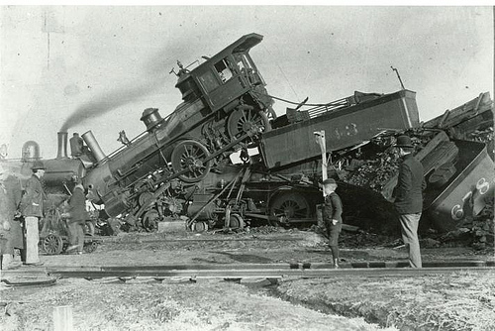
coexistence
noun
the state or fact of living or existing at the same time or in the same place.
Good Coexistence => rapidly growing opportunity
Poor Coexistence => missed opportunity

