Slide 1
Measurement of Radio Noise and Interference over 920 MHz band in Japan
Date: 2019-07-15
Authors:
Notice: This document has been prepared to assist IEEE 802.19. It is offered as a basis for discussion and is not binding on the contributing individual(s) or organization(s). The material in this document is subject to change in form and content after further study. The contributor(s) reserve(s) the right to add, amend or withdraw material contained herein.

Slide 2
Abstract
In sub-1-GHz band, not only IEEE 802.11ah and IEEE 802.15.4 SUN, but also other radio system such as RFID coexist.
Moreover, several kinds of machinery emit powerful radio noise in this frequency band, and it may have a large impact on the system performance of wireless communication systems.
This contribution shows some measurement results of radio noise and interference over the 920 MHz band in Japan.
These results can be useful to establish the recommended practice for good spectrum sharing between IEEE 802.11ah and IEEE 802.15.4 SUN.

Slide 3
Spectrum measurement over 920 MHz band in Japan
From January 2019 to May 2019, we measured the spectrum utilization in 920 MHz band at several places in Japan to survey the current spectrum use in this frequency band.
Railway stations
A station at an underground floor.
Another station at the second floor (open space) in a downtown area.
University in a suburban area.
Large exhibition center during an event that focuses on the R&D of wireless communication technologies.

Slide 4
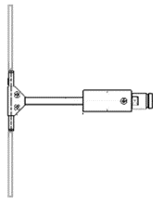
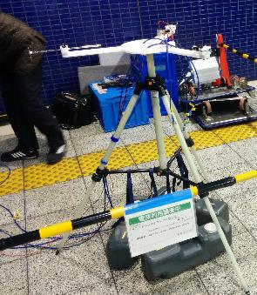
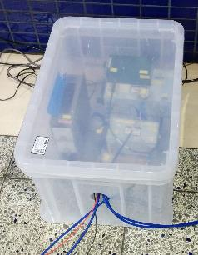
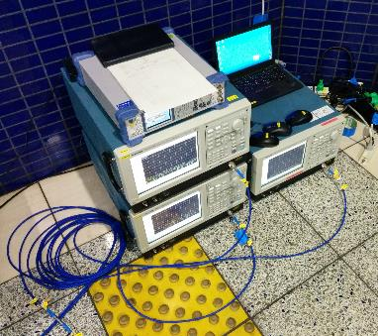
Measurement system
Spectrogram in the 920 MHz band is obtained using a real-time spectrum analyzer.
Dipole antenna
Band pass
filter
Low noise
amplifier
Real time
spectrum analyzer

Slide 5
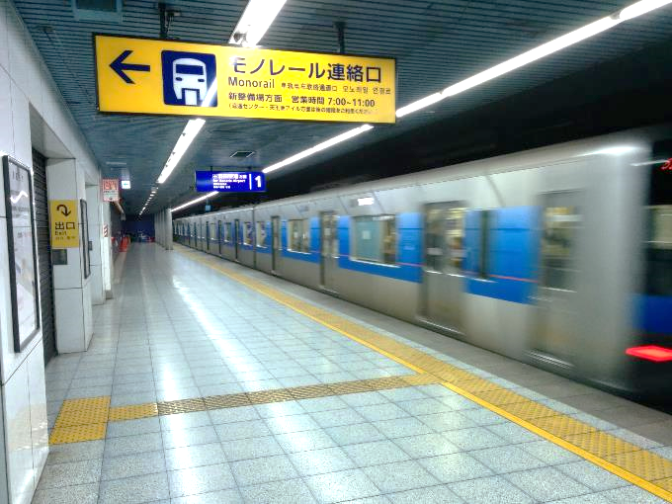
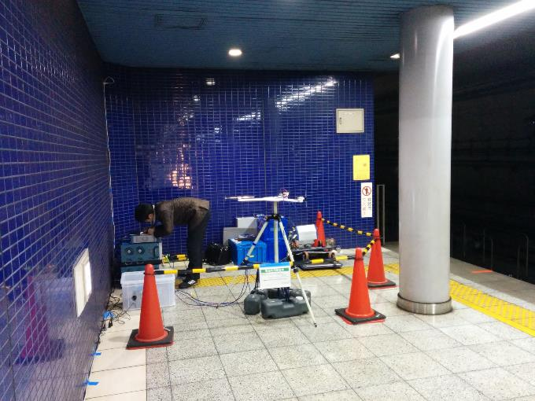
Measurement location (1) Underground railway station
We conducted measurement at a platform of a underground station near Haneda International Airport.
Train stops or goes through every several minutes.
Measurement equipment
Measurement point

Slide 6
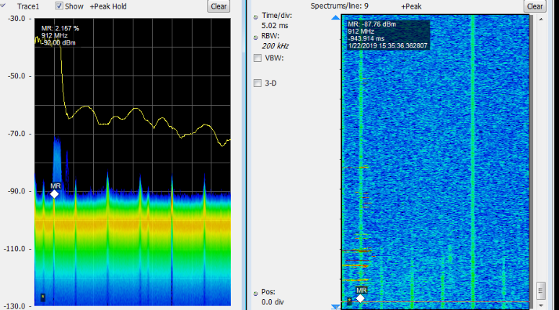
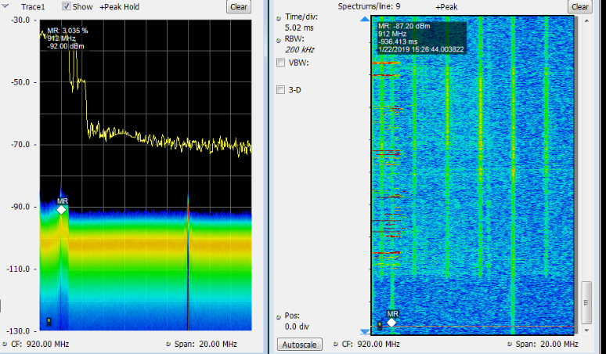
Measurement result at underground station
-30
-50
-70
-90
-110
-130
Train continuously emits radio noise at multiple frequencies in the 920 MHz band.
During doors are opened, the radio noise becomes more powerful.
Whether or not train emits radio noise may depend on the type of car.
Received power [dBm/100 kHz]
-50
-70
-90
-110
Doors are opened.
Train is in the station.
920 MHz
940 MHz
920 MHz
940 MHz

Slide 7
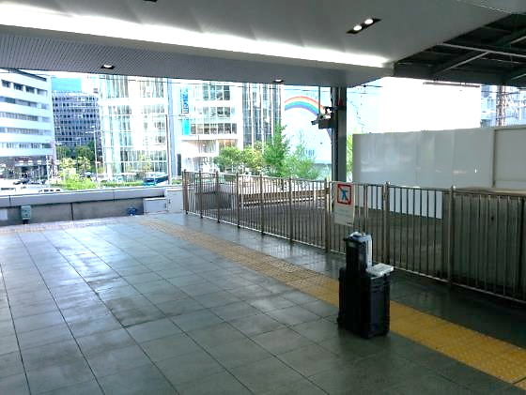
Measurement location (2) Railway station (open space)
We also conducted measurement at the end of a platform of a terminal station in downtown area. The platform is at the second floor, and there is no wall at the both sides (North and South) of this station.
Train stops every several minutes.
Measurement equipment

Slide 8
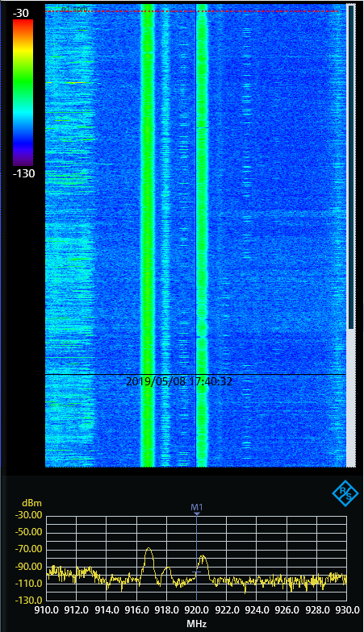
Measurement result at station (open space)
-30 dBm per 300 kHz
Unknown multiple continuous signals are measured at 916.7 MHz, 918 MHz, 919.5 MHz and 920.5 MHz.
In particular, signals at 916.7 MHz and 920.5 MHz have a bandwidth of 1 MHz and a received power of -70 ~ -80 dBm.
These spectrum is different from that measure at the underground station.
-130 dBm per 300 kHz
50 seconds
910 MHz
930 MHz

Slide 9
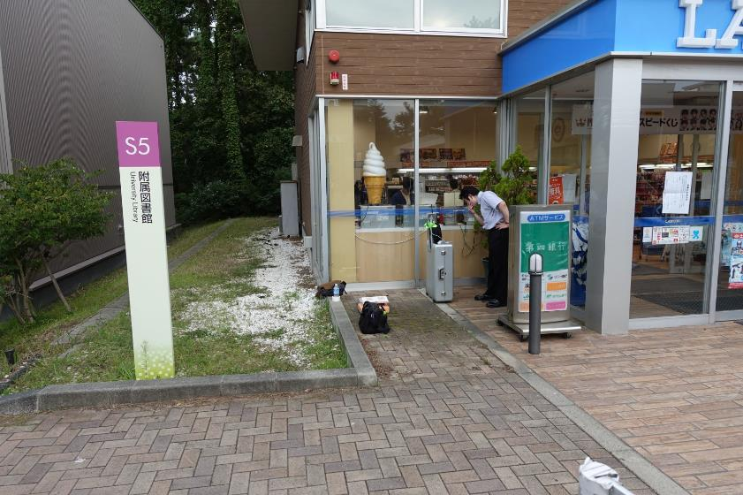
Measurement location (3) University in a suburban area
We conducted measurement on near by a convenience store in a university located in a suburban area.
An RFID system is used in the next building (library).
Library
Convenience store
Measurement point

Slide 10
Measurement result at university
There are several unknown continuous signals at some frequencies as well as signals of known systems. Some of these signals are very strong.
-115 -105 -95 dBm / 1 kHz
Unknown
Signal
(912 MHz)
RFID in library
60 seconds
RFID (active)
Cellular
Unknown signals
(920, 925.2, and 929 MHz)
910 MHz
920 MHz
930 MHz

Slide 11
Measurement location (4) Exhibition of wireless technologies
We conducted another measurement at one of Japan's largest-scale exhibition events that focuses on the latest R&D of wireless communication technologies.
During this event, many exhibitors demonstrated their wireless systems using the 920 MHz band including IEEE 802.11ah ^{[Note 1]} , wireless power transfer system, original communication system, etc.
Similar situation will occur when S1G devices are widely deployed.
[Note 1] AHPC (802.11ah Promotion Council) exhibited IEEE 802.11ah demo system under experimental station license. IEEE 802.11ah is still under discussion to utilize them in Japan.

Slide 12
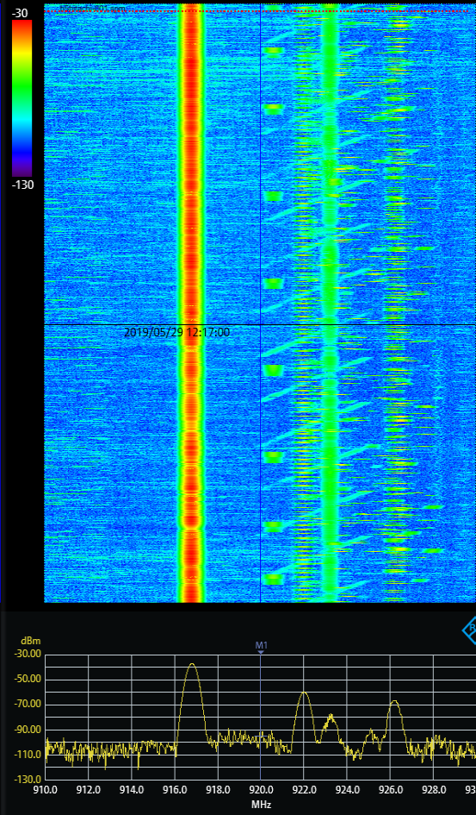
Measurement result at exhibition center
-30 dBm per 300 kHz
There are many signals with different transmission patterns (i.e., spectrum shape and duty cycle).
A wireless power transfer system will cause severe interference.
Wideband noise
-130 dBm per 300 kHz
60 seconds
Signals with different duty cycle
Chirp signal of an
original communication system
(not LoRa)
910 MHz
930 MHz
Strong interference (may be from a wireless power transfer system)

Slide 13
Summary
This contribution showed measurement results of radio noise and interference at two stations and a university over the 920 MHz band in Japan.
Several powerful signals continuously emitted by train and RFID were found. In addition, several unknown continuous signals with a non-negligible level of power were also found. In future, wireless power transfer systems and other wireless systems may cause severe interference. These signals may become severe interference both for IEEE 802.11ah and IEEE 802.15.4 SUN.
So, we may need to take care of such interference for good operation of IEEE 802.11ah and IEEE 802.15.4 SUN.

