Slide 1
May 2019 Sub 1 GHz Task Group
Date: 2019-05-13
Authors:
Notice: This document has been prepared to assist IEEE 802.19. It is offered as a basis for discussion and is not binding on the contributing individual(s) or organization(s). The material in this document is subject to change in form and content after further study. The contributor(s) reserve(s) the right to add, amend or withdraw material contained herein.

Slide 2
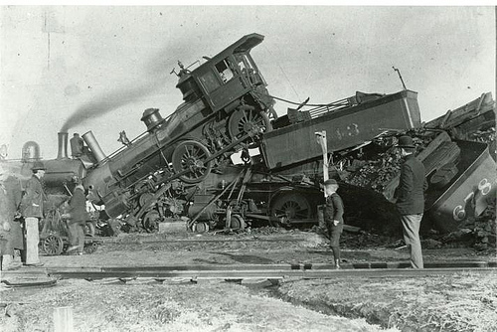
coexistence
noun
the state or fact of living or existing at the same time or in the same place.
Good Coexistence => rapidly growing opportunity
Poor Coexistence => missed opportunity

Slide 3
Task Group Organization
Chair: Ben Rolfe
Recording secretary: TBD
Vice Chair: Shoichi Kitazawa
Technical Editor: Jianlin Guo
Notes:
1. Secretary volunteer:

Slide 4
Opening
Meeting Preamble
Review and Approve Agenda
Review Objectives
Plan for the week

Slide 5
Sub-1GHz Coexistence Task Group
Recommended Practice for Local and Metropolitan Area Networks - Part 19: Coexistence Methods for 802.11 and 802.15.4 based systems operating in the Sub-1 GHz Frequency Bands
Scope:
This recommended practice provides guidance on the implementation, configuration and commissioning of systems sharing spectrum between IEEE Std 802.11ah-2016 and IEEE Std 802.15.4 Smart Utility Networking (SUN) Frequency Shift Keying (FSK) Physical Layer (PHY) operating in Sub-1 GHz frequency bands.

Slide 6
Meeting Preamble
Be aware of:
https://development.standards.ieee.org/myproject/Public/mytools/mob/slideset.pdf
Any questions or disclosures?

Slide 7
Agenda
TG3 Agenda:
https://mentor.ieee.org/802.19/dcn/19/19-19-0026-00-0003-may-2019-agenda.xlsx
Discussion
Approval of agenda in doc 19-19-0026-01

Slide 8
March Minutes
Minutes from March
https://mentor.ieee.org/802.19/dcn/19/19-19-0033-00-0003-march-minutes-tg3.pdf
Approval of minutes from March Task Group meeting doc # 19-19-0033r0

Slide 9
Meeting Goals
Planning for Draft Development
Proposal guidelines and CFP drafting
Usage scenarios discussion
Outreach to WiFi Alliance for use case input
Other outreach possibilities
Next steps
Updates on situation in Japan
Continuing to monitor
Update on simulation tools and results
Next steps

Slide 10
Overview and Schedule
January 2019 TG organization and first technical input, outline for RP content, issue Call for Proposals
March 2019 Review contributions and prepare call for proposals
May 2019 Hear technical proposals – start drafting process
July 2019 more proposals, complete draft for WG Ballot, initiate WG ballot
Sept 2019 Comment resolution, continue WG Balloting
Nov 2019 EC approval for Standards Association Ballot
Jan 2020 Comment Resolution
Feb 2020 Recirc/comments/recirc
Mar 2020 Final comment resolution
Apr 2020 Stable draft, last recirc
May 2020 Final package
July 2020 EC approval to RevCom

Slide 11
Technical Presentations
TBD

Slide 12
Soliciting Proposals
Usage scenarios document
Technical criteria and guidance
Call for proposals content

Slide 13
Useful links
PAR text as approved:
https://mentor.ieee.org/802.19/dcn/18/19-18-0093-00-S1GH-par-as-approved-by-revcom-dec-2018.pdf
TG3 Agenda:
https://mentor.ieee.org/802.19/dcn/19/19-19-0024-02-0000-recommended-text-on-802-coexistence-process.docx
WG19 opening slides:
https://mentor.ieee.org/802.19/dcn/19/19-19-0030-00-0000-may-2019-opening-report.pptx

