Slide 1
S1G Coexistence Simulation Profile
Date: 2019-03-14
Authors:
Notice: This document has been prepared to assist IEEE 802.19. It is offered as a basis for discussion and is not binding on the contributing individual(s) or organization(s). The material in this document is subject to change in form and content after further study. The contributor(s) reserve(s) the right to add, amend or withdraw material contained herein.

Slide 2
Introduction
802.19.3 Task Group (TG) in sub-1GHz coexistence has been established in IEEE 802.19
Simulation results have been presented at several IEEE meetings
This document aims to provide consensus of simulation profile for subsequent simulations
The focus here is on 802.11ah and 802.15.4g operating on channels with shared frequency band, which may apply in regulatory domains where there is limited spectrum for these technologies (e.g. Japan)
This is intended for the worst case co-channel operation case, when both networks in the same vicinity are operating on the channels with shared frequency band
This document is based on 19-18/0039r2 and 19-18/0016r1

Slide 3
Notes
This document aims to provide a framework for simulations and does not restrict the ranges of the parameters
The values of the parameters are region and/or PHY and/or use case dependent
For example, some parameters are based on Japan regulatory and some parameters are based on SUN PHYs specified in IEEE 802.15.4g-2012 (Section 18.1 MR-FSK PHY, Section 18.2 MR-OFDM PHY, Section 18.3 MR-O-QPSK PHY).
Most of the 802.11ah parameters are fixed
Most of the 802.15.4g parameters are symbol rate dependent

Slide 4
Transmit Parameters
Parameter | 802.11ah | 802.15.4g
Frequency Band | 920-928 MHz | 920-928 MHz
Channel Bandwidth | 1 MHz | 200kHz/400 kHz
AP/PANC Transmit Power | 13 dBm | 13 dBm
STA/Node Transmit Power | 13 dBm | 13 dBm
Modulation | OFDM | Binary FSK
PHY Rate | 300 kb/s | 100 kb/s
Per Station Regulatory Duty Cycle Limit* | 360/720 seconds every 3600 seconds | 360/720 seconds every 3600 seconds
AP refers radio equipment that acts as the 802.11ah access point
PANC refers radio equipment that acts as the 802.15.4g PAN coordinator
STA refers radio equipment that acts as the 802.11ah station
Node refers radio equipment that acts as the 802.15.4g station
* Japan regulatory for radio equipment

Slide 5
Receive Parameters
Parameter | 802.11ah | 802.15.4g
RX Sensitivity | -95 dBm | -88 dBm
Carrier Sense Level | -95 dBm | -88 dBm
Energy Detection Level | -75 dBm | -78 dBm
Note: These parameters are PHY dependent

Slide 6
Traffic Parameters
Parameter | 802.11ah | 802.15.4g
Packet Size | 100 bytes | 100 bytes
Number of Stations | [50, 100] | [50, 100]
Network Uplink Offered Load | [1, 10] kb/s | [1, 10] kb/s
Note 1: These parameters are use case dependent
Note 2: According to Japan regulations, the maximum allowed per station duty cycle is 10% for single channel case and 20% for multiple channel case.

Slide 7
802.11 and 802.15.4 Abbreviations
Abbreviation | 802.11 Definition | Usage
SIFS | Short interframe space | Time between frame and ACK
DIFS | Distributed interframe space | Minimum idle time needed to start a transmission
AIFS | Arbitration interframe space | QoS generalization of the DIFS
CW | Contention window | To draw random backoff slots
Abbreviation | 802.15.4 Definition | Usage
SIFS | Short interframe spacing | Minimum idle time after a short frame transmission process
AIFS | ACK interframe spacing | Time between frame and ACK
BE | Backoff exponent | To draw random backoff periods
CW | Contention window | Number of backoff periods to be idle before transmission

Slide 8
CSMA Parameters
802.11ah Parameter | Value
CCA Time¹ | 128 µs
Slot Time | 52 µs
SIFS (time till ACK) | 160 µs
DIFS (minimum Idle time) | 264 µs
802.15.4g Parameter | Value
phyCCADuration² | 140 µs
UnitBackoffPeriod³ | 1140 µs
AIFS⁴ | 1000 µs
Minimum idle time⁵ | 1000 µs
¹ Minimum CCA Time of 128 us is set by Japan regulations. In 802.11ah, CCATime ≤ 40 us.
² For the SUN PHYs operating in the 920 or 950 MHz band, phyCCADuration is from 0 to 1000 symbols (symbol duration is 20 us for SUN-FSK PHY). For all other PHYs, it is called CCATime instead of phyCCADuration.
³ For the SUN PHYs operating in the 920 or 950 MHz band, the value is TurnaroundTime + phyCCADuration. For all other PHYs, the value is TurnaroundTime + CCATime. For SUN PHYs, TurnaroundTime is 1ms.
⁴ AIFS is 1ms for SUN PHYs, LECIM PHYS, or TVWS PHYs and is equal to macSIFSPeriod for other PHYs.
⁵ For SUN-FSK PHY, the minimum inter-frame space (called SIFS in standard) is 1ms.

Slide 9
CSMA Parameters
802.11ah Parameter | Value
CW_{min} | 15
CW_{max} | 1023
CW | [CW_{min}, CW_{max}]
RetryLimit | 7
802.15.4g Parameter | Value
MinBE | 3
MaxBE | 5
BE | [MinBE, MaxBE]
RetryLimit | 4
CW | 1
Note 1: For 802.11ah, the number of random backoff slots is drawn from a uniform distribution over the interval [0,CW] with CW = CW_{min} initially.
Note 2: 802.11ah performs CCA in every backoff slot.
Note 3: For 802.15.4g, the number of random backoff periods is drawn from a uniform distribution over the interval [0, 2^{BE}-1] with BE = MinBE initially.
Note 4: 802.15.4g performs CCA after backoff completes.
Note 5: For 802.15.4g, CW = 1 for non-beacon enabled network and CW = 2 for beacon enabled network.

Slide 10
Network Topology
Description | 802.11ah Configuration | 802.15.4g Configuration
Number of hops | 1,2,3 | 1,2,3
Node density | 500/km² | 500/km²
Routing method | RPL or other | RPL or other
Router | AP or all nodes | PANC or all nodes
Duty cycle of router | Do not count relay data | Do not count relay data
Deployment case | Urban or suburban | Urban or suburban
Note1: density in urban is different from that in suburban
Note2: RPL = IPv6 Routing Protocol for LLNs, IETF routing protocol

Slide 11
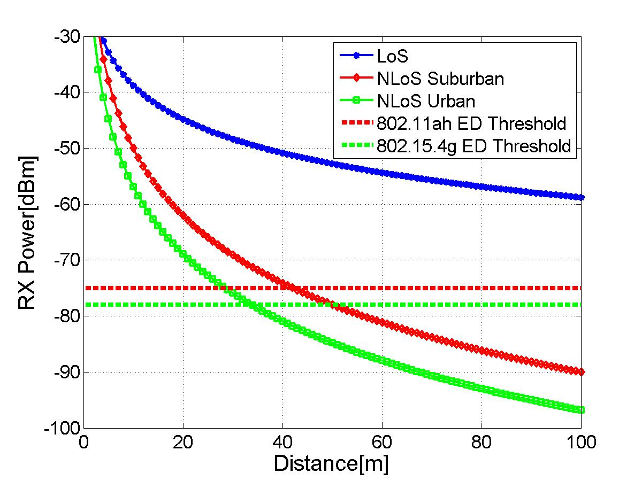
Propagation Model
ITU-R P.1411-8 model for propagation between terminals from below roof-top height to near street level
L_{urban} = 0 for suburban
TX power: 13dBm
920 MHz band
11ah ED Threshold: -75dBm
15.4g ED Threshold: -78dBm

