Slide 1
S1G Coexistence Simulation Update
Date: 2019-05-14
Authors:
Notice: This document has been prepared to assist IEEE 802.19. It is offered as a basis for discussion and is not binding on the contributing individual(s) or organization(s). The material in this document is subject to change in form and content after further study. The contributor(s) reserve(s) the right to add, amend or withdraw material contained herein.

Slide 2
Summary
Presentation to TG3 of simulation update for coexistence of IEEE 802.15.4g and IEEE 802.11ah using new simulation parameters for smart utility use cases based on comments on March IEEE 802.19.3 meeting toward recommended practice document
Results showed same trend with previous simulation results with mutual interference
This document gathers relevant material from 19-19/0019r0, 19-18/0056r3, 19-18/0039r1 and 19-19/0021r2.

Slide 3
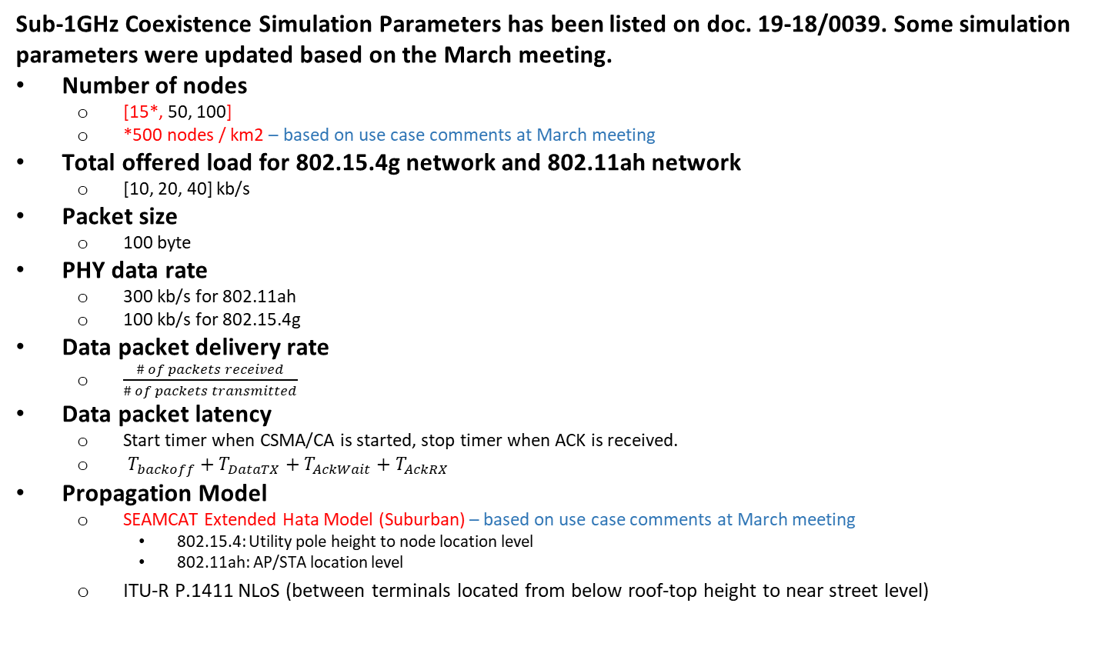
Simulation Parameters and Performance Metrics
Sub-1GHz Coexistence Simulation Parameters has been listed on doc. 19-18/0039. Some simulation parameters were updated based on the March meeting.
Number of nodes
  [15*, 50, 100]
  *500 nodes / km2 – based on use case comments at March meeting
Total offered load for 802.15.4g network and 802.11ah network
  [10, 20, 40] kb/s
Packet size
  100 byte
PHY data rate
  300 kb/s for 802.11ah
  100 kb/s for 802.15.4g
Data packet delivery rate
  $\frac{\# of packets received}{\# of packets transmitted}$
Data packet latency
  Start timer when CSMA/CA is started, stop timer when ACK is received.
  $T_{backoff}+T_{DataTX}+T_{AckWait}+T_{AckRX}$
Propagation Model
  SEAMCAT Extended Hata Model (Suburban) – based on use case comments at March meeting
    802.15.4: Utility pole height to node location level
    802.11ah: AP/STA location level
  ITU-R P.1411 NLoS (between terminals located from below roof-top height to near street level)

Slide 4
Node Deployment : 15 nodes (500 nodes/km2)
802.11ah (AP/STA) #1
802.11ah (AP/STA) #2
802.11ah (AP/STA) #3
802.15.4g (PANC)
*
802.15.4g (NODE)

Slide 5
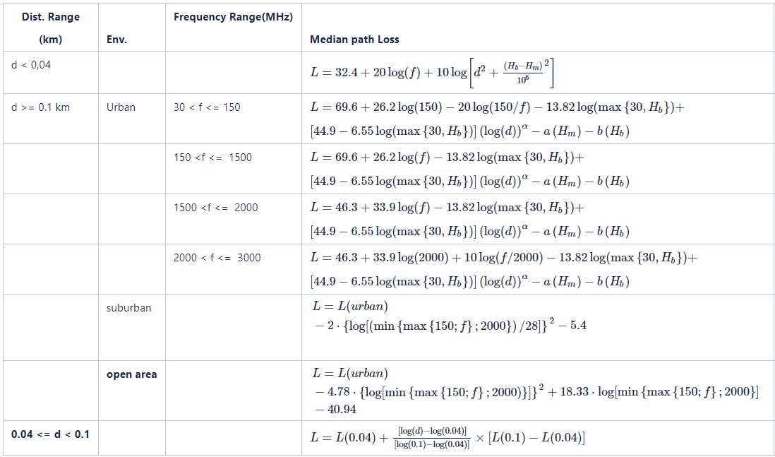

Propagation Model
In consideration of device location, SEAMCAT Extended Hata Model (Suburban) was also added for simulation.
Device location
  802.15.4: Utility pole height to node location level
  802.11ah: AP/STA location level
SEAMCAT Extended Hata Model
ITU-R P.1411
Models for propagation between terminals located from below roof-top height to near street level

Slide 6
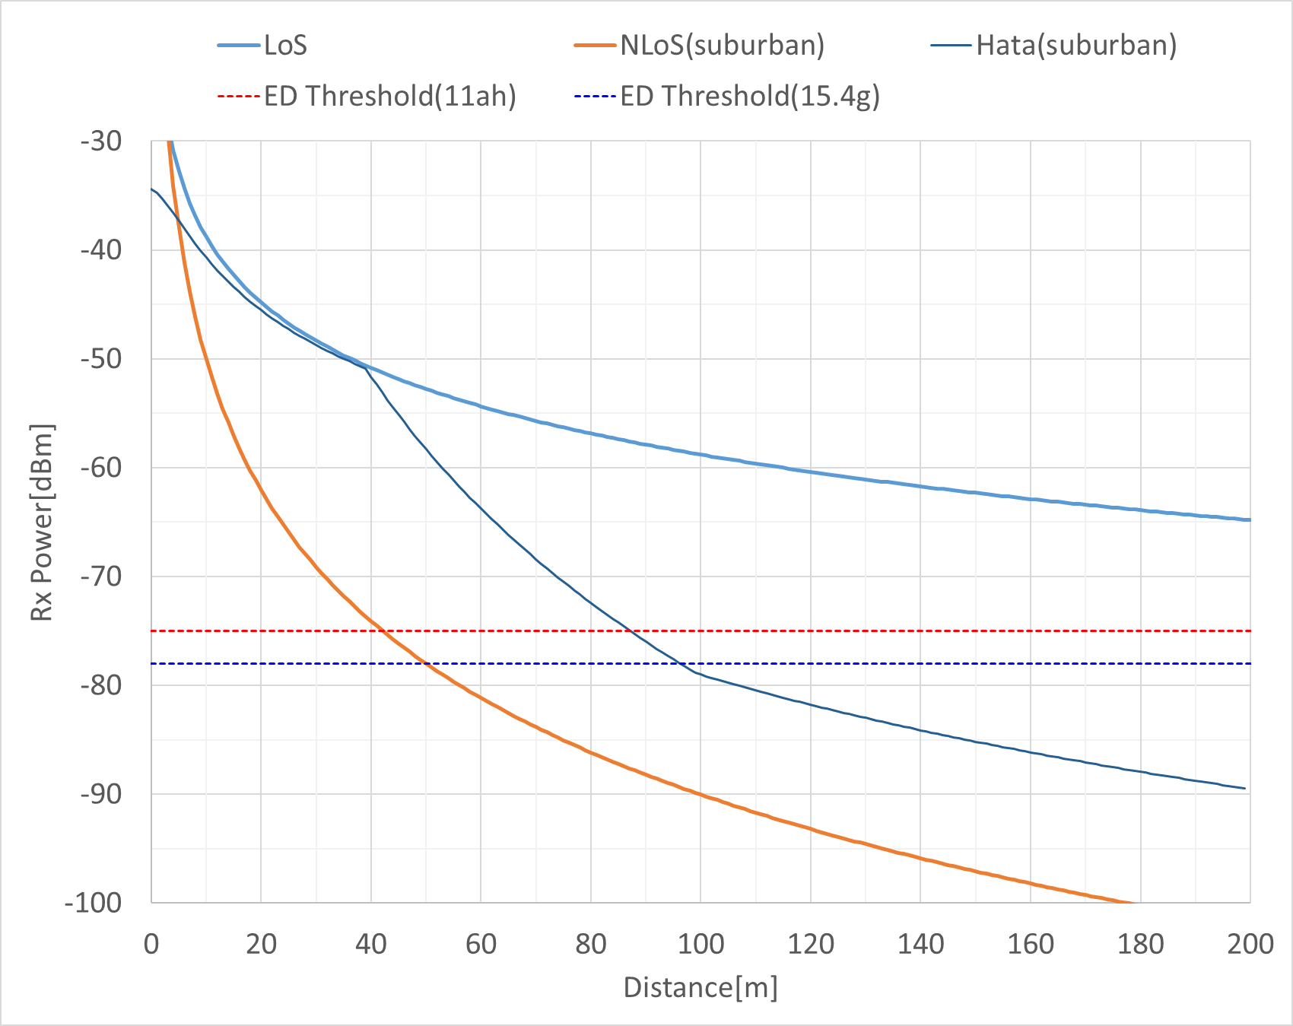
Propagation Model
SEAMCAT Extended Hata Model (Suburban)
802.15.4g

Slide 7
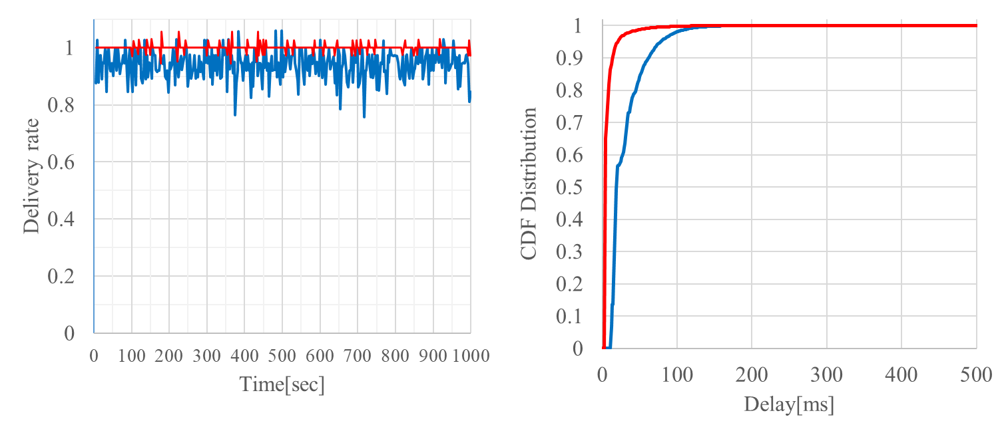
Case 11: 15 Nodes, 10 kbps for 802.11ah and 10 kbps for 802.15.4g
Packet delivery rate
  802.11ah delivers 100% of packets
  802.15.4g delivers 96.4% of packet
Packet latency
  In general, 802.11ah achieves shorter packet latency than 802.15.4g
  802.11ah delay in [4.9ms, 189.1ms], 802.15.4g delay in [12.7ms, 206.3ms]
15.4g CSMA → ACK Rx
11ah CSMA → ACK Rx

Slide 8
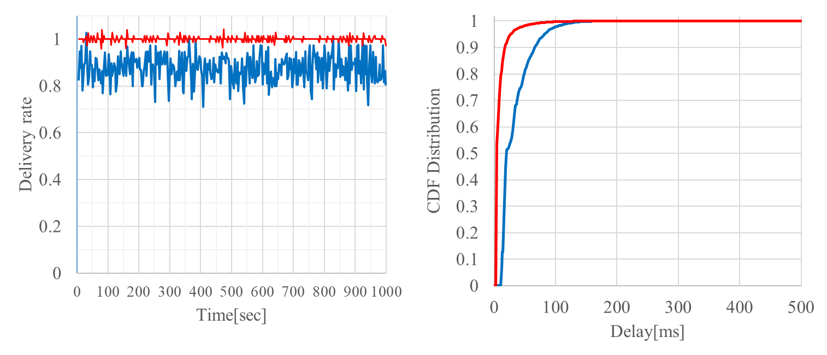
Case 12: 15 Nodes, 20 kbps for 802.11ah and 10 kbps for 802.15.4g
Packet delivery rate
  802.11ah delivers 100% of packets
  802.15.4g delivers 91.9% of packet
Packet latency
  In general, 802.11ah achieves shorter packet latency than 802.15.4g
  802.11ah delay in [4.9ms, 378.4ms], 802.15.4g delay in [12.8ms, 198.1ms]
15.4g CSMA → ACK Rx
11ah CSMA → ACK Rx

Slide 9
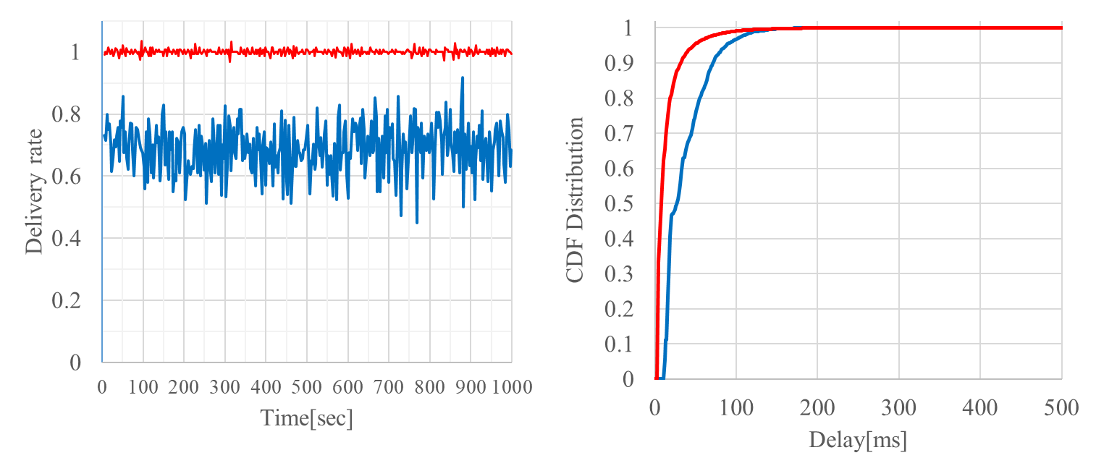
Case 13: 15 Nodes, 40 kbps for 802.11ah and 10 kbps for 802.15.4g
Packet delivery rate
  802.11ah delivers 100% of packets
  802.15.4g delivers 75.9% of packet
Packet latency
  In general, 802.11ah achieves shorter packet latency than 802.15.4g
  802.11ah delay in [4.9ms, 414.4ms], 802.15.4g delay in [12.8ms, 224.6ms]
15.4g CSMA → ACK Rx
11ah CSMA → ACK Rx

Slide 10
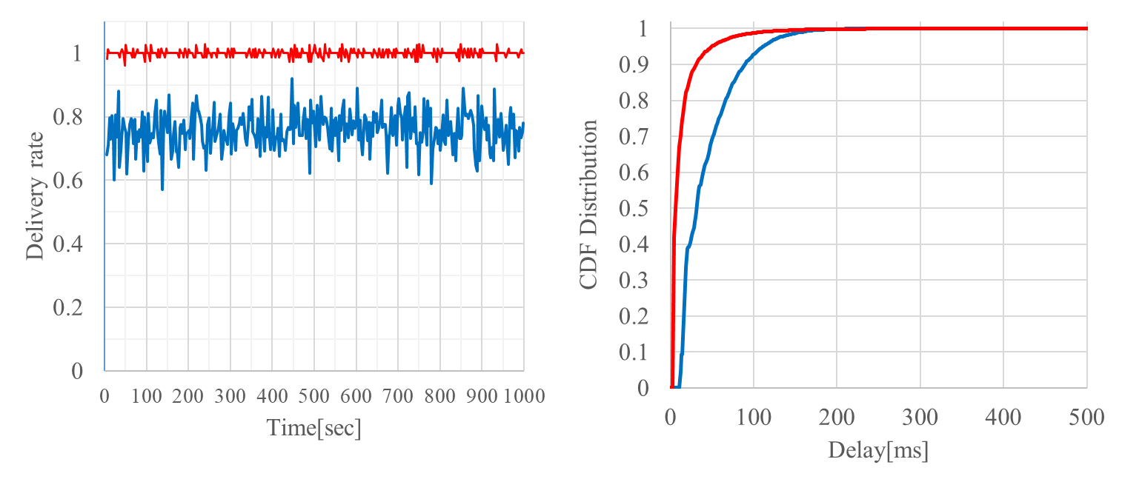
Case 14: 15 Nodes, 20 kbps for 802.11ah and 20 kbps for 802.15.4g
Packet delivery rate
  802.11ah delivers 99.9% of packets
  802.15.4g delivers 82.1% of packet
Packet latency
  In general, 802.11ah achieves shorter packet latency than 802.15.4g
  802.11ah delay in [4.9ms, 550.3ms], 802.15.4g delay in [12.8ms, 263.5ms]
15.4g CSMA → ACK Rx
11ah CSMA → ACK Rx

Slide 11
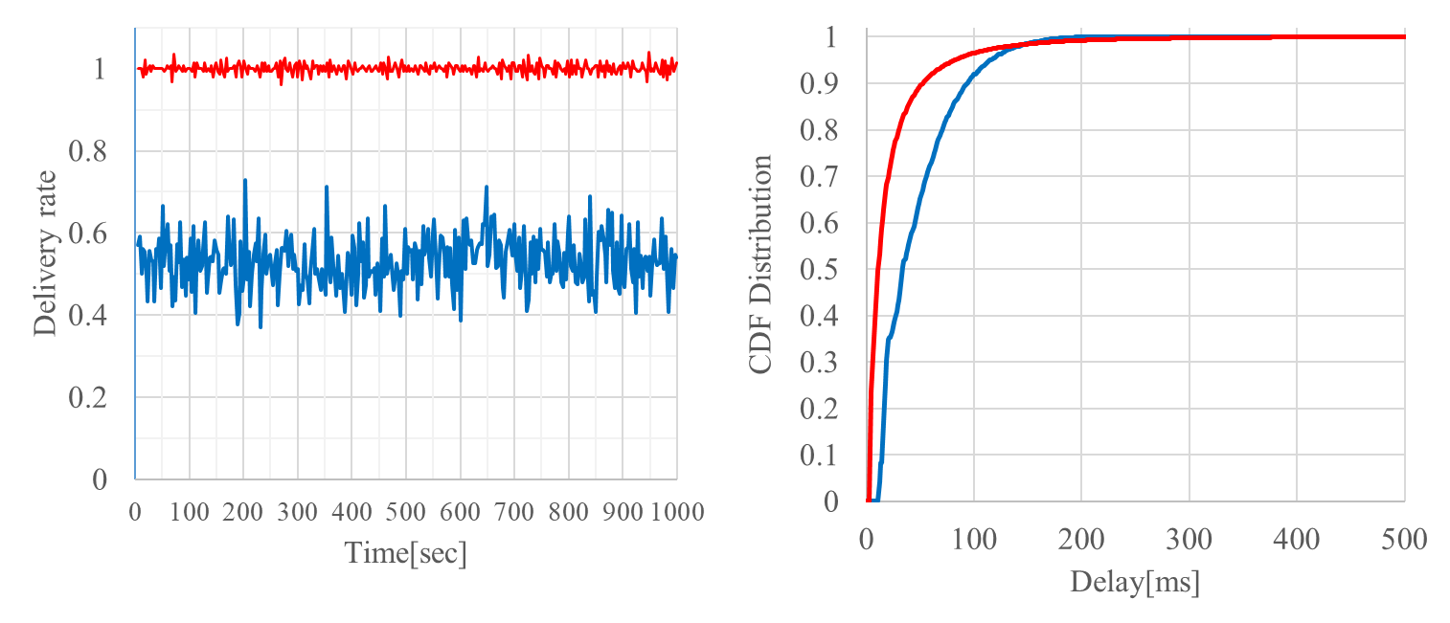
Case 15: 15 Nodes, 40 kbps for 802.11ah and 20 kbps for 802.15.4g
Packet delivery rate
  802.11ah delivers 99.9% of packets
  802.15.4g delivers 60.7% of packet
Packet latency
  In general, 802.11ah achieves shorter packet latency than 802.15.4g
  802.11ah delay in [4.9ms, 989.1ms], 802.15.4g delay in [12.8ms, 296.6ms]
15.4g CSMA → ACK Rx
11ah CSMA → ACK Rx

Slide 12
Simulation Results Summary
Case | Node | Total Offered Load [kbps] |  | Packet Delivery Rate [%] |  | Packet Latency [avg., min, max] [ms]
 |  | 11ah | 15.4g | 11ah | 15.4g | 11ah | 15.4g
11 | 15 | 10 | 10 | 100 | 96.4 | [8.7, 4.9, 189.1] | [32.3, 12.7, 206.3]
12 | 15 | 20 | 10 | 100 | 91.9 | [10.0, 4.9, 378.4] | [33.6, 12.8, 198.1]
13 | 15 | 40 | 10 | 100 | 75.9 | [15.2, 4.9, 414.4] | [36.8, 12.8, 224.6]
14 | 15 | 20 | 20 | 99.9 | 82.1 | [15.2, 4.9, 550.3] | [43.6, 12.8, 263.5]
15 | 15 | 40 | 20 | 99.9 | 60.7 | [25.4, 4.9, 989.1] | [46.3, 12.8, 296.6]

Slide 13
Summary
Simulation results with new parameters commented on March meeting showed same trend with previous simulation results.
802.11ah impacts 802.15.4g packet delivery
802.15.4g impacts 802.11ah packet latency
802.11ah packet latency is unbounded
  CCA is required in each backoff slot
  Backoff counter decreases only if the channel is idle
802.15.4g packet latency is bounded
  CCA is not required during random backoff period
  CCA is performed after random backoff period
We would like the IEEE 802.19.3 to continue the discussion of simulation as inputs for Recommended Practice

