Slide 1
Jan 2019 Sub 1 GHz Task Group
Date: 2019-01-14
Authors:
Notice: This document has been prepared to assist IEEE 802.19. It is offered as a basis for discussion and is not binding on the contributing individual(s) or organization(s). The material in this document is subject to change in form and content after further study. The contributor(s) reserve(s) the right to add, amend or withdraw material contained herein.

Slide 2
Opening
Meeting Preamble
Review and Approve Agenda
Review Objectives
Plan for the week

Slide 3
Sub-1GHz Coexistence Task Group
Recommended Practice for Local and Metropolitan Area Networks - Part 19: Coexistence Methods for 802.11 and 802.15.4 based systems operating in the Sub-1 GHz Frequency Bands
Scope:
This recommended practice provides guidance on the implementation, configuration and commissioning of systems sharing spectrum between IEEE Std 802.11ah-2016 and IEEE Std 802.15.4 Smart Utility Networking (SUN) Frequency Shift Keying (FSK) Physical Layer (PHY) operating in Sub-1 GHz frequency bands.

Slide 4
Meeting Preamble
Be aware of:
https://development.standards.ieee.org/myproject/Public/mytools/mob/slideset.pdf
Any questions or disclosures?

Slide 5
Agenda
TG3 Agenda:
https://mentor.ieee.org/802.19/dcn/18/19-18-0092-01-S1GH-s1gh-tg-agenda-jan-2019.xlsx
Approval: Aprove agenda in doc 19-18-0092r02

Slide 6
November Minutes
Minutes from Nov
https://mentor.ieee.org/802.19/dcn/18/19-18-0090-00-S1GH-s1gh-november-meeting-minutes.docx
Approve minutes from Nov Study Group meeting doc # 19-18-0090r0

Slide 7
Meeting Goals
Task Group organization and mechanics
Overview of RP development and schedule
Suggested outline for RP
Technical Presentations
Contribution discussion

Slide 8
Task Group Organization
Chair: Ben Rolfe
Recording secretary: Jianlin Guo
Vice Chair: Shoichi Kitazawa
Vice Chair: ??
Technical Editor(s): Jianlin Guo

Slide 9
Overview and Schedule
January 2019 TG organization and first technical input, outline for RP content, issue Call for Proposals
March 2019 Hear technical proposals – start drafting process
May 2019 more proposals, continue draft development
July 2019 Finish draft, start WG LB
Sept 2019 Comment resolution, continue WG Balloting
Nov 2019 EC approval for Sponsor Ballot
Jan 2020 Comment Resolution
Feb 2020 Recirc/comments/recirc
Mar 2020 Final comment resolution
Apr 2020 Stable draft, last recirc
May 2020 Final package
July 2020 EC approval to RevCom

Slide 10
Technical Presentations
CSMA and CCA differences between 802.11 and 802.15.4
Simulation updates
TBD

Slide 11
Contribution discussion
Use case
Technical criteria and guidance
Call for contributions

Slide 12
Useful links
PAR text as approved:
https://mentor.ieee.org/802.19/dcn/18/19-18-0093-00-S1GH-par-as-approved-by-revcom-dec-2018.pdf
TG3 Agenda:
https://mentor.ieee.org/802.19/dcn/18/19-18-0092-00-S1GH-s1gh-tg-agenda-jan-2019.xlsx
WG19 opening slides:
https://mentor.ieee.org/802.19/dcn/19/19-19-0002-01-0000-january-2019-opening-report.pptx

Slide 13

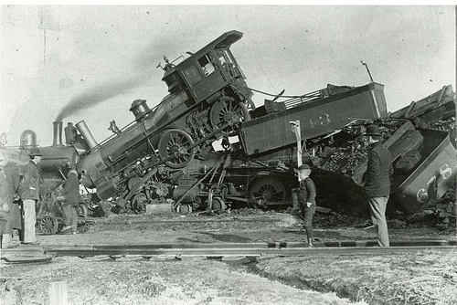
coexistence
noun
the state or fact of living or existing at the same time or in the same place.
Good Coexistence => rapidly growing opportunity
Poor Coexistence => missed opportunity

