Slide 1
Jan 2019 Sub 1 GHz Interest Group
Date: 2019-01-14
Authors:
Notice: This document has been prepared to assist IEEE 802.19. It is offered as a basis for discussion and is not binding on the contributing individual(s) or organization(s). The material in this document is subject to change in form and content after further study. The contributor(s) reserve(s) the right to add, amend or withdraw material contained herein.

Slide 2
Opening
Meeting Preamble
Review and Approve Agenda
Review Objectives
Plan for the week

Slide 3
Meeting Preamble
Be aware of:
http://standards.ieee.org/board/pat/pat-slideset.ppt
Any questions or disclosures?

Slide 4
Sub-1GHz Coexistence Task Group
Recommended Practice for Local and Metropolitan Area Networks - Part 19: Coexistence Methods for 802.11 and 802.15.4 based systems operating in the Sub-1 GHz Frequency Bands
Scope:
This recommended practice provides guidance on the implementation, configuration and commissioning of systems sharing spectrum between IEEE Std 802.11ah-2016 and IEEE Std 802.15.4 Smart Utility Networking (SUN) Frequency Shift Keying (FSK) Physical Layer (PHY) operating in Sub-1 GHz frequency bands.

Slide 5
Agenda
TG3 Agenda:
https://mentor.ieee.org/802.19/dcn/18/19-18-0092-00-S1GH-s1gh-tg-agenda-jan-2019.xlsx
Approval: Aprove agenda in doc 19-18-0092rxx
Moved:
Second:

Slide 6
November Minutes
Minutes from Nov
https://mentor.ieee.org/802.19/dcn/18/19-18-0090-00-S1GH-s1gh-november-meeting-minutes.docx
Motion: Approve minutes from Nov Study Group meeting doc # 19-18-090r0

Slide 7
Useful links
PAR text as approved:
https://mentor.ieee.org/802.19/dcn/18/19-18-0093-00-S1GH-par-as-approved-by-revcom-dec-2018.pdf
TG3 Agenda:
https://mentor.ieee.org/802.19/dcn/18/19-18-0092-00-S1GH-s1gh-tg-agenda-jan-2019.xlsx
WG19 opening slides:
https://mentor.ieee.org/802.19/dcn/19/19-19-0002-01-0000-january-2019-opening-report.pptx

Slide 8
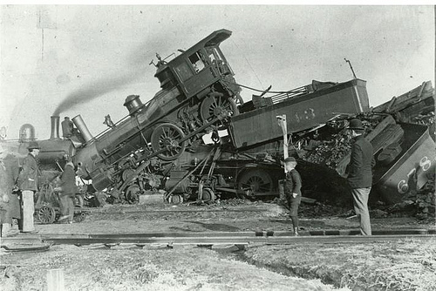
coexistence
noun
the state or fact of living or existing at the same time or in the same place.
Good Coexistence => rapidly growing opportunity
Poor Coexistence => missed opportunity

