Slide 1
Nov 2018 Sub 1 GHz Study Group
Date: 2018-11-14
Authors:
Notice: This document has been prepared to assist IEEE 802.19. It is offered as a basis for discussion and is not binding on the contributing individual(s) or organization(s). The material in this document is subject to change in form and content after further study. The contributor(s) reserve(s) the right to add, amend or withdraw material contained herein.

Slide 2
Sub 1 GHz Study Group
Closing Report, November 2018

Slide 3
Sub-1GHz Coexistence Study Group
SG Chair: Benjamin Rolfe (BCA, MERL)
Recording Secretary: Jianlin Guo
Purpose and Objectives of Study Group:
  Develop PAR and Criteria for Standards Development for a recommended practice
  Discuss and decide on RP scope and objectives
  Draft PAR and CSD
This Weeks Objective

Slide 4
Meeting Objectives
November Accomplishments:
Finished PAR and CSD
  Resolved Comments
  Update PAR and CSD text
  WG Approved comment resolutions, PAR and CSD changes
Technical presentations:
  Update on Regulatory Sub 1GHz changes in Japan
  Update on simulation efforts
  Self-transmission control for coexistence improvement

Slide 5
Next Steps
Friday 1 – 6 PM – EC meeting: approval of EC
Start work as Task Group:
Call for contributions – to go out following EC approval
Hear technical proposals in January
Teleconferences Nov to Jan, TBD (discuss via reflector)

Slide 6
Relevant links
PAR and CSD
Comments and resolutions:
https://mentor.ieee.org/802.19/dcn/18/19-18-0087-03-0000-s1gh-par-and-csd-comment-motions.pptx
Revised PAR Text:
https://mentor.ieee.org/802.19/dcn/18/19-18-0086-01-S1GH-revised-par-text-with-changes-tracked.docx
Revised CSD
https://mentor.ieee.org/802.19/dcn/18/19-18-0072-04-S1GH-draft-csd-for-s1gh.docx
Technical presentations
Regulatory update for Japan
https://mentor.ieee.org/802.19/dcn/18/19-18-0084-00-S1GH-920-mhz-status-update-in-japan.pptx
Self-transmission control
https://mentor.ieee.org/802.19/dcn/18/19-18-0085-02-S1GH-self-transmission-control-for-coexisting-802-11ah-and-802-15-4g.pptx
Simulation effort update
https://mentor.ieee.org/802.19/dcn/18/19-18-0056-03-0000-s1g-coexistence-simulation-update.pptx

Slide 7

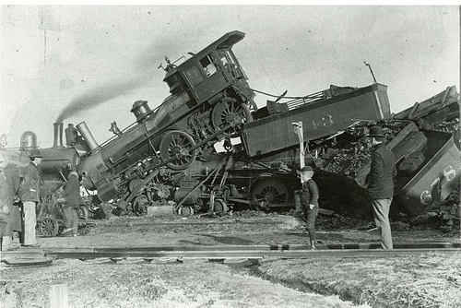
coexistence
noun
the state or fact of living or existing at the same time or in the same place.
Good Coexistence => rapidly growing opportunity
Poor Coexistence => missed opportunity

