Slide 1
Self-Transmission Control for Coexisting 802.11ah and 802.15.4g
Date: 2018-11-11
Authors:
Notice: This document has been prepared to assist IEEE 802.19. It is offered as a basis for discussion and is not binding on the contributing individual(s) or organization(s). The material in this document is subject to change in form and content after further study. The contributor(s) reserve(s) the right to add, amend or withdraw material contained herein.

Slide 2
Abstract
Presentation to Sub-1 GHz (S1G) Band Coexistence Study Group of the IEEE 802.19 Working Group on Self-Transmission Control for Coexisting IEEE 802.11ah and IEEE 802.15.4g.

Slide 3
802.11ah Self-Transmission Control
802.11ah predicts upcoming 802.15.4g transmission time and suspends its transmission within a potential time period to avoid the predicted 802.15.4g transmission
Each 802.11ah device
  Records all detected transmission starting time
  Delete the time corresponding to successful 802.11ah transmissions and collided 802.11ah transmissions
  Store transmission time of 802.15.4g transmission
Using recorded 802.15.4g transmission time history to predict the upcoming 802.15.4g transmission time
Key is how to determine 802.15.4g transmission
Predicted Time
Predicted time
Time
Suspension period

Slide 4
Determine 802.15.4g Transmission
For an 802.11ah device, the busy channel can be caused by
  Class-1: Successful 802.11ah transmissions or
  Class-2: Other transmissions
Class-2 transmissions include
  802.15.g transmissions
  Collided 802.11ah transmissions
Therefore, Class-2 transmissions are considered as potential 802.15.4g transmissions
802.11ah device can determine successful 802.11ah transmissions
802.11ah device can compute the packet collision probability P_{c} by using number of transmission attempts and number of ACK packets received
  A potential 802.15.4g transmission is a collided 802.11ah transmission with the probability P_{C}
  A potential 802.15.4g transmission is considered as a 802.15.4g transmission with the probability 1 - P_{C}

Slide 5
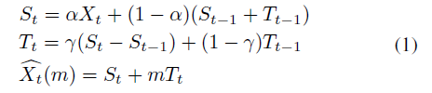
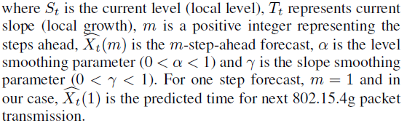
Predict Next 802.15.4g Packet Transmission Time
Given past 802.15.4g transmission time history
  X₁ X₂, …, X_{t}
Predict next 802.15.4g time X_{t+1}
Holt’s additive trend prediction method is used for prediction
  For a time series X₁, X₂, …, X_{t}, the forecast algorithm is formulated as

Slide 6
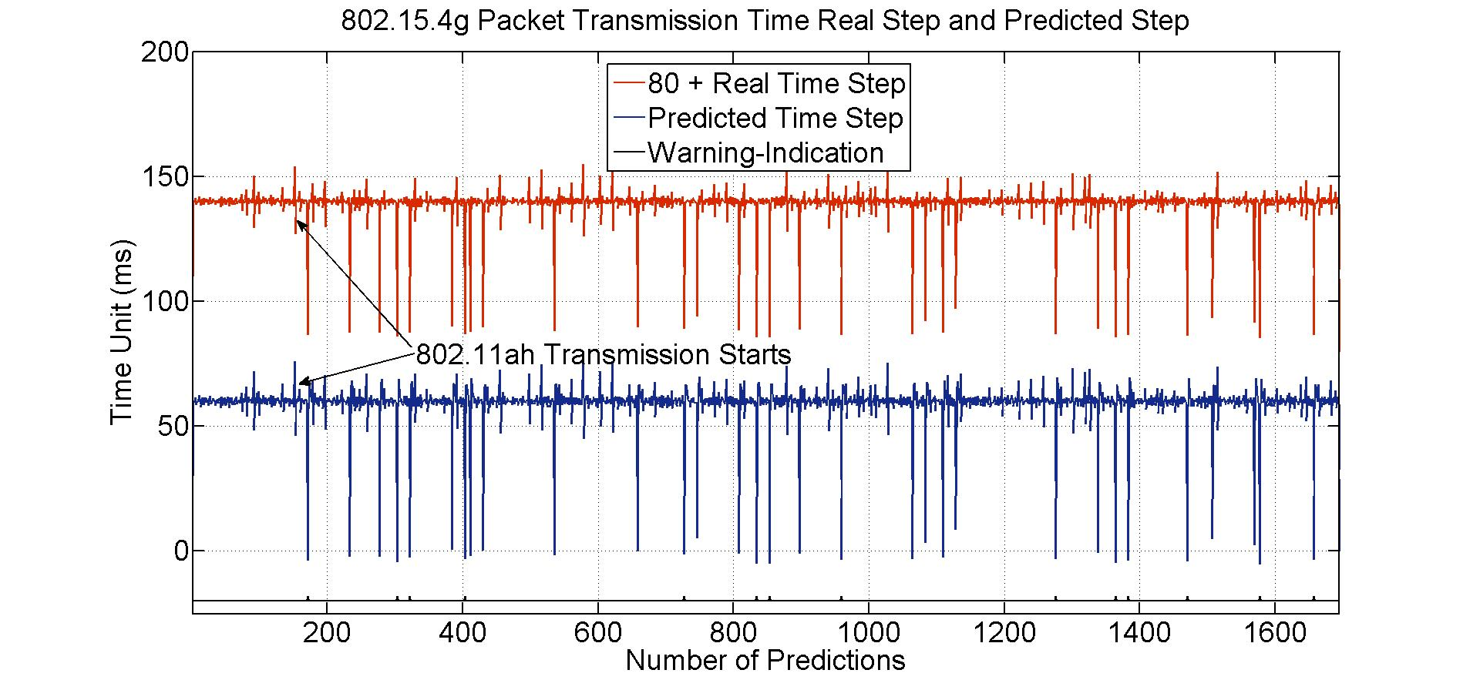
802.15.4g Packet TX Time Prediction Accuracy
Define a metric called time step
  Time gap between two consecutive 802.15.4g packets
  α = 0.5, γ = 0.5, m = 1
Predicted time step matches measured time step well

Slide 7
Simulation Parameters
802.11ah nodes
  5
802.15.4g nodes
  5
802.11ah PHY rate
  2.4 mbps
802.15.4g PHY rate
  250 kbps
Network load for 802.11ah
  800 kbps
Network load for 802.15.4g
  50 kbps
802.11ah packet size
  500 bytes
802.15.4g packet size
  50 bytes

Slide 8
802.11ah Packet Delivery Rate
Self-Transmission control decreases 802.11ah packet delivery rate by 20%

Slide 9
802.15.4g Packet Delivery Rate
Self-Transmission control improves 802.15.4g packet delivery rate by 35%

Slide 10
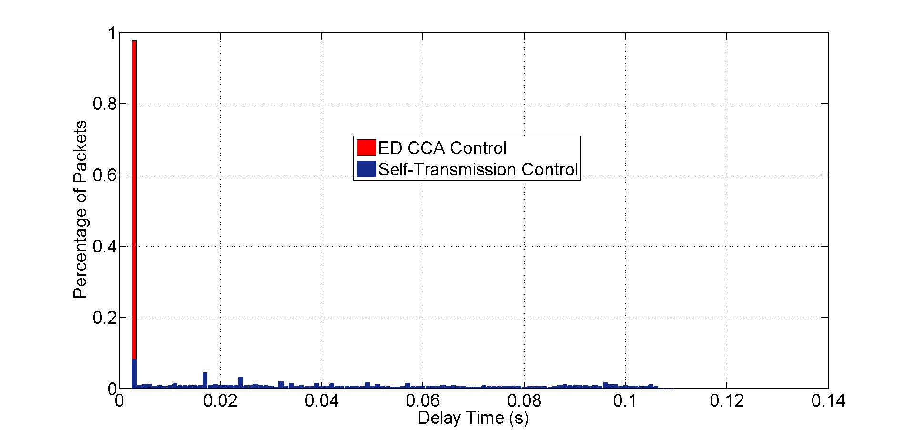
802.15.4g Packet Latency
Self-Transmission control increases 802.11ah packet latency

Slide 11
802.15.4g Packet Latency
Self-Transmission control reduces 802.15.4g packet latency

