Slide 1
920 MHz Status Update in Japan
Date: 2018-11-14
Authors:
Notice: This document has been prepared to assist IEEE 802.19. It is offered as a basis for discussion and is not binding on the contributing individual(s) or organization(s). The material in this document is subject to change in form and content after further study. The contributor(s) reserve(s) the right to add, amend or withdraw material contained herein.

Slide 2
Abstract
Share the 920MHz regulation status in Japan toward simulation and use case scenario discussion

Slide 3
Channelization in Japan
Several wireless systems operate on same frequency band which were standardized as ARIB STD-T106, T107 and T108
ARIB STD-T108 (20mW) on 920.5 ~ 928.1MHz (7.6MHz) includes 802.15.4g system, but coexistence operation with Passive System (250mW) and STD-T108 (250mW) is required for 920.5 ~ 923.5MHz (3.0MHz). So, 923.5 ~ 928.1MHz (4.6MHz) is only dedicated channels for 802.15.4g
Coexistence Operation
Passive System (RFID, etc)
①
1W ARIB STD-T106 Licensed/Registered
②
250mW ARIB STD-T107 Unlicensed
916.0
919.2
920.6
923.4
928.0
929.65
MHz
③
1mW ARIB STD-T108 Unlicensed
④
20mW ARIB STD-T108 Unlicensed
⑤
250mW ARIB STD-T108 Licensed/Registered
IEEE802.15.4g, etc
Active System (LPWA, 802.15.4g, etc)
Ch: 200KHz
Dedicate channels for sensor networks
Ch: 100KHz

Slide 4
ARIB STD-T108 (20mW)
[1]
Specified Low-Power Radio Station (Unlicensed, Active System)
for 802.15.4g and 802.11ah^{*2}
Item |  | Parameters and functionality
Frequency Band |  | 920.5MHz ~ 928.1MHz (7.6MHz) 920.5 ~ 923.5 MHz (3.0MHz) --- Coexistence with others 923.5 ~ 928.1 MHz (4.6MHz) --- Dedicated channel for STD-T108
Channel bandwidth |  | 200KHz
Transmission Power |  | 20mW
Transmission method | Contents | Data signal
 | Modulation | Not specified
Antenna Gain |  | 3dBi or less (absolute gain). However, in case EIRP is less than the value of 3dBi plus 1mW or 20mW of antenna power, it is allowed to fill in the gap by the antenna gain
Carrier Sense (CS) and Duty Cycle | CS ≧ 5msec, 920.5 ~ 923.4 MHz | Tx Time ≦ 4sec, Wait ≧ 50ms
 | 5msec < CS ≧ 128us 920.5 ~ 928.1 MHz | Tx Time ≦ 400ms, Wait ≧ 2ms, Total Tx Time ≦ 360s/h/station
Note |  | Refer IEEE 802.15.4g for PHY parameters
*1: IEEE 802.11ah is not specified on ARIB STD-T108 at this moment [1]

Slide 5
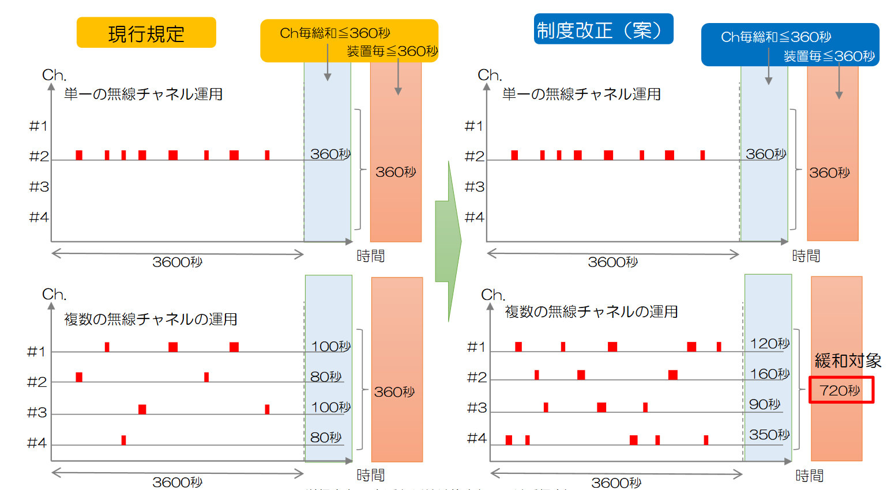
Deregulation of Duty Cycle for Active System
[2]
Each specified low-power radio station can transmit radio signal for 360 seconds/hour at most in the current 920MHz regulation.
MIC (Ministry of Internal Affairs and Communications) is considering deregulate the current duty cycle regulation:
When a specified low-power radio station use multiple channels in time division, duty cycle is 720 seconds/hour.
Duty cycle of each channel is 360 seconds/hour/station.
Current regulation
Total Tx Time ≦ 360sec.
Per station ≦ 360sec.
Deregulation of Duty Cycle
Total Tx Time ≦ 360sec.
Per station ≦ 360sec.
Using single channel
Using single channel
360sec.
360sec.
360sec.
360sec.
3600 seconds
Time
3600 seconds
Time
Using multiple channels
100sec.
Using multiple channels
120sec.
80
360sec.
160
720 sec.
100
90
80
350
3600 seconds
Time
3600 seconds
Time

Slide 6
Summary
MIC is considering deregulation of duty cycle to 720 seconds/hour/station in the case of using multiple channels.
We would like the Sub 1GHz SG to consider the deregulation of duty cycle in the future.

Slide 7
References
https://www.arib.or.jp/english/html/overview/doc/5-STD-T108v1_0-E1.pdf
MIC, http://www.soumu.go.jp/main_content/000551143.pdf, 2018/05/15
MIC (Ministry of Internal Affairs and Communications)

