Slide 1
Overview of IEEE802.15.4s
Date: 2018-09-13
Authors:
Notice: This document has been prepared to assist IEEE 802.19. It is offered as a basis for discussion and is not binding on the contributing individual(s) or organization(s). The material in this document is subject to change in form and content after further study. The contributor(s) reserve(s) the right to add, amend or withdraw material contained herein.

Slide 2
Abstract
This document aims to provide information about IEEE 802.15.4s-2018.
This amendment defines Spectrum Resource Measurement (SRM) and Transmit power control (TCP) to realizes the better use of spectrum resources in WPAN
802.11 defines the following standards
  802.11k Radio Resource Measurement of Wireless LANs
  802.11v Wireless Network Management
Notes:
As various wireless systems are deployed in the shared and license exempt frequency bands including 2.4GHz and
915MHz bands, heavy interference has limited performance of the wireless systems. In order for these wireless systems to operate more
effectively, a standardized set of spectrum resource measurements is needed that will facilitate management functions in these networks.

Slide 3
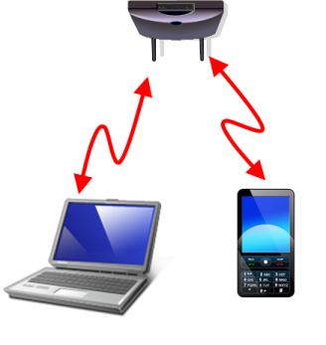
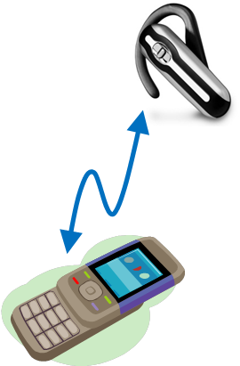
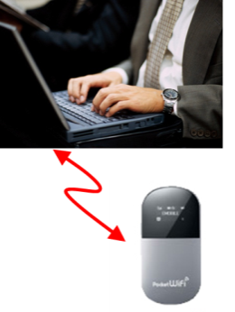
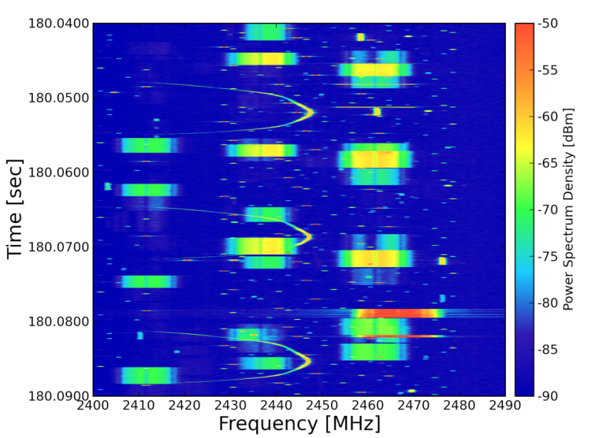

Problem statement
Many WPAN, WLAN systems use unlicensed frequency bands including 2.4 GHz and 900 MHz bands
  Heavy interference occurs among these systems and/or other disparate systems
Such heavy congestion in these conditions needs to be solved
802.15.4s aims for efficient use of the spectrum resource
50 ms
WLAN
Bluetooth
WLAN
WPAN

Slide 4
General use case
TG4s aims at building a standard to specify MAC framework for exchanging information on SRM.
Network manager(s)
The Network Manager or a group of Network Managers control(s) PHY/MAC parameter based on spectrum resource usage.
Detecting spectrum resource usage and notifies to the management entity.
802.15.4
Coordinator
802.15.4
Coordinator
802.15.4
Coordinator
Radio resource contention will be occur
between different piconet
Notes:
This use case depicts coexistence with multiple PAN’s.
Each PAN coordinator notifies the spectrum resource usage information to the Network manager or a group of Network Managers. The network manager(s) may use the spectrum resource usage information for controls PHY and MAC parameter

Slide 5
Metrics defined by 802.15.4s
  SRM: Spectrum Resource Measurement
  TPC: Transmit Power Control
SRM specifies the following functions and procedures in order to effectively operate wireless systems that could have heavy interferences within or outside the network:
spectrum resource measurements and network performance metrics, such as packet error ratio, delay, etc,
information elements and data structures to capture these measurements,
procedures for collecting and exchanging spectrum resource measurement information with higher layers or other devices and for Transmit Power Control (TPC).

Slide 6
SRM Functions
Attribute name
macED
MacTxFailTime
macTxDeferredTime
macRetryHistogram
macChannelUtilization
macRcpi
macRsni
macRssi
macNoiseHistogram
macFrameErrorCount
macCounterOctets
macRetryCount
macMultipleRetryCount
macTxFailCount
macTxSuccessCount
macFcsErrorCount
Attribute name
macDuplicateFrameCount
macRxSuccessCount
macNackCount
macDeferredTxCount
macAverageBufferUtilization
macMaximumBufferUtilization
macTxFragmentCount
macRxFragmentCount
macTxMulticastCount
macRxMulticastCount
macAverageAccessDelay
macChannelPage
macChannelNumber
macRxAddrMode
macRxDeviceAddress
Reserved

Slide 7
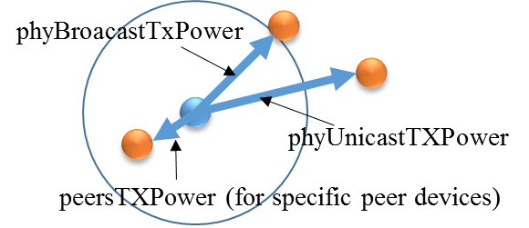
TPC Functions
Attribute name
phyTxPower
phyNomTxPower
phyCapableTxPower
phyBroadcastTxPower
phyUnicastTxPower
phyPeersTxPower
phyMinSnr
phyMinLinkMargin

Slide 8
SRM Flow
PNC#1
(Concentrator)
[SRM Request]
Timing: On demand
Request type:
- information get: PIB attributes
- information set: TPC
Layer 0
Router
Router
Layer 1
Router
Router
Leaf
Layer 2
[SRM Response/Report]
Timing:
- Response: in response to SRM request
- Report: periodical or event-driven
Information type:
- Response: PIB attributes
- Report: Status
[SRM Information/Extended Beacon]
Timing: On demand or periodical
- Extended Beacon: before MAC join
- SRM Information: after MAC join
Information type: information set (TPC)

Slide 9
Applications
Hospital/Medical/Healthcare
Industrial Automation
Source: “IEEE 802.15-14-0555-13-004s-tg4s-technical-guidance-document.”, March 2016

Slide 10
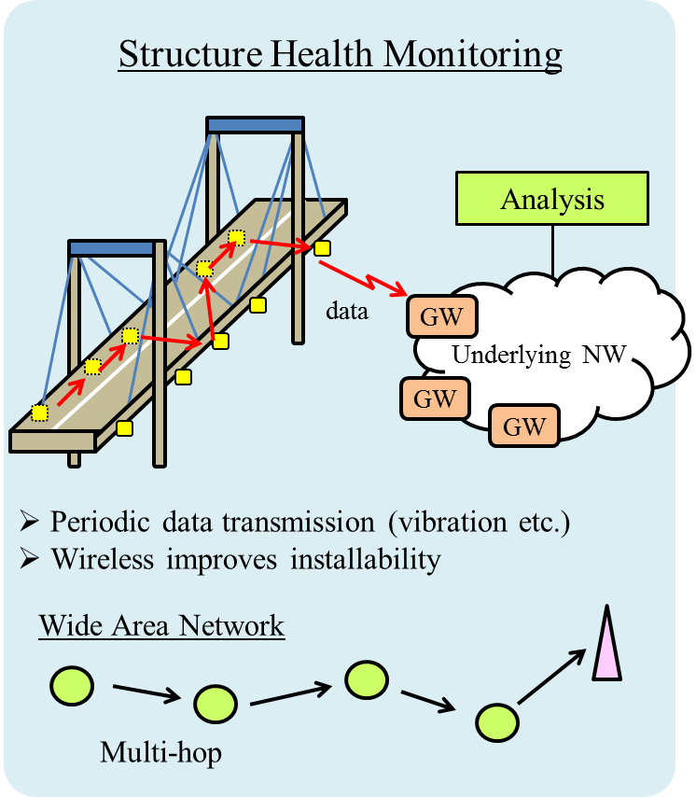
Applications (Cont’d)
Infrastructure Monitoring
Advanced Metering Infrastructure (AMI)
Source: “IEEE 802.15-14-0555-13-004s-tg4s-technical-guidance-document.”, March 2016

Slide 11
IEEE 802.11k
WLAN Radio Measurements enable STAs to observe and gather data on radio link performance and on the radio environment.
A STA may choose to make measurements locally, request a measurement from another STA, or may be requested by another STA to make one or more measurements and return the results.

Slide 12
IEEE 802.11v
Defines mechanisms and services for Wireless Network Management of STAs
  BSS transition management, channel usage and coexistence, collocated interference reporting, diagnostic, multicast diagnostic and event reporting, flexible multicast, efficient beacon mechanisms, proxy ARP advertisement, location, timing measurement, directed multicast, extended sleep modes, traffic filtering, and management notification.

Slide 13
References
IEEE 802.15.4s-2018
IEEE 802.15-14-0555-13-004s-tg4s-technical-guidance-document

