Slide 1
Sub-1GHz Coexistence Simulation Models Update
Date: 2018-09-11
Authors:
Notice: This document has been prepared to assist IEEE 802.19. It is offered as a basis for discussion and is not binding on the contributing individual(s) or organization(s). The material in this document is subject to change in form and content after further study. The contributor(s) reserve(s) the right to add, amend or withdraw material contained herein.

Slide 2
Abstract
Share the Sub-1GHz Coexistence Simulation Models for simulation and use case scenario discussion
NS-3 can be reasonable for Coexistence Simulation by adding coexistence interface between 802.15.4g and 802.11ah modules

Slide 3
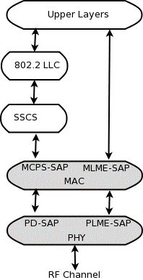
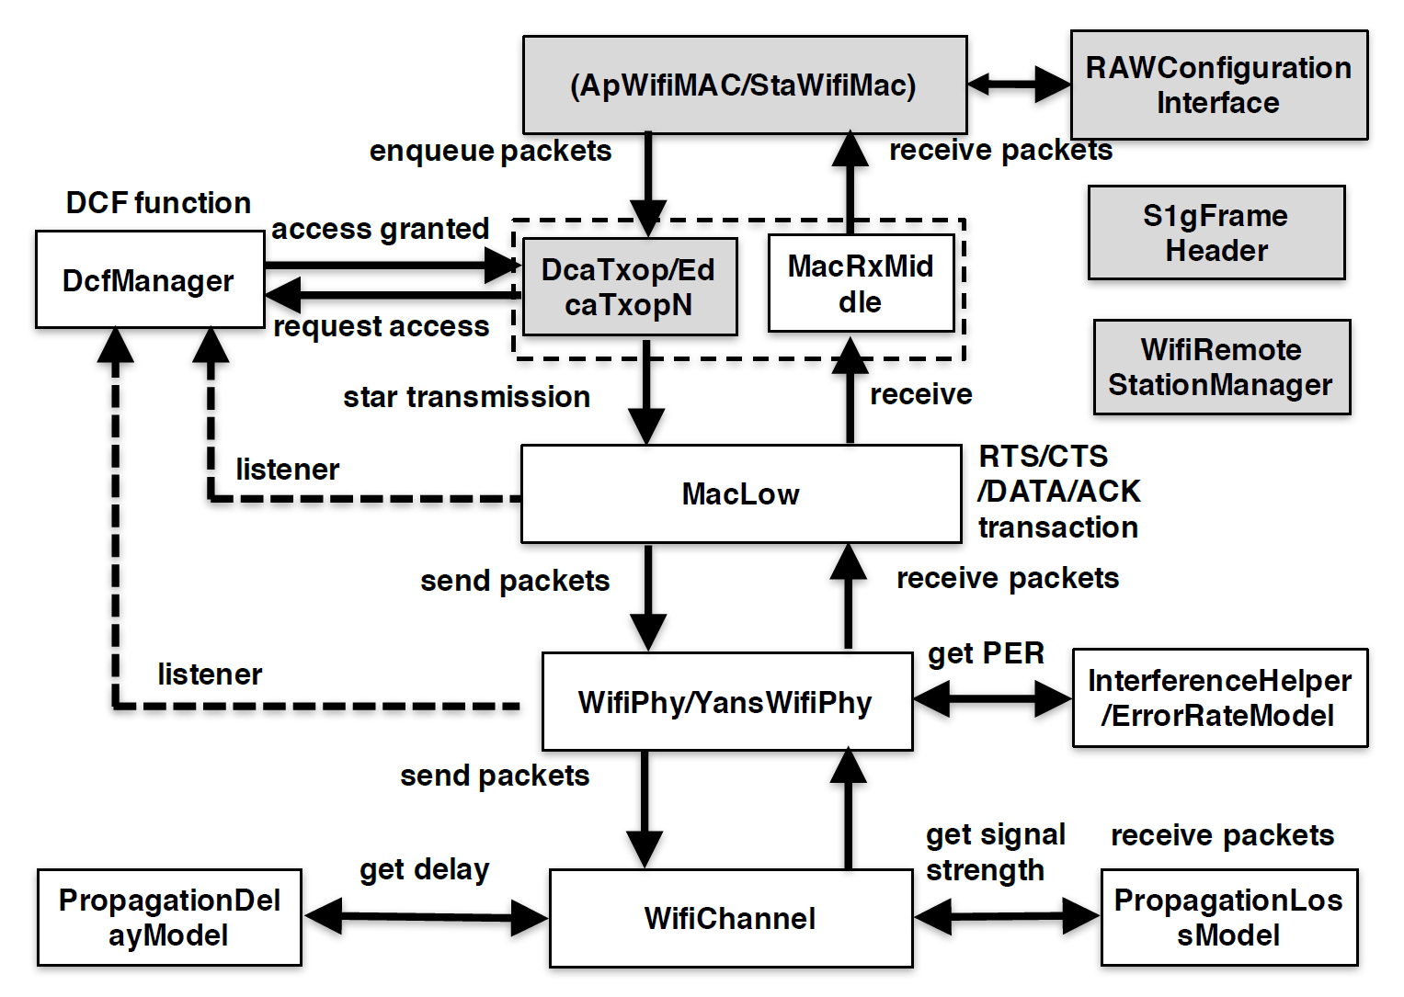
802.15.4g and 802.11ah Simulation Model
Current NS-3 does NOT include 802.11ah module, but 3rd party 802.11ah module can be implemented without coex function.
Additional coexistence interface between modules are needed.
802.15.4g module[1]
802.11ah module[2]

Slide 4
Sub-1GHz Coexistence Simulation Model
Additional Coexistence interfaces and functions on PHY/ channel modules are able to notify “Tx Info” each other to calculate mutual interference.
“Tx Info” includes the following information: node position, Tx frame duration, Tx power, antenna gain, frequency and band width.
Notify 802.11ah Tx Info.
Notify 802.15.4g Tx Info.
802.15.4g module[1]
802.11ah module[2]

Slide 5
Calculation of interference between 802.15.4g and 802.11ah
Each PHY module calculates SINR from Rx power of own system’s frame, Rx power of another system’s frame and noise.
Frame Error Rate (FER) can be calculated by SINR versus Bit Error Rate (BER) table.
t₁
t₂
t₃
t₄
Tx frame
of 15.4g node
15.4g frame
Time
Tx frame
of 11ah node A
11ah frame
Time
SINR of 11ah node B
Time
SINR decreases by receiving power of 15.4g frame while 15.4g node transmits frame.

Slide 6
Simulator Development Schedule
A new version of IEEE 802.11ah module for NS-3 has been released in May 2018[3]. And, new functions are implemented. For the higher accuracy of simulation results, we would like to port current coexistence functions into new NS-3 version.
Status of porting into the new version of NS-3 will be reported by January meeting.

Slide 7
Conclusion
Shared the Sub-1GHz Coexistence Simulation Models for simulation and use case scenario discussion. Simulation results can be applied to Recommended Practice in the future.
NS-3 can be reasonable for Coexistence Simulation by adding coexistence interface between 802.15.4g and 802.11ah PHY/channel modules

Slide 8
References
[1] Low-Rate Wireless Personal Area Network (LR-WPAN) https://www.nsnam.org/docs/models/html/lr-wpan.html
[2] L. Tian, L. Latré, J. Famaey, “Implementation and validation of an IEEE 802.11ah module for NS-3,” Workshop on ns3 (WNS3), 2016
[3] IEEE802.11ah ns-3 https://github.com/imec-idlab/IEEE-802.11ah-ns-3

