Slide 1
Sept 2018 Sub 1 GHz Interest Group
Date: 2018-9-08
Authors:
Notice: This document has been prepared to assist IEEE 802.19. It is offered as a basis for discussion and is not binding on the contributing individual(s) or organization(s). The material in this document is subject to change in form and content after further study. The contributor(s) reserve(s) the right to add, amend or withdraw material contained herein.

Slide 2
Opening
Meeting Preamble
Review and Approve Agenda
Review Objectives
Hear technical presentations
Discussion
Conclusions/Recommendations

Slide 3
Meeting Preamble
Be aware of:
http://standards.ieee.org/board/pat/pat-slideset.ppt
Any questions or disclosures?

Slide 4
Sub-1GHz Coexistence Interest Group Summary and Conclusions
IG Chair: Benjamin Rolfe (BCA, MERL); Recording Secretary: Jianlin Guo (MERL)
Reviewed simulation based studies of cosexistence performance of 802.15.4 FSK (4g) and 802.11ah
Developed a useful set of simulation scenarios and reviewed results
Identified MAC and PHY features and characteristics that affect coexistence
Had a lot of useful technical discussion (use cases, simulation parameters, …)
Determined
Coexistence between 802.15.4 and 802.11 in sub-1GHz bands is very important
There are mechanisms in both standards which can be used to enhance coexistence
Providing recommendations on how to use the various features of each standard would be useful
Conclusion: Establish a study group 802.19 to create a PAR and CSD for a recommended practice in
Recommendation by Interest Group; Approved by 802.19 WG and EC in July

Slide 5
Sub-1GHz Coexistence Study Group
SG Chair: Benjamin Rolfe (BCA, MERL)
Recording Secretary: TBD
Purpose and Objectives of Study Group:
Develop PAR and Criteria for Standards Development for a recommended practice
Discuss and decide on RP scope and objectives
Draft PAR and CSD

Slide 6
Meeting Objectives
September Objectives:
Review IG efforts
Review work since July
Draft PAR and CSD for Submission to 802

Slide 7
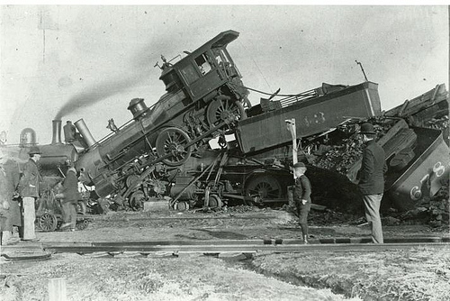
coexistence
noun
the state or fact of living or existing at the same time or in the same place.
Good Coexistence => rapidly growing opportunity
Poor Coexistence => missed opportunity

