Slide 1
S1G Coexistence Simulation Update
Date: 2018-11-11
Authors:
Notice: This document has been prepared to assist IEEE 802.19. It is offered as a basis for discussion and is not binding on the contributing individual(s) or organization(s). The material in this document is subject to change in form and content after further study. The contributor(s) reserve(s) the right to add, amend or withdraw material contained herein.

Slide 2
Abstract
Presentation to Sub-1 GHz (S1G) Band Coexistence Study Group of the IEEE 802.19 Working Group on Simulation Update of the Coexisting IEEE 802.15.4g and IEEE 802.11ah Using New Simulation Parameters, and Japan Regulatory on Transmission Time Control for Low Power Radio Stations (ARIB STD-T108).

Slide 3
802.11ah and 802.15.4g Backoff Overview
802.11ah Backoff
Random Backoff Period
Busy: Re-backoff
Busy
DIFS
CCA
Backoff
counter = 0
Clear: Transmit
Busy: hold backoff counter
Clear: decrease backoff counter
802.15.4g Backoff
Random Backoff Period
Busy: Re-backoff
CCA
Backoff
counter = 0
Clear: Transmit
Observation
802.11ah backoff time can be very long
802.15.4g Backoff time is bounded

Slide 4
Simulation Parameters and Performance Metrics
802.11ah STAs and 802.15.4g nodes
[50, 100]
Total offered load for 802.15.4g network and 802.11ah network
[10, 40] kb/s
Packet size
100 bytes
PHY data rate
300 kb/s for 802.11ah
100 kb/s for 802.15.4g
Data packet delivery rate
$\frac{\# of packets received}{\# of packets transmitted}$
Data packet latency
$T_{backoff}+T_{DataTX}+T_{AckWait}+T_{AckRX}$

Slide 5
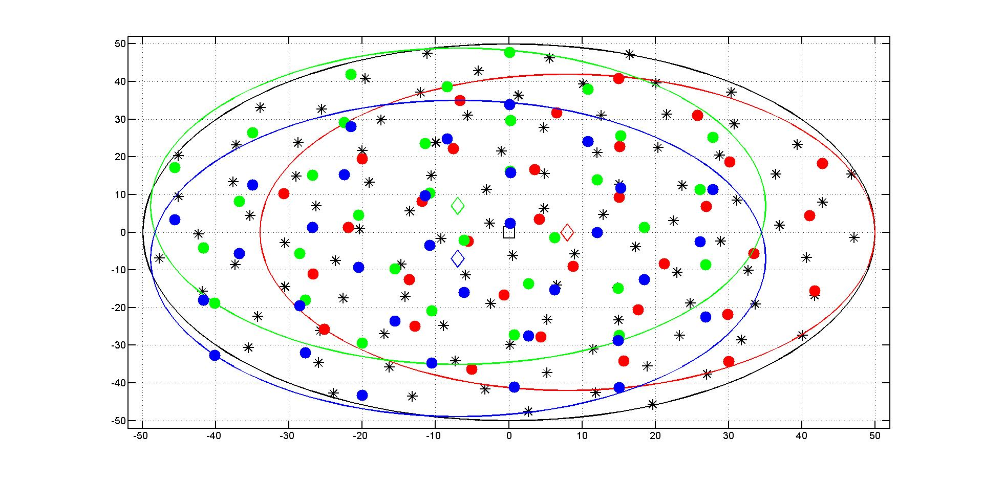
Node Deployment
802.15.4g Node
802.11ah Node

Slide 6
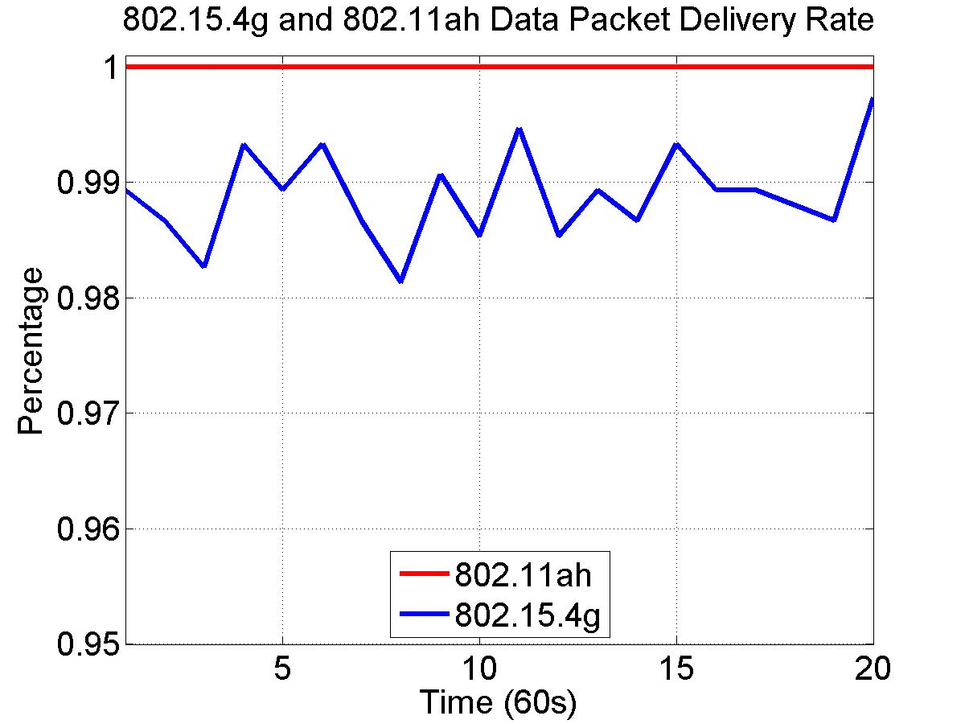
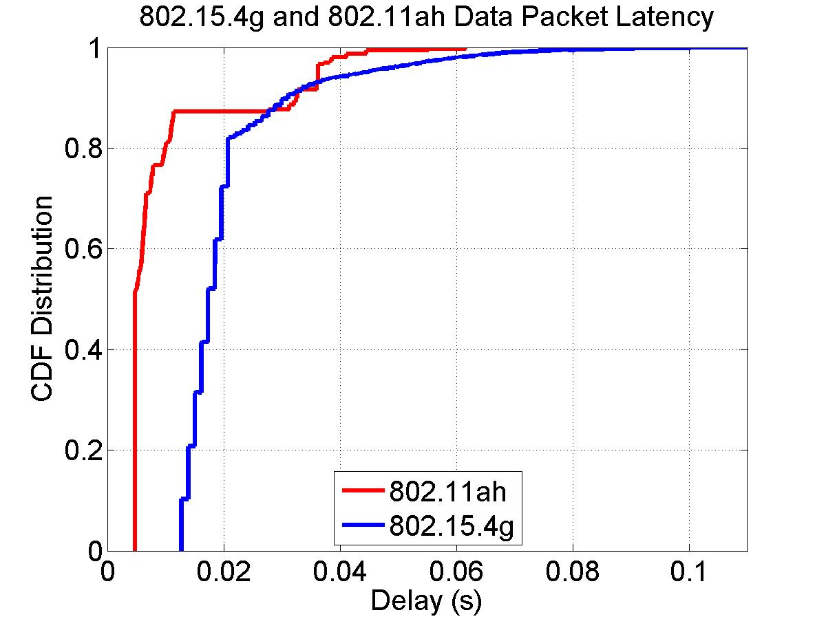
50 Nodes, 10 kbps for 802.11ah and 10 kbps for 802.15.4g
Packet delivery rate
802.11ah delivers 100% of packets
802.15.4g delivers 98.8944% of packet
Packet latency
802.11ah achieves shorter packet latency than 802.15.4g
802.11ah delay in [4.8ms, 61.6ms], 802.1.5.4g delay in [12.8ms, 110ms]

Slide 7
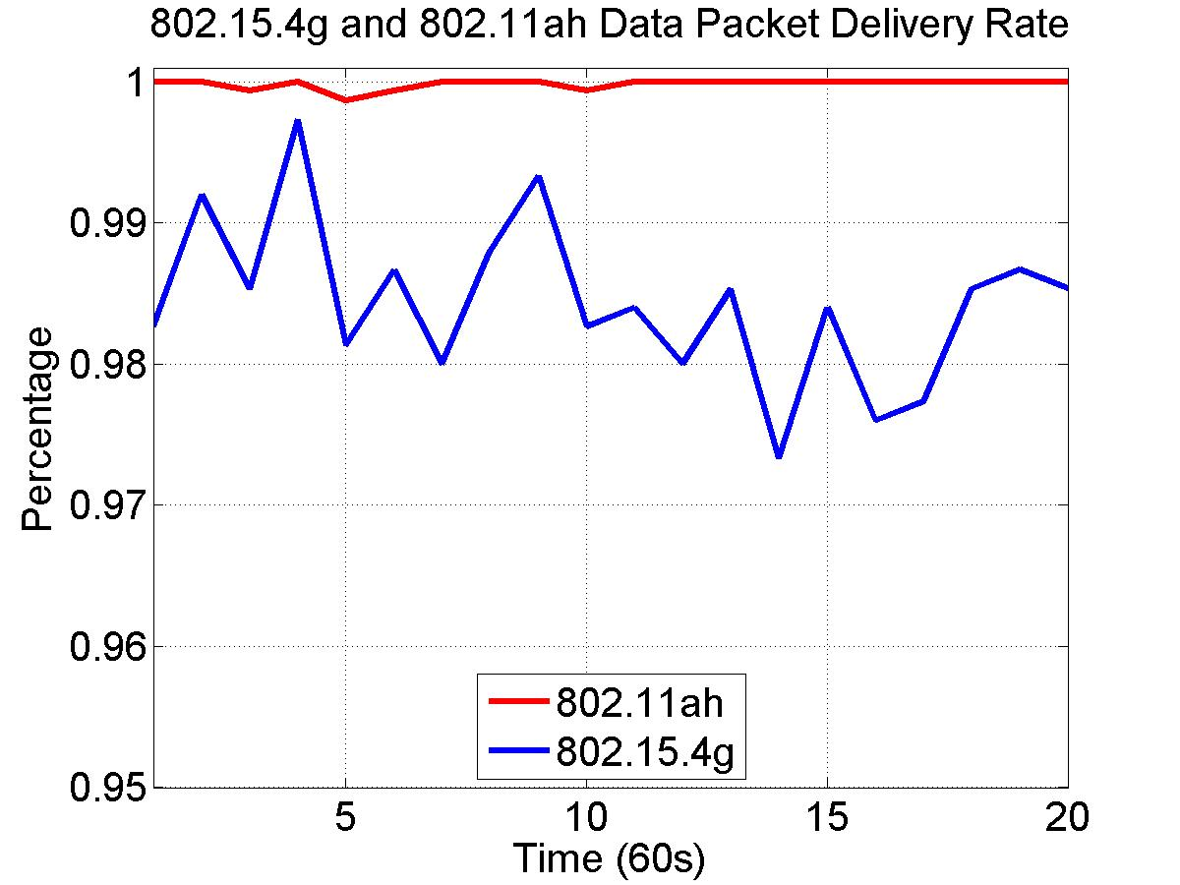
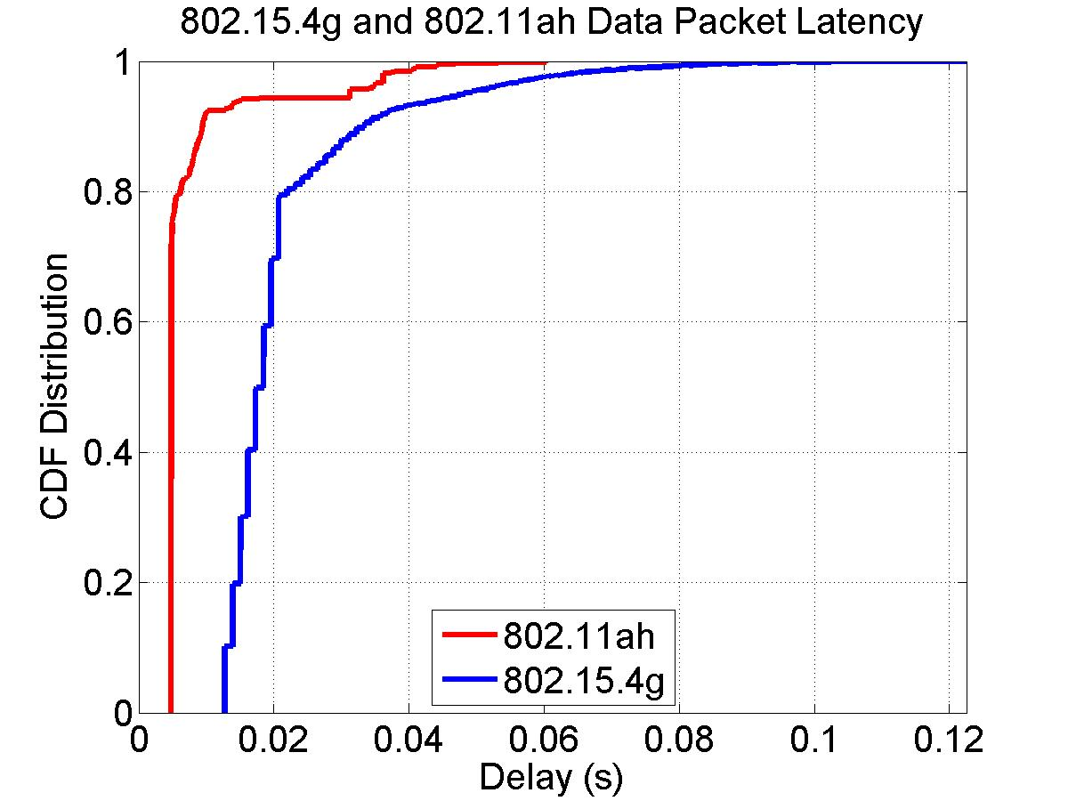
50 Nodes, 20 kbps for 802.11ah and 10 kbps for 802.15.4g
Packet delivery rate
802.11ah delivers 99.9869% of packets
802.15.4g delivers 98.4281% of packet
Packet latency
802.11ah achieves shorter packet latency than 802.15.4g
802.11ah delay in [4.8ms, 60.3ms], 802.1.5.4g delay in [12.8ms, 122.5ms]

Slide 8
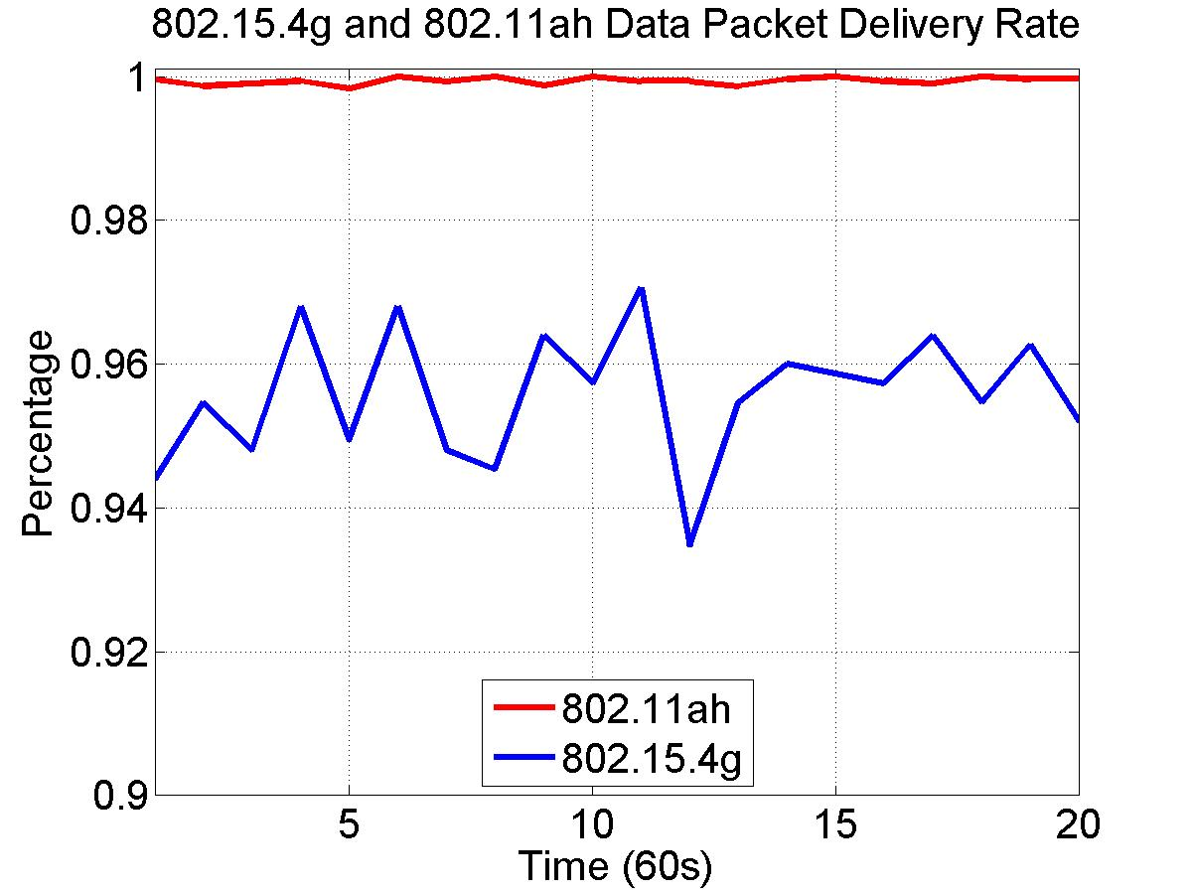
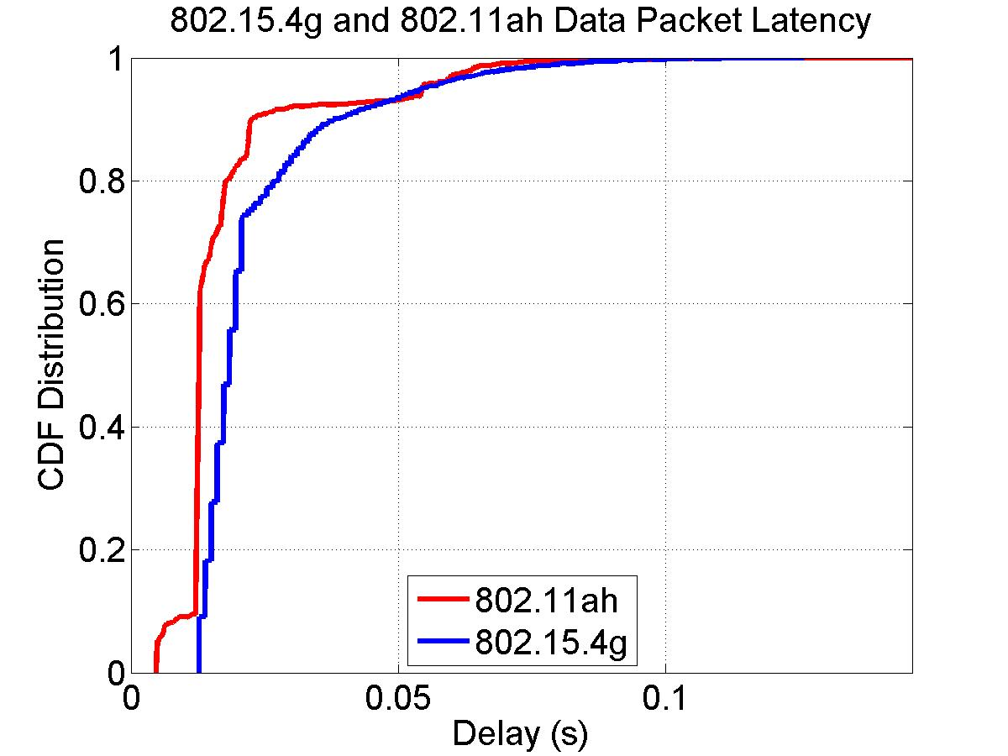
50 Nodes, 40 kbps for 802.11ah and 10 kbps for 802.15.4g
Packet delivery rate
802.11ah delivers 99.9408% of packets
802.15.4g delivers 95.5775% of packet
Packet latency
802.11ah achieves shorter packet latency than 802.15.4g
802.11ah delay in [4.8ms, 146.1ms], 802.1.5.4g delay in [12.8ms, 125.9ms]

Slide 9
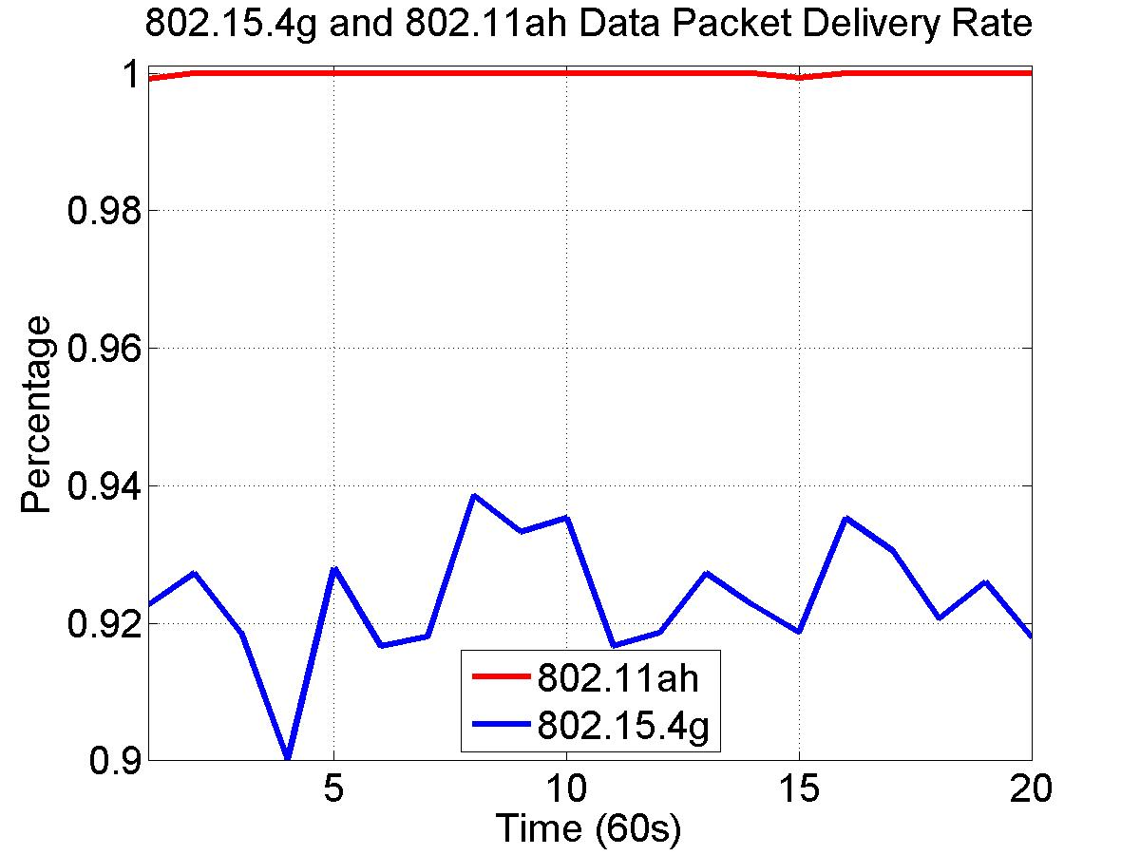
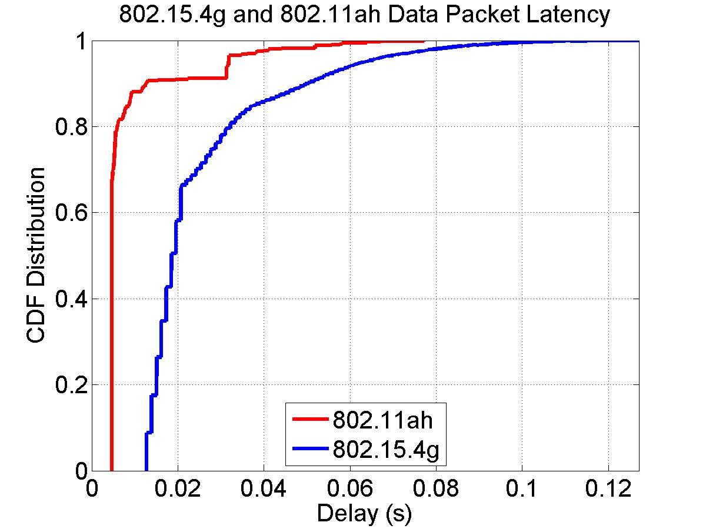
50 Nodes, 20 kbps for 802.11ah and 20kbps for 802.15.4g
Packet delivery rate
802.11ah delivers 99.9998% of packets
802.15.4g delivers 92.3671% of packet
Packet latency
802.11ah achieves shorter packet latency than 802.15.4g
802.11ah delay in [4.8ms, 77.2ms], 802.1.5.4g delay in [12.8ms, 127.1ms]

Slide 10
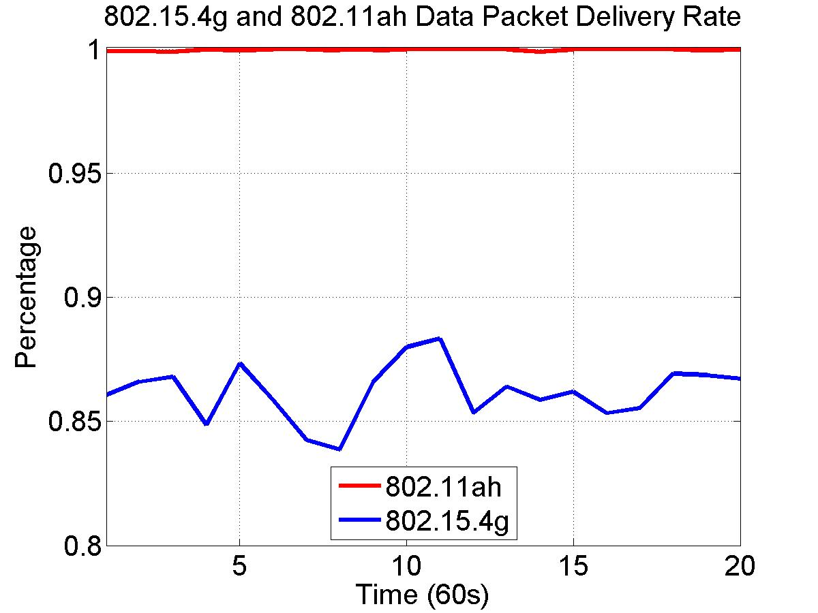
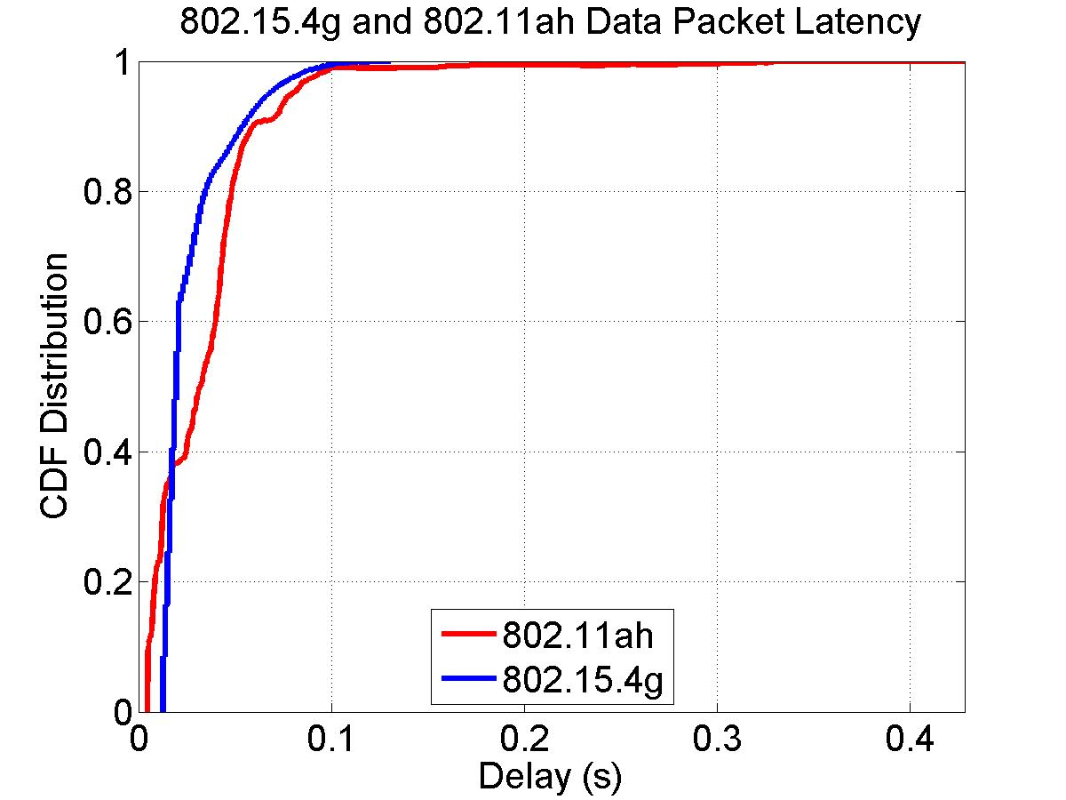
50 Nodes, 40 kbps for 802.11ah and 20 kbps for 802.15.4g
Packet delivery rate
802.11ah delivers 99.9852% of packets
802.15.4g delivers 86.1796% of packet
Packet latency
802.11ah achieves similar packet latency as 802.15.4g
802.11ah delay in [4.8ms, 428.2ms], 802.1.5.4g delay in [12.8ms, 130.5ms]

Slide 11
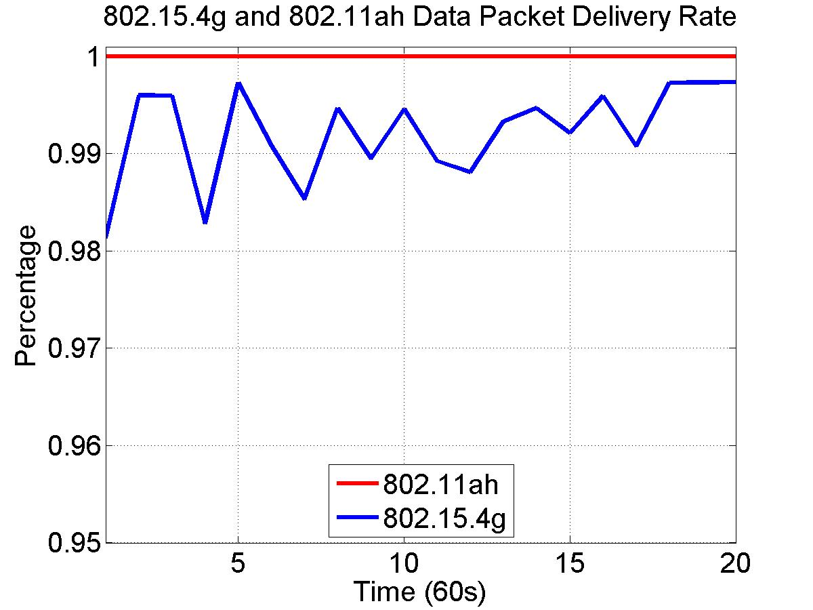
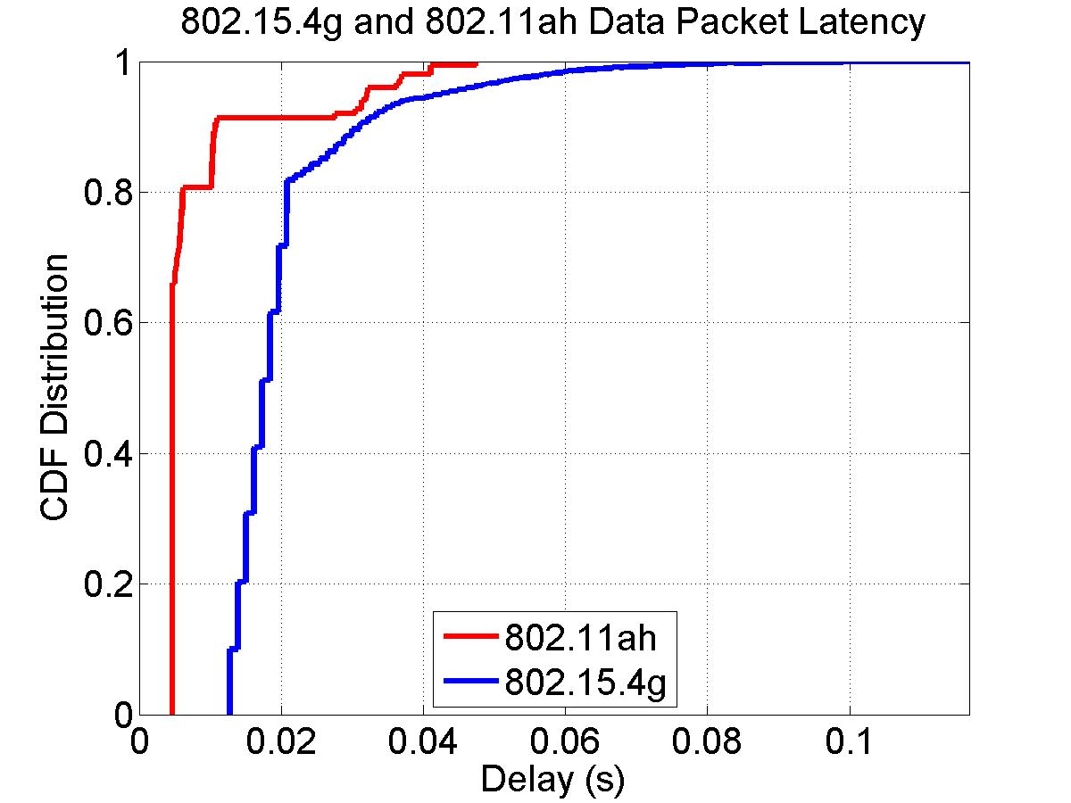
100 Nodes, 10 kbps for 802.11ah and 10 kbps for 802.15.4g
Packet delivery rate
802.11ah delivers 100% of packets
802.15.4g delivers 99.2073% of packet
Packet latency
802.11ah achieves shorter packet latency than 802.15.4g
802.11ah delay in [4.8ms, 47.4ms], 802.1.5.4g delay in [12.8ms, 116.8ms]

Slide 12
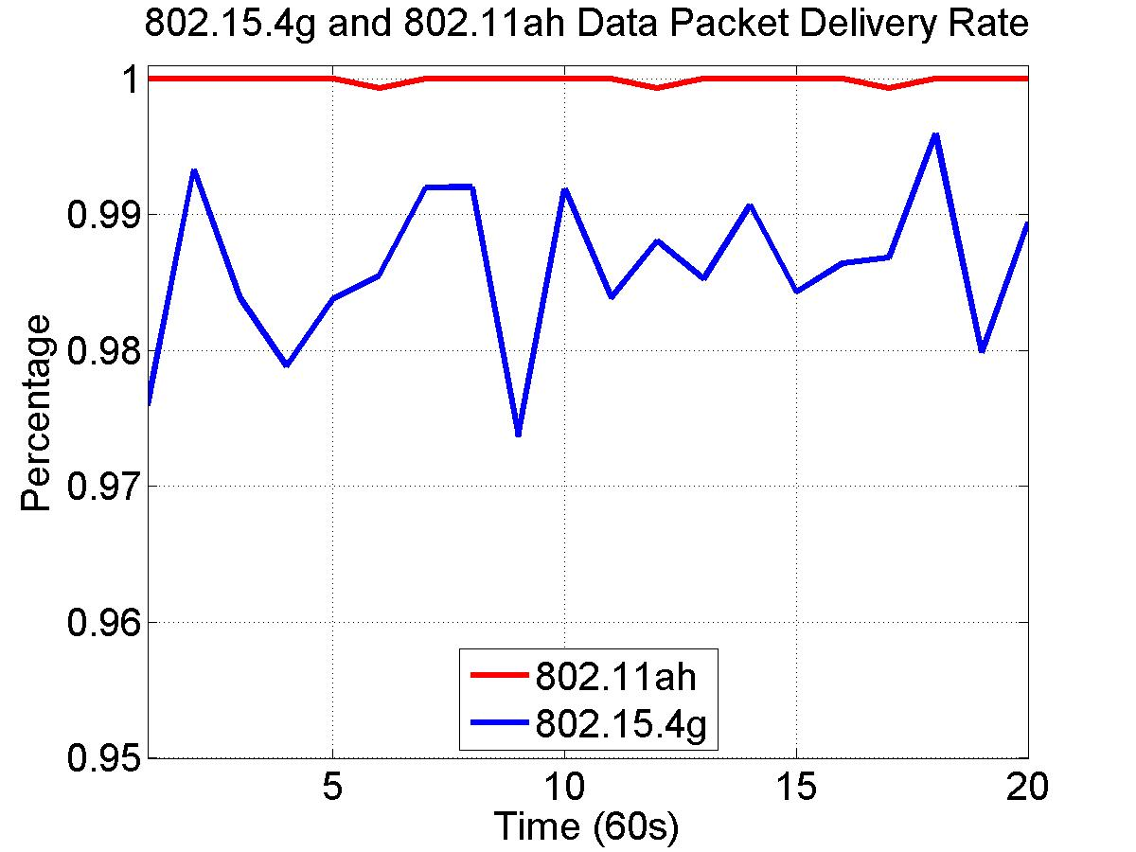
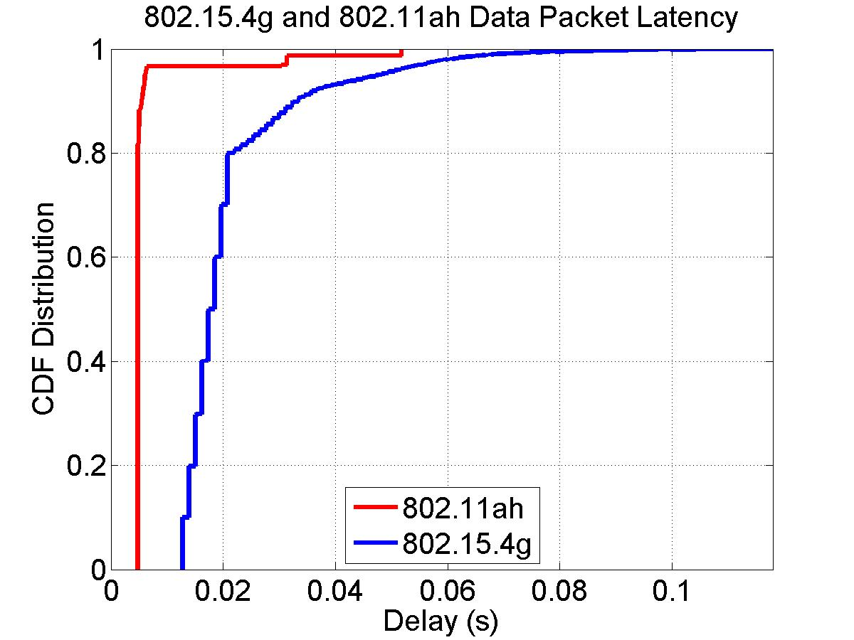
100 Nodes, 20 kbps for 802.11ah and 10 kbps for 802.15.4g
Packet delivery rate
802.11ah delivers 99.9846% of packets
802.15.4g delivers 98.6011% of packet
Packet latency
802.11ah achieves shorter packet latency than 802.15.4g
802.11ah delay in [4.8ms, 51.9ms], 802.1.5.4g delay in [12.8ms, 118.0ms]

Slide 13
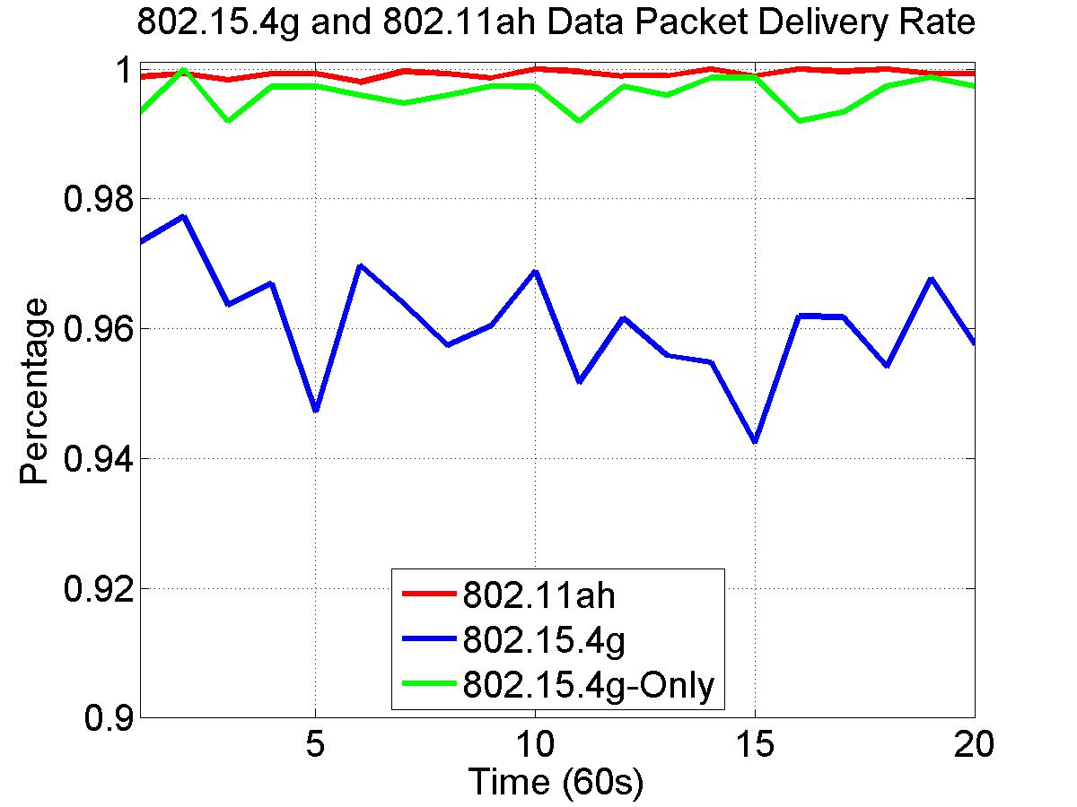
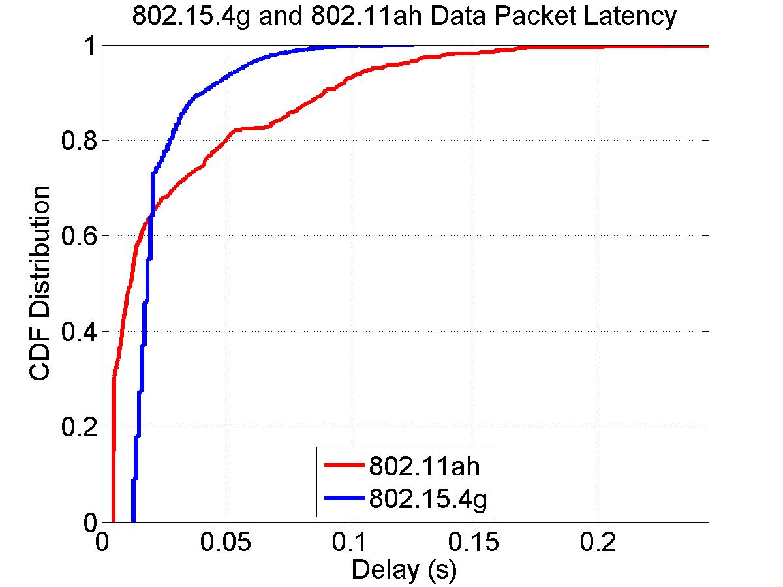
100 Nodes, 40 kbps for 802.11ah and 10 kbps for 802.15.4g
Packet delivery rate
802.11ah delivers 99.9322% of packets
802.15.4g delivers 96.0831% of packet
Packet latency
802.11ah achieves longer packet latency than 802.15.4g
802.11ah delay in [4.8ms, 244.6ms], 802.1.5.4g delay in [12.8ms, 125.9ms]

Slide 14
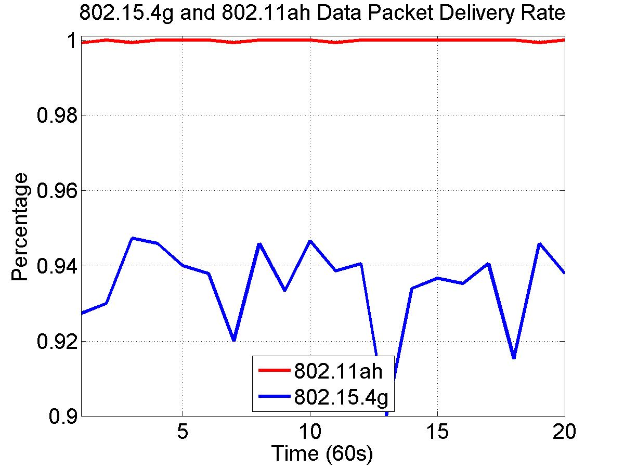
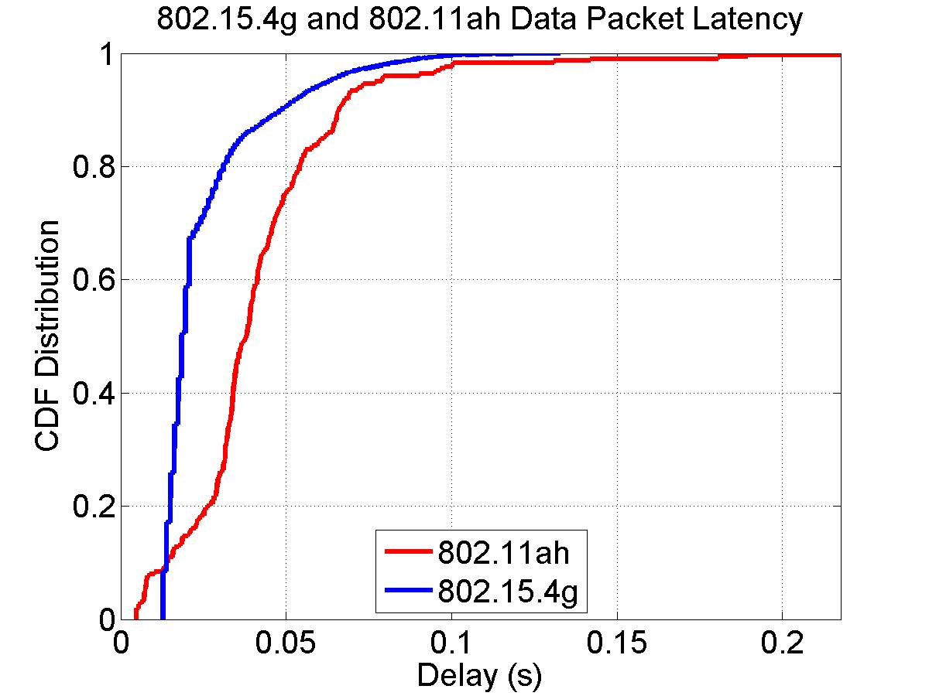
100 Nodes, 20 kbps for 802.11ah and 20 kbps for 802.15.4g
Packet delivery rate
802.11ah delivers 99.9966% of packets
802.15.4g delivers 93.5012% of packet
Packet latency
802.11ah achieves longer packet latency than 802.15.4g
802.11ah delay in [4.8ms, 217.6ms], 802.1.5.4g delay in [12.8ms, 132.8ms]

Slide 15
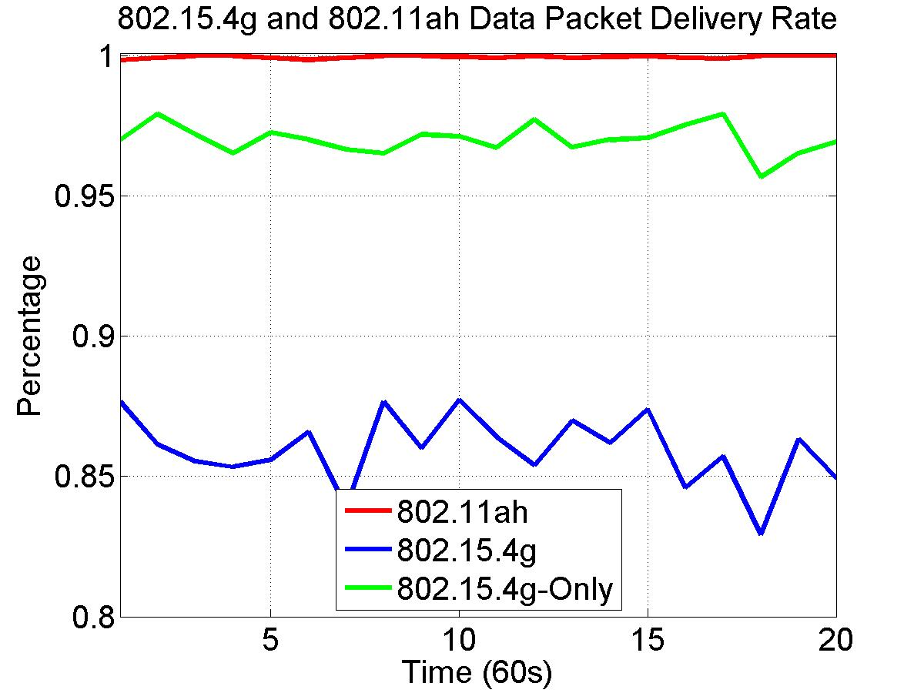
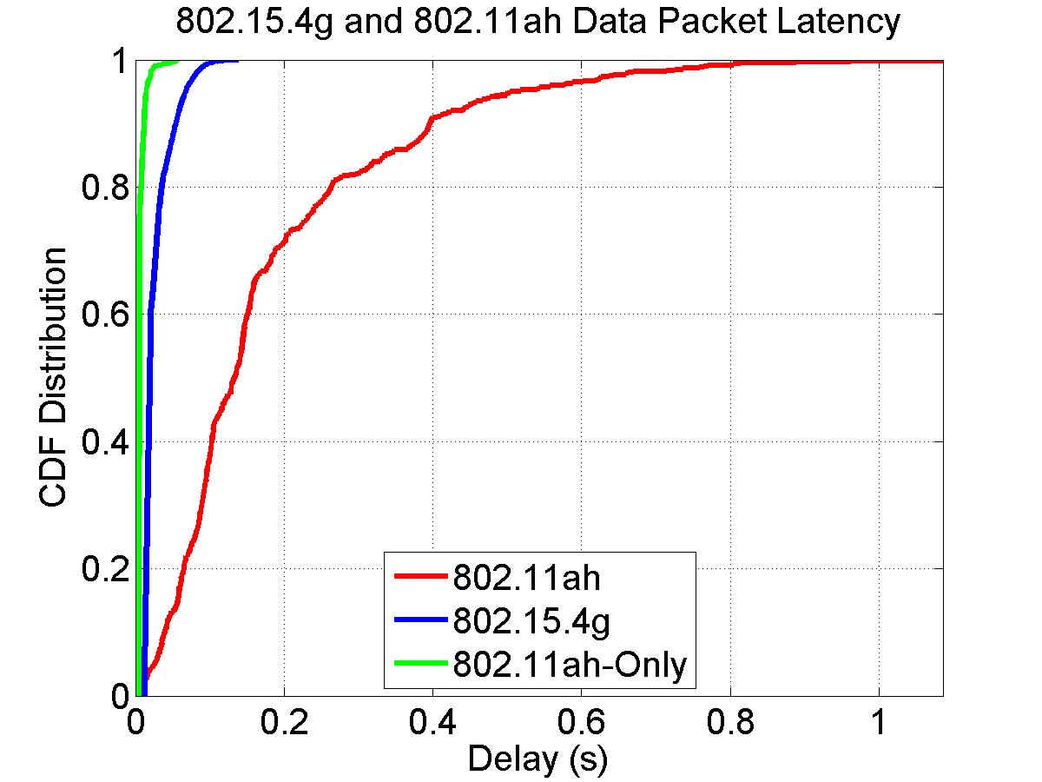
100 Nodes, 40 kbps for 802.11ah and 20 kbps for 802.15.4g
Packet delivery rate
802.11ah delivers 99.9560% of packets
802.15.4g delivers 85.9632% of packet
Packet latency
802.11ah achieves much longer packet latency than 802.15.4g
802.11ah delay in [11.3ms, 1085.8ms], 802.1.5.4g delay in [12.8ms, 138.5ms]

Slide 16
Summary
802.11ah interferes with 802.15.4g packet delivery
802.15.4g interferes with 802.11ah packet latency
802.11ah packet latency is unbounded
CCA is required in each backoff slot
Backoff counter decreases only if the channel is idle
802.15.4g packet latency is bounded
CCA is not required during random backoff period
CCA is performed after random backoff period

Slide 17
References
Steve Shellhamer, et. al., “Sub-1GHz Coexistence Simulation Parameters” IEEE 802.19-18/39r2, September 2018
ARIB STD-T108 Version 1.0, “920MHz-Band Telemeter, Telecontrol and Data Transmission Radio Equipment”, February 2012

