Slide 1
S1G Coexistence Simulation Update
Date: 2018-09-10
Authors:
Notice: This document has been prepared to assist IEEE 802.19. It is offered as a basis for discussion and is not binding on the contributing individual(s) or organization(s). The material in this document is subject to change in form and content after further study. The contributor(s) reserve(s) the right to add, amend or withdraw material contained herein.

Slide 2
Abstract
Presentation to Sub-1 GHz (S1G) Band Coexistence Study Group of the IEEE 802.19 Working Group on Simulation Update of the Coexisting IEEE 802.15.4g and IEEE 802.11ah Using New Simulation Parameters, and Japan Regulatory on Transmission Time Control for Low Power Radio Stations (ARIB STD-T108).

Slide 3
Simulation Parameters
Simulation parameters are described in document [1]
802.15.4g nodes and 802.11ah STAs
  [50, 100]
Total offered load for 802.15.4g network and 802.11ah network
  [1, 10] kb/s
Packet size
  100 bytes
Packet rate for 802.15.4g network and 802.11ah network
  [1.25, 12.5] packets/s
Packet rate per 802.15.4g node and 802.11ah STA
  [0.0125, 0.025, 0.125, 0.25] packet/s, i.e.,
  1 packet per [80s, 40s, 8s, 4s]
PHY data rate
  100 kb/s for 802.15.4g
  300 kb/s for 802.11ah

Slide 4
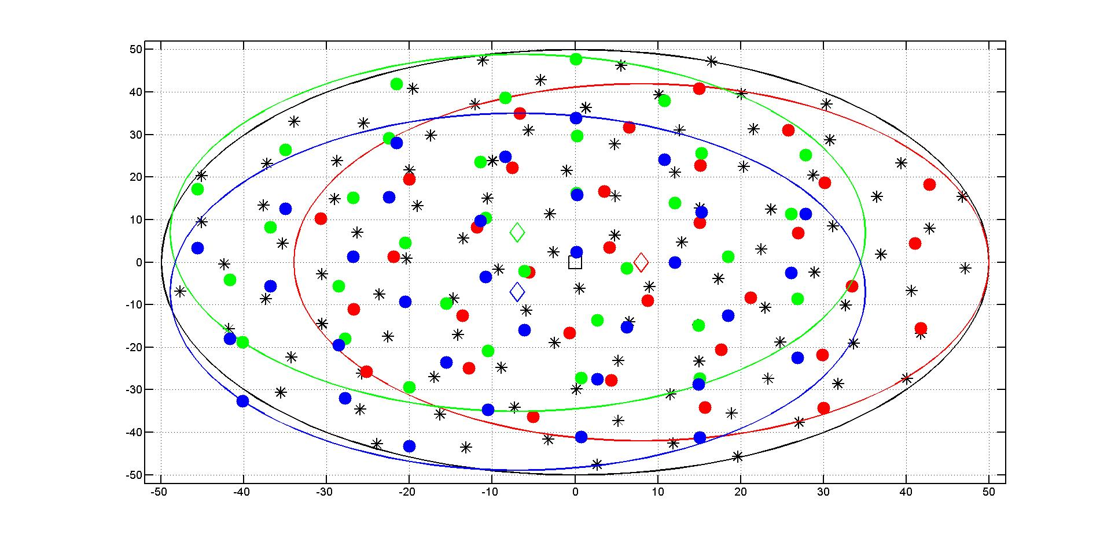
Node Deployment
802.15.4g Node
802.11ah Node

Slide 5
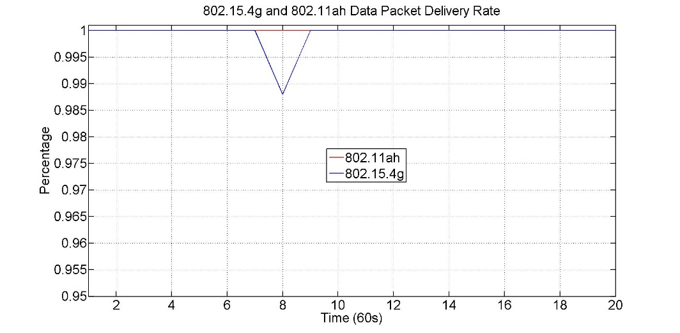
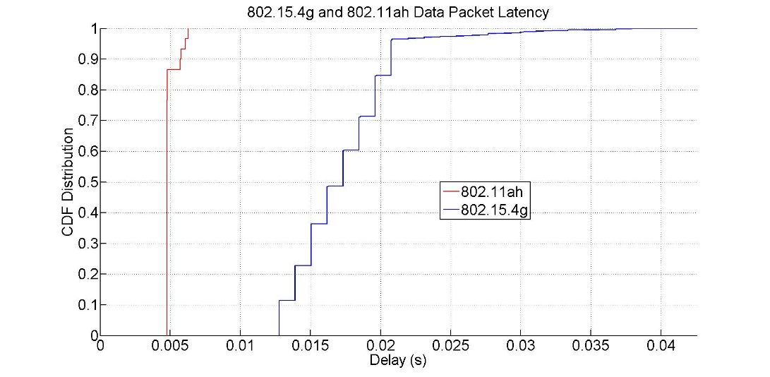
50 Stations and 1 Kb/s Offered Load Per Network
802.11ah delivered 100% of packets
802.15.4g delivered 99.9334% of packet, lost 1 packet
About 86% of 802.11ah packets had immediate channel access
About 4% of 802.15.4g packets had re-backoff

Slide 6
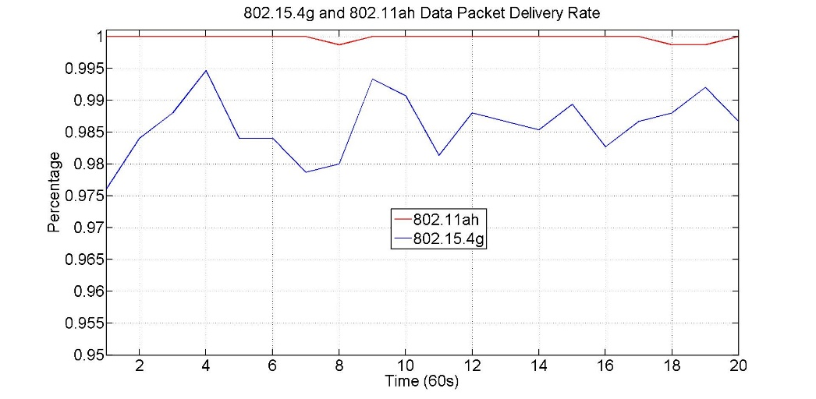
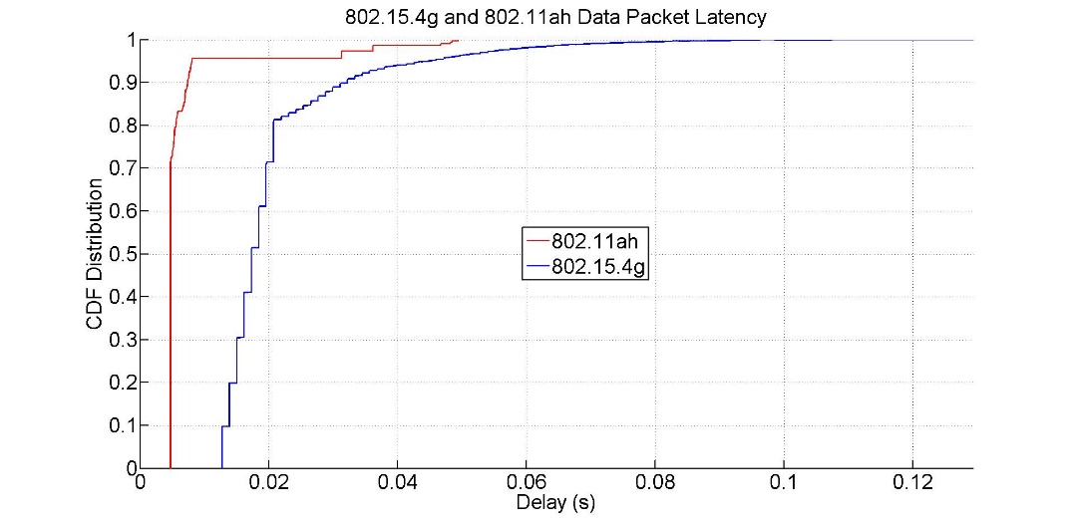
50 Stations and 10 Kb/s Offered Load Per Network
802.11ah delivered 99.9803% of packets, lost 3 packets
802.15.4g delivered 98.6013% of packets, lost 210 packets
About 72% of 802.11ah packets had immediate channel access
About 18% of 802.15.4g packets had re-backoff

Slide 7
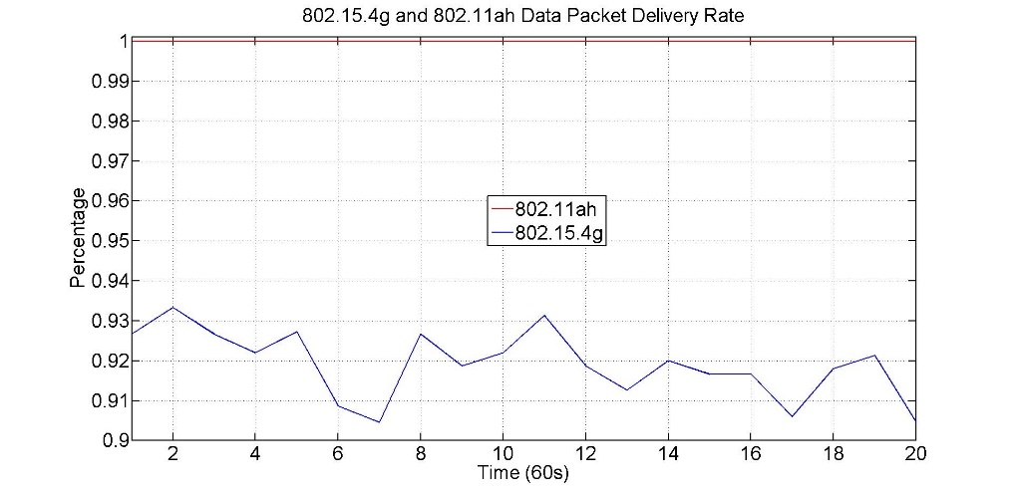
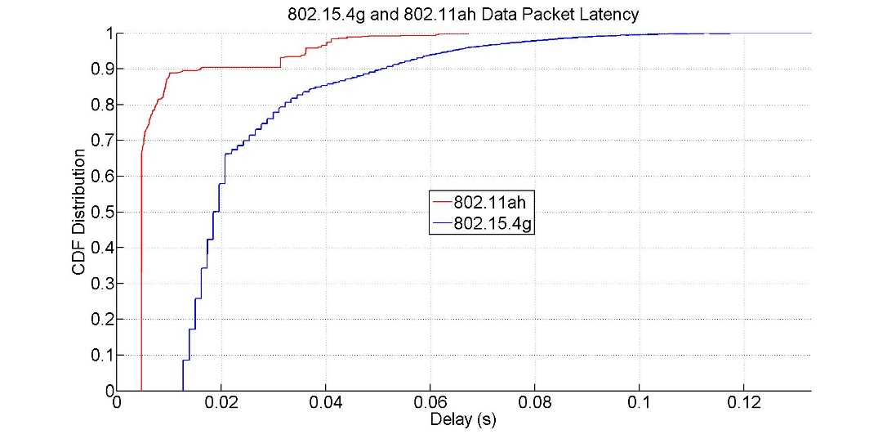
50 Stations and 20 Kbps Offered Load Per Network
802.11ah delivered 100% of packets
802.15.4g delivered 91.9142% of packets, lost 2428 packets
About 67% of 802.11ah packets had immediate channel access
About 34% of 802.15.4g packets had re-backoff

Slide 8
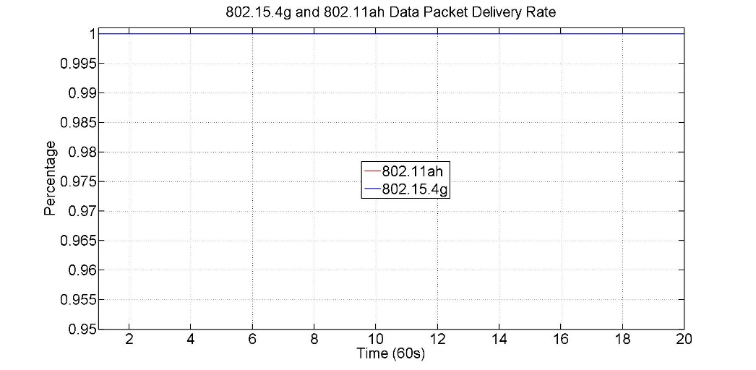
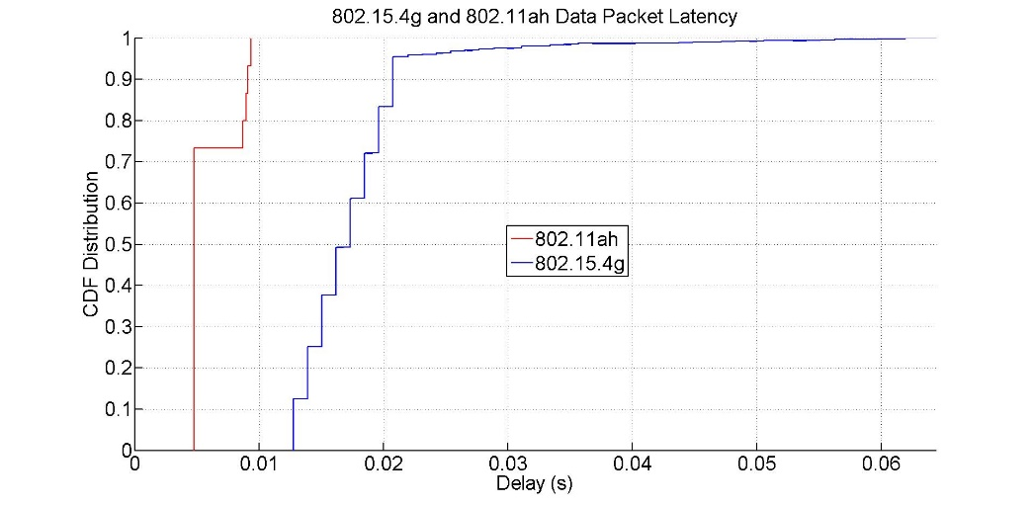
100 Stations and 1 Kbps Offered Load Per Network
802.11ah delivered 100% of packets
802.15.4g delivered 100% of packets
About 74% of 802.11ah packets had immediate channel access
About 4% of 802.15.4g packets had re-backoff

Slide 9
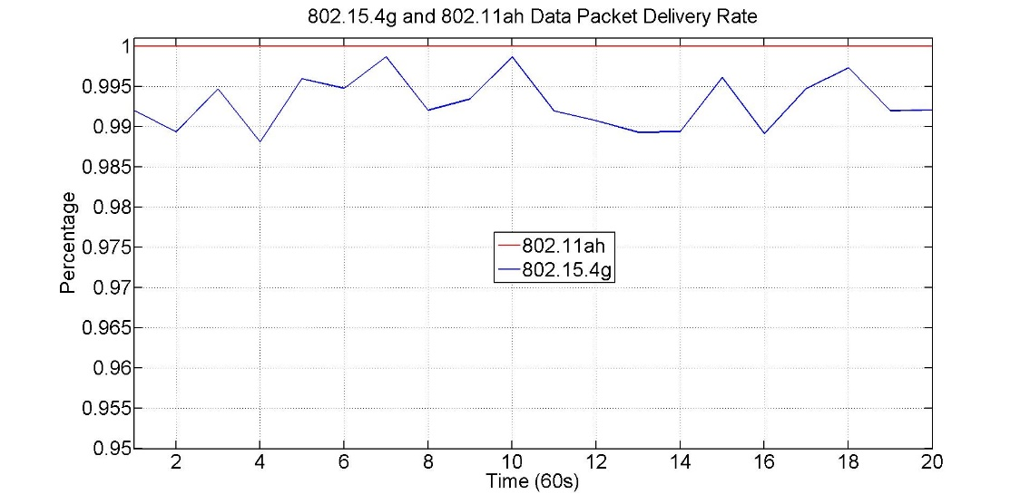
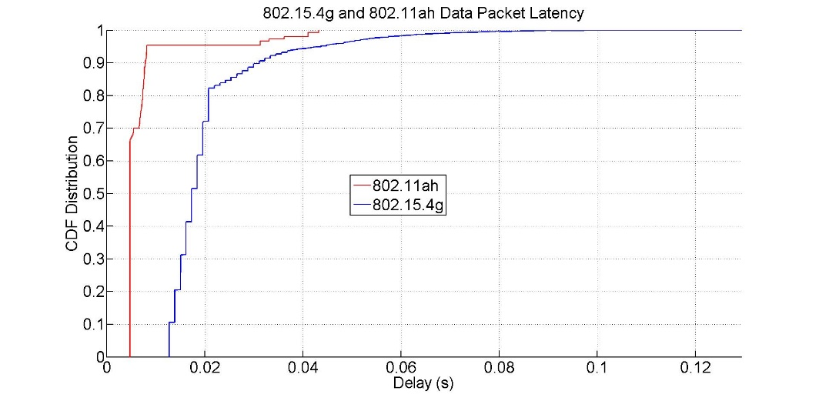
100 Stations and 10 Kb/s Offered Load Per Network
802.11ah delivered 100% of packets
802.15.4g delivered 99.2872% of packets, lost 107 packets
About 67% of 802.11ah packets had immediate channel access
About 18% of 802.15.4g packets had re-backoff

Slide 10
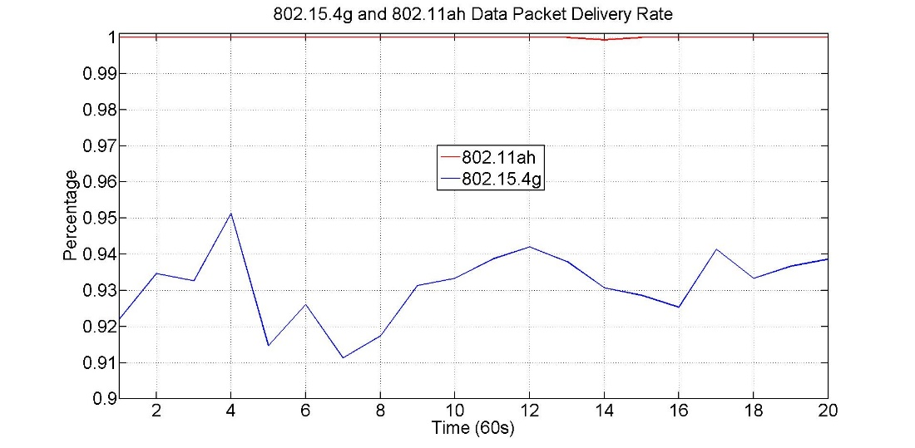
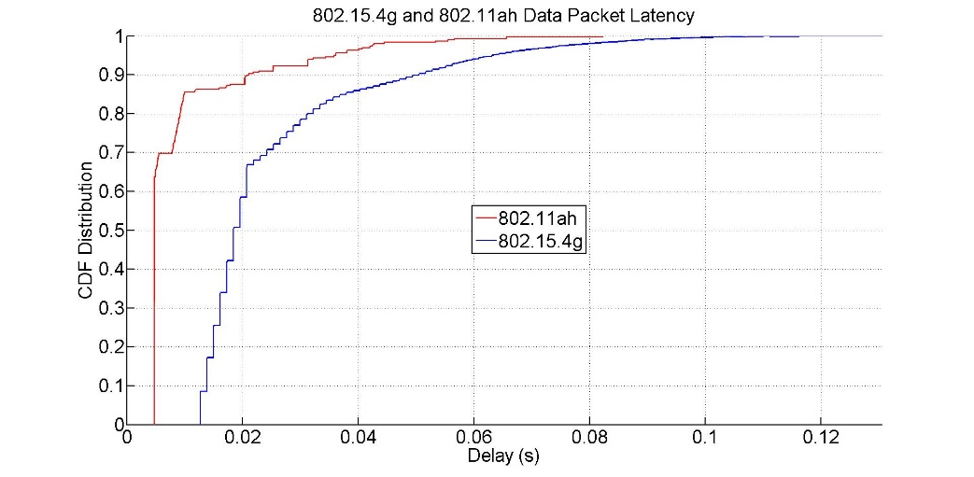
100 Stations and 20 Kb/s Offered Load Per Network
802.11ah delivered 99.9932% of packets, lost 2 packets
802.15.4g delivered 93.1448% of packets, lost 2058 packets
About 65% of 802.11ah packets had immediate channel access
About 32% of 802.15.4g packets had re-backoff

Slide 11
Simulation Result Summary
With 10% of duty cycle and 100 kb/s data rate, the maximum allowed offered load for an 802.15.4g node is
  10 kb/s, i.e.,
  about 12.5 packets/s with packet of 100 bytes
With 10% of duty cycle and 300 kb/s data rate, the maximum allowed offered load for an 802.11ah STA is
  30 kb/s, i.e.,
  about 37.5 packets/s with packet of 100 bytes
Therefore, total offered load per network could be much higher than the simulated load
For 0.25/0.025 packets/s offered load, 802.15.4g lost about 2% of packets
As number of stations or offered load increases, the 802.15.4g will lose more packets

Slide 12
Discussion
It is critical to maintain normal operation of the deployed 802.15.4g devices
Lower rate 802.15.4g was published in 2012 and higher rate 802.11ah was published in 2016
  Did 802.15.4g foresee the upcoming 802.11ah?
  Are they targeting same set of applications or different sets of applications?
What are the worst case scenarios in real applications?
  Offered load
  Node density
  Network density
  Node deployment
IEEE 802 community needs to address the coexistence of the heterogeneous wireless technologies in S1G band, especially IEEE 802 coexistence

Slide 13
ARIB STD-T108 Definition of Radio Equipment
A telemeter, telecontrol and data transmission radio equipment consists of radio equipment, data processing equipment and power supply equipment as shown in Figure 1-1. This standard specifies the technical requirements of the radio equipment.
Transmission Time Control

Slide 14
Radio Station Sending Control
Consider following parameter ranges
  Carrier sense time
    128us <= carrier sense < 5ms
  Frequency band
    923.5-928.1MHz
  Transmission power
    1 mW < TX Power <= 20 mW
Using one unit radio channel, i.e., 200 kHz channel
  Radio equipment shall stop its emission of radio wave less than 400ms after it starts to emit radio wave.
  The sum of emission time per arbitrary one hour shall be 360s or less.
  Meanwhile, if the emission time is more than 200ms, it shall wait for ten times or more of the former emission time. If the emission time is more than 6ms and is 200ms or less, it shall wait for 2ms for the consecutive emission.

Slide 15
Radio Station Sending Control
Using two unit radio channels, i.e., 400 kHz channel
  Radio equipment shall stop its emission of radio wave less than 200ms after it starts to emit radio wave.
  The sum of emission time per arbitrary one hour shall be 360s or less.
  Meanwhile if the emission time is more than 3ms, it shall wait for 2ms for the consecutive emission.
Using 3, 4, or 5 unit radio channels, i.e., 600, 800 or 1000 kHz channel
  Radio equipment shall stop its emission of radio wave less than 100ms after it starts to emit radio wave.
  The sum of emission time per arbitrary one hour shall be 360s or less.
  Meanwhile if the emission time is more than 2ms, it shall wait 2ms for the consecutive emission.
Transmission time control indication
  360s transmission constraint is for a radio equipment

Slide 16
Skipping Carrier Sense in A Response
If the emission is a response to request by other radio equipment, and following conditions are satisfied, carrier sense is not necessary, and the response time is not included in the sum of emission time per arbitrary one hour.
  Using one unit radio channel
    The emission starts within 2ms after the reception of the request is completed, and the emission ends within 50ms.
  Using 2, 3, 4, or 5 unit radio channels
    The emission starts within 2ms after the reception of the request is completed, and the emission ends within 5ms.
ACK is a response

Slide 17
References
Steve Shellhamer, et. al., “Sub-1GHz Coexistence Simulation Parameters” IEEE 802.19-18/39r2, September 2018
ARIB STD-T108 Version 1.0, “920MHz-Band Telemeter, Telecontrol and Data Transmission Radio Equipment”, February 2012

