Slide 1
920 MHz Status in Japan
Date: 2018-07-10
Authors:
Notice: This document has been prepared to assist IEEE 802.19. It is offered as a basis for discussion and is not binding on the contributing individual(s) or organization(s). The material in this document is subject to change in form and content after further study. The contributor(s) reserve(s) the right to add, amend or withdraw material contained herein.

Slide 2
Abstract
Share the 920MHz regulation status in Japan toward simulation and use case scenario discussion

Slide 3
Channelization in Japan
Several wireless systems operate on same frequency band which were standardized as ARIB STD-T106, T107 and T108
ARIB STD-T108 (20mW) on 920.5 ~ 928.1MHz (7.6MHz) includes 802.15.4g system, but coexistence operation with Passive System (250mW) and STD-T108 (250mW) is required for 920.5 ~ 923.5MHz (3.0MHz). So, 923.5 ~ 928.1MHz (4.6MHz) is only dedicated channels for 802.15.4g
Coexistence Operation
Passive System (RFID, etc)
①
1W ARIB STD-T106 Licensed/Registered
②
250mW ARIB STD-T107 Unlicensed
916.0
919.2
920.6
923.4
928.0
929.65
MHz
③
1mW ARIB STD-T108 Unlicensed
④
20mW ARIB STD-T108 Unlicensed
⑤
250mW ARIB STD-T108 Licensed/Registered
IEEE802.15.4g, etc
Active System (LPWA, 802.15.4g, etc)
Ch: 200KHz
Dedicate channels for sensor networks
Ch: 100KHz

Slide 4
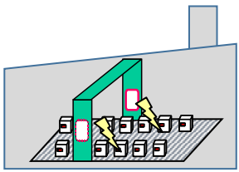
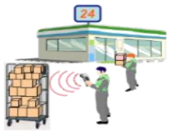
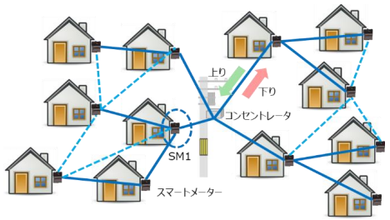
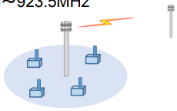
Current Use Cases
[1][2][3]
Current use cases in the market for each wireless system^{*1}.
Only Specified Low-Power Radio Station (20mW, Unlicensed) for 802.15.4g and 802.11ah^{*2}
① Inside Radio Station
(Licensed/Registered, Passive System)
Tx Power: 1W
Frequency: 916.7~920.9MHz
Use Cases: RFID for Logistics Management, etc
ARIB STD-T106
② Specified Low-Power Radio Station (Unlicensed, Passive System)
Tx Power: 250mW
Frequency: 916.7~923.5MHz
Use Cases: RFID for inside/outside
ARIB STD-T107
③ Specified Low-Power Radio Station
(Unlicensed, Active System)
Tx Power: 1mW
Frequency: 915.9 ~ 929.7MHz
Use Cases: Home Security, Remote Control
ARIB STD-T108
④ Specified Low-Power Radio Station
(Unlicensed, Active System)
Tx Power: 20mW
Frequency: 920.5 ~ 928.1MHz
Use Cases: Smart Mater (Electric, Gas, Water), etc
ARIB STD-T108
⑤ Land Mobile Station
(Licensed/Registered, Active System)
Tx Power: 250mW
Frequency: 920.5 ~ 923.5MHz
Use Cases: LPWA for sensors (forest, bridge, etc)
ARIB STD-T108
*1: MIC is going to deregulate the current standard to meet the future use cases (Inside/Outside, Tx Time, Duty Cycle, etc)[3]
*2: IEEE 802.11ah is not specified on ARIB STD-T108 at this moment [2]

Slide 5
ARIB STD-T108 (20mW)
[3][4]
Specified Low-Power Radio Station (Unlicensed, Active System)*
Item |  | Parameters and functionality
Frequency Band |  | 920.5MHz ~ 928.1MHz (7.6MHz) 920.5 ~ 923.5 MHz (3.0MHz) --- Coexistence with others 923.5 ~ 928.1 MHz (4.6MHz) --- Dedicated channel for STD-T108
Channel bandwidth |  | 200KHz
Transmission Power |  | 20mW
Transmission method | Contents | Data signal
 | Modulation | Not specified
Antenna Gain |  | 3dBi or less (absolute gain). However, in case EIRP is less than the value of 3dBi plus 1mW or 20mW of antenna power, it is allowed to fill in the gap by the antenna gain
Carrier Sense (CS) and Duty Cycle | CS ≧ 5msec, 920.5 ~ 923.4 MHz | Tx Time ≦ 4sec, Wait ≧ 50ms
 | 5msec < CS ≧ 128us 920.5 ~ 928.1 MHz | Tx Time ≦ 400ms, Wait ≧ 2ms, Total Tx Time ≦ 360s/h/station
Note |  | Refer IEEE 802.15.4g for PHY parameters
*: MIC is going to deregulate the current standard to meet the future use cases [3]

Slide 6
Summary
802.15.4g specified on ARIB STD-T108 (20mW) can operate on
920.5 ~ 928.1MHz (7.6MHz) , but
920.5 ~ 923.5MHz (3.0MHz) --- Coex. with Passive Systems and LPWA
923.5 ~ 928.1MHz (4.6MHz) --- Dedicated channel for sensor net.
We would like the Sub 1GHz IG to consider coexistence between 802.15.4g and 802.11ah under the conditions and operational constraints noted above.

Slide 7
References
MIC, http://www.soumu.go.jp/main_content/000544861.pdf, 2018/04/10
MIC, http://www.soumu.go.jp/main_content/000550848.pdf, 2018/05/14
MIC, http://www.soumu.go.jp/main_content/000551143.pdf, 2018/05/15
https://www.arib.or.jp/english/html/overview/doc/5-STD-T108v1_0-E1.pdf
MIC (Ministry of Internal Affairs and Communications)

